Slide 1

Managing Customer
Relationships &
Building Loyalty
Zeenat Jabbar

Slide 2
Overview
The Search for Customer Loyalty
Understanding the Customer-Firm Relationship
The Wheel of Loyalty
Building a Foundation for Loyalty
Strategies for Building Loyalty Bonds with Customers and Reducing Customers' Defections
CRM: Customer Relationship Management

Slide 3
The Search for
Customer Loyalty

Slide 4
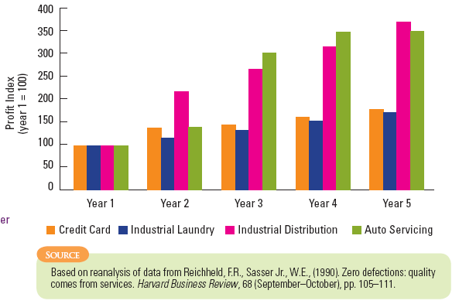
How Much Profit a Customer Generates Over Time

Slide 5
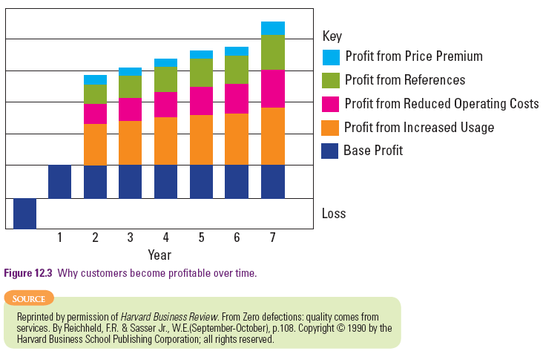
Why Customers Are More Profitable
Over Time

Slide 6
Why is Customer Loyalty Important to a Firm’s Profitability?
Customers become more profitable the longer they remain with a firm:
  Increased purchases and/or account balances
    - Customers/families purchase in greater quantities as they grow
  Reduced operating costs
    - Fewer demands from suppliers and operating mistakes as customer becomes experienced
  Referrals to other customers
    - Positive word-of-mouth saves firm from investing money in sales and advertising
  Price premiums
    - Long-term customers willing to pay regular price
    - Willing to pay higher price during peak periods

Slide 7
Assessing the Value of a Loyal Customer
Must not assume that loyal customers are always more profitable than those making one-time transactions
  Costs
    - Not all types of services incur heavy promotional expenditures to attract a new customer
    - Walk-in traffic more important at times
  Revenue
    - Large customers may expect price discounts in return for loyalty
    - Revenues don’t necessarily increase with time for all types of customers

Slide 8
Assessing the Value of a Loyal Customer
Profit impact of a customer varies according to stage of service in product life cycle
  e.g., referrals and negative word-of-mouth have a higher impact in early stages
Tasks:
  determine costs and revenues for customers from different market segments at different points in their customer lifecycles
  predict future profitability

Slide 9
Measuring Customer Equity:
Lifetime Value of Each Customer
Acquisition revenues less costs
  Revenues (application fee + initial purchase)
  Costs (marketing + credit check + account set up)
Projected annual revenues and costs
  Revenues (annual fee + sales + service fees + value of referrals)
  Costs (account management + cost of sales + write-offs)

Slide 10
Measuring Customer Equity:
Lifetime Value of Each Customer
Value of referrals
  Percentage of customers influenced by other customers
  Other marketing activities that drew the firm to an individual’s attention
Net Present Value
  Sum anticipated annual values (future profits)
  Suitably discounted each year into the future

Slide 11
Gap Between Actual and Potential Customer Value
What is current purchasing behavior of customers in each target segment?
What would be impact on sales and profits if they:
  buy all services offered by the firm,
  use these to the exclusion of any purchases from competitors,
  pay full price?
How long, on average, do customers remain with firm?
What impact would it have if they remained customers for life?

Slide 12
Why are Customers Loyal?
Customers stay loyal when we create value for them
Value can be created for customers through:
  Confidence benefits
    Confidence in correct performance
    Ability to trust the provider
    Lower anxiety when purchasing
    Knowing what to expect and receive
  Social benefits
    Mutual recognition and friendship
  Special treatment
    - Better price
    - Discounts not available to most customers
    - Extra services
    - Higher priority when there is a wait

Slide 13
Understanding the
Customer-Firm Relationship

Slide 14

Transactional Marketing
Transactional Marketing
  One transaction or a series of transactions does not necessarily constitute a relationship
  Requires mutual recognition and knowledge between the parties

Slide 15
Relationship Marketing
Marketing that creates extended relationships with customers
Database Marketing:
  Includes market transaction and information exchange
  Technology is used to
    Identify and build database of current and potential customers
    Deliver differentiated messages based on customers’ characteristics
    Track each relationship to monitor cost of acquiring that customer and lifetime value of resulting purchases

Slide 16
Relationship Marketing
Interaction Marketing:
  Face-to-face interaction between customers and supplier’s representatives
  Value is added by people and social processes
  Increasing use of technologies make maintaining relationships with customers a challenge
    e.g., self service technology, interactive website, call centers
Network Marketing:
  Common in B2B context
  Companies commit resources to develop positions in a network

Slide 17
Relationships with Customers
Type of Relationship Between the Service
Organization and its Customers
Nature of Service Delivery | Membership Relationship | No Formal Relationship
Continuous | Cable TV Insurance Policy College enrollment | Radio Station Police Lighthouse
Discrete Transactions | Subscriber phone Theater subscription Warranty repair | Pay Phone Movie Theatre Public Transport

Slide 18
The Wheel of Loyalty

Slide 19
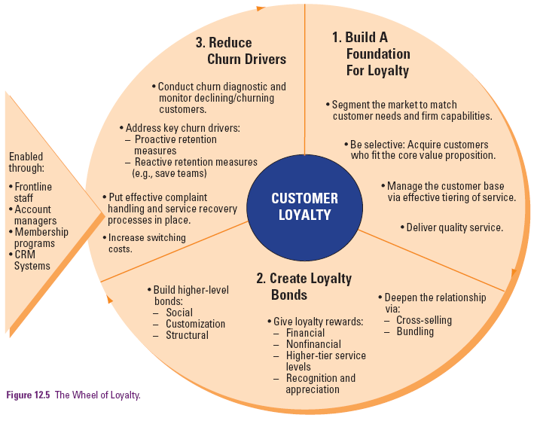
The Wheel of Loyalty

Slide 20
Building a
Foundation for Loyalty

Slide 21
Targeting the Right Customers
Target the right customer
  How do customer needs relate to operations elements?
  How can service personnel meet expectations of different customers?
  Can company match or exceed competing services that are directed at same types of customers?
Focus on number of customers served and value of each customer
  Some customers more profitable than others in the short term
  Others may have room for long-term growth
“Right customers” are not always high spenders
  Can be a large group of people that no other supplier is serving well

Slide 22
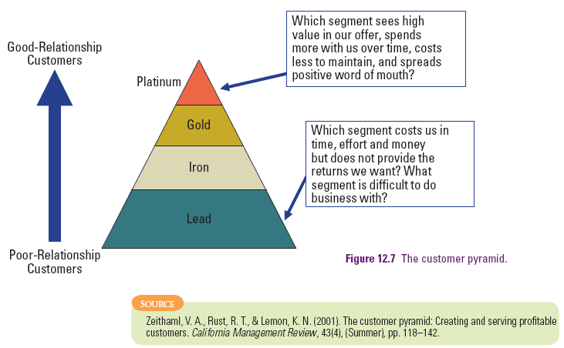
Effective Tiering of Service
The Customer Pyramid

Slide 23
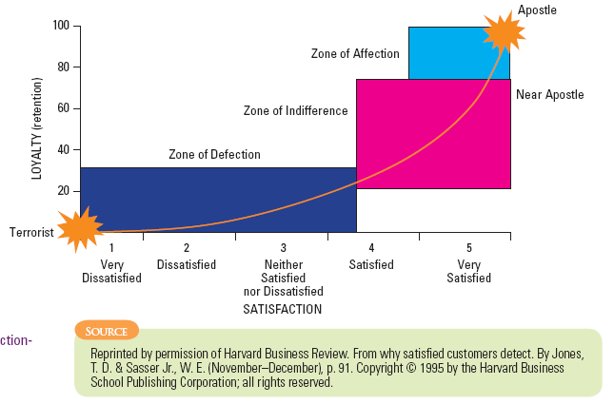
The Customer Satisfaction
Loyalty Relationship

Slide 24
Strategies for Building Loyalty Bonds with Customers

Slide 25

Strategies for Developing Loyalty Bonds with Customers
Deepening the relationship
  Bundling/Cross-selling services makes switching a major effort that customer is unwilling to undertake
  Customers benefit from consolidating their purchasing of various services from the same provider
    One-stop-shopping, potentially higher service levels
    Higher service tiers, etc.

Slide 26
Strategies for Developing Loyalty Bonds with Customers
Reward Based Bonds: Incentives that offer rewards based on frequency of purchase, value of purchase, or combination of both
  Financial bonds
    - Discounts on purchases, loyalty program rewards (e.g., frequent flyer miles), cash-back programs
  Non-financial rewards
    - Priority to loyalty program members for waitlists and queues in call centers; higher baggage allowances, priority upgrading
  Intangible rewards
    - Special recognition and appreciation, tiered loyalty programs
Reward-based loyalty programs are relatively easy to copy and rarely provide a sustained competitive advantage

Slide 27
Strategies for Developing Loyalty Bonds with Customers
Social Bonds
  Based on personal relationships between providers and customers
  Harder to build and imitate and thus, better chance of retention in the long term
Customization Bonds
  Customized service for loyal customers
    e.g., Starbucks
  Customers may find it hard to adjust to another service provider who cannot customize service

Slide 28
Strategies for Developing Loyalty Bonds with Customers
Structural Bonds
  Mostly seen in B2B settings
  Align customers' way of doing things with supplier’s own processes
    - Joint investments in projects and sharing of information, processes and equipment
  Can be seen in B2C environment too
    - Airlines - SMS check-in, SMS e-mail alerts for flight arrival and departure times
  Difficult for competition to draw customers away when they have integrated their way of doing things with existing supplier

Slide 29
Strategies for Reducing Customer Defections

Slide 30
Analyze Customer Defections and Monitor Declining Accounts
Understand reasons for customer switching
Churn Diagnostics
  Analysis of data warehouse information on churned and declining customers
  Exit interviews:
    - Ask a short set of questions when customer cancels account; in-depth interviews of former customers by third party agency
  Churn Alert Systems:
    - Monitor activity in individual customer accounts to predict impending customer switching
    - Proactive detention efforts – send voucher, customer service representative calls customer

Slide 31
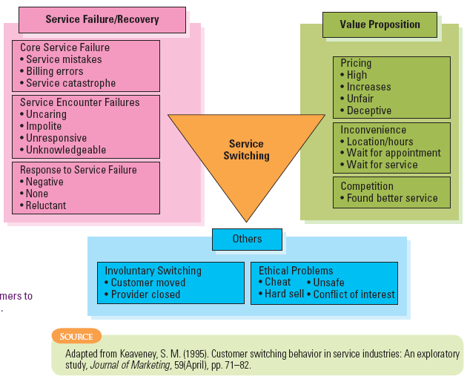
What Drives Customers to Switch?

Slide 32
Addressing Key Churn Drivers
Delivery quality
Minimize inconvenience and non-monetary costs
Fair and transparent pricing
Industry specific drivers
  Cellular phone industry: handset replacement a common reason for subscribers discontinuing services – offer proactive handset replacement programs
Reactive measures
  Save teams

Slide 33
Other Ways to Reduce Churn
Implement Effective Complaint Handling and Service Recovery Procedures
Increase Switching Costs
  Natural switching costs
    - e.g., Changing primary bank account – many related services tied to account
  Can be created by instituting contractual penalties for switching
    - Must be careful not to be perceived as holding customers hostage
    - High switching barriers and poor service quality likely to generate negative attitudes and word of mouth

Slide 34
CRM: Customer
Relationship Management

Slide 35
Objectives of CRM Systems
Data collection
  Customer data such as contact details, demographics, purchasing history, service preferences
Data analysis
  Data captured is analyzed and categorized
  Used to tier customer base and tailor service delivery accordingly
Sales force automation
  Sales leads, cross-sell and up-sell opportunities effectively identified and processed
  Track and facilitate entire sales cycle

Slide 36
Objectives of CRM Systems
Marketing automation
  Mining of customer data enables the firm to target its market
  Goal to achieve one-to-one marketing and cost savings
  Results in increasing the ROI on its marketing expenditure
  Enables the assessment of the effectiveness of marketing campaigns through the analysis of responses
Call center automation
  Call center staff have customer information at their fingertips resulting in improved service levels to customers.
  Caller ID and account numbers allow call centers to identify the customer tier the caller belongs to, and to tailor the service accordingly.

Slide 37
Integrated Framework for
CRM Strategy
Strategy Development Process
Value Creation
Process
Multi-channel Integration Process
Performance Assessment Process
Information Management Process
Source: Adapted from: Adrian Payne and Pennie Frow, “A Strategic Framework for Customer Relationship Management,” Journal of Marketing 69 (October 2005): 167-176.

Slide 38
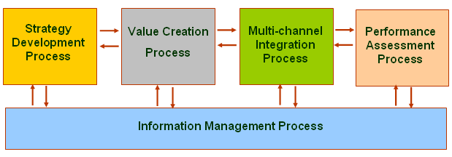
CRM: Strategy Development
Strategy Development
  Responsibility of top management
  Used to guide the development for the customer strategy
  Assessment of business strategy

Slide 39
CRM: Value Creation
Value Creation
  Translates business and customer strategies into specific value propositions for both customers and firm
    - Customers benefit from priority, tiered services, loyalty rewards, and customization
    - Company benefits from reduced customer acquisition and retention costs, and increased share-of-wallet
  Dual creation of value: customers need to participate in CRM to reap value from firm’s CRM initiatives

Slide 40
CRM: Multi-Channel Integration
Multi-Channel Integration
  Serve customers well across many potential interfaces
  Offer a unified interface that delivers customization and personalization

Slide 41
CRM: Performance Assessment
Performance Assessment
Is CRM system creating value for key stakeholders?
Are marketing and service standard objectives being achieved?
Is CRM system meeting performance standards?

Slide 42
CRM: Information Management
Information Management
  Collect customer information from all channels
  Integrate it with other relevant information
  Make useful information available to the frontline
  Create and manage data repository, IT systems, analytical tools, specific application packages

Slide 43
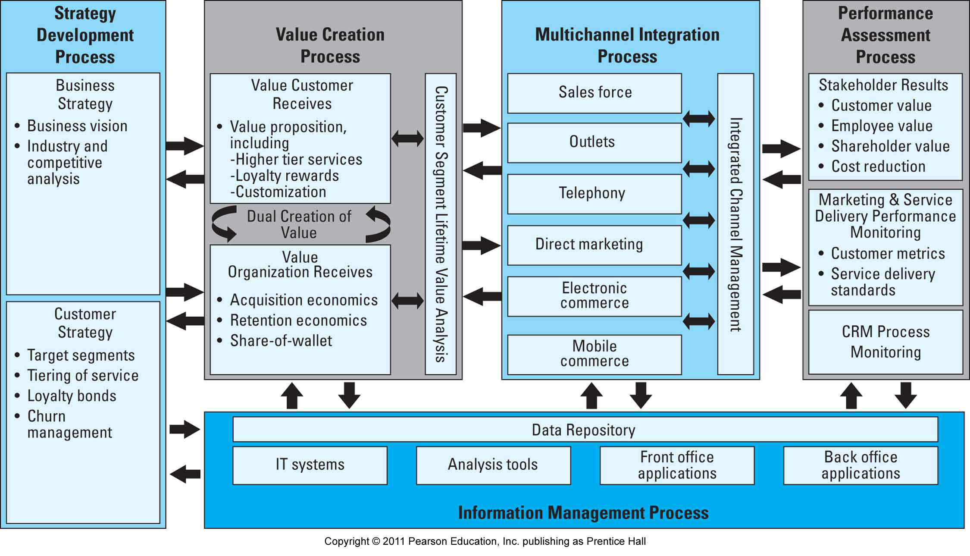
Integrated Framework for
CRM Strategy

Slide 44
Common Failures in
CRM Implementation
Service firms often equate installing CRM systems with having a customer relationship strategy
Common reasons for failures
  Viewing CRM as a technology initiative
  Lack of customer focus
  Insufficient appreciation of customer lifetime value (CLV)
  Inadequate support from top management
  Failure to reengineer business processes
  Underestimating the challenges in date integration

Slide 45
Defining a CRM Strategy
How should our value proposition change to increase customer loyalty?
How much customization or one-to-one marketing and service delivery is appropriate and profitable?
What is incremental profit potential of increasing share-of-wallet with current customers? How much does this vary by customer tier and/or segment?
How much time and resources can we allocate to CRM right now?
If we believe in customer relationship management, why haven’t we taken more steps in that direction in the past?
What can we do today to develop customer relationships without spending on technology?

Slide 46
Summary
Customer loyalty is an important driver of profitability so firms need to assess lifetime customer value and narrow gap between actual and potential value
Building a foundation of loyalty involves
  Good fit between customer needs and capabilities
  Tiering services effectively
  Obtaining customer satisfaction through service quality
Customer loyalty bonds include
  Reward-based, social, customization, and structural bonds
  Created through membership and loyalty programs

Slide 47
Summary
Strategies for reducing customer defections include
  Analyzing customer defections and monitoring declining accounts
  Addressing key churn drivers, increasing switching costs
  Implementing effective complaint-handling and service recovery procedures
A successful CRM program requires understanding of common failures while including the following processes
  Strategy development process
  Value creation process
  Multichannel integration process
  Performance assessment process

