Slide 1
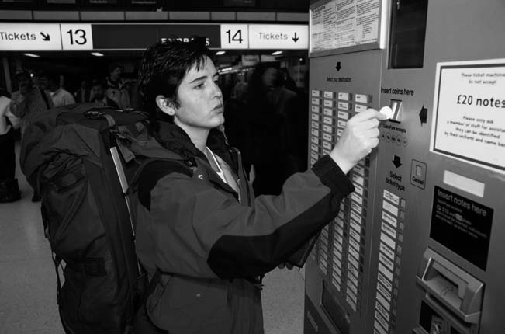
Designing and Managing
Service Processes
Zeenat Jabbar

Slide 2
Overview
Flowcharting Customer Service Processes
Blueprinting Services to Create Valued Experiences and Productive Operations
Service Process Redesign
The Customer as Co-Producer
Self-Service Technologies

Slide 3
Flowcharting Customer Service Processes

Slide 4
Flowcharting Service Delivery
Helps to Clarify Product Elements
Technique for displaying the nature and sequence of the different steps in delivery service to customers
Offers way to understand total customer service experience
Shows how nature of customer involvement with service organizations varies by type of service:
  People processing
  Possession processing
  Mental Stimulus processing
  Information processing

Slide 5
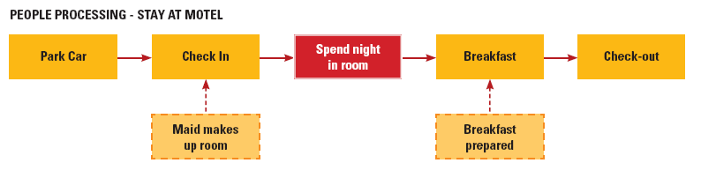
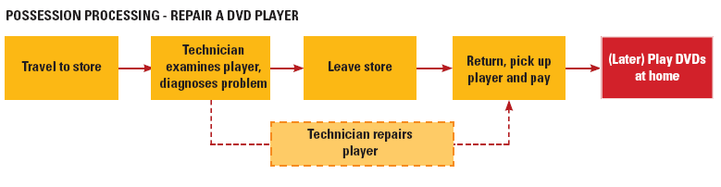
Flowcharts for People and Possession Processing Services

Slide 6
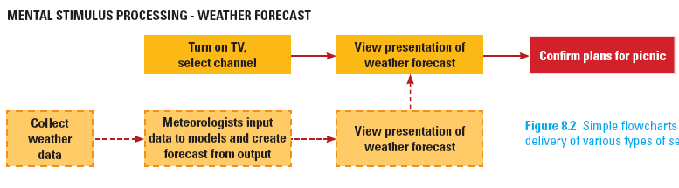
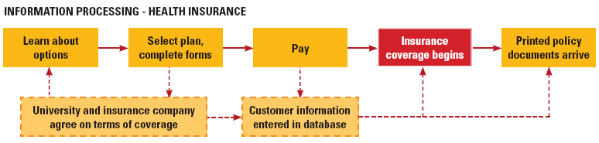
Flowcharts for Mental Stimulus and Information Processing Services

Slide 7
Blueprinting Services to Create Valued Experiences and Productive Operations

Slide 8
Developing a Blueprint
Developing a Blueprint
  Identify key activities in creating and delivering service
  Define “big picture” before “drilling down” to obtain a higher level of detail
Advantages of Blueprinting
  Distinguish between “frontstage” and “backstage”
  Clarify interactions and support by backstage activities and systems
  Identify potential fail points; take preventive measures; prepare contingency
  Pinpoint stages where customers commonly have to wait

Slide 9
Key Components of a Service Blueprint
Define standards for frontstage activities
Specify physical evidence
Identify principal customer actions
Line of interaction
Frontstage actions by frontline personnel
Line of visibility
Backstage actions by customer contact personnel
Support processes involving other personnel
Support processes involving IT
Objectives:
Identify fail points & risks of excessive waits
Set service standards
Fail-proof process

Slide 10
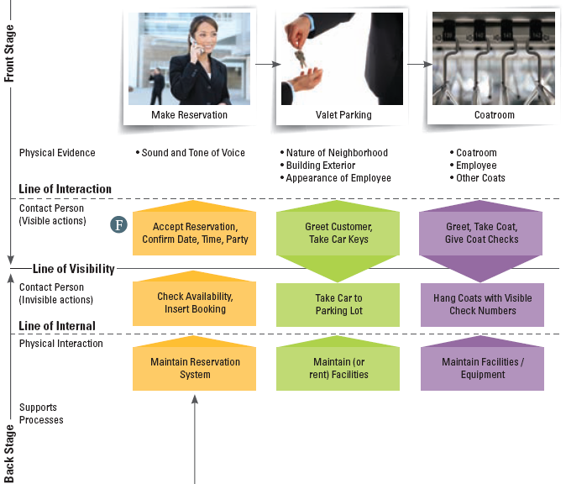
Blueprinting the Restaurant Experience: Act 1

Slide 11
Blueprinting the Restaurant Experience: A Three-Act Performance
Act 1: Prologue and Introductory Scenes
Act 2: Delivery of Core Product
  Cocktails, seating, order food and wine, wine service
  Potential fail points: Menu information complete? Menu intelligible? Everything on the menu actually available?
  Mistakes in transmitting information a common cause of quality failure
  Customers may not only evaluate quality of food and drink, but how promptly it is served or serving staff attitudes
Act 3: The Drama Concludes
  Remaining actions should move quickly and smoothly, with no surprises at the end
  Customer expectations: accurate, intelligible and prompt bill, payment handled politely, guest are thanked for their patronage

Slide 12
Improving Reliability of Processes Through Fail-Proofing
Identify fail points
Analysis of reasons for failure reveals opportunities for failure-proofing to reduce/eliminate future errors
Need fail-safe methods for both employees and customers

Slide 13
Setting Service Standards and Targets
Service providers set standards for each step sufficiently high to satisfy and even delight customers
  Include time parameters, script and prescriptions for appropriate style and demeanor
  Must be expressed in ways that permit objective measurement
Performance targets – specific process and team performance targets for which staff are responsible for
Evaluated based on distinction between standards and targets

Slide 14
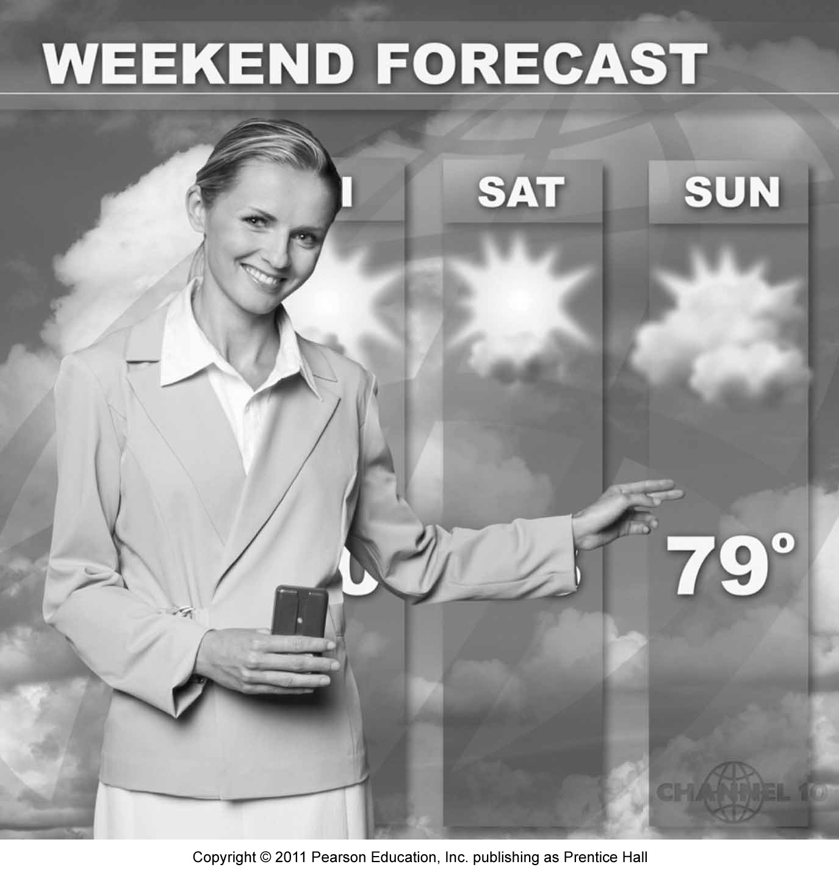
Setting Service Standards and Targets
First impression is important
  Affects customer’s evaluations of quality during later stages of service delivery as customer perceptions of service experiences tend to be cumulative
For low-contact service, a single failure committed front stage is relatively more serious than in a high-contact service

Slide 15
Setting Standards and Targets for Customer Service Processes
Service Attributes
Service Process Indicators
Service Process Standards
Performance Targets
Responsiveness
Reliability
Competence
Accessibility
Courtesy
Communication
Credibility
Confidentiality
Listening to the customer
Processing time to approve applications
24 hours
80% of all applications in 24 hours
Creates a Base to Measure Customer Satisfaction
Define Service Quality Goals for Staff
Define/Process Departmental Service Goals

Slide 16
Redesigning Service Processes

Slide 17
Why Redesign?
Revitalizes process that has become outdated
Changes in external environment make existing practices obsolete and require redesign of underlying processes
Rusting occurs internally
  Natural deterioration of internal processes; creeping bureaucracy; evolution of spurious, unofficial standards
  Symptoms:
    - Extensive information exchange
    - Data that is not useful
    - High ratio of checking control activities to value-adding activities

Slide 18
Why Redesign?
“Institutions are like steel beams—they tend to rust. What was once smooth and shiny and nice
tends to become rusty.”
Mitchell T. Rabkin, MD,
former president of Boston’s Beth Israel Hospital

Slide 19
Why Redesign?
Redesign aims to achieve these performance measures:
  Reduced number of service failures
  Reduced cycle time from customer initiation of a service process to its completion
  Enhanced productivity
  Increased customer satisfaction

Slide 20
Process Redesign: Approaches and Potential Benefits
Eliminating non-value-adding steps
Streamline front-end and back-end processes of services
Shifting to self-service
Delivering direct service
Improve productivity and customer satisfaction
Increase in productivity and service quality
Lower costs and perhaps prices
Enhance technology reputation
Differentiates company
Improve convenience for customers
Productivity can be improved by eliminating expensive retail locations
Increase customer base

Slide 21
Process Redesign: Approaches and Potential Benefits
Bundling
services
Redesigning physical aspects of service process
A better fit to the needs of target segment
Increase productivity with customized service
Increase per capita service use
Involves grouping multiple services into one offer, focusing on a well-defined customer group
Focus on tangible elements of service process (facilities and equipment)
Increase convenience
Enhance satisfaction and productivity of frontline staff
Cultivate interest in customers

Slide 22
The Customer as Co-Producer

Slide 23
Levels of Customer Participation
High – Customer works actively with provider to co-produce the service
Medium – Customer inputs required to assist provider
Low – Employees and systems do all the work
Service cannot be created without customer’s active participation
Customer can jeopardize quality of service outcome
Provide needed information and instructions
Make some personal effort; share physical possessions
Involves standardized work

Slide 24
Customers as Partial Employees
Customers can influence productivity and quality of service processes and outputs
Customers not only bring expectations and needs but also need to have relevant service production competencies
For the relationship to last, both parties need to cooperate with each other

Slide 25
Managing Customers
Recruitment and Selection
Job Analysis
Motivate
Recruit customers that possess the competency to perform the necessary tasks
Are customers aware of their roles and equipped with the required skills?
Education and Training
Information required for them to perform their roles via instructions or video demonstration
Ensure that they will be rewarded for good performance
Appraise
For sub-par performances, improve customer training or change the role or process
Ending
Last resort: if customer is non compliant consider termination of the relationship

Slide 26
Self-Service Technologies

Slide 27
Self-Service Technologies (SSTs)
SSTs are the ultimate form of customer involvement where customers undertake specific activities using facilities or systems provided by service supplier
  Customer’s time and effort replace those of employees
Information-based services lend selves particularly well to SSTs
  Used in both supplementary services and delivery of core product

Slide 28
Self-Service Technologies (SSTs)
Many companies and government organizations seek to divert customers from employee contact to Internet-based self-service
Advantages:
  Time and Cost savings
  Flexibility
  Convenience of location
  Greater control over service delivery
  High perceived level of customization
Disadvantages:
  Anxiety and stress experienced by customers who are uncomfortable with using them
  Some see service encounters as social experiences and prefer to deal with people

Slide 29
What Aspects Of SSTs Please Or Annoy Customers?
People love SSTs when… | People hate SSTs when…
SST machines are conveniently located and accessible 24/7– often as close as the nearest computer! Obtaining detailed information and completing transactions can be done faster than through face-to-face or telephone contact | SSTs fail – system is down, PIN numbers not accepted, etc. Customers themselves mess up – forgetting passwords; failing to provide information as requested; simply hitting wrong buttons
Key weakness: Few firms incorporate service recovery systems such that customers are still forced to make telephone calls or personal visits

Slide 30
Putting SSTs to Test by
Asking a Few Simple Questions
Does the SST work reliably?
  Firms must ensure that SSTs are dependable and user-friendly
Is the SST better than interpersonal alternatives?
  Customers will stick to conventional methods if SST doesn’t create benefits for them
If it fails, what systems are in place to recover?
  Always provide systems, structures, and technologies that will enable prompt service recovery when things fail

Slide 31
Managing Customer’s Reluctance to Change
Increasing customer’s participation level in a service can be difficult
Marketing communications to be used to:
  Prepare customer for change
  Explain the rationale and benefits
  What customers need to do differently in the future

Slide 32
Summary
Service blueprinting can be used to design a service and create a satisfying experience for customers. Key components of the blueprint include:
Blueprinting a restaurant (or other service) can be a three-act performance
  Prologue and introductory scenes
  Delivery of the core product
  Conclusion of the drama

Slide 33
Summary
Service standards and targets are different and can be used to evaluate performance
Service process redesign reduces service failure and enhances productivity
When the customer is a co-producer, issues to consider are
  Levels of customer participation
  Self-service technologies (SST)
  Psychological factors in customer co-production
  Aspects of SST that please or annoy customers

