Slide 1
Benefits and Compensation
Notes:
The main purpose of this chapter is to explain how to create and implement an equitable pay plan. The main topics we cover include What Determines How Much You Pay, How to Create a Market-Competitive Pay Plan, Incentive Plans, Employee Benefits, and Current Compensation Trends.

Slide 2
Learning Objectives
When you finish studying this chapter, you should be able to:
Discuss four basic factors determining pay rates.
Explain each of the steps in establishing market-competitive pay rates.
Compare and contrast piecework and team or group incentive plans.
List and describe each of the basic benefits most employers might be expected to offer.
Notes:
When you finish studying this chapter, you should be able to:
Discuss four basic factors determining pay rates.
Explain each of the steps in establishing market-competitive pay rates.
Compare and contrast piecework and team or group incentive plans.
List and describe each of the basic benefits most employers might be expected to offer.

Slide 3
What Determines How Much You Pay?
Notes:
Employee Compensation: All forms of pay or rewards going to employees has two main components, which are direct and indirect financial payments. Four basic factors determine what people are paid are legal, union, policy, and equity factors.

Slide 4

What Determines How Much
You Pay?
Legal: Important compensation laws
How unions influence compensation decision
Compensation policies
Notes:
Legal: Important Compensation Laws — Numerous laws stipulate what employers can or must pay in terms of minimum wages, overtime rates, and benefits. There are many laws that govern compensation. For example, the Fair Labor Standards Act (FLSA) regulates the minimum wage and requires that overtime be paid at a rate of one and one half times the normal rate of pay for hours worked over 40 in a work week. Employees are categorized as exempt from the act, or not exempt (non-exempt) from its provisions. Other compensation laws include the Equal Pay Act, the Civil Rights Act, other discrimination laws such as the Age Discrimination in Employment Act (ADEA), and the Americans with Disabilities Act (ADA).
How Unions Influence Compensation Decisions — Unions and labor relations laws influence pay plan design. Besides wages, unions include time off with pay, income security, cost-of-living (COLA) adjustments, and various benefits such as health care.
Compensation Policies — The basic thrust in pay plans today is to produce an aligned reward strategy to create compensation plans that guide employee behaviors in the desired, strategic direction. While locality is a consideration, distinguishing between high and low performers is a policy issue, as is seniority-based pay.
Equity and Its Impact on Pay Rates — External and internal equity are crucial in pay rates. External equity refers to pay comparing favorably with rates in other organizations. Internal equity refers to employees viewing their pay as equitable given other pay rates in the organization. Individual equity refers to the fairness of an individual’s pay as compared with what his/her coworkers are earning for the same or very similar jobs in the company. Last, procedural equity refers to the perceived fairness of the processes and procedures used to make decisions regarding the allocation of pay.

Slide 5
How to Create a Market-Competitive Plan
Notes:
Employers use two basic approaches to setting pay rates, market-based approaches, and evaluation approaches. In practice, setting pay rates while ensuring external and internal equity (in other words, creating a market-competitive pay plan) usually entails six steps:
1. Determine the worth of each job in your organization through job evaluation (to help ensure internal equity).
2. Group similar jobs into pay grades.
3. Price each pay grade with a wage curve.
4. Conduct a salary survey of what other employers are paying comparable jobs.
5. Compare and adjust current and market wage rates for jobs or grades.
6. Develop rate ranges.

Slide 6
Step 1: Determine the Worth of Each Job: Job Evaluation
Purpose of job evaluation
Compensable factors
Job evaluation methods
  Ranking
  Job classification
  The point method
Notes:
The job evaluation helps the employer build a pay plan that is internally equitable.
The purpose of job evaluation is to determine a job’s relative worth through formal and systematic comparison of jobs to determine the worth of one job relative to another.
2. Compensable Factors determine the definition of job content, establish how the jobs compare to one another, and set the compensation paid for each job.
3. Job Evaluation Methods are simple, widely used methods in which you categorize jobs into groups.
Ranking is the simplest method, which ranks each job relative to all other jobs on some overall factor. The steps of the ranking method include: 1) obtaining job information; 2) selecting raters and jobs; 3) selecting compensable factors; 4) ranking jobs; and 5) combining ratings.
Job Classification (or grading) is a simple, widely used method in which you categorize jobs into groups. The groups are called classes if they contain similar jobs or grades if they contain jobs that are similar in difficulty but otherwise different.
The Point Method is a more quantitative technique that involves identifying 1) several compensable factors, each having several degrees, as well as 2) the degree to which each of these factors is present in the job.

Slide 7
Step 2: Group Similar Jobs into
Pay Grades
Points from Job Evaluation Process | Job Grade
50 – 60 | 1
61 – 70 | 2
71 – 80 | 3
81 – 90 | 4
91 – 100 | 5
Notes:
Step 2. Group Similar Jobs into Pay Grades — The committee will probably group similar jobs into grades for pay purposes, instead of having to deal with hundreds of pay rates.

Slide 8
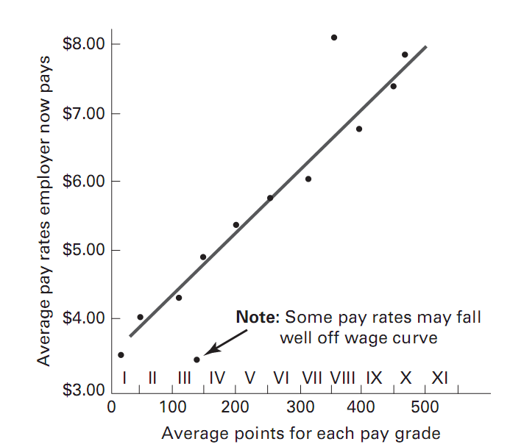
Step 3. Price Each Pay Grade
Notes:
Step 3. Price Each Pay Grade: Wage Curves are typically used to help assign pay rates to each pay grade or job. They show the relationship between the value of the job and the average wage paid for this job relative to the points or rankings assigned to each job or grade by the job evaluation.

Slide 9

Step 4: Conduct Salary Survey
Benchmark job
20% or more directly from the marketplace
Collect data on benefits
Notes:
Step 4: Conduct the Salary Survey — Such surveys are used to help assign pay rates to each pay grade or job. They show the relationship between the value of the job and the average wage paid for this job.
Salary surveys are used to price benchmark jobs.
Next, employers usually price 20% or more of their positions directly from the marketplace.
Finally, surveys also collect data on benefits in addition to wages and salary.

Slide 10
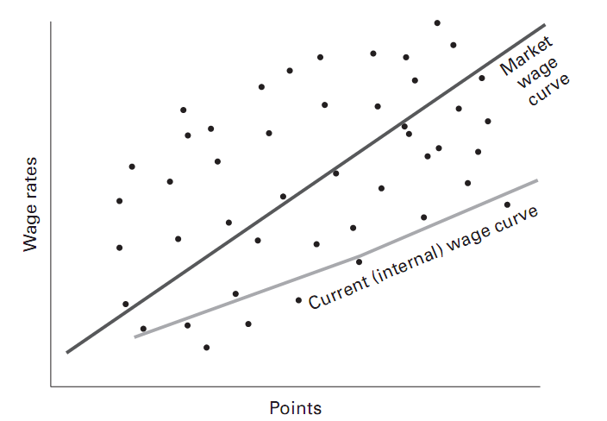
Step 5: Compare and Adjust
Notes:
Step 5: Compare and Adjust Current and Market Wage Rates for Jobs — The employer wants its pay rates for each job to be equitable not just internally (relative to each other) but also externally (relative to what others are paying). To do this we compare the two wage curves. The “internal” or “current” wage curve plots what we are now paying for jobs grouped in each grade. The “external” wage curve plots what others are paying for these same jobs.

Slide 11
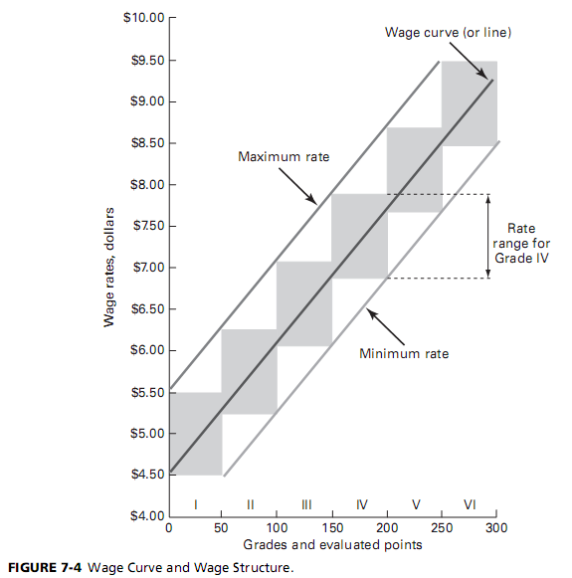
Step 6: Develop Rate Ranges
Notes:
Step 6: Develop Rate Ranges — Most employers develop vertical pay (rate) ranges for each horizontal pay grade. These pay ranges may appear as vertical boxes within each grade, showing minimum, maximum, and midpoint pay rates for that pay grade (see Figure 7.4). You may depict the pay ranges as steps or levels, with specific corresponding pay rates for each step within each pay grade.

Slide 12
Pricing Managerial and Professional Jobs
Pay package elements
Strategy and executive pay
  Strategic direction
  Skills and competencies list
  Does existing pay plan produce results?
  If not, re-design
Pay for professionals
Notes:
Pricing Managerial and Professional Jobs — For such jobs, job evaluation provides only a partial answer to the question of appropriate pay. One study concluded that job complexity, the employer’s ability to pay and the executive’s human capital accounts for most of executive compensation variance.
Pay Package Elements — Basic compensation elements for top executives include: base pay, short-term incentives, long-term incentives, and executive benefits and perks. Shareholder activism has tightened the restrictions on what companies pay top executives. Employers are now shifting to an annual bonus plan for motivating top executives.
Strategy and Executive Pay — Pay plans for professionals should make sense strategically.
Identify the company’s strategic direction
List the skills and competencies your professional employees should have and the behaviors they should exhibit
Evaluate the extent to which the existing pay plan produces these skills, competencies, and behaviors.
If not, design and implement a new pay plan.

Slide 13
Incentive Plans (1)
Piecework plans
Team or group incentive plans
Incentives for managers and executives
  Stock Options
  Sarbanes-Oxley
Incentives for salespeople
Notes:
Piecework Plans — Piecework involves paying the worker a sum (piece rate) for each unit he/she produces. Straight piecework entails a strict proportionality between results and rewards, regardless of output. With a standard hour plan, the worker gets a premium equal to the percent by which his/her performance exceeds the standard.
Team or Group Incentive Plans – There are several ways to build team incentive plans. Some examples include the following: Members are paid based on one of three formulas — all members receive the pay a) earned by the highest producer, b) earned by the lowest producer, or c) equal to the average pay earned by the group.
Incentives for Managers and Executives — As noted, most managers get short-term bonuses and long-term incentives in addition to salary. While many employers focus on singular criteria (such as bottom-line profitability) in awarding top-executive incentive pay, using multiple, strategy-based criteria is best.
Stock Options account for over half of executives’ compensation. A stock option is the right to purchase a specific number of shares of company stock at a specific price during a specific period of time; the executive thus hopes to profit by exercising his/her option to buy the shares in the future but at today’s price.
Sarbanes-Oxley — The Sarbanes-Oxley Act of 2002 made executives and board members personally liable for violating their fiduciary responsibilities to their shareholders.
Incentives for Salespeople – Most companies pay salespeople a combination of salary and commissions, usually with a sizable salary component. Combination plans give salespeople a floor to their earnings, and still provide an incentive for superior performance. But they can become complicated, and misunderstandings can result.

Slide 14
Incentive Plans (2)
Non-tangible and recognition-based merit pay as an incentive
Profit-sharing plans
Employee Stock Ownership Plans (ESOPs)
Gainsharing plans
Earnings-at-risk pay plans
Notes:
Non-Tangible and Recognition-Based Awards — The term “recognition program” usually refers to formal programs, such as employee-of-the-month programs. “Social recognition” programs are more informal manager–employee exchanges, including praise and approval. “Performance feedback” is similar, but provides quantitative or qualitative information on performance in order to change the performance or maintain it. Most employers combine both financial and nonfinancial incentives to motivate employees.
Online Award Program — Web sites can offer a much broader range of products than most employers could catalog and offer themselves.
Merit Pay as an Incentive — Merit pay or raise is any salary increase the firm awards to an employee based on his/her individual performance. It is different from a bonus in that it usually becomes part of the employee’s base salary, whereas a bonus is a one-time payment.
Profit-Sharing Plans involve employees receiving a share of the company’s annual profits. There are several types of profit-sharing plans: cash plans, Lincoln Incentive system, and deferred profit-sharing plans.
Employee Stock Ownership Plans (ESOPs) are company-wide plans in which a firm contributes shares of its own stock or cash to purchase the stock to a trust established to purchase shares of the firm’s stock for employees.
Gainsharing Plans are incentive plans that engage many or all employees in a common effort to achieve a company’s productivity objectives, with any resulting cost-savings gains shared among employees and the company. For example, a Scanlon Plan is an incentive plan developed in 1937 by Joseph Scanlon. The basic features of the plan include philosophy of cooperation, identity, competence, involvement system, and sharing of benefits formula.
Earnings-at-Risk Pay Plans are plans that put some portion of the employee’s weekly pay at risk, subject to the firm meeting its financial goals.

Slide 15
Incentive Plans (3)
Incentives at Nucor Corporation
Improving Productivity through HRIS
Job Design
Designing effective Incentive Program
  The five building blocks of effective incentive plans
Notes:
Incentives at Nucor Corporation — Nucor is the largest steel producer in the United States. It also has the highest productivity, wages, and lowest labor cost per ton in the American steel industry. They use a production incentive plan, a department manager incentive plan, a professional and clerical bonus plan, and a senior officers’ incentive plan.
Improving Productivity through HRIS — Benefits administration can be an enormously labor-intensive and time-consuming activity for an HR department. One of the main ways HR managers are increasing the productivity of their benefits dollars is by increasing the utilization of technology such as an Enterprise Incentive Management (EIM) system and by outsourcing benefits administration.
Job Design involves reorganizing jobs to give workers more autonomy and responsibility.
The Five Building Blocks of Effective Incentive Plans — Seventy percent of employees feel their firm’s incentive plans are ineffective. The five building blocks of effective incentive plans are as follows:
- Ask: Does it make sense to use incentives here?
- Link the incentive with your strategy
- Make sure the program is motivational
- Set complete standards
- Be scientific

Slide 16
Employee Benefits
Notes:
Employee Benefits are indirect monetary and nonmonetary payments an employee receives for continuing to work for the company. Health care benefit costs rose by 8% in 2011 and 8.5% in 2012 resulting in total health care benefit costs per employee well over $9,500 added to employer costs.

Slide 17

Employee Benefits (1)
Pay for time not worked
  Unemployment insurance
  Vacations and holidays
  Sick leave
  FMLA
  Severance
Notes:
We can define benefits as indirect monetary and nonmonetary payments an employee receives for continuing to work for the company (rather than direct payments, as for wages). We will classify benefits as pay for time not worked, insurance benefits, retirement benefits, and employee services benefits.
Pay for Time Not Worked — Also known as supplemental pay benefits includes pay for vacation.
Unemployment Insurance — All states have unemployment insurance or compensation acts (that follow federal guidelines), which provide for weekly benefits if a person is unable to work through some fault other than his/her own.
Vacations and Holidays — The number of paid employee vacation days and holidays varies considerably from employer to employer.
Sick Leave provides pay to employees when they’re out of work due to illness. Most sick leave policies grant full pay for a specified number of permissible sick days.
FMLA — Family Medical Leave Act stipulates that: 1) private employers of 50 or more employees must provide eligible employees up to 12 weeks of unpaid leave for their own serious illness, the birth or adoption of a child, or the care of a seriously ill child, spouse, or parent; 2) employers may require employees to take any unused paid sick leave as part of the 12-week leave provided in the law; 3) employees taking leave are entitled to receive health benefits while they are on unpaid leave, and 4) employers must guarantee employees the right to return to their previous or equivalent position with no loss of benefits at the end of the leave.
Severance Pay is a one-time payment when terminating an employee, severance is a humanitarian gesture, and good public relations. Most managers expect employees to give them at least one or two weeks’ notice if they plan to quit; it therefore seems appropriate to provide at least one or two weeks’ severance if an employee is being dismissed.

Slide 18
Employee Benefits (2)
Insurance benefits
  Workers’ compensation
Hospitalization, medical and disability insurance
  Pregnancy Discrimination Act
  COBRA
  Insurance cost control
  Protection and Affordable Care Act of 2010
Notes:
Workers’ Compensation refers to the sure, prompt income and medical benefits provided in work-related accidents to the victims or their dependents, regardless of fault.
Hospitalization, Medical, and Disability Insurance targets providing protection against hospitalization costs and loss of income arising from accidents or illness occurring from off-the-job causes, and is offered by most employers because medical care and insurance are so expensive.
The Pregnancy Discrimination Act — PDA aims to prohibit sex discrimination based on “pregnancy, childbirth, or related medical conditions.”
COBRA Requirements — (Comprehensive Omnibus Budget Reconciliation Act - COBRA) requires most private employers make continued health benefits available to terminated or retired employees and their families for a period of time, generally 18 months.
Health-Care Insurance Cost Control — Employers are trying to control costs by changing their medical plans through: 1), online administration; 2) outsourcing; 3) wellness programs; 4) claims audits; 5) medical tourism; 6) technology; and 7) mini plans.
Protection and Affordable Care Act of 2010 — Signed into law by President Obama in 2010, employers face several requirements under the new Patient Protection and Affordable Care Act. For example, employers must begin reporting the value of health care benefits on employees’ W-2 statements. The act also includes ensuring that all citizens are eligible to receive cost-effective health care even with serious medical pre-existing conditions, allowing children to remain on their parent’s health care plan, and many other benefits.
Separately, the Genetic Information Nondiscrimination Act of 2008 (GINA) prohibits certain genetically related employer actions.

Slide 19

Employee Benefits (3)
Long-term care
Retirement benefits
  Social security
  Pension plans
  401(k) plans
  Cash balance pensions
  ERISA
  Vesting
Notes:
Long-Term Care is a new benefit aimed at supporting people in their old age. The Health Insurance Portability and Accountability Act (HIPAA), enacted in 1996, lets employers and employees deduct the cost of long-term care insurance premiums from their annual income taxes.
Retirement Benefits
Social Security provides three types of benefits: retirement benefits, survivor’s (death) benefits, and disability payments.
Pension Plans — There are a variety of pension plans. We can classify pension plans in three ways: contributory versus noncontributory plans; qualified versus nonqualified plans; and defined contribution versus defined benefit plans.
401(k) Plans are a popular defined contribution plan in which the employee can have money deducted from his/her paycheck and deposited in the account before payroll taxes.
Cash Balance Pension Plans — These are defined benefit plans for federal tax purposes, but have the portability advantages of defined contribution plans.
ERISA — The Employee Retirement Income Security Act aims to protect pensions of workers and to stimulate plan growth.
Vesting — Under ERISA, participants in pension plans must have a non-forfeitable right to 100% of their accrued benefits after three years of service under cliff vesting, and 100% by the end of six years under a graded vesting schedule.

Slide 20
Employee Benefits (4)
Employee services and family-friendly/work-life
  Family-friendly benefits
  Why Work-Life Benefits?
  Workplace flexibility
Flexible benefits
Employee leasing
Websites
Notes:
Although an employer’s time off, insurance, and retirement benefits account for the main part of its benefits costs, many employers also provide various services.
Family-Friendly Benefits — There are more families in which both adults work, more one-parent households, more women working, and more people older than 55 working.
Why Work-Life Benefits? — For the employer, programs like these produce advantages, not just costs. For instance, absences can be reduced through programs that include eldercare, sick leave, personal counseling, and so on.
Workplace Flexibility — When given the opportunity to choose, employees do prefer flexibility in their benefits plan.
Flexible Benefits — Also called “cafeteria plans” involves each employee being given a benefits fund budget to spend on whichever benefits he/she wants once the employer limits the total cost for each benefits package and includes certain non-optional items.
Benefits and Employee Leasing — Employee leasing firms arrange to have all the employer’s employees transferred to the employee leasing firm’s payroll.
Benefits Web Sites — To reduce costs, many employers enable employees to manage much of their own benefit changes via a Web site.

Slide 21
Current Compensation Trends
Notes:
How employers pay employees is evolving. This section looks at important trends including competency-based pay, actively managing compensation, broadbanding, board oversight of executive pay, and total rewards.

Slide 22
Current Compensation Trends
Competency and skill-based pay
Broadbanding
Actively managing pay allocation and talent management
Board oversight of executive pay
Total rewards
Notes:
Competency- and Skill-based Pay — The company pays for the employee’s range, depth, and types of skills and knowledge, rather than for the job title he/she holds. Competency or skill-based pay programs generally contain five elements. The employer defines specific required skills and chooses a method for tying the person’s pay to his or her skill competencies. A training system lets employees seek and acquire skills. There is a formal competency testing system and, the work is designed so that employees can easily move among jobs of varying skill levels.
Broadbanding — means collapsing salary grades and ranges into just a few wide levels or bands. Figure 7.5 shows a sample of setting three bands.
Actively Managing Pay Allocations, and Talent Management — As previously noted, we have seen employers actively allocate resources to employees deemed “mission critical.”
Board Oversight of Executive Pay — There are various reasons why boards of directors are clamping down on executive pay. Questions a board should ask include the following: (1) Is our compensation committee being properly advised?; (2) Do our procedures demonstrate diligence and independence?; and (3) Is our committee appropriately communicating its decisions?
Total rewards programs encompass the traditional compensation components, plus recognition, more challenging redesigned jobs, telecommuting, health and well-being programs, and training and career development.

Slide 23

Position Bases of Power
To influence others to do what you want
Formal Authority
  Legitimate
  Whomever in position
Rewards
Punishments
Which are best?
  Better love or fear?
  Al Capone
Zone of acceptance
Acceptance is key

Slide 24

Personal Sources of Power
To influence others to do what you want
Rewards
Punishments
Expertise
  MD, CPA
Information
  Map, secretary
Reference
Association
  Agee & Cunning, Cook

Slide 25

Guidelines for Political Behavior
Frame in terms of organization goals
Develop the right image
Utilize social networking
Gain control of resources
Become indispensable
Be visible
Get a mentor
Develop powerful allies
Avoid tainted members
Support your boss

Slide 26
Networking Skills for Impression Management
Map out your ideal network
    Determine who knows what’s going on
    Figure out who is critical in the workflow
    Assess who knows how to get around roadblocks
    Determine who can help you the most
Take action to build the network
    Don’t be shy; most other people will be receptive and want to help
    Start conversations with: “I’m new here. Can you help me get to know people who ...?”
Reciprocate and invest in your network
    Share information useful to others
    Take the time to stay in touch with network members
    Update your network as people and situations change

Slide 27

Specific Political Strategies
Reasoning
Friendliness
Coalitions
Bargaining
Higher authority
Assertiveness
Sanctions

Slide 28
Cost-Benefit Analysis
What are potential costs versus benefits?
“Power is effective when held in balance.”
When used cause imbalance
Actions to correct imbalance
For every action there is reaction
Implications?
Minimize resentment via reason, friendliness, rewards
Avoid coercion = win the battle but lose the war

Slide 29
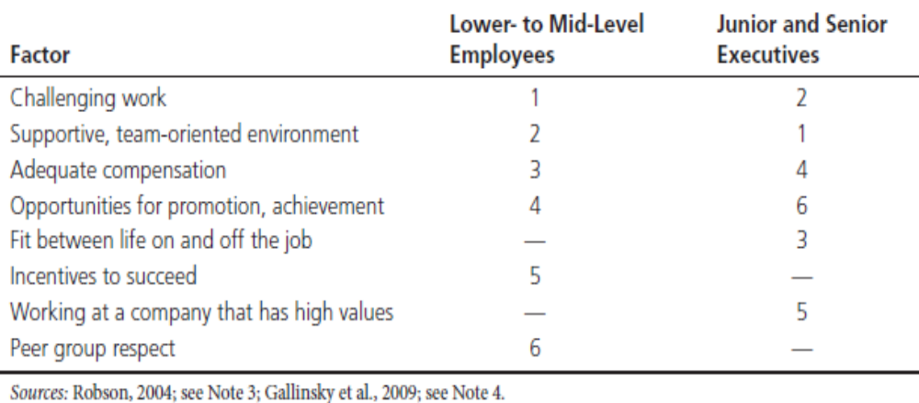
What Motivates People to Work?

Slide 30
Motivating by Enhancing Fit
Motivational fit approach - motivation is based on the connection between the qualities of individuals and the requirements of the jobs they perform in their organizations.

Slide 31
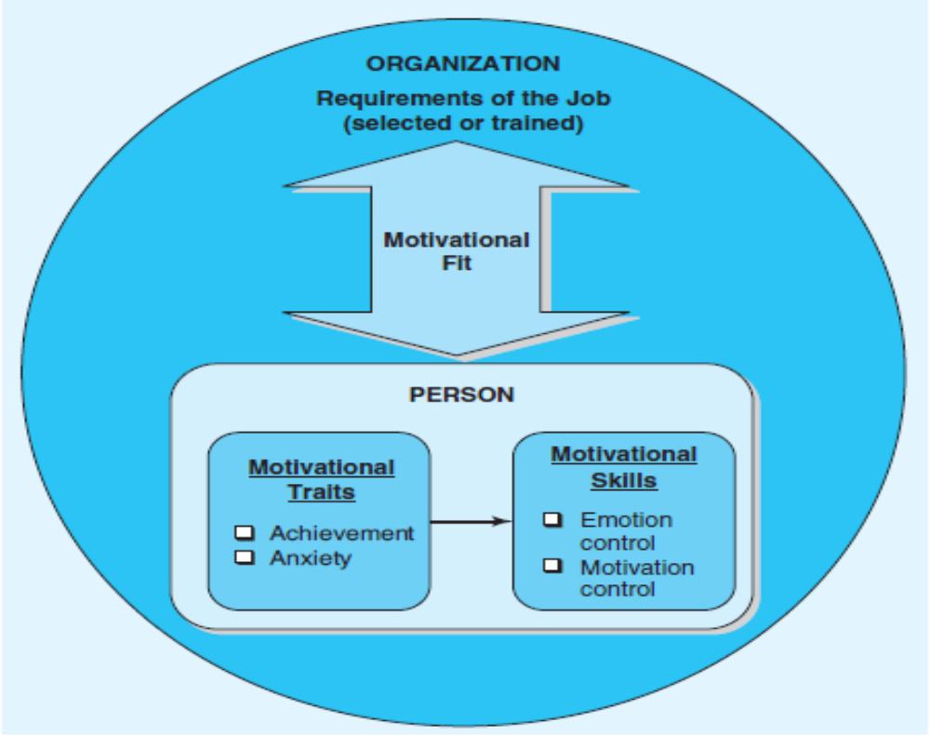
Motivational Fit Approach

Slide 32
Motivating Traits and Skills
Two motivational traits are particularly important:
  Achievement
  Anxiety
The most highly motivated employees have high levels of achievement and low levels of anxiety.

Slide 33
Motivating Traits and Skills
Motivational skills - the particular strategies used when attempting to meet objectives
  Emotion control
  Motivational control
Employees with high levels of emotional control and high levels of motivational control are more successful.

Slide 34
Motivating Workers – Fit Approach
Fit can be enhanced by:
  Prescreening for desired traits and skills
  Building motivational skills

Slide 35
Motivating by Setting Goals
Goal setting - striving for, and attaining goals
Goal setting theory - goals motivate for three reasons:
  Self-efficacy
  Goal commitment
  Task performance

Slide 36
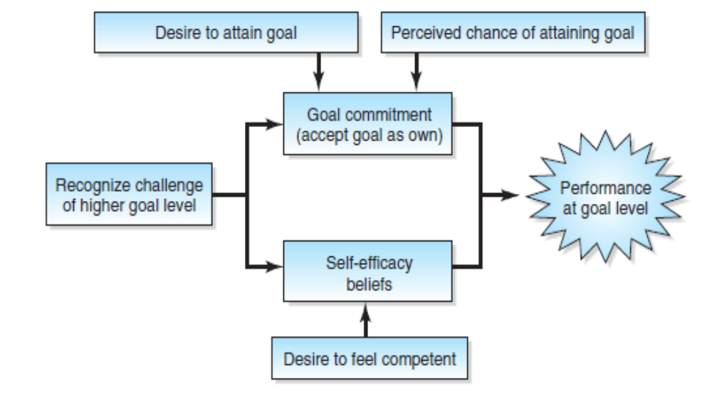
Motivating by Setting Goals

Slide 37
Setting Performance Goals
Guideline for setting performance goals:
  Goals should be specific
  Goals should be difficult
    Vertical stretch goals
    Horizontal stretch goals
  Goals should be attainable
  Provide feedback on goal attainment

Slide 38
Equity Theory
Equity theory - people are motivated to maintain fair or equitable relationships between themselves and others, and to avoid those relationships that are unfair, or inequitable.
Focus on:
  Outcomes - what they get out of their jobs
    Pay, fringe benefits, prestige
  Inputs - the contributions they make to their jobs
    Time worked, effort exerted, units produced
People make equity judgments by comparing their own outcome/input ratios to the outcome/input ratios of others.

Slide 39
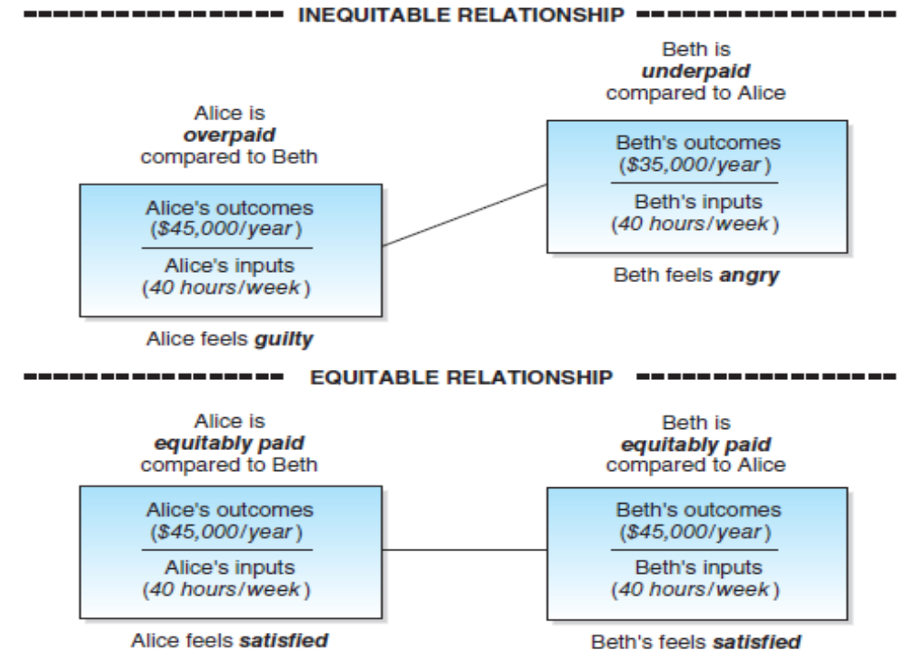
Equity Theory

Slide 40
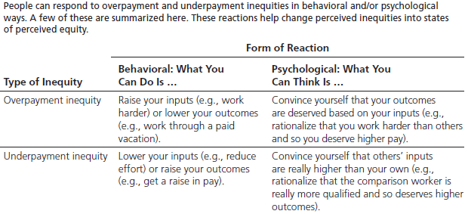
Reactions to Inequity

Slide 41
Extreme Responses to Inequities
Getting sick
Going on strike
Stealing from employers
Quitting the job

Slide 42
Managerial Implications
Avoid underpayment
Avoid overpayment
Be open and transparent about pay
  Transparency - make information about pay available openly

Slide 43
Expectancy Theory
Expectancy theory claims that people will be motivated to exert effort on the job when they believe that doing so will help them achieve the things they want
Components of motivation:
  Expectancy - the belief that one’s effort will affect performance
  Instrumentality - the belief that one’s performance will be rewarded; pay-for performance plans are an example of instrumentality
  Valence - the perceived value of the expected rewards

Slide 44
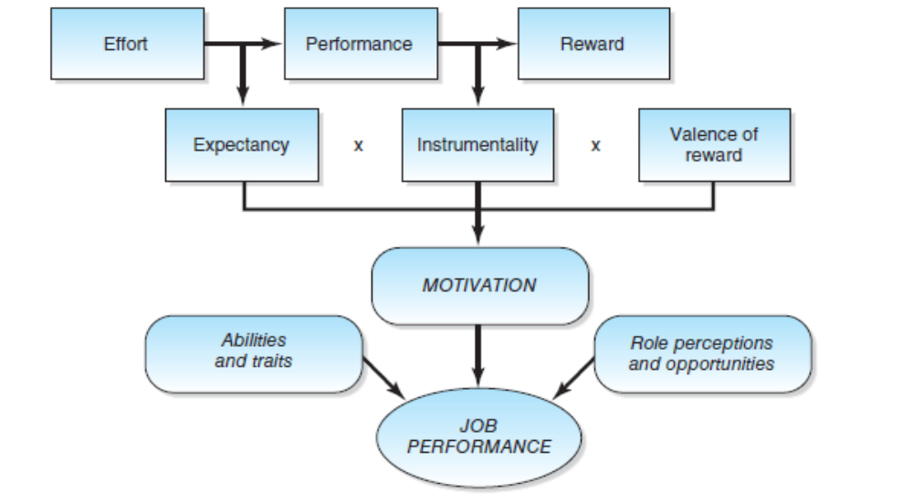
Expectancy Theory

Slide 45
Managerial Implications
Expectancy theory suggests that employees can be motivated by
  Administering rewards that have positive valence to employees
    Cafeteria-style benefit plans
  Clearly linking valued rewards to performance
    Pay-for-performance plans
    Incentive stock option (ISO) plans

Slide 46
Designing Jobs that Motivate
Job design - the process of creating jobs that people are motivated to perform because they are inherently appealing
  Job enlargement - giving employees more tasks to perform at the same level
    Jobs are changed horizontally
  Job enrichment - giving employees a wider variety of tasks that require higher levels of skills and responsibility
    Jobs are changed vertically

Slide 47
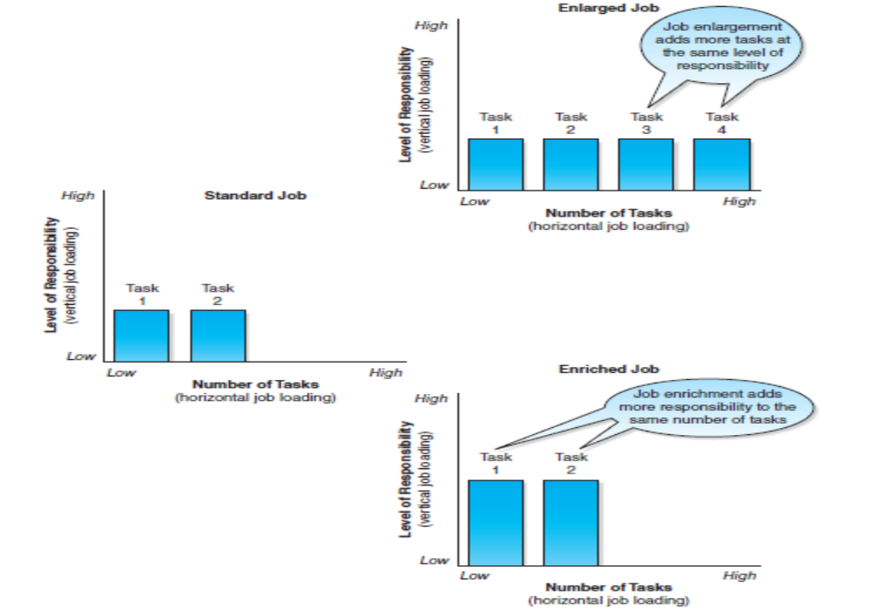
Job Enlargement and Enrichment

Slide 48
Job Characteristics Model
The Job Characteristics Model (JCM) identifies how jobs can be designed to help people feel that they are doing meaningful and valuable work.

Slide 49
Basic Elements of JCM
Skill variety is the extent to which a job requires using different skills and talents.
Task identity is the degree to which a job requires doing a whole task from beginning to end.
Task significance is the amount of impact a job is believed to have on others.
Autonomy is the extent to which employees have the freedom and discretion to plan, schedule, and carry out their jobs as desired.
Feedback is the extent to which the job allows people to have information about the effectiveness of their performance.

Slide 50
Other Components of JCM
Experienced meaningfulness of the work
  the extent to which a job is considered to be highly important, valuable, and worthwhile
Experienced responsibility
  the extent to which employees feel as if they have control over their work efforts
Knowledge of results
  the extent to which employees understand how effectively they have performed
  Growth need strength - an individual’s need for personal growth and development

Slide 51
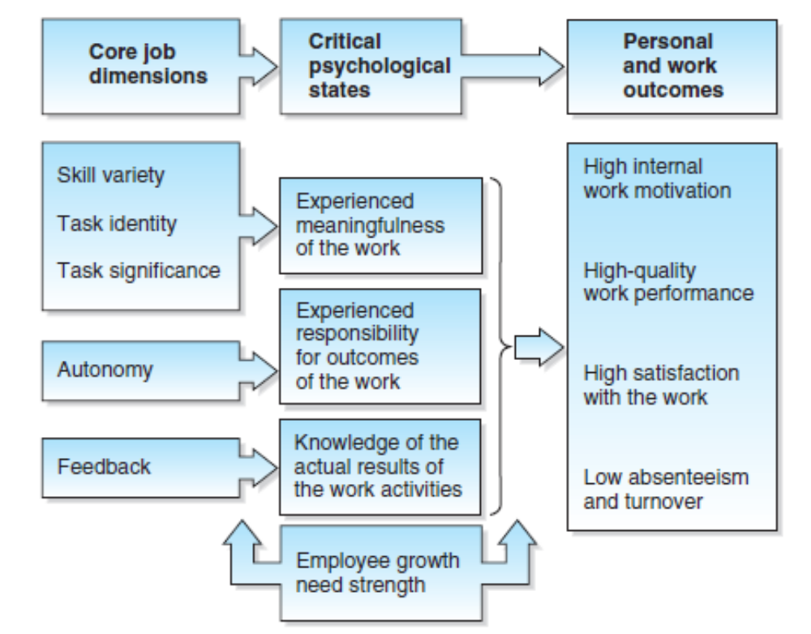
The Job Characteristics Model

Slide 52
Designing Jobs to Motivate
The job characteristics model suggests that:
  Each person should perform an entire job rather than using several workers, each of whom performs a separate part of the job.
  Jobs should be set up so that the person performing a service comes into contact with the recipient of the service.
  Jobs should be designed to give employees as much feedback as possible.

