Slide 1
Public Sector Issues
Zeenat Jabbar

Slide 2
Learning Objectives
DEFINE what is meant by a group and IDENTIFY different types of groups operating within organizations
DESCRIBE the importance of norms, status, and cohesiveness within organizations
EXPLAIN how individual performance in groups is affected by the presence of others (social facilitation) and the number of others with whom one is working (social loafing)
DEFINE what teams are and DESCRIBE the various types of teams that exist in organizations
DESCRIBE the evidence regarding the effectiveness of teams in organizations
EXPLAIN why some teams fail to operate as effectively as possible and DESCRIBE steps that can be taken to build successful teams

Slide 3
Three Good Reasons Why You Should Care About . . . Groups and Teams
The dynamics among people in groups is largely responsible for both the success and failure of many work groups, as well as the satisfaction of the individuals working in them.
Groups and teams can be very effective if you know how to manage them properly.
Teams are a fact of organizational life – one of the most popular way of coordinating the activities of people on the job. Knowing how they operate and how to manage them effectively will give you a competitive advantage.
Notes:
2

Slide 4

Group Dynamics
Group dynamics focus on the nature of groups – the variables governing their formation and development, their structure, and their interrelationships with individuals, other groups, and the organizations within which they exist.

Slide 5
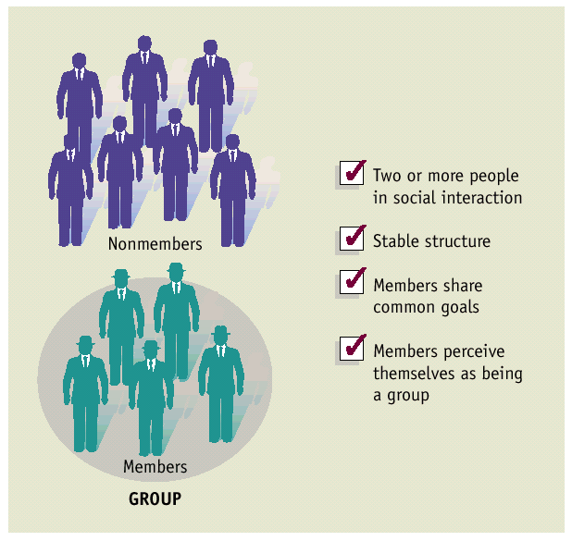
What is a Group?
A group is a collection of two or more interacting individuals with a stable pattern of relationships among them who share common goals and who perceive themselves as being a group.

Slide 6
Key Elements of Groups
Social interaction
Stability
Common interest or goals
Recognition as being a group

Slide 7
Types of Groups
Formal groups – designed to direct members toward some important organizational goal
  Command groups
  Task groups
    Standing committee
    Ad hoc committee
    Task force

Slide 8
Types of Groups
Informal groups – develop naturally without any direction from management
  Interest groups
  Friendship groups

Slide 9
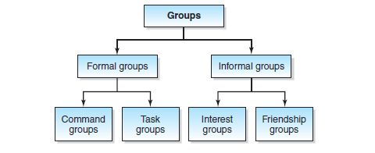
Types of Groups

Slide 10

Building Blocks of Group Dynamics
Roles
Norms
Status
Cohesiveness

Slide 11
Roles: The Hats We Wear
Role - typical behaviors that characterize a person in a social context
  Role incumbent
  Role expectations
Role differentiation – members play different roles in the social structure of the group
  Task-oriented role
  Socioemotional role
  Self-oriented role

Slide 12

Norms: Unspoken Rules
Generally agreed upon informal rules that guide group members’ behavior
Prescriptive norms dictate the behaviors that should be performed
Proscriptive norms dictate specific behaviors that should be avoided

Slide 13
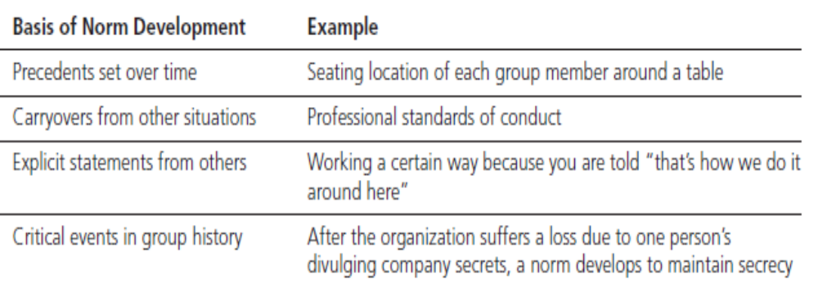
Norm Development

Slide 14
Status: The Prestige of Membership
Status - the relative social position or rank given to groups or group members by others
  Formal Status - attempts to differentiate among the degrees of formal authority given employees by an organization
    Status Symbols - objects reflecting the position of any individual within an organization’s hierarchy
Informal Status - the prestige accorded individuals with certain characteristics that are not formally recognized by the organization

Slide 15

Group Cohesiveness
Cohesiveness refers to the strength of group members’ desires to remain a part of their groups.
Determinants of cohesiveness:
  Severity of initiation
  External threat
  Group size
  History of success

Slide 16
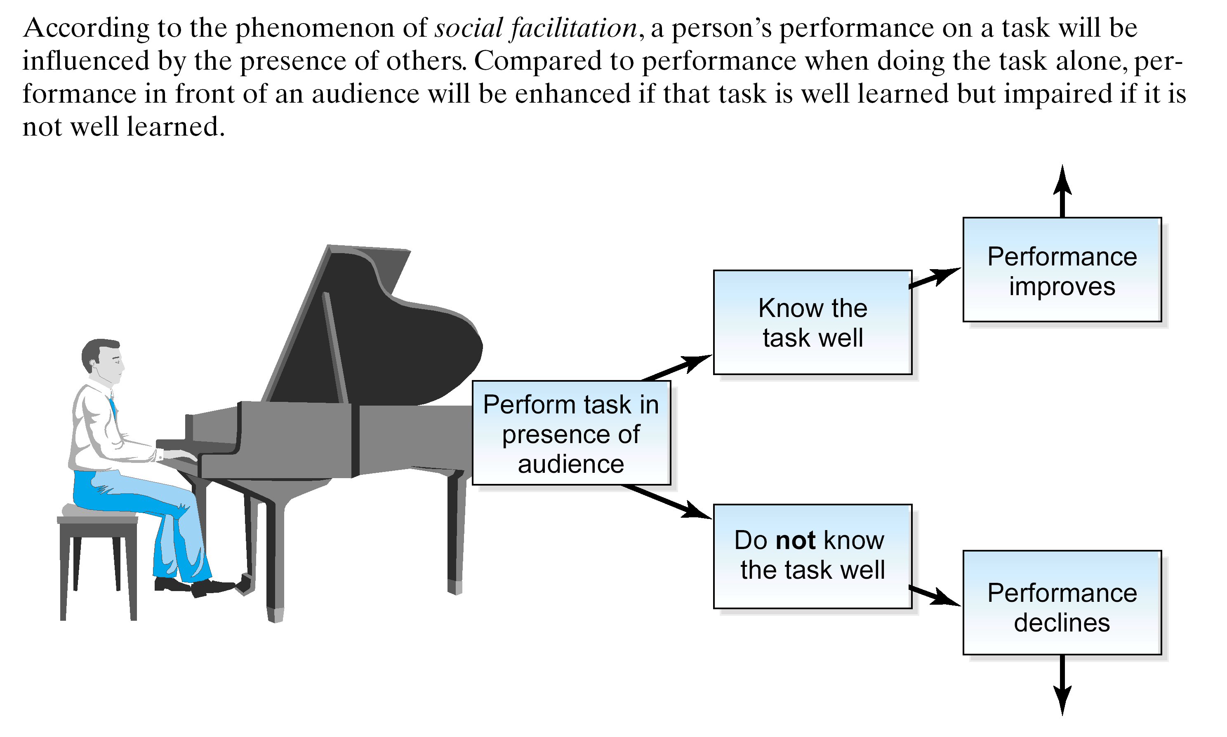
Social Facilitation Effect

Slide 17

Social Loafing
Social loafing - the tendency for group members to exert less individual effort on an additive task as the size of the group increases
  Additive task - a type of group task in which the each person’s contributions can be added together with another’s

Slide 18
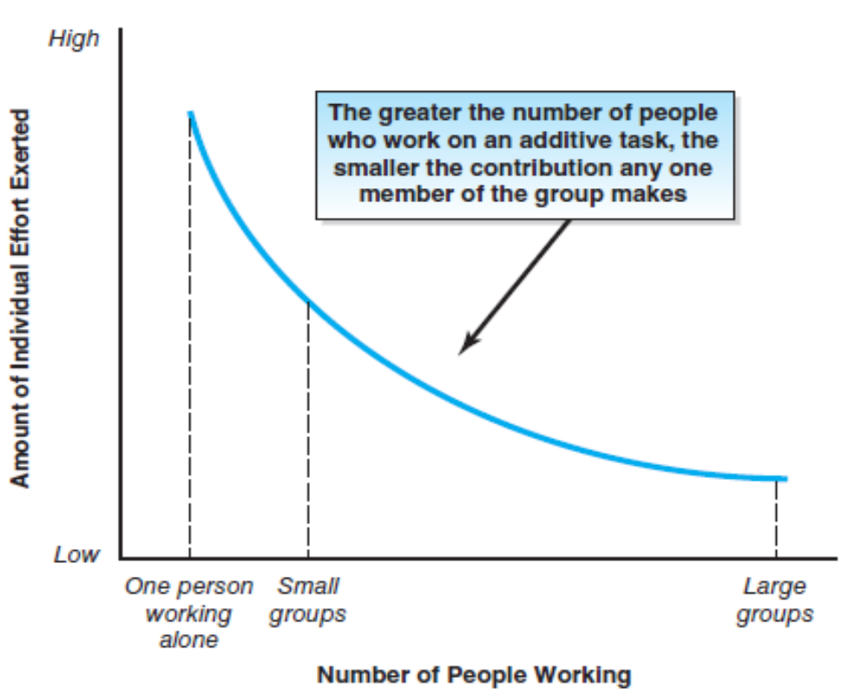
Social Loafing

Slide 19

Overcoming Social Loafing
Make each performer identifiable
Make work tasks more important and interesting
Reward individuals for contributing to their group’s performance
Threaten punishment

Slide 20
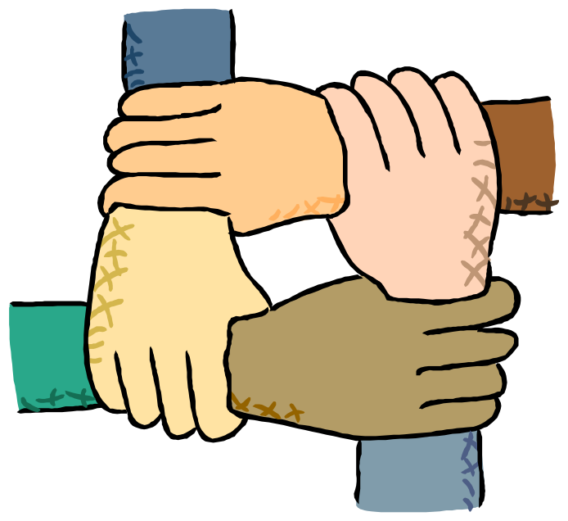
What is a Team?
A team refers to a group whose members have complementary skills and are committed to a common purpose or set of performance goals for which they hold themselves mutually accountable.

Slide 21
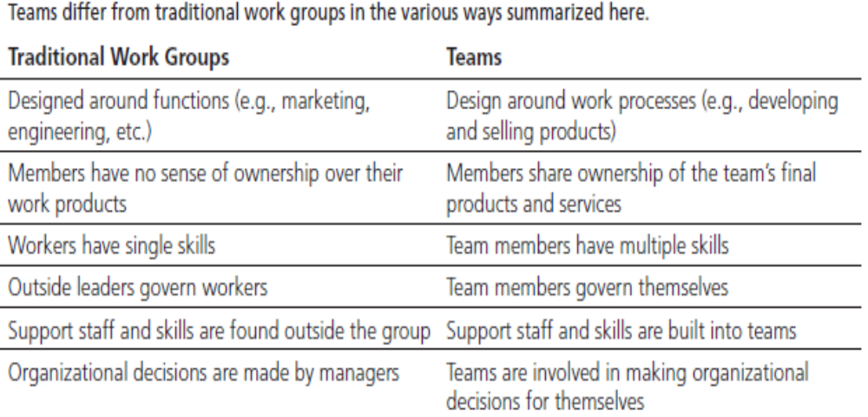
Teams vs. Traditional Work Structures

Slide 22
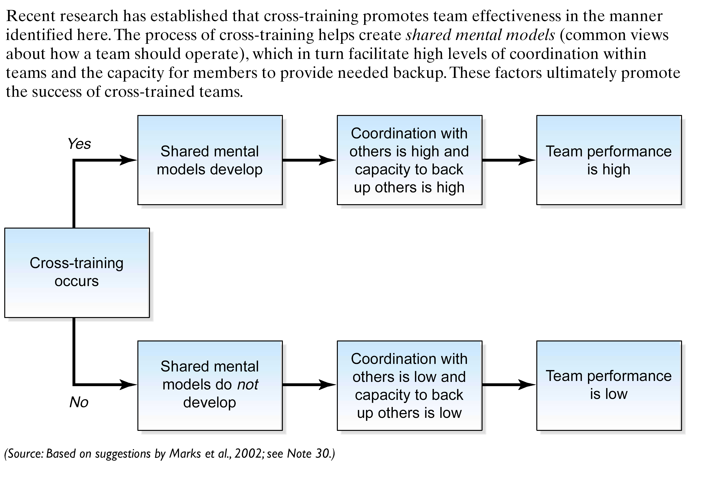
Cross-Training in Teams

Slide 23
Types of Teams
Work teams and improvement teams
Temporary and permanent teams
Work groups and self-managed work teams
Intact and cross-functional teams
Physical and virtual teams

Slide 24
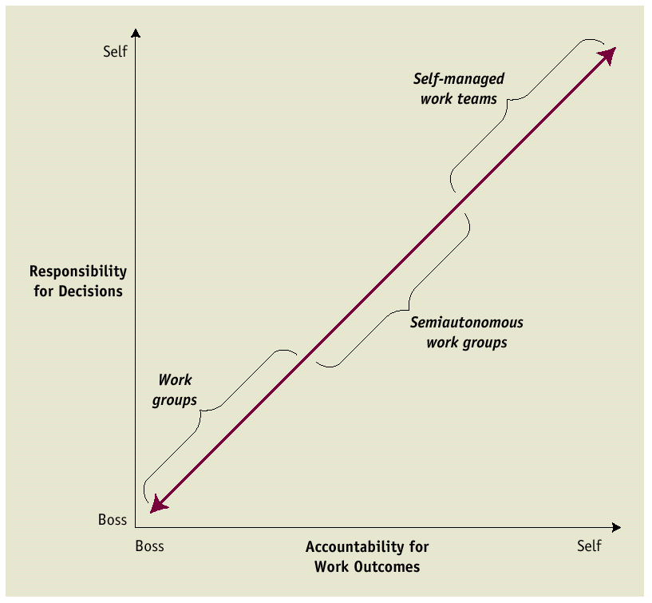
Continuum of Autonomy
In work groups, bosses have responsibility over decisions and are accountable for work outcomes. The workers themselves have very little autonomy.
By contrast, in self-managed work teams the workers themselves have responsibility over decisions and are accountable for work outcomes.
Semiautonomous work groups are positioned between these two extremes.

Slide 25
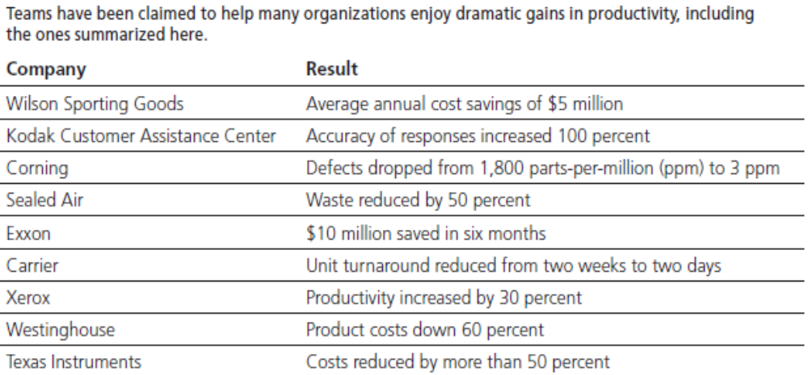
The Effectiveness of Teams

Slide 26
What Might Make Teams Effective?
Two mechanisms at work:
  Peer-based normative control - the desire to be a part of a community that pursues accepted goals
  Peer-based rational control - the motive to go along with the team based on the belief that the team can reward them for doing what it deems appropriate

Slide 27
Why Some Teams Fail
Lack of cooperation
Lack of support
Reluctance to relinquish control
Failure to cooperate with other teams

Slide 28

Developing Successful Teams
Provide training in team skills
Compensate team performance
Communicate the urgency of the team’s mission
Promote cooperation within and between teams
Select team members based on their skills or potential skills
Back up teammates selectively

Slide 29
Provide Training in Team Skills
Making teams more effective may require:
  Team building - formal efforts directed toward making teams more effective
    Used when established teams are showing signs of trouble

Slide 30
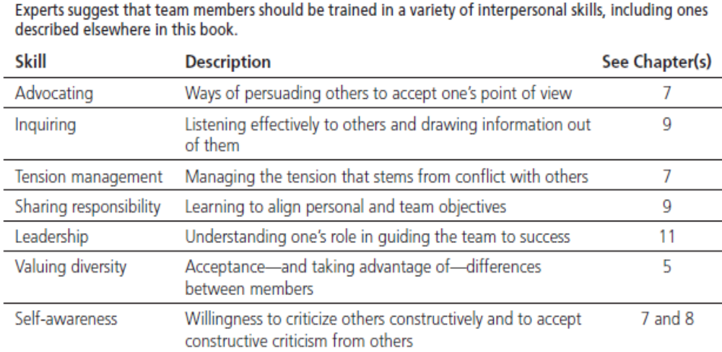
Interpersonal Skills

Slide 31
It Takes Time….
Building successful teams requires time and patience
Peter Drucker: “You can’t rush teams.”

Slide 32

Technical
Engineering
Cost Estimating
Finance
Production
Accounting
Communication
Sending, receiving, nonverbal
(Plan, instructions, incentives)
Emotional intelligence (empathy)
Problem Solving
Conflict Resolution
Management
Planning
Organizing
Directing
Controlling

Slide 33

Consequences of Poor Communication
Fail to achieve objectives
Fail to satisfy needs
Waste energy
Make bad decisions
Frustrating meetings
Hurt feelings
Destroyed relationships

Slide 34
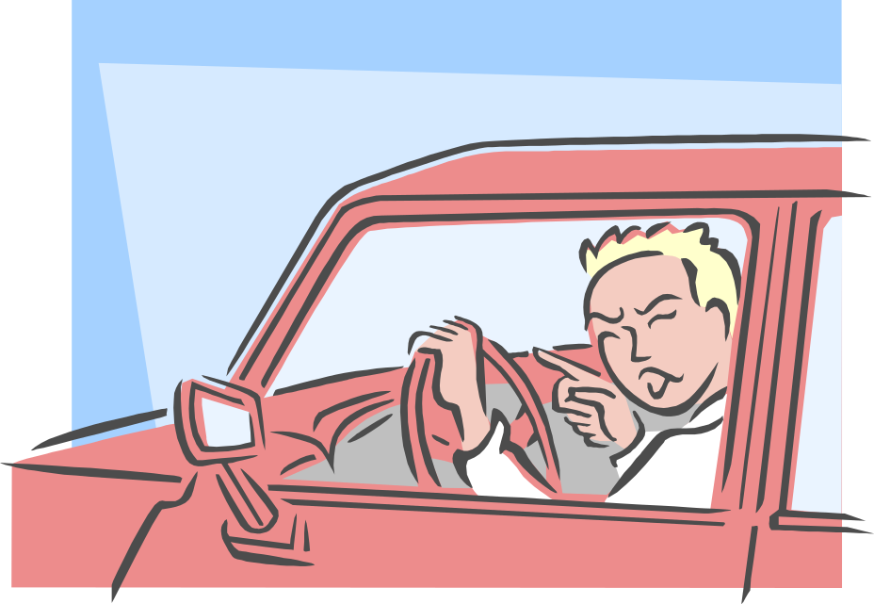
COMMUNICATION:
One person sends a message to another with intent to share meaning and evoke a response
Verbal e.g., “Does anyone have a suggestion?”
Non Verbal e.g., Somebody flips you off or gives you a dirty look

Slide 35
MAKE SURE YOU ARE A POWERFUL RADIO STATION
1. CLEAR SIGNAL: Clear strong voice matching your intended meaning
2. CLEAR ENVIRONMENT: Send messages at a good time when there are no distractions or interference
3. BE SURE LISTENER’S RADIO IS ON: Get receiver’s attention and be on the right frequency

Slide 36
Verbal Communication Styles
Direct vs. indirect statements or questions
  Direct: North American – “No, I can’t do that”
  Try to convey true feelings through word choice
  Versus
  Indirect: Korean – “It might be possible”
  Try to hide real feelings
(Toyota CEO explain vs US senator “just yes or no”)
Quantity of talk
  Elaborate – Arabic: a lot of detail, repetition, metaphors, stories
  Exacting – precision & right amount of words
      -- England, Germany, Sweden
  Succinct – low quantity of talk, understatements
      -- China, Japan, Korea
Personal (informal) focus on speaker as a person – U.S. (first names) versus (Palin)
Contextual (formal) focus on role of speaker – Japanese
Instrumental (sender uses goal-oriented, sender-focused language)
    Australia, U.S., Denmark (e.g., goal to persuade listener)
  versus
  Affective (sender is process oriented & receiver focused)
    Puerto Ricans, Middle East, Asia do not want to put speaker or receiver in uncomfortable position

Slide 37
Monochronic & Polychronic Use of Time
Monochronic—focus on a single activity and then move on to the next activity
Polychronic—focus on multiple activities at the same time
Shapes the schedule, dealing with interruptions, time horizon, pace of activity, & punctuality
Associated with use of space, priority to task accomplishment vs. relationships

Slide 38
Use of time
Monochronic Germany & U.S. | Polychronic Latin & Middle East
Task oriented & follow through; can implement time management techniques | Relationship oriented & less likely to follow through; unlikely to implement time management techniques
Being on time | Flexible as to schedules
Respect others’ privacy & private property (don’t lend or borrow) | Low barriers to privacy & private property (lend & borrow)
Accept short-term relationships | Sustain long-term relationships

Slide 39
The Five Basic Rules of Effective Goals
Goals should be:
Specific
Challenging
Set with a time limit for accomplishment
Mutually determined
Designed to provide feedback
  Ideally, feedback on goal progress should be self-generated rather than provided externally

Slide 40
How to Set Goals
Seven steps for obtaining optimum results from goal setting:
Specify the general objective and tasks to be done.
Specify how performance will be measured.
Specify the standard or target to be reached.
Specify the time span involved.
Prioritize goals.
Rate goals according to their difficulty and importance.
Determine coordination requirements.

Slide 41
Obtaining Goal Commitment from Employees
Managerial support
  Create a supportive climate in which subordinates view the manager as a goal facilitator
Use participation
  Manager demonstrates authentic interest in employee’s participation in the goal-setting process
Know your subordinate’s capabilities
Use Rewards
Clarify expectations
  When the expectations of either side are not fulfilled, anger and resentment can undermine trust and good faith

Slide 42
Behavioral Checklist
The Effective Goal Setter:
Identifies an employee’s key job tasks
Establishes specific and challenging goals for each key task
Specifies deadlines for each goal
Allows the subordinate to actively participate
Prioritizes goals
Rates goals for difficulty and importance
Builds in feedback mechanisms to assess goal progress
Commits rewards contingent on goal attainment

