Slide 1
Performance Management, Appraisals, and Careers
Notes:
The topics we cover include Basic Concepts in Performance Appraisal and Management, Basic Appraisal Methods, Some Practical Suggestions for More Effective Appraisals, Coaching and Career Management, Performance Management, and Talent Management Practices for Strategic Employee Appraisals.

Slide 2
Learning Objectives (1)
When you finish studying this chapter, you should be able to:
Explain the purpose of performance appraisal.
Answer the question, “Who should do the appraising?”
Discuss the pros and cons of at least eight performance appraisal methods.
Notes:
When you finish studying this chapter, you should be able to:
Explain the purpose of performance appraisal.
Answer the question, “Who should do the appraising?”
Discuss the pros and cons of at least eight performance appraisal methods.

Slide 3
Learning Objectives (2)
Explain the purpose of performance appraisal.
Answer the question, Who should do the appraising?
Discuss the pros and cons of at least eight performance appraisal methods.
Notes:
You also should be able to:
Explain the purpose of performance appraisal.
Answer the question, Who should do the appraising?
Discuss the pros and cons of at least eight performance appraisal methods.

Slide 4
Basic Concepts in Performance Appraisal and Management
Notes:
Comparing Performance Appraisal and Performance Management — Performance appraisal is part of a total integrated process of performance management, which consolidates goal setting, performance appraisal, and development into a single, common system, the aim of which is to ensure that the employee’s performance is supporting the company’s strategic aims.

Slide 5

Basic Concepts in Performance Appraisal and Management
Why appraise performance?
Continuous feedback
Performance management
  Definition
Notes:
Why Appraise Performance? — For several reasons: 1) they play an integral role in the employer’s performance management process; 2) the appraisal lets the boss and subordinate develop a plan for correcting any deficiencies, and reinforce those things he does correctly; 3) they serve a useful career planning purpose; and 4) it plays a part in salary decisions.
The Importance of Continuous Feedback — To accomplish several (or all) of these aims, traditional annual or semi-annual appraisal reviews make sense.
Performance Management — Many employers take a continuous process approach including having self-directed (and trained) work teams give themselves ongoing appraisal information.
Performance Management Defined — Performance management is a goal-oriented and continuous way to appraise and manage employees’ performance.

Slide 6
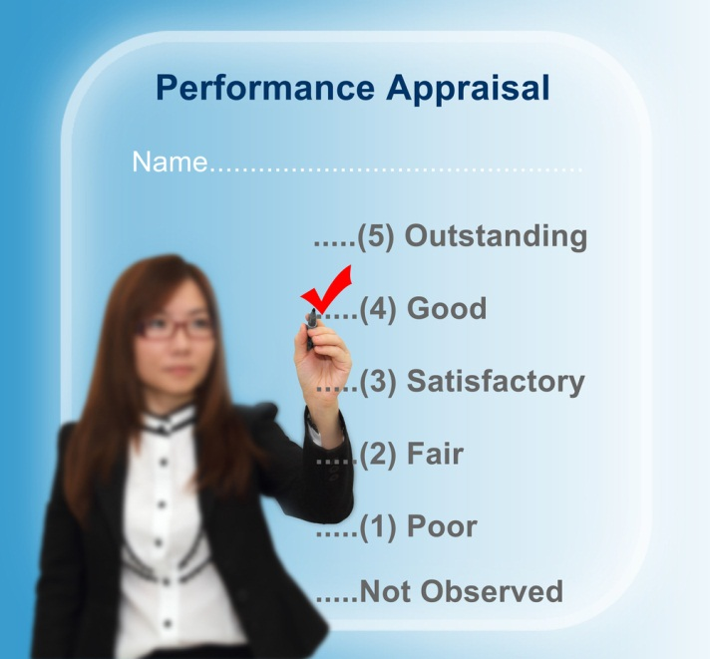
Basic Concepts in Performance Appraisal and Management
The appraisal cycle
Setting effective goals and work standards
Who should do the appraising?
Notes:
The Appraisal Cycle — The three-step process is as follows: (1) setting work standards; 2) assessing performance relative to such standards; and 3) providing feedback aimed at improving performance during the next cycle.
Setting Effective Goals and Work Standards — Some guidelines for effective goal setting are as follows: 1) assign specific goals; 2) assign measurable goals; 3) assign challenging but doable goals; and 4) encourage participation.
Who Should Do the Appraising?
The Immediate Supervisor is usually in the best position to observe and evaluate the subordinate’s performance, and is responsible for that person’s performance.
Peer Appraisals are becoming more popular with firms using self-managing teams.
Rating Committees consist of multiple raters, typically the employee’s immediate supervisor and three or four other supervisors.
Self-Ratings tend to be higher than supervisor or peer ratings.
Appraisal by Subordinates or upward feedback, is when subordinates anonymously rate their supervisor’s performance.
360-Degree Feedback is when ratings are collected from the employee, the employee’s supervisors, subordinates, peers, and internal or external customers. This method is the subject of considerable debate. One study found significant correlation between 360-degree ratings and conventional ratings. Firms should carefully assess potential costs, carefully train those giving feedback, and not rely solely on 360-degree feedback.

Slide 7
Basic Appraisal Methods
Notes:
The manager usually conducts the appraisal using one or more of the methods described in this section.

Slide 8
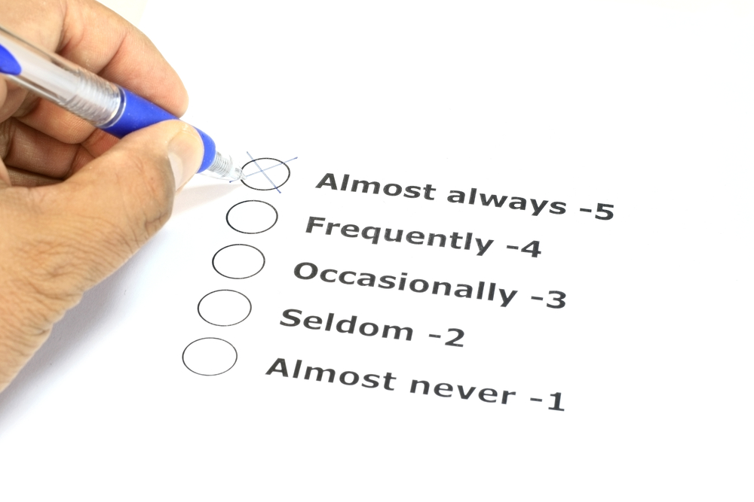
Basic Appraisal Methods
Graphic rating scale
Alternation ranking
Paired comparison
Forced distribution
Notes:
Graphic Rating Scale Method is the simplest and most popular performance appraisal technique. A scale is used to list a number of traits and a range of performance for each, then the employee is rated by identifying the score that best describes his/her performance level for each trait. Managers must decide which job performance aspects to measure. Some options include generic dimensions, actual job duties, or behaviorally recognizable competencies.
Alternation Ranking Method involves employees being ranked from best to worst on a particular trait. One way to do this is to list the highest, then the lowest, and then second highest and second lowest, and so forth until all are ranked.
Paired Comparison Method involves ranking employees by making a chart of all possible pairs of employees for each trait and indicating which is the better employee of the pair.
Forced Distribution Method — Predetermined percentages of rates are placed in various performance categories; similar to grading on a curve.

Slide 9
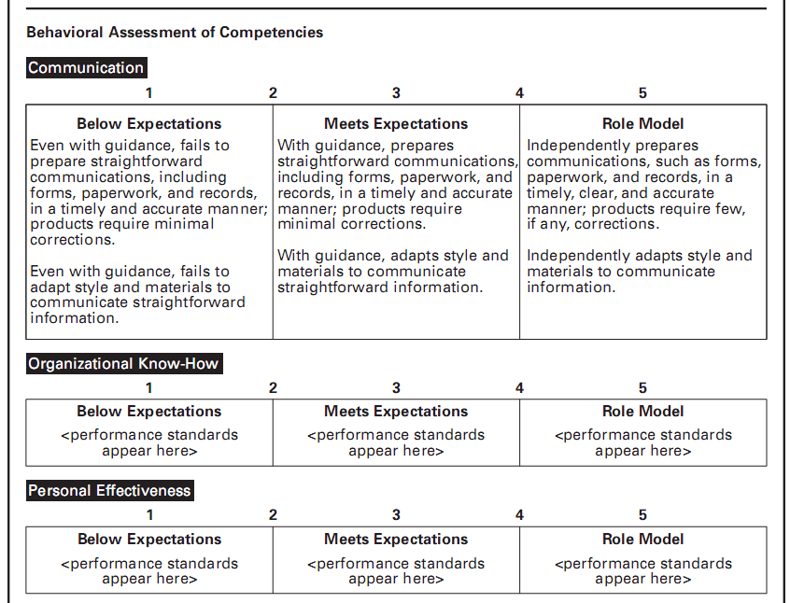
Notes:
This is a portion of a graphic rating scale with behavioral examples. Some of the key elements of this approach are the operational definitions for the categories listed. Such a set of definitions are helpful to any manager conducting an appraisal interview in that they can rate the employee yet have issues to discuss with them for possible improvement.

Slide 10
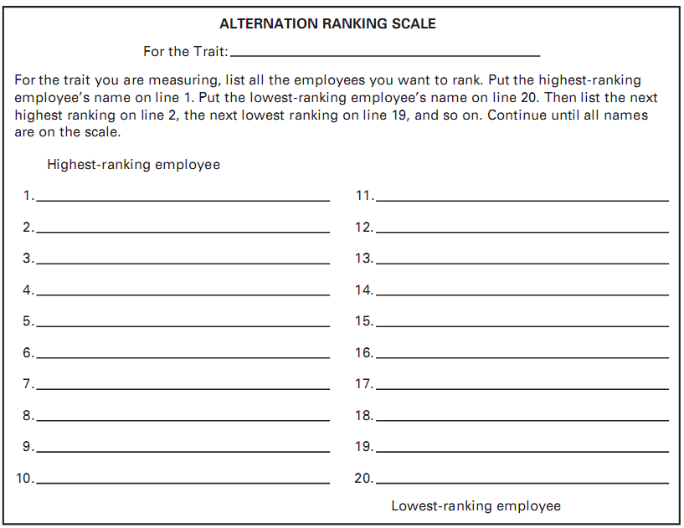
Notes:
Alternation Ranking Method involves employees being ranked from best to worst on a particular trait. One way to do this is to list the highest, then the lowest, then second highest, second lowest, and so forth until all are ranked.

Slide 11

Basic Appraisal Methods
Critical incident
Behaviorally Anchored Rating Scales (BARS)
Appraisal forms in practice
Notes:
Critical Incident Method — A supervisor keeps a detailed record of uncommonly good or undesirable examples of an employee’s work-related behavior, and reviews it with the employee at predetermined times.
Behaviorally Anchored Rating Scales (BARS) combine the benefits of narratives, critical incidents, and quantified scales, by anchoring a scale with specific behavioral examples of good or poor performance. The five steps in developing a BARS are as follows: 1) generate critical incidents; 2) develop performance dimensions; 3) reallocate incidents; 4) scale the incidents; and 5) develop final instrument. The advantages of BARS include a more accurate gauge, clearer standards, feedback, independent dimensions, and consistency.
Appraisal Forms in Practice involve rating the employee’s performance for each performance factor, writing down examples and an improvement plan, aiding the employee in understanding where his/her performance was good or bad, and summarizing by focusing on problem solving.

Slide 12
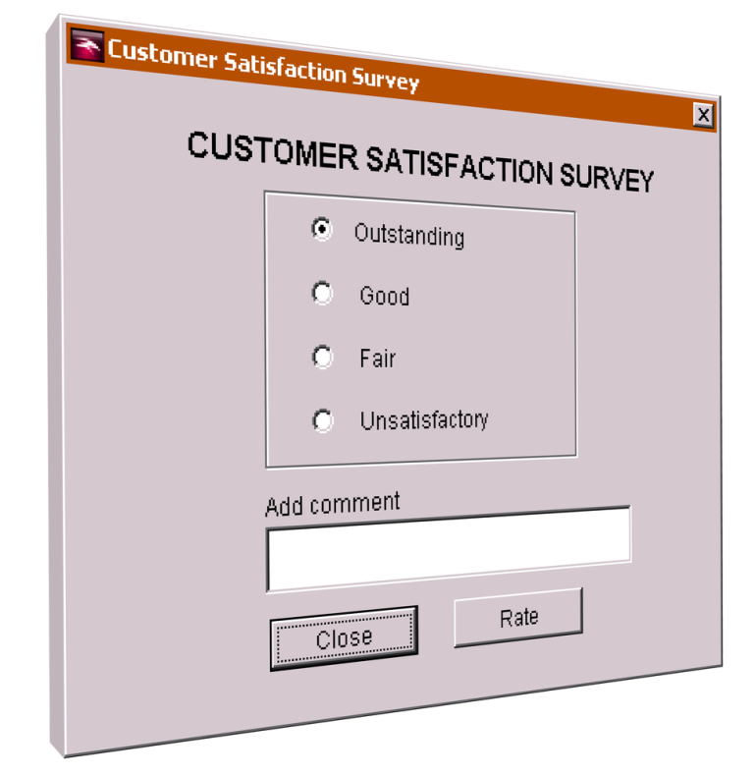
Basic Appraisal Methods
Management By Objectives (MBO)
Computerized and web-based performance appraisals
Electronic performance monitoring
Notes:
Management by Objectives (MBO) requires the manager to set specific measurable goals with each employee and then periodically discuss his/her progress toward these goals. The process consists of six steps: 1) set the organization’s goals; 2) set departmental goals; 3) discuss departmental goals; 4) mutually define expected results; 5) conduct performance reviews; and 6) provide feedback.
Computerized and Web-Based Performance Appraisal generally enables managers to keep notes on subordinates during the year, rate employees on a series of performance traits, and then generate written text to support each part of the appraisal. About one-third of employers use online performance management tools for at least some employees.
Electronic Performance Monitoring are systems used to allow managers access to their employees’ computers and telephones.

Slide 13
Practical Suggestions for More Effective Appraisals
Ensure fairness
Deal with common appraisal problems
Understand the legal aspects of performance appraisal
Notes:
Ensure Fairness — The first challenge is to make sure the subordinate views the appraisal as fair. Many managers don’t focus on the developmental aspect of the appraisal, but instead use it for political purposes.
Deal with Common Appraisal Problems — It can be difficult to rate performance for several reasons. Much depends on a good rating, including career progress, or being able to obtain a raise. There are also technical problems that can affect the fairness of the process.
Unclear Standards — Ambiguous traits and degrees of merit can result in an unfair appraisal.
Halo Effect — The influence of a rater’s general impression on ratings of specific qualities can be a problem.
Central Tendency — Involves supervisors sticking to the middle of the rating scales, thus, rating everyone approximately average.
Leniency or Strictness — Supervisors have the tendency to rate everyone either high or low.
Bias — The tendency to allow individual differences such as age, race, and sex to affect the appraisal ratings employees receive is a problem.
Understand the Legal Aspect of Performance Appraisal — Performance appraisals have legal implications because they often affect raises, promotions, training, and other HR actions.
Conduct First-Rate Appraisal Feedback Interviews — An interview in which the supervisor and subordinate review the appraisal and make plans to remedy deficiencies and reinforce strengths.

Slide 14

Conduct the Appraisal Feedback Interview Effectively
Conduct the interview effectively
Preparing
Conducting
Notes:
Conduct First-Rate Appraisal Feedback Interviews — An interview in which the supervisor and subordinate review the appraisal and make plans to remedy deficiencies and reinforce strengths.
Preparing for the Appraisal Interview
Step 1 — Give the subordinate enough notice to review his/her work.
Step 2 — Study his/her job description.
Step 3 — Choose the right place for the interview and schedule enough time for it.
Conducting the Interview — Prepare for the interview by conducting the interview in a private area without interruptions. Talk in terms of objective, observable work data using examples. Get agreement with the employee of how you will know improvement has occurred. Ensure the process is fair and learn how to deal with defensiveness.

Slide 15
Coaching and Career Management
Notes:
After appraising performance, the manager typically faces several tasks. The employee may require coaching, career advice, and mentoring. The purpose of this section is to help you be more effective at coaching and mentoring employees, and at supporting career planning and talent management needs.

Slide 16
Coaching and Career Management
Improving your coaching skills
The basic coaching process
  Preparing to coach
  Planning
  Active coaching
  Follow-up
Notes:
Improving Your Coaching Skills — Coaching means educating, instructing, and training subordinates. Mentoring means advising, counseling, and guiding. Coaching focuses on teaching shorter-term job related skills, mentoring on helping employees navigate longer term career hazards.
The Basic Coaching Process — Preparing to coach involves understanding the problem, the employee, and his or her skills. Planning requires reaching consensus on the problem and what to change. Finally, once agreement is reached, educating, instructing, training, and ongoing encouragement are the important steps in the change process.

Slide 17
Coaching and Career Management
Career management methods
The employee’s role
Mentoring
The employer’s and manager’s roles
Notes:
Career management is the process of enabling employees to better understand and develop their career skill and interests and to use these skills and interests both within the company and even after they leave the firm.
Mentoring — Having a mentor — a senior person in the firm who can be a sounding board for your career questions and concerns — can enhance career satisfaction and success.
The Employee’s Role — An individual must accept responsibility for his/her own career; assess his/her own interests, skills, and values; and take the steps required to ensure a happy and fulfilling career. Finding a mentor who can be a sounding board is often helpful. Mentoring programs can be informal or formal.
The Employer’s Role — Employers can support career development efforts in many ways. There are several organizational career planning practices. The means for helping to further an employee’s career depends on the length of time the employee has been with the firm.

Slide 18
Coaching and Career Management
Gender issues
Managing promotions and transfers
Retirement
  Honor experience
  Modify selection
  Flexible work
  Part-time work
Notes:
Gender Issues in Career Development — Women and men face different challenges as they advance through their careers. Women face the glass ceiling. Minority women may be particularly at risk.
Managing Employees’ Promotions and Transfers
Making Promotion Decisions — Promotions usually provide opportunities to reward the exceptional performance of tested and loyal employees. However, unfairness, arbitrariness, or secrecy can diminish the effectiveness of the promotion process for all concerned.
Handling Transfers — Transfers are moves from one job to another, usually with no change in salary or grade. The frequent relocating of transfer employees has been assumed to have a damaging effect on transferees’ family life. Transfers are also costly.
Retirement — Some employers are instituting formal preretirement counseling aimed at easing the passage of their employees into retirement. A large majority of employees have said they expect to continue to work beyond the normal retirement age. Part-time employment is an alternative to outright retirement. Employers can benefit from retirement planning by becoming able to anticipate labor shortages.
Create a Culture that Honors Experience — Changing cultures that are explicitly or implicitly biased against older workers can help make a company more attractive to retirees.
Modify Selection Procedures
Offer Flexible Work — Redesigning jobs to include telecommuting and other options will attract and retain workers.
Phased retirement — Phased retirement programs combine reduced work hours, job change, and reduced responsibilities.

Slide 19
Performance Management
Notes:
Earlier in this chapter, we said that performance management is the continuous process of identifying, measuring, and developing the performance of individuals and teams and aligning their performance with the organization’s goals. In this section, we will look at performance management more closely.

Slide 20
Performance Management
Performance management vs. performance appraisal
Using IT to support performance management
Improving productivity through HRIS
Notes:
Performance management vs. Performance Appraisal refers to an ongoing process of deciding upon goals, evaluating results, and providing feedback. It is always goal-directed. We can summarize performance management’s six basic elements as follows:
Direction sharing
Goal alignment
Ongoing performance monitoring
Ongoing feedback
Coaching and developmental support
Recognition and rewards
Using Information Technology to Support Performance Management allows the supervisor to assign financial and nonfinancial goals to each team’s activities and to keep all employees informed of their goals. Special performance management software then shows a real-time overview of each team’s performance.
Talent Management Practices and Strategic Employee Appraisals
Appraising and Actively Managing Employees — Several examples of strategically managing employees performance and value to the organization are provided.
Segmenting and Actively Managing Employees in Practice — Compass Group, Tesco PLC, McKinsey Consulting, and others are highlighted as examples.

Slide 21
Talent Management Practices for Strategic Employee Appraisals

Slide 22
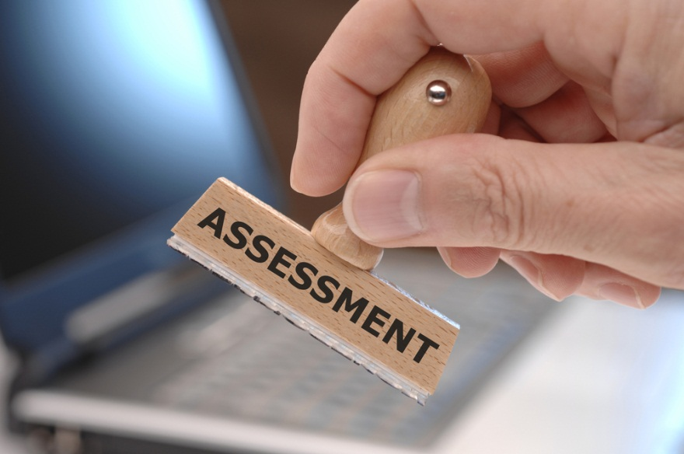
Talent Management Practices for Strategic Employee Appraisals
Appraising and actively managing employees
Segmenting and actively managing employees
Notes:
Appraising and Actively Managing Employees — Talent management requires actively managing decisions related to allocating pay and development opportunities (among other HR functions) across the board or based on performance or both.
Segmenting and actively managing employees in practice — Examples include:
Compass Group PLC identifies top performers, and then assesses them for promotability, promotability timeframe, and leadership potential.
GE prioritizes jobs and focuses on what it calls its employee “game changers.”
Tesco PLC segments employees according to personal and professional goals.

Slide 23
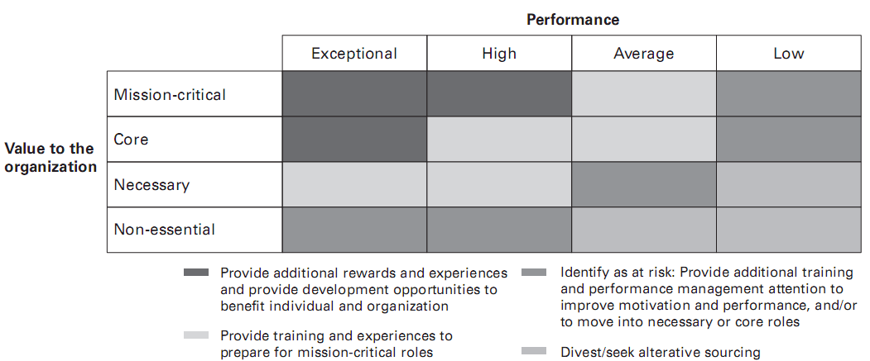
Accenture’s Strategic Role Assessment Matrix
Notes:
This is a chart showing one consulting company’s method of segmenting and actively appraising its employees in a systematic manner.

