Slide 1
Motivation
Zeenat Jabbar

Slide 2
Learning Objectives
DISTINGUISH between emotions and moods
EXPLAIN how emotions and moods influence behavior in organizations
DESCRIBE ways in which people manage their emotions in organizations
IDENTIFY the major causes of organizational stress
DESCRIBE the adverse effects of organizational stress
IDENTIFY various ways of reducing stress in the workplace
4-2

Slide 3
Three Good Reasons Why You Should Care About . . . Emotions and Stress
People’s everyday emotions can have dramatic effects on the way they feel and how they perform their jobs.
Knowing how to choose a career can help you make the optimal career choice.
Managers are capable of doing many things to reduce the levels of stress experienced by their subordinates if they know how.
4-3
Notes:
2

Slide 4
Understanding Emotions & Moods
Emotions
  Properties of emotions
  Types of emotions
  The basic nature of mood
4-4

Slide 5
Emotions
Emotions are overreactions that express feelings about events.
4-5

Slide 6
Properties of Emotions
Emotions always have an object - something or someone that or who triggers emotions.
The spread of emotions is contagious.
  Emotional contagion
Expression of emotions is universal.
Culture determines how and when people express emotions.
  Display rules
4-6

Slide 7
Types of Emotions
Self-conscious - refers to feelings that stem from within
  shame, guilt, embarrassment, and pride
Social emotions - refer to people’s feelings based on information external to themselves
  pity, envy, jealousy, and scorn
4-7

Slide 8
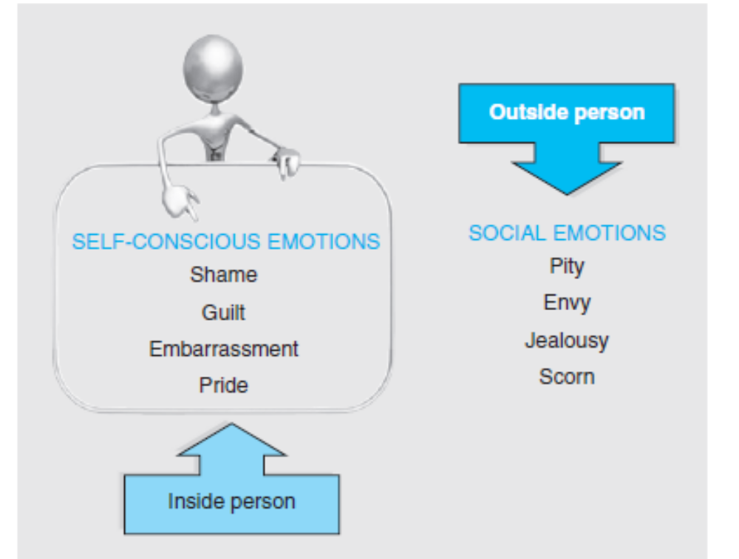
Self-Conscious vs. Social Emotions
4-8

Slide 9
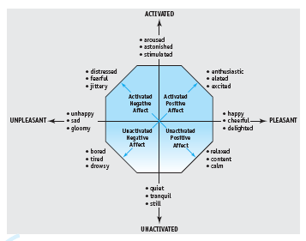
Circumplex Model of Affect
4-9

Slide 10
The Basic Nature of Mood
Mood is an unfocused, relatively mild feeling that exists as background to our daily experiences.
4-10

Slide 11
Role of Emotions and Mood
Are happier people more successful in their jobs?
  Yes
    Higher job performance and better jobs – more meaning, autonomy and variety in their jobs
    Higher income – not just in the U.S., but in countries throughout the world
4-11

Slide 12
Role of Emotions and Mood
Why are happier workers more successful?
  Decision quality – more accurate decisions
  Evaluation – perceive the positive side of others’ work
  Cooperation – more generous and inclined to help coworkers
4-12

Slide 13
Affective Events Theory
Affective events theory - identifies factors that lead to people’s emotional reactions on the job and how these reactions affect those individuals.
4-13

Slide 14
Affective Events Theory
Emotional labor - degree to which people have to work hard to display what they believe are appropriate emotions on their jobs
Daily hassles - unpleasant or undesirable events that put people in bad moods
Daily uplifts - pleasant or desirable events that put people in good moods
4-14

Slide 15
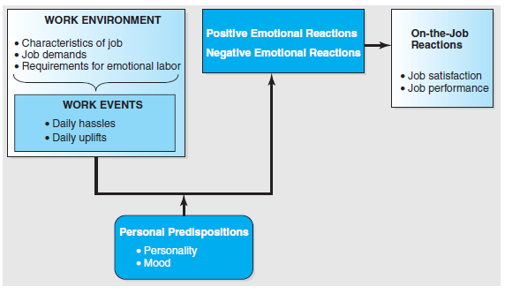
Affective Events Theory
4-15

Slide 16
Managing Emotions
Ways to effectively manage emotions in organizations:
  Develop emotional intelligence
    Self awareness
    Social awareness
    Self-management
    Relationship management
  Cope with emotional dissonance
  Control anger before it controls you
4-16

Slide 17
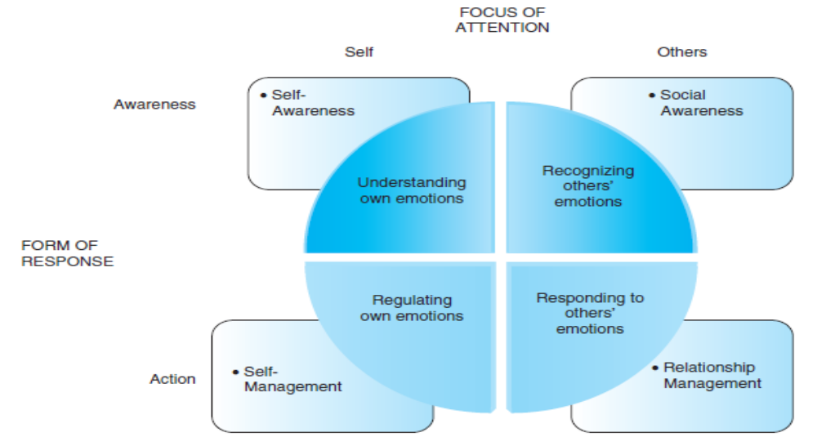
Emotional Intelligence
4-17

Slide 18
Emotional Dissonance
Emotional dissonance - is likely to occur in situations in which there are strong expectations regarding the emotions one is expected to display by virtue of one’s job requirements.
  Felt emotions - emotions people actually experience
  Displayed emotions - emotions people show others
4-18

Slide 19
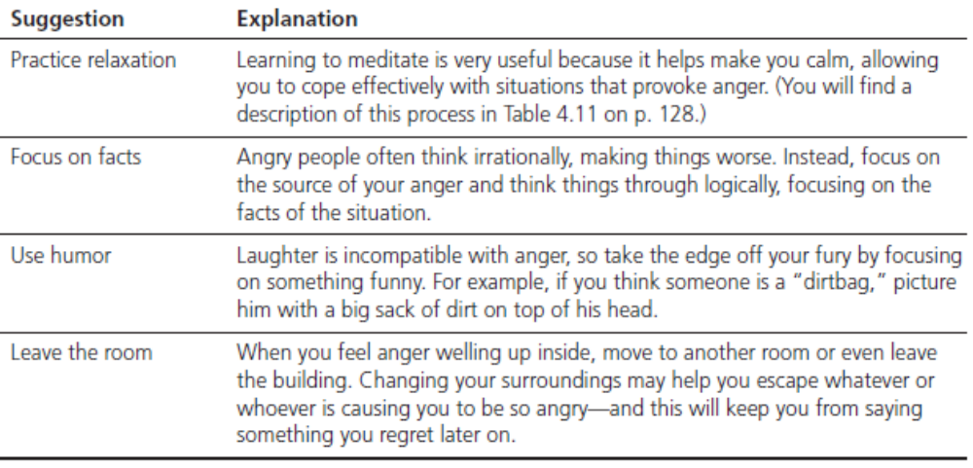
Managing Anger
4-19

Slide 20
The Basic Nature of Stress
Stressor - any demand, either physical or psychological in nature, encountered during the course of living.
  Acute stressors bring some form of sudden change that threatens us either physically or psychologically, requiring people to make unwanted adjustments.
  Episodic stressors are the result of experiencing lots of acute stressors in a short period of time.
  Chronic stressors are the most extreme type of stressor, because they are constant and unrelenting, having a long-term effect on the body, mind, and spirit.
4-20

Slide 21
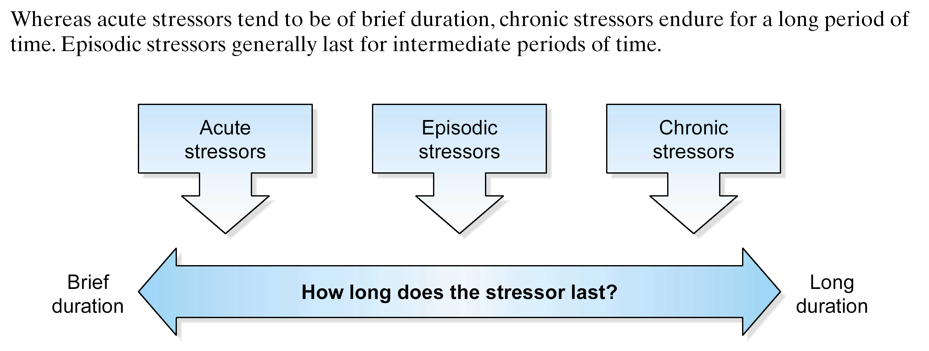
Different Types of Stressors
4-21

Slide 22
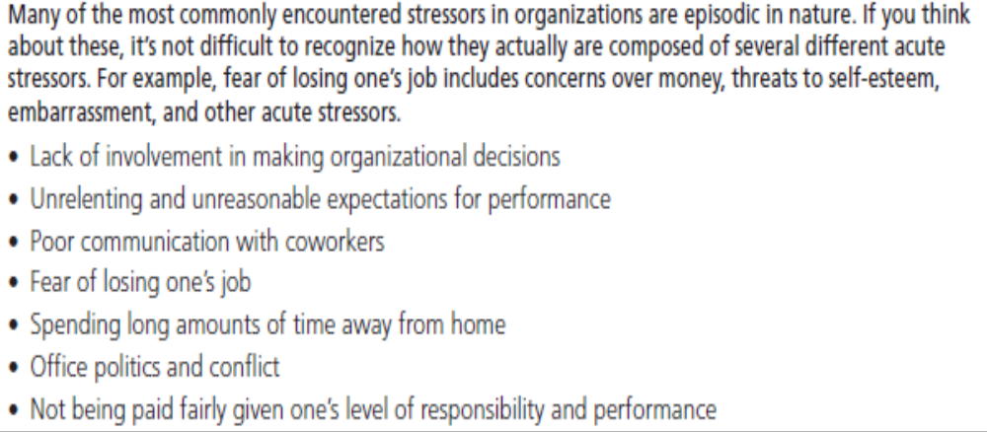
Common Episodic Stressors
4-22

Slide 23
The Cognitive Appraisal Process
Cognitive appraisal - the process of judging the extent to which an environmental event is a potential source of stress.
  Flight response
4-23

Slide 24
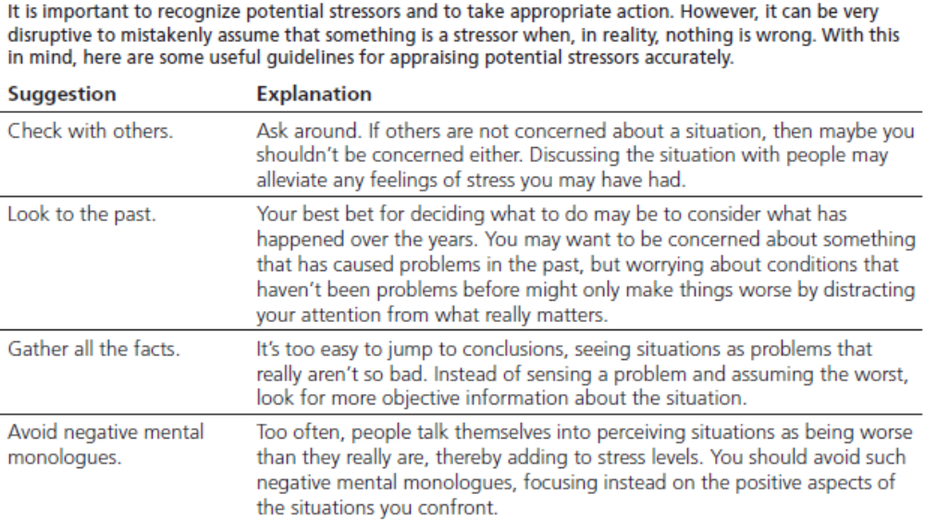
Tips for Assessing Stressors
4-24

Slide 25
Bodily Responses to Stressors
Reactions to stressors:
  Strain - deviations from normal states of human functioning resulting from prolonged exposure to stressful events
  Burnout - a syndrome of emotional, physical, and mental exhaustion coupled with feelings of low self-esteem or low-self efficacy, resulting from prolonged exposure to intense stress and the strain reactions following from them
4-25

Slide 26
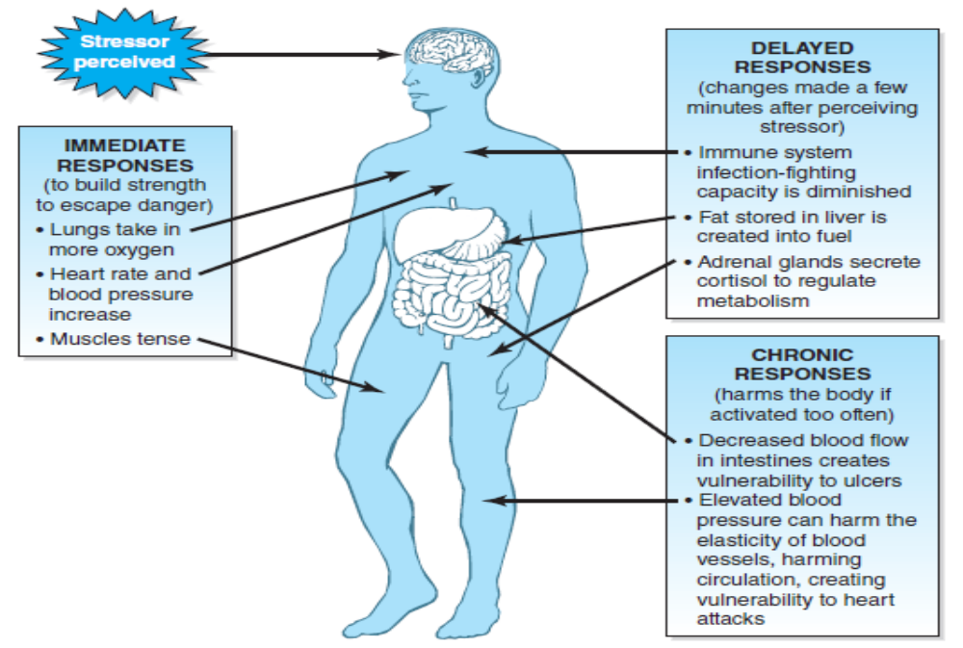
The Body’s Reaction to Stress
4-26

Slide 27
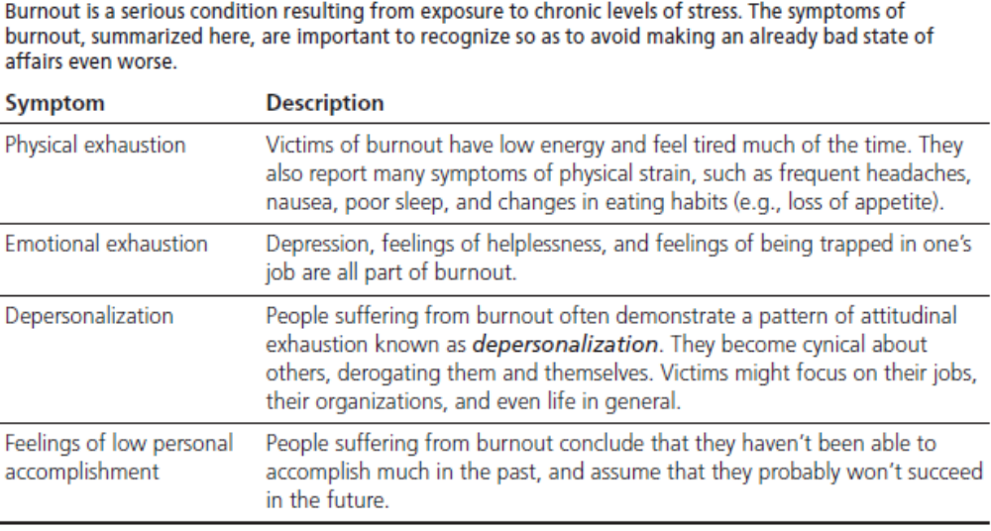
Symptoms of Burnout
4-27

Slide 28
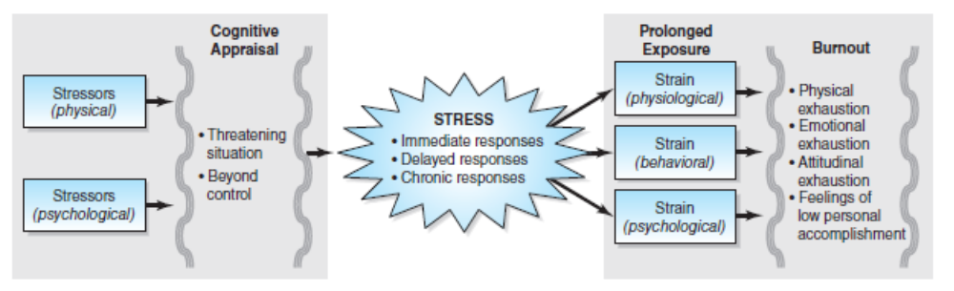
Burnout Process
4-28

Slide 29

Causes of Stress in the Workplace
Occupational demands
Conflict between work and nonwork
Stress from uncertainty
Overload
Responsibility for others
Lack of social support

Slide 30
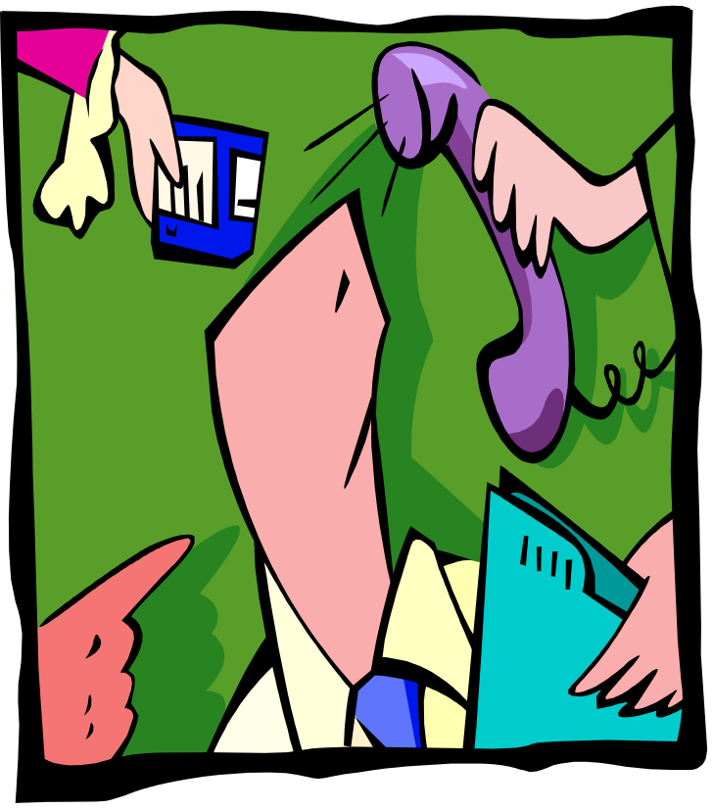
Occupational Demands
Making decisions
Constantly monitoring devices or materials
Repeatedly exchanging information with others
Working in unpleasant physical conditions
Performing unstructured rather than structured tasks

Slide 31
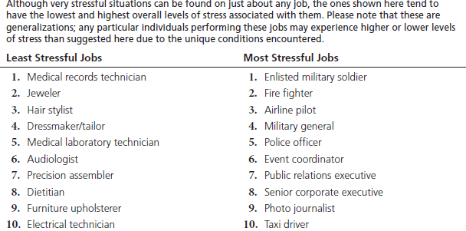
Most and Least Stressful Jobs in the U.S.
4-31

Slide 32
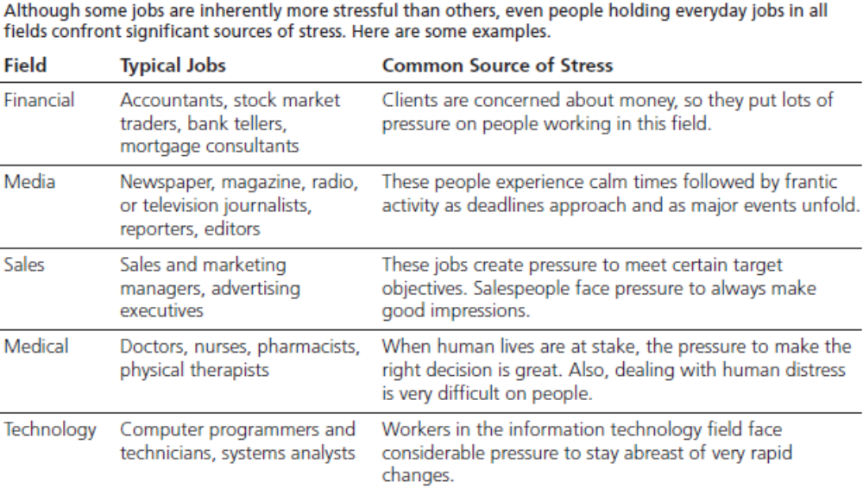
Sources of Stress in Everyday Jobs
4-32

Slide 33

Work Versus Nonwork
Role conflict -incompatibilities between the various sets of obligations people face
Rule juggling - the need to switch back and forth between the demands of work and family
4-33

Slide 34

Stress from Uncertainty
Role ambiguity -
Uncertainty about what one is expected to do on a job
4-34

Slide 35
Overload: So Much Work
Overload - the belief that one is required to do more work than possibly can be completed in a specific period
  Quantitative overload
  Qualitative overload
Information anxiety - pressure to store and process information in our heads as we strive to keep up with it all
4-35

Slide 36
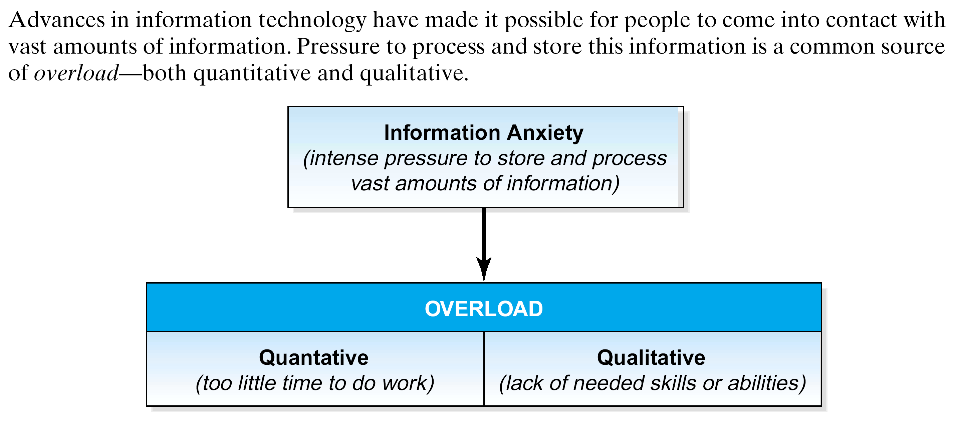
Information Anxiety
4-36

Slide 37
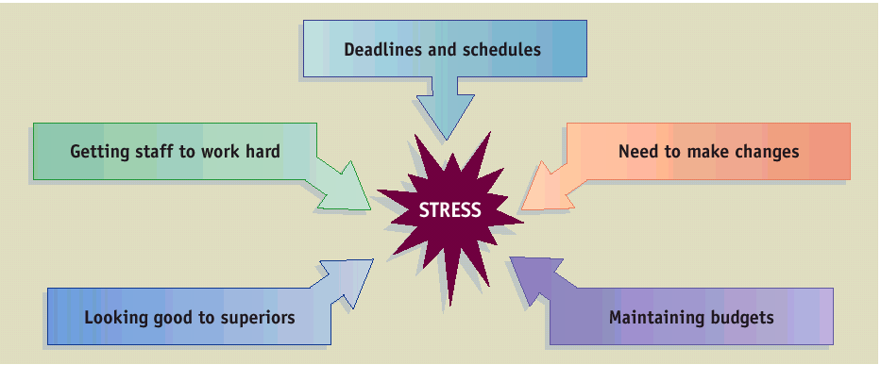
Responsibility for Others
4-37

Slide 38
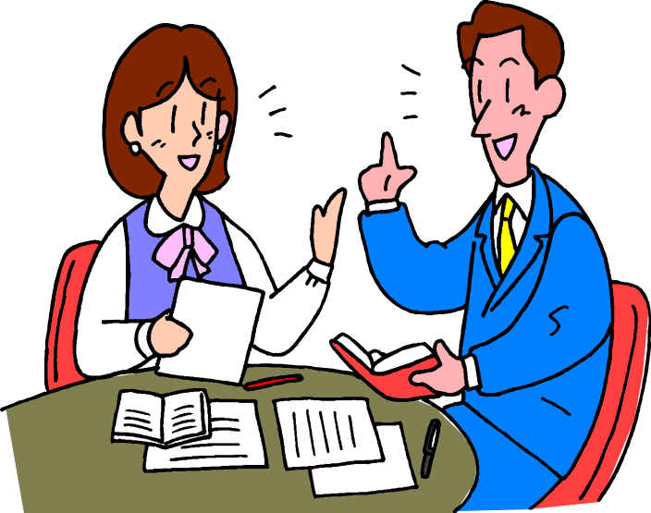
The Cost of Isolation
Social support refers to the friendship and support of coworkers
Social support can help
reduce stress by:
  Boosting self-esteem
  Sharing information
  Providing diversions
  Giving needed resources
4-38

Slide 39
Adverse Effects of Stress
Lowered task performance – but only sometimes
Desk rage - lashing out at others in response to stressful encounters on the job
Stress and health – stress is involved in 50-70% of all forms of physical illness
4-39

Slide 40
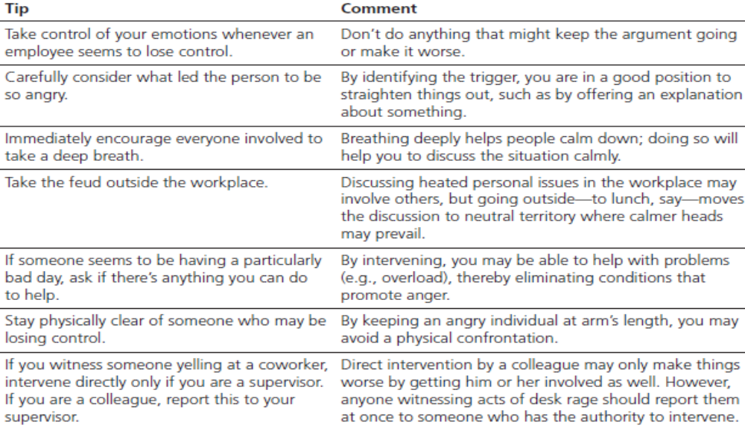
Desk Rage: Tips for Managers
4-40

Slide 41
Reducing Stress
Employee Assistance Programs (EAPs) - plans that provide employees with assistance for various personal problems (e.g., substance abuse, career planning, and financial and legal problems)
Stress management programs - systematic efforts to train employees in a variety of techniques that they can use to become less adversely affected by stress
Wellness programs - company-wide programs in which employees receive training regarding things they can do to promote healthy lifestyles
4-41

Slide 42
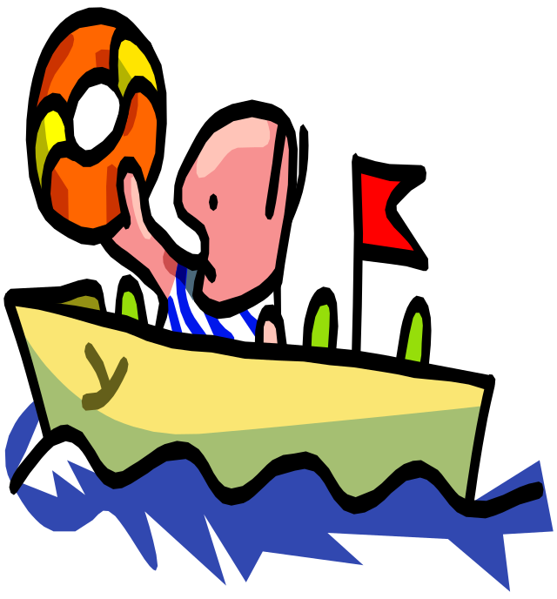
Managing Stress
Manage your time
Eat a healthy diet and be physically fit
Relax and meditate
Get a good night’s sleep
Avoid inappropriate self-talk
Take a time-out
4-42

Slide 43
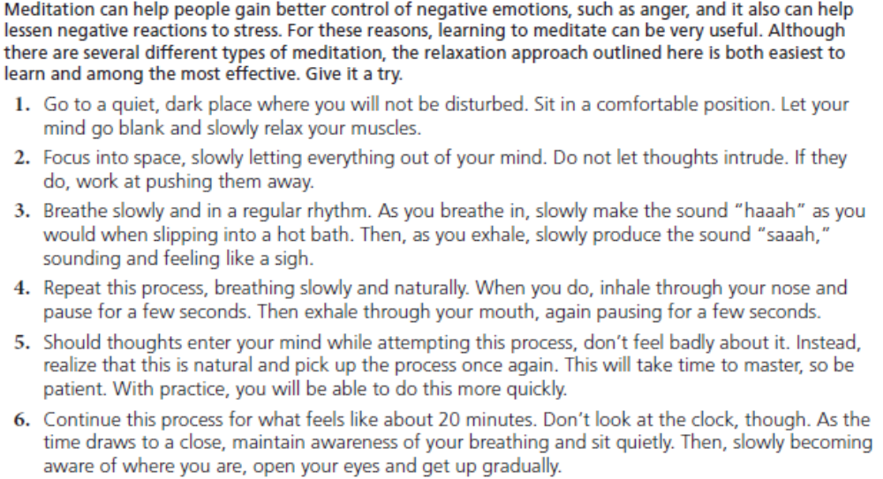
How to Meditate

