Slide 1


Slide 2

Fundamentals of
Public Administration
MPA - 406
Lecture – 17
FACILITATOR
      Prof. Dr. Mohammad Majid Mahmood

Slide 3
Reflections

Slide 4
ALL THINKING
IS NOT OF THE SAME QUALITY
Aimless Thinking:
We are naturally proficient at daydreaming and fantasizing.
Lacks a purpose.
Few people need training in aimless thinking.
Thinking that is random, that roams aimlessly is not critical.
High Quality Thinking:
Has a purpose.
We originate and produce with a sense of why we are doing so.
When thinking takes on a challenging task, the mind comes alive, ready for intellectual labor for the achievement of its goal.
Dr. Richard Paul and Dr. Linda Elder,
The Foundation for Critical Thinking Press, 2010

Slide 5
Should You Believe
Everything You See?

Slide 6
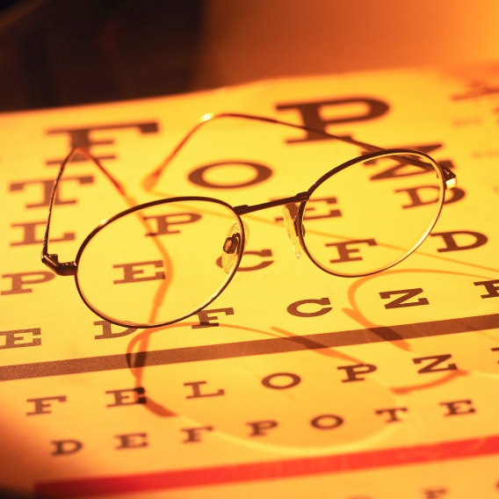
Perception
We often see and hear what we want to see and hear, based upon our past experiences, interests, motives, expectations; to stay within our comfort zone.

Slide 8
What does the absence of Critical Thinking look like?
We blindly accept all statements.
We blindly believe TV commercials.
We blindly follow others.

Slide 9
People Don’t Always Use
Critical Thinking Skills
It is not uncommon for people to say…
  “I thought it was no big deal.”
  “I just wasn’t thinking”
  “How was I supposed to know?”
  “I can’t think of everything!”
  “My bad luck……”
  People who have poor critical thinking skills are
  “their own worst enemies.”

Slide 10
A Necessary Condition
to the Development of
Critical Thinking is:
Questioning Mind
Notes:
Summary
Heading. Text.
Heading. Text.
Heading. Text.
Heading. Text.
Use this space for overall reminders or special tips linked to the slide or occassion. Simply select this text and replace it with your own reminders.

Slide 11

Language
The landscape of the mind.
The software of the brain.

Slide 12
Language
Words can have two kinds of meaning:
  Denotative
  Connotative
What does each mean?

Slide 13
Language
Denotative:
  Dictionary meaning:
  What is an apple?
    edible, usually rounded fruit.

Slide 14
Language
Connotative:
  Suggestions beyond the dictionary meanings.
  What do you think of when you hear the word apple?

Slide 15
Brain Fitness
Like the body, the brain has its own form of fitness or excellence.
To achieve brain fitness, the brain must learn to:
    take charge of itself,
    energize itself,
    press forward when difficulties emerge,
    become attentive, and reflective
Dr. Richard Paul and Dr. Linda Elder,
The Foundation for Critical Thinking Press, 2010

Slide 16
Critical Thinking
Thinking is the hardest work, which is probably why so few engage in it.
        Henry Ford
Some people’s minds close up & they live on their intellectual fat.
        William Lyon

Slide 17
Thinking Errors
Denial
  Refuse to accept reality.
Projection
  We see in others what is really happening to us.
Rationalization
  Lying to ourselves about the real reasons for our behaviors and feelings.

Slide 18
Thinking Errors
Personalization
  Thinking in which the world revolves around an individual
Polarized Thinking
  There is only black or white – no gray
Catastrophizing
  Always consider the worst possible outcome (all the time)

Slide 19
Thinking Errors
Selective abstraction
  Focusing on one detail of a situation and ignoring the larger picture
Overgeneralization
  Drawing broad conclusions on the basis of a single incident.

Slide 20
Characteristics of
Critical Thinkers:
Strive for understanding
Are honest with themselves
Base judgment on evidence
Are interested in other people’s ideas
Control their feelings/emotions

Slide 21
Characteristics of
Critical Thinkers:
They keep an open mind
They are highly observant
Identify key issues and raise questions
Obtain relevant facts
Evaluate findings and form judgments

Slide 22
In thinking critically,
we take command of the meanings we create.

Slide 23
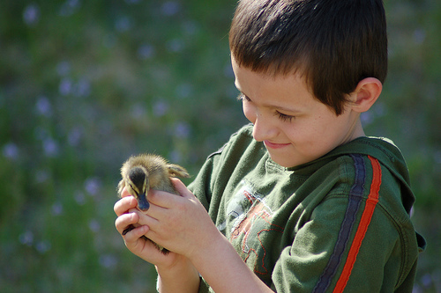
“Sometimes when I consider what tremendous consequences come from little things … I am tempted to think … there are no little things”
Bruce Barton

Slide 24
Conclusions

Slide 25

Thank you
for your kind attention!
FACILITATOR
      Prof. Dr. Mohammad Majid Mahmood Bagram

