Slide 1


Slide 2

Fundamentals of
Public Administration
MPA - 406
Lecture – 16
FACILITATOR
      Prof. Dr. Mohammad Majid Mahmood

Slide 3
Reflections

Slide 4
Centralization
Different Kinds of Centralization
1. Centralization of performance
2. Departmental centralization
3. Centralization as an aspect of Management
1. Centralization of performance
It pertains to geographic concentration; it characterizes an organization operating in a single location
2. Departmental centralization
It refers to centralization of specialized activities, generally in one department. For example,maintenance for a whole plant may be carried out by a single department.

Slide 5
Centralization
3. Centralization as an aspect of management:
It is the tendency to restrict delegation of decision making.
A high degree of authority is held at or near the top by managers in the hierarchy.

Slide 6
How is Authority Delegated?
The process of delegation involves following steps:
Determining the results expected from a position:
2. Assigning tasks to the position:
3. Delegating authority to accomplish the tasks:
4. Holding the person responsible for task completion:

Slide 7
Guides to Overcoming Weak Delegation
There are certain ways by which weak delegation can be overcome. These are as follows:
1. Define assignments and delegate authority in light of results expected or give sufficient authority to make possible the achievement of assigned goals.
2. Select the person suitable to do the job

Slide 8
Guides to Overcoming Weak Delegation
3. Maintain open lines of communication with subordinate so that you are able to tell them as well as listen to them.
4. Establish proper control by establishing standards of work
5. Reward effective delegation and successful assumption of authority

Slide 9

Role of Critical Thinking in Organizations

Slide 10


Slide 11
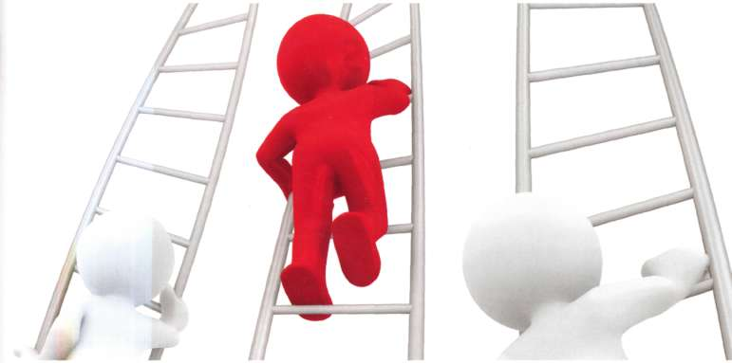
"Step Up the Stairs or Stare at the Steps.“
Ralph Nichols

Slide 12
Problem is not a Problem,
the way we see the Problem is the REAL PROBLEM
Notes:
The way an individual perceives, understands and interprets the surrounding world.
If we want to significant changes, first we must change our paradigms.
Thomas Kuhn the author of a landmark book, "The Structure of Scientific Revolutions" made a point that almost every significant breakthrough in science is first a break with tradition, old ways of thinking, or old paradigms.

Slide 13
Your Thinking
can either
Trap
You
Free
You
How?

Slide 14
Your Thinking
can either
Trap
You
Free
You
hold you
hostage within
uncritically
held
beliefs
Open your
mind
to new ways
of thinking

Slide 15
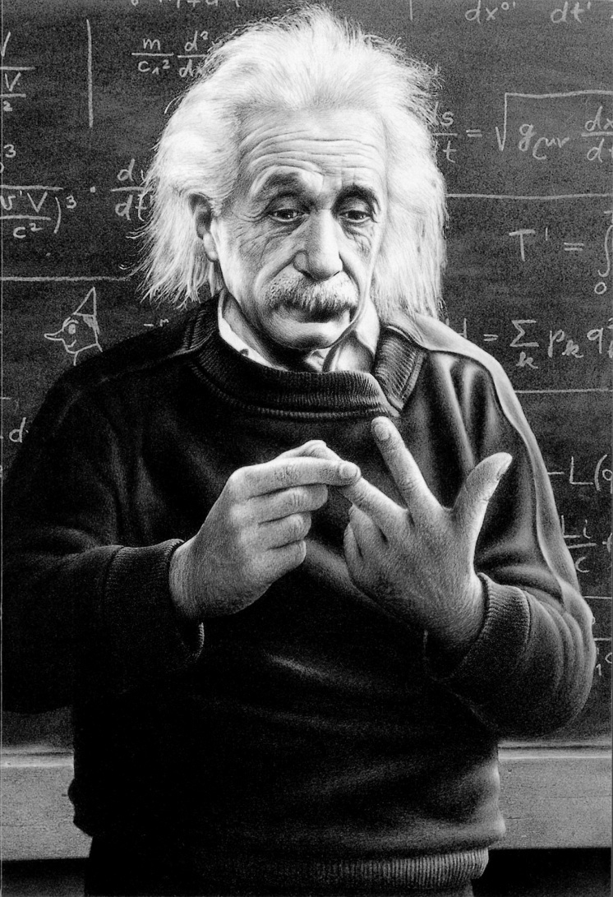

Thinking Outside the Box: Einstein

Slide 16
We don’t achieve excellence in thinking with no end in view.

Slide 17
Who SHOULD think critically?

Slide 18
Who SHOULD think critically?
EVERYBODY !

Slide 19
Thinking - examples
If I think that I don’t need a college degree to get a good job, I will feel satisfied with a high school education. Therefore I will not pursue higher education.
If I feel humiliated in the classroom because I think I have been treated unfairly by the teacher, I will avoid actively participating in group discussions

Slide 20
Thinking - examples
If I think that learning should be easy, I will feel frustrated when it is difficult. Therefore I will avoid difficult learning situations
If I value what I am learning, I think that it is relevant to my life. Therefore I will feel excited about learning

Slide 21
Listening
Any problem, big or small, always seems to start with bad communication. Someone isn't listening.

Slide 22
Seven Levels of Listening
1 Not listening: Not paying attention to or ignoring the other person’s communications.
2 Pretend listening: Acting like or giving the impression that you are paying attention to another person’s communications, but in actuality not really paying attention to that individual.
3 Partially listening: Only focusing on part of the other person’s communication or only giving it your divided attention.
4 Focused listening: Giving the other person your undivided attention to his or her communication.

Slide 23
Seven Levels of Listening
5 Interpretive listening: Going beyond just paying attention but really trying to understand what the other person is communicating.
6 Interactive listening: Being involved in the communications by asking clarifying questions or acknowledging understanding of the communication.
7 Engaged listening: Being fully engaged in communications involves listening to the other person’s views, feelings, interpretations, values, etc., In engaged listening, both parties are given the opportunity to fully express their views, feelings, and ideas.

Slide 24
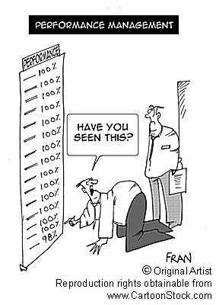

Slide 25
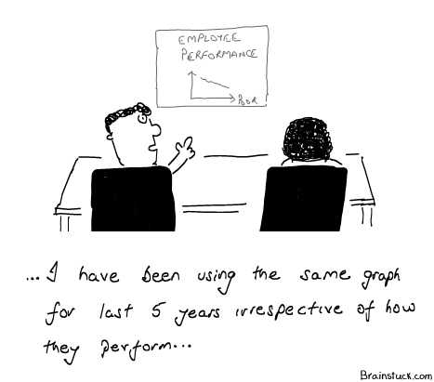

Slide 26
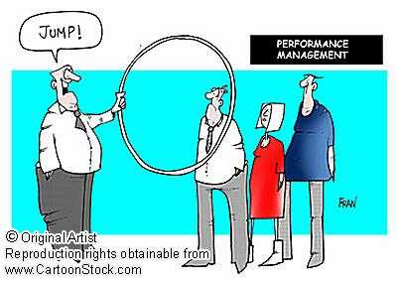

Slide 27
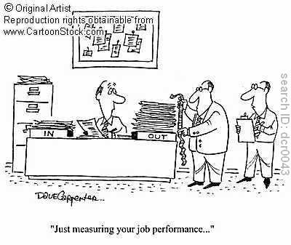

Slide 28
Definitions of Critical Thinking
  In “everyday” language:
  Thinking “outside” the box
  Thinking about thinking
  “Unlimited” thinking
  Different thinking
T H I N K I N G

Slide 29
Thinking Critically means…
Examining different viewpoints
Learn to think from different perspectives.
View those opinions which differ from yours.
Avoid automatic responses.

Slide 30
Critical Thinking helps
To recognize propaganda
To analyze hidden assumptions in arguments
To recognize deliberate deception
To assess credibility of information
To work through problems/decisions in the best way
Harpern, 1996

Slide 31
Conclusions

Slide 32

Thank you
for your kind attention!
FACILITATOR
      Prof. Dr. Mohammad Majid Mahmood Bagram

