Slide 1
Public Finance
(MPA405)
Dr. Khurrum S. Mughal

Slide 2
Lecture 32
Revision

Slide 3
Government Subsidies and Income Support for the Poor
Public Finance

Slide 4
Economic Analysis of the Effects of Government Transfers
Effect on Resource allocation
Consumer may consume where MSB is less that MSC
Loss of willingness to work if after work income is less
Analysis highlights the equity-efficiency trade-off

Slide 5
Price Distorting Subsidies
Price Distorting Subsidies lower the price of the particular good relative to others for eligible people.

Slide 6
Price Distorting Subsidies
Example of Housing subsidy
  Hiring apartment at below the market rent
  Govt pays the difference

Slide 7
Dead Weight Loss or
Excess Burden
Dead Weight Loss (sometimes called Excess Burden ) is the measure of the dollar value of the distortion that exceeds the amount transferred to the recipient.

Slide 8
Implications
Induces low-income people to increase their consumption – increased demand
More resources are allocated for building more houses
  But value exceeds the benefits
  Important to compare costs to tax payers and the benefits accruing to low income tenants

Slide 9
Full Subsidization of Medical Services
B
E₁
A
25 = P*
Price (Dollars per Month)
Excess Burden
MB_{L}
E₂
0
Q*
Q_{G}
Medical Office Visits per Year

Slide 10
Implications
Consumption till MB equals zero
Excess burden is the due to subsidy in kind
Medicaid recipients would be better off with cash subsidy

Slide 11
The Impact of Government Assistance Programs on Incentive to Work
Grant ensures minimum level of income independent of work
Larger the grant size, greater is the disincentive to work
  Because of income effect that makes work unfavorable
Transfers could cause people to work more or less depending on whether leisure is a normal good.

Slide 12
The Income Effect of a Transfer
F
U₃
C
U₂
E₃
A
Income per Day
U₁
G
E₂
E₁
D
Transfer
Payment
0
L₁
L₂
24
Leisure Hours per Day

Slide 13
Implication
Increase in transfer payments induces individual to increase leisure hours and reduce wok per day.

Slide 14
A Negative Income Tax
A Negative Income Tax is a system where there is no status test but there is an income guarantee and a take-back rate.
A minimum income guarantee for everyone
People below the floor will receive subsidies, while above that people will pay taxes
Floor would vary with household size

Slide 15
Negative Income Tax
Earned Income I_{E} | Transfer T = I_{G} – t_{N}I_{E} | Disposable Income I_{D}
0 | 5,000 | 5,000
1,000 | 5,000 – (.5 × 1000) = 4,500 | 5,500
2,000 | 5,000 – (.5 × 2000) = 4,000 | 6,000
3,000 | 5,000 – (.5 × 3000) = 3,500 | 6,500
4,000 | 5,000 – (.5 × 4000) = 3,000 | 7,000
5,000 | 5,000 – (.5 × 5000) = 2,500 | 7,500
6,000 | 5,000 – (.5 × 6000) = 2,000 | 8,000
7,000 | 5,000 – (.5 × 7000) = 1,500 | 8,500
8,000 | 5,000 – (.5 × 8000) = 1,000 | 9,000
9,000 | 5,000 – (.5 × 9000) = 500 | 9,500
10,000 | 5,000 – (.5 × 10000) = 0 | 10,000

Slide 16
A Negative Income Tax
Implication:
  A very expensive program if I_{G} is set at a reasonable level.
  Assuming I_{G} equal to $20, 000 per year for a family of four and t_{N} = 50%
  All families of four with income less than $40,000 will be eligible, specially in absence of status test
  If t_{N} is set lower to improve work incentive like 20% then the break-even income level would rise to $100,000 per year
  Tax rates and prices of other Govt services would have to increase a lot to finance such activity

Slide 17
Social Security and Social Insurance
Public Finance

Slide 18
Pay-as-you-go Pension System
In an unfunded defined benefit pension
  no assets are set aside and the benefits are paid for by the employer or other pension sponsor as and when they are paid.
Pension arrangements provided by the state in most countries in the world are unfunded, with benefits paid directly from current workers' contributions and taxes.

Slide 19
Pay-as-you-go Pension System
Economic Theory
  Distorts saving and work choices
  No conclusive evidence confirms this
Combined effect of influence on choices of
  Those who pay taxes to finance
  Those already receiving or close to receiving
  Our analysis is for those who are eligible

Slide 20
Impact of Social Security on Savings and Work Incentives
Income and Substitution Effects
The Substitution Effect leads to decreased saving and work.
The Income Effect may lead to an increase or decrease in savings and work. Most economists believe the income effect also decreases savings and work.
We discuss the impact of pension and earnings test on worker’s work incentive

Slide 21
Savings Incentives of Social Security
Asset Substitution Effect: People save less than they would if Social Security did not exist because they are substituting government promises of a benefit for private savings. Stated simply, people save less because government is “saving” for them.
Induced Retirement Effect: People save more than they would if Social Security did not exist because they would not have retired or would not have retired as early had Social Security not been there. Given that it does exist, people choose to ultimately retire or retire earlier and save in order to do so.
Bequest Effect: People save more than they would have if Social Security did not exist in order to give more to the children and grandchildren when they die.

Slide 22
The Net Effect of Social Security on Savings
Martin Feldstein: Social Security leads to a substantial reduction in savings – Asset Substitution Effect
Alicia Munnell: The net effect of the Asset Substitution Effect and Induced Retirement Effect is nearly zero

Slide 23
Introduction to Government Finance
Public Finance

Slide 24
Federal, State, and Local Revenue
Taxes are user charges for Govt provided services
Fundamental difference between Govt and Market provided goods & Services:
  Immediate payment – hence, Prices ration the goods
  Taxes do not
    not a prerequisite
    Services are financed by taxes but the link is missing
Sources:
  Taxes:
    Payroll
    Income (Corporate and Personal)
    Property
    Sales and Excise
    Estate
    Tariffs
  Fees
  Tuition
  Licenses

Slide 25
How Much We Are Taxed Also Affects….
Political Equilibrium
  Tax share and voting choices
Market Equilibrium and Its Efficiency with which resources are employed in private use
  Distort prices – might result in inefficiency
The Distribution of Income
  Reducing the income people have to spend
  Prices and amounts of private goods & services

Slide 26
Tax Basics
Tax Base
  The item or the activity that is to be taxed.
    Income
    Consumption
    wealth
  The three bases are related to each other
  General Tax
    Taxes all the bases
  Selective Tax
    Tax on certain portion of tax base
      Excise Tax on production and sale of goods
      Property Tax as a tax on one type wealth
      Tax on profit is selective tax on a type of income

Slide 27
Tax Basics
Tax Rate Structure
  The relationship between the amount that is to be paid in tax and the tax base for a given accounting period.
Average Tax Rate
  The total amount of tax divided by the total amount of the tax base.
Marginal Tax Rate
  The amount by which the tax increases when the tax base increases.
ATR = (Total Taxes Paid)/(Value of the Tax Base)
MTR = (∆Total Taxes Paid)/(∆ Value of the Tax Base)
Tax bracket
  The range of the tax base in which the marginal rate is constant.

Slide 28
Descriptors of the Tax Rate Structure
A Progressive Tax has a structure where the marginal tax rate is increasing and greater than the average tax rate.
A Proportional Tax has a structure where the marginal tax rate is constant and equal to the average tax rate.
A Regressive Tax has a structure where the marginal tax rate is decreasing and less than the average tax rate.

Slide 29
How Should the Burden of Government Be Financed
Benefit Principle
  Those that benefit the most from a particular program should pay the most for that program (Lindahl Tax principle at work).
    Fuel Tax to finance road construction
Ability-to-Pay Principle
  Those who have the greatest ability to pay should be required to pay the most.
    Horizontal equity
    Vertical equity

Slide 30
How Should the Burden of Government Be Financed
Horizontal Equity
  Same tax on people of same economic ability.
  As per income
  Then what about ability to pay?
    Same income yet varying responsibilities?
    Same income yet varying choices of leisure and work?
Vertical Equity
  People with differing economic ability pay different level of taxes based on some norm of fairness
    As income increases the Marginal Benefit to dollar decreases – by how much
    Does it actually fall for someone who fears future inability to work?

Slide 31
Criteria for Evaluating Alternative Methods of Government Finance
Equity
  The distribution of the burden of government finance should coincide with commonly held notions of fairness and ability-to-pay.
Efficiency
  The system of government finance should raise revenues with only a minimal loss in efficiency in the private sector.
Administrative ease
  A government finance system should be relatively easy to administer in a consistent manner without excessive costs to collect, enforce, and comply with taxes and tax laws.

Slide 32
Tax Compliance and Evasion
Tax Evasion is the term for illegal ways of avoiding paying taxes. It is typically the result of not declaring income or overstating otherwise legal deductions.
Tax Avoidance is the term for the legal ways of avoiding paying taxes, typically the result of avoiding activities that are taxed, delaying the time in which taxes are owed, or taking an action designed to lower a tax burden.

Slide 33
Reducing Tax Evasion
A
B
MC
MC
Cost and Benefit
E
Cost and Benefit
E
E
1
2
MB = MTR
MB₂
MB₁ = MTR₁
0
D*
0
D*
D*
2
1
Unreported Income per Year (Dollars)
Unreported Income per Year (Dollars)
C
MC₂
MC₁
E
Cost and Benefit
E₁
MB = MTR
0
D*
D*
2
1
Unreported Income per Year (Dollars)

Slide 34
Alternatives to Taxation
Debt Finance is the means of financing expenditures through the issuing of bonds.
  People willingly buy bonds because the interest payment is sufficient to offset the requirement of current consumption
  Taxes are used to pay off debt
Inflationary Finance is the means of financing expenditures through the printing of money.
  Reduction in real value, inflationary tax, reduces command over resources in private sector

Slide 35
User Charges & Efficiency
Can also create efficiency if benefits of government goods are congestible
Road Congestion example
  No price required if traffic is below the point of congestion
  Above that, price may be charged equivalent to the point where MSB=MSC

Slide 36
Taxation, Prices Efficiency, and the Distribution of Income
Public Finance

Slide 37
Price Distorting Taxes
A price distorting tax is a tax that alters the relative price of goods.
Example: Tax on Gasoline
  The budget line pivots on the y-axis shifts on x-axis
  The purchase price increased for consumers
  Also shows a scenario if a Lump-sum tax was applied instead

Slide 38
Unit Taxes
A unit tax adds to the price by a fixed amount. Examples include the 32 cents per pack of cigarettes and 24 cents per gallon of gasoline in federal taxes.

Slide 39
Excess Burden is Zero When Demand or Supply is Perfectly Inelastic
A
Supply
B
Demand
Supply
after Tax
Supply
Price
Price
Demand
Net Price
after Tax
0
q
0
q
Quantity per Month
Quantity per Month

Slide 40
Efficiency Loss Ratio of a Tax
The Efficiency Loss Ratio is the deadweight loss per dollar of revenue raised DWL/R .

Slide 41
Incidence of a Tax
The Legal Incidence is the burden of a tax as determined by who is legally obligated to pay the tax.
The Economic Incidence is the burden of a tax as determined by how much the parties are affected in terms of paying higher prices, or receiving lower prices.

Slide 42
Shifting of Taxes
Forward Shifting is the transfer of the burden of the tax from the seller, who is legally obligated to pay it, to the buyer.
  Gasoline example
Backward Shifting is the transfer of the burden of the tax from the buyer, who is legally obligated to pay it, to the seller.
  Payroll tax if income decreases

Slide 43
Independence of Legal and Economic Incidence
It does not matter whether the buyer or seller is legally liable for a tax.
The economic incidence of the tax is determined by supply and demand elasticities, the amount of the tax, and the original equilibrium price and quantity.

Slide 44
Impact of a Tax on a Good with a Perfectly Elastic Supply
Generally the supply of goods and services is more elastic in the long run than in the short run.
Therefore, buyers are more likely to pay the taxes in the long run.
Industries where resources can be easily shifted for other use have elastic supply curves in long run.

Slide 45
Multimarket Analysis of Excess Burden
(Minimizing the excess burden)
A
B
E₂
E₂
P_{C}(1 + t)
S'
P_{F}(1 + t)
S'
E₁
Price
E₁
P_{C}
S
P_{F}
S
B
A
D_{C}
ΔQ_{F}
D_{F}
ΔQ_{C}
Q_{F2}
Q_{F1}
0
Q_{C2}
Q_{C1}
Food per Year
Clothing per Year

Slide 46
Implication
Efficiency loss can be minimized
  Goods are taxed at rates that decrease with elasticity of demand
More inelastic demand needs higher tax
Efficient system of taxes will have to face political opposition

Slide 47
Multimarket Analysis Incidence
A
B
S' = MC + T
S
S
S'
E₂
E₁
P_{G}
P
Price
P*
E₁
P'
E₂
_{F}
P_{N}
D
D
0
Q'
Q*
0
Q_{F}
Q'
_{F}
Clothing per Year
Food per Year

Slide 48
Implication
Price of clothing to increase but that of food to decrease
Effect on specialized capital and labor of clothing industry
The specialized inputs of one industry face a decrease in income when they move to another industry

Slide 49
Budget Balance and Government Debt
Public Finance

Slide 50
Budget Terms
A Budget Surplus exists when Tax Revenues are greater than Expenditures and is the difference between the two.
A Budget Deficit exists when Expenditures are greater than Tax Revenues and is the difference between the two.
The National Debt is the sum of deficits minus the sum of all surpluses

Slide 51
Government Demand for Loanable Funds and the Market Rate of Interest
S
i₂
E'
i₁
E
Interest Rate
D₁ + ΔD_{G}
D₁
0
L₁
L₂
Loanable Funds per Year

Slide 52
Ricardian Equivalence
Ricardian Equivalence is the view that deficits do not alter interest rates because citizens today see that deficits today will be financed with higher taxes tomorrow and citizens save in order to have the funds to pay those higher taxes.

Slide 53
Ricardian Equivalence: Deficits Do Not Affect Interest Rates
S
S'
i₂
E'
Interest Rate
E
E''
i₁
D₁ + ΔD_{G}
D₁
ΔL
0
L₁
L₂
L₃
Loanable Funds per Year

Slide 54
Economic Effects of Federal Budget Surpluses
Unified budget surpluses allow government to provide capital to the loanable funds market.

Slide 55
Impact of a Budget Surplus on
Credit Markets
S
S' = S₁ + ΔL
E
I₁
E'
Interest Rate
I₂
D
ΔL
0
L₁
L₂
Loanable Funds per Year

Slide 56
Public Finance I: Resource Mobilization and the Structure of Taxation

Slide 57
Inter Govt. Fiscal Relations
1. Provincial and Local Governments
Before the implementation of District Govt. system in 2001, Local Govt’s were extensions of Provincial Govt. and the former acted on behalf of the later.
Therefore, there was a great deal of overlap between these tiers of Govt.

Slide 58
Cont…
2. Federal and Provincial Governments
Federal Govt. is required to transfer revenues from taxes, as may be specified from time to time, to the provincial Govt’s.
Taxes to be included in the divisible pool and the share to be given to each province is determined various awards/commission.

Slide 59
Cont…
National Finance Commission (NFC) is a body constituted by President of Pakistan which is meant to divide the revenue-sharing formula for the divisible pool, from Federal to Provincial Govt’s.
NFC is supposed to announced an award every 5 years.

Slide 60
Overall Evaluation of the Intergovernmental Transfer System
The intergovernmental transfer arrangements in Pakistan, which include shared taxes based on population, straight transfers based on collection origin and various grants, have been criticized by experts for several reasons.
The straight transfers component (12% of total transfer revenue) returns selected resources revenues (oil, gas excise and royalties, and hydroelectric profits) to the point of collection.
These arrangements are criticized for having no particular economic justifications.

Slide 61
Public Finance: The Basic Facts
Main source of revenue has historically been from customs duties, i.e. taxation on trade.
With high tariff barriers and imports substituting industrialization, this is a logical outcome.
Taxes from imports were, until recently, the main source of revenue for the exchequer.

Slide 62
Cont…
Despite the impressive industrialization and dynamic economic growth that took place in the 1960s, the contribution of income and corporate taxes actually declined as a percentage of total revenue receipts for United Pakistan (Pakistan + Bangladesh).
On expenditure side, Pakistan was with more than half of the total expenditure being spent on defense from 1947 to at least 1970/1.
In 1970/1, 53 % of total expenditure was on defense.

Slide 63
Cont…
Pakistan’s economy was highly dependent on aid and that much of the industrialization boom of the decade of development was foreign funded.
The interesting fact is that even after 16 years of structural reforms, very little has changed, and in fact, in the case of tax revenues as a per cent of GDP, there is much deterioration, presented in next table 10.6.
Tables 10.7 and 10.8 then break down the revenue and expenditure statements of the Govt. in greater detail.

Slide 64
Cont…
Revenue from taxation is far greater than that from non-tax revenue, and that indirect taxes are many times as large as direct taxes.
In indirect tax category, import duties used to dominate by far, and provided the largest source of income to the Govt.
This has all changed and has been one of the most significant changes in Pakistan’s economy as a result of lowering tariffs and overall reforms.

Slide 65
Cont…
Data for 2002/3 also show that defense and interest payments accounts for more than half of all Govt. expenditures.
This issue is the key importance to the economy and politics.
Development expenditure is far less than current or non-development expenditure, and in 2002/3 was less than 19% of total provincial and federal current expenditures.

Slide 66
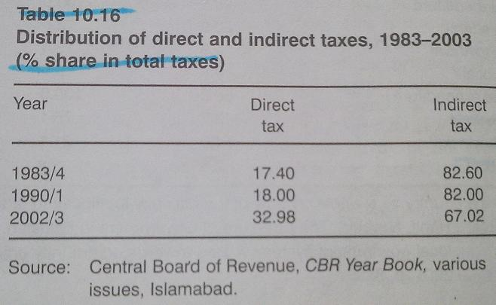

Slide 67
Public Finance: The Basic Facts (contd…)
The Elasticity Coefficient of a tax measures the built-in response of tax revenue to growth in income without any change in tax rate.
Buoyancy Coefficient measures the total responsiveness in the tax revenue to the growth of income, inclusive of changes in tax rates.
Table 10.19 show the extent of both for some important taxes.

Slide 68
Cont…
In most of the cases, a elasticity less than one shows that a one percent increase in income has a smaller effect on revenue
Less than one Buoyancy shows the same effect but considering all the discretionary measures by the government.
Might be due to
  presence of a large unofficial sector
  Wide array of tax exemptions
  Poor tax administration
Moving on to provincial efforts…..

Slide 69
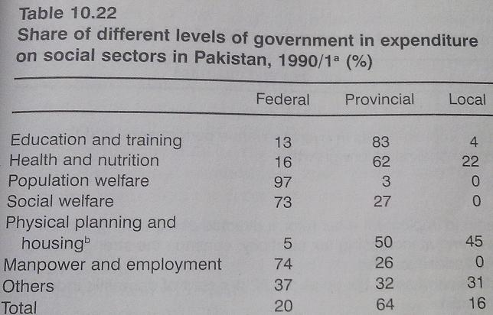
Notes:
Keynes posited that in good economic times, the government should run a budget surplus and pay off the deficits that were run up in bad economic times. This part of Keynes’s prescription was never incorporated into Keynesian theory.

Slide 70
Important Issues in Public Finance and Revenue Mobilization
Federal Taxes
Problems of the Federal tax system are as follows:
  1st. Overall level of fiscal effort is low and the tax-to-GDP ratio has remained, more or less, stagnant at between 12 to 13 %.
  This is the main reason for high budget deficit.

Slide 71
Cont…
  2nd. There is overdependence on indirect taxes, which until recently accounted for a share in revenues of over 80%.
    This has imposed a higher excess burden of taxation.
  3rd. Within indirect taxes there is domination of taxes on international trade, which has promoted inefficiency, distorted the allocation of resources and encouraged illicit trade.

Slide 72
Cont…
  4th. The effective tax bases of most taxes is narrow due to wide ranging exemptions and concessions and rampant tax evasion.
  5th. Tax administration is characterized by primitive and out-moded procedures, complex laws and considerable arbitrariness and discretion.
    The common perception is one of high levels of corruption and inefficiency.

Slide 73
Cont…
World Banks recommendations prior to commencement of structural adjustment programs:
  Low income elasticity because of narrow tax base
  Agri income for taxation
  A general consumption type tax (VAT) as an extension of sales tax
    Which doesn’t differentiate between imported and local goods
Proper documentation of the economy
Removing unnecessary exemptions
Reform of the tax administration

Slide 74
Resource Mobilization at the Provincial Level
Almost 90% of revenue is collected at the federal level and the remaining 10% distributed between the two lower tiers of Govt.
The role played by both Provincial and local governments play in the delivery of services is often critical.
Social services, in particular, such as education, health and water supply and sanitation are provided by provincial and local governments.

Slide 75
Cont…
Problems in the provincial resource mobilization structure are as follows:
  1. Limited scope of resource mobilization as the large and relatively buoyant taxes, such as import duties, income and corporate tax, excise duties and sales tax, are with the federal
  2. The Islamization process has caused loss of revenue from provincial excises, entertainment tax and land revenue.

Slide 76
Cont…
  3. Provincial governments have not been able to exploit the agricultural income tax, tax on value added in the services sector and capital gains on immovable properties.
  4. The elasticity of provincial taxes is low, which means low growth in tax revenues.
  5. Incentive environment prevalent in the country
    Access to ad hoc revenue deficit grant
  6. Poor tax administration.

Slide 77
Local Government Revenues
Provincial Govt’s. are perceived to be the main providers of benefits to the people.
It is also assumed that they are also better at raising revenues.
However, the surprising evidence is that local Govt’s. in the earlier and now defunct system, especially in large cities, have been successful in increasing their contribution to total revenues and there has been an improvement in the revenue mobilization efforts of local Govt’s.

Slide 78
Cont…
In the 1980s, local taxes grew by an annual rate of 18 %, far higher than the growth in revenues at the federal or provincial level.
Current pattern of intergovernmental fiscal relations between the provincial and local Govt’s. in the country is such that the former is instrumental in retarding the development, in terms of expenditure growth, of the latter.
  This is the case because the provincial Govt substitute local Govt in the provision of some important local services.

Slide 79
Cont…
Buoyancy of Property tax depends on property value assessment
  Considerable effort but why should the province do it?
Current pattern of intergovernmental fiscal relations between the provincial and local Govt’s. in the country is such that the former is instrumental in retarding the development, in terms of expenditure growth, of the latter.
  This is the case because the provincial Govt substitute local Govt in the provision of some important local services.

Slide 80
Cont…
Applied Economic Research Center (AERC) reports on local Govt’s decentralization argued that its is justified on
  Economic Ground
    Reduction in cost or improvement in quality of services
  Political ground
    Sense of participation at grass root level
    Local representatives have better knowledge of local problems

Slide 81
Public Finance II: Debts and Deficits

Slide 82
Debt and Deficits
Academicians, policy makers and politicians have spent extensive time and written numerous papers and reports regarding the problems of public debt and of the fiscal deficit.
The general concern is that the existing levels of budgetary deficit are abnormal and undesirable, and many OECD countries have felt the need to follow budgetary strategies that attempt to reduce, and if possible eliminate, the entire deficit as soon as possible.

Slide 83
Cont…
The general consensus seems to be that these large current deficits are not sustainable, and that unless some forceful an direct action is taken, the deficits are likely to continue growing until they swamp the entire economy.
In the case of underdeveloped countries, the importance attached to fiscal deficits is even greater.

Slide 84
Cont…
The World Bank and IMF believe that the fiscal deficit is the single most important policy variable that affects the rest of the economy, and they are able to express their belief through the implementation of their structural adjustment programmes.

Slide 85
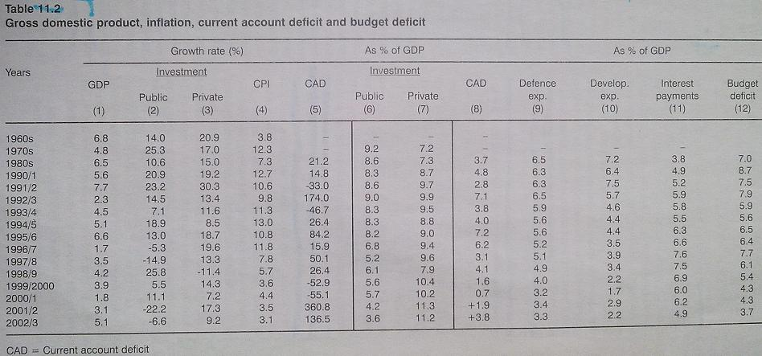
Effect of Budget deficit on
  Growth
  Inflation
  Private investments – crowding out
Keynesian perspective

Slide 86
The IMF/World Bank View of Pakistan’s Fiscal Deficit, 1980-97.
The IMF/World Bank admit that
“the macro consequences of fiscal deficits in Pakistan have apparently been quite dissimilar from those in other developing countries with fiscal deficits of comparable magnitude. Specifically, Pakistan has experienced neither hyperinflation nor debt rescheduling … Growth has remained quite strong through the last two decades, inflation has not been high, and the current account deficit has averaged about 2 % of GNP, remaining largely financeable and not posing debt servicing problems for the country.”

