Slide 1
Public Finance
(MPA405)
Dr. Khurrum S. Mughal

Slide 2
Public Finance II: Debts and Deficits

Slide 3
Debt and Deficits
Academicians, policy makers and politicians have spent extensive time and written numerous papers and reports regarding the problems of public debt and of the fiscal deficit.
The general concern is that the existing levels of budgetary deficit are abnormal and undesirable, and many OECD countries have felt the need to follow budgetary strategies that attempt to reduce, and if possible eliminate, the entire deficit as soon as possible.

Slide 4
Cont…
The general consensus seems to be that these large current deficits are not sustainable, and that unless some forceful an direct action is taken, the deficits are likely to continue growing until they swamp the entire economy.
In the case of underdeveloped countries, the importance attached to fiscal deficits is even greater.

Slide 5
Cont…
The World Bank and IMF believe that the fiscal deficit is the single most important policy variable that affects the rest of the economy, and they are able to express their belief through the implementation of their structural adjustment programmes.

Slide 6
Does the fiscal deficits matters?
There is a great deal of confusion about what the implications and consequences of large and/or increasing budget deficits really are?
Do government deficits absorb positive savings?
Does public debt diminish private demand for stocks of productive capital assts?
Can the burden of current government expenditure be shifted to future generations?
Are inflations caused by deficits and public debt?

Slide 7
Cont…
5. Will government borrowing continue to raise interest rates?
6. And will a tax cut mean bigger deficits while it stimulates aggregated demand, employment, and output, or will it have no real consequences whatsoever?

Slide 8
Cont…
William Buiter
“probably more uniformed statements have been made on the issue of public sector debt and deficits than on any other topic in macroeconomics”

Slide 9
Should Budgets always be balanced?
Possibly, the converse of public debt and deficit is no debt and no deficit, i.e. a surplus or at least a balanced budget.
The argument is that like households and firms governments should also live within their means and not go into indefinite and extensive debt.
Central Govt. is different from other economic agents.

Slide 10
Cont…
An appropriate way to maintain fiscal discipline without stabilizing the economy would be to determine the level of government spending on its own merits, independent of the requirements of stabilization policy, and to set tax rates so as to produce a balance at full employment.

Slide 11
Cont…
Tobin argues that federal deficits may even be economically desirable in specific circumstances, and what is really important is appropriate public policy, which may or may not produce a balanced budget.
However, he argues that making deficits unconditional would increase economic instability.

Slide 12
The Problem of Measuring the Deficit
Robert Eisner and Piepper argue that Conventional measures of fiscal deficit and debt are fundamental flawed.
In their analysis they correct the figures for debt for changes in the market value of government debt due to changes in interest rates and changes in the real value due to inflation.

Slide 13
Cont…
They find these adjustments in measurement critical to their findings: ‘failure to measure deficits correctly has not only contributed to a false view of fiscal impotence, but has possibly lead to an overestimate of the importance of money’.

Slide 14
Fiscal deficits, Intertemporal Equity, and Distribution
I Ihori asks the important question of Whether increasing debt finance is adding an increasingly unfair burden on future generations?
If the answer is in the affirmative, then one may conclude that present generations are benefiting by consuming services provided currently, while future generations will have to foot the bill; hence, one should not borrow.

Slide 15
Cont…
On the other hand, one may be able to argue that, by borrowing now, there will be greater intergenerational equity, since part of the cost of capital outlays will be passed on the future.
He feels that the answer to the question of whether debt is passed on to future generations depends critically on the definition of the burden of debt.

Slide 16
Cont…
Modigliani’s definition rests on the assumptions that a permanent increase in government debt would crowd out private investment in the long run, causing net decrease in the capital stock.

Slide 17
Macroeconomic Implications
The IMF and the World Bank are agreed on one point, that dealing with budget deficits is one of the most vexing problem for the majority of underdeveloped countries and hence fiscal policy is now an essential component of adjustment programmes where fiscal discipline and restraint are viewed as prerequisites for macroeconomic stabilization.

Slide 18
Cont…
Many observers argue that the fiscal deficit is a useful indicator of overall economic performance, and have found a significant statistical relationship between the deficit and many though not all, macroeconomic performance variables.

Slide 19
Cont…
The budget deficit is held responsible for high inflation low growth, a current account deficit, and the crowding out of private investment and consumption.
The relationship between deficits and other macroeconomic variables is said to depend on how the deficits are financed.

Slide 20
Critical concerns regarding Pakistan’s Fiscal Deficit
We can summarize the main features of Pakistan’s public finances and fiscal deficit as follows:
Total expenditure exceeds total revenue and the growth in expenditure is greater than that in revenue.
Current expenditure alone exceeds total revenue.
Development expenditure has been falling, while current expenditure has grown.
Defense expenditure has been very high, and much higher than even development expenditures.

Slide 21
Cont…
5. Interest payments along with defense expenditure constitute more than half of annual expenditures.
6. The main source for financing the fiscal deficit has been non-bank borrowing, rather than bank borrowing.
7. Domestic debt is greater than foreign debt.
8. The financing of the deficit is very substantially from domestic sources rather than from foreign sources.
9. The fiscal deficit of the government of Pakistan has been around 8% of GDP for much of the 1980s.

Slide 22
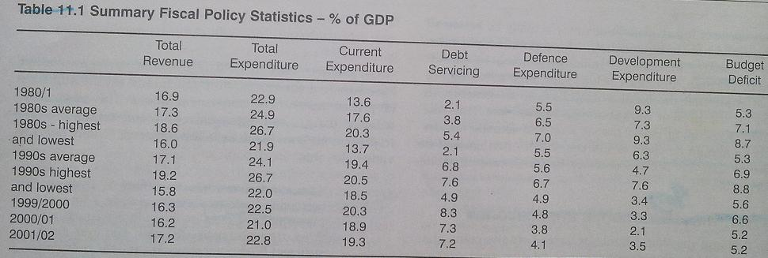

Slide 23
Cont…
Moreover, table 11.1 shows some interesting trend since 1980, which are also worth highlighting.
Total revenue has remained, with some variations over time, more or less the same in 22 years, despite reforms of different sorts.
Total expenditure has fallen.
Although total expenditure has fallen, current expenditure has actually risen.
Debt servicing has increased over a time.
Defense expenditure has fallen over a time.
Development exp has fallen very dramatically.
The budget deficit has been brought down to early 1980 levels.

Slide 24
Cont…
Moreover, table 11.1 shows some interesting trend since 1980, which are also worth highlighting.
Total revenue has remained, with some variations over time, more or less the same in 22 years, despite reforms of different sorts.
Total expenditure has fallen.
Although total expenditure has fallen, current expenditure has actually risen.
Debt servicing has increased over a time.
Defense expenditure has fallen over a time.
Development exp has fallen very dramatically.
The budget deficit has been brought down to early 1980 levels.

Slide 25
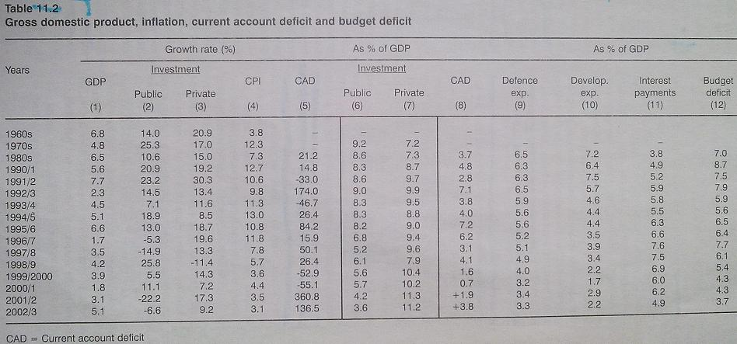
Effect of Budget deficit on
  Growth
  Inflation
  Private investments – crowding out
Keynesian perspective

Slide 26
The IMF/World Bank View of Pakistan’s Fiscal Deficit, 1980-97.
The IMF/World Bank admit that
“the macro consequences of fiscal deficits in Pakistan have apparently been quite dissimilar from those in other developing countries with fiscal deficits of comparable magnitude. Specifically, Pakistan has experienced neither hyperinflation nor debt rescheduling … Growth has remained quite strong through the last two decades, inflation has not been high, and the current account deficit has averaged about 2 % of GNP, remaining largely financeable and not posing debt servicing problems for the country.”

Slide 27
Cont…
The IMF believes that the deficit has not behaved in Pakistan as it should have in this period, for several reasons:
There was a very high rate of growth of real output (6% per annum) which permitted a fairly rapid expansion of both interest-bearing and non-interest-bearing debt without recourse to inflationary finance.
The equilibrium deficit was quite high-5.5 % of GNP- despite a low inflation rate because of a very high underlying rate of growth of real output.

Slide 28
Cont…
3. The government of Pakistan was able to borrow, both domestically and externally, at rates below the marginal cost of funds in the international private capital markets.

Slide 29
Fiscal and Monetary Policy
Economic Survey of Pakistan 2013-14
Notes:
In this chapter the cold hard facts of “we must pay for our spending” come to light.
This previously ignored part of Keynesian economics became a major point of controversy in 2011.

Slide 30
1. Fiscal Development
Present government soon after coming into power in June, 2013, took instant measures to improve the fiscal situation through expenditure management strategy and raising tax and non-tax revenues during fiscal year 2013-14.
Under prudent expenditure management strategy, various initiatives have been taken including 30 percent cut in current budget of ministries/Divisions except pay and allowances, phasing out of electricity subsidies and announced restructuring of bleeding PSEs.
Notes:
In this chapter the cold hard facts of “we must pay for our spending” come to light.
This previously ignored part of Keynesian economics became a major point of controversy in 2011.

Slide 31
Cont…
As a result of these efforts, initial gains started to emerge as fiscal deficit reduced to 3.2 percent of GDP during July-March, 2013-14, against 4.7 percent in the comparable period of last year.
Total expenditure of Rs. 5,297.2 billion was estimated for the full year, comprising of Rs. 3,963. 0 billion of current expenditure (74.8 percent of total) and Rs. 1,334.3 billion of development expenditure and net lending (25.2 percent of total).
Notes:
In this chapter the cold hard facts of “we must pay for our spending” come to light.
This previously ignored part of Keynesian economics became a major point of controversy in 2011.

Slide 32
Cont…
During July-March, 2013-14, total expenditures contained at 3.7 percent against 20.4 percent growth in the same period of 2012-13.
Total revenue increased by 16.6 percent during July-March, 2013-14, and stood at Rs. 2,477.4 billion compared to Rs. 2,124.9 billion in the same period of 2012-13.
Notes:
In this chapter the cold hard facts of “we must pay for our spending” come to light.
This previously ignored part of Keynesian economics became a major point of controversy in 2011.

Slide 33
Cont…
Tax revenues amounted to Rs. 1,786.2 billion against Rs.1, 527.8 billion in the same period last year, thus posted a growth of 16.9 percent.
Significant growth in tax revenues was mainly on account of considerable rise in federal tax collection by 16.3 percent
While, non tax revenues posted a significant growth of 15.8 percent during July-March, 2013-14, which amounted to Rs. 691.2 billion against Rs.597.0 billion in the same period last year.
Notes:
In this chapter the cold hard facts of “we must pay for our spending” come to light.
This previously ignored part of Keynesian economics became a major point of controversy in 2011.

Slide 34
Cont…
Fiscal accounts witnessed some relief on account of reduced subsidies, which remained lower than last year as it reached to Rs. 201.8 billion during July-March, 2013-14 against Rs. 270.0 billion in the comparable period of 2012-13.
Following a growth of 24.3 percent in provincial tax revenues and 13.9 percent in federal transfers, the provincial surpluses posted a higher growth and reached to Rs. 257.9 billion during July-March, 2013-14.
Notes:
In this chapter the cold hard facts of “we must pay for our spending” come to light.
This previously ignored part of Keynesian economics became a major point of controversy in 2011.

Slide 35
Cont…
During July-April, 2013-14, FBR collected an amounted of Rs. 1,744.8 billion as provisional tax against Rs. 1,505.5 billion in the comparable period of 2012-13, reflecting a growth of around 15.9 percent.
During the first ten months of current fiscal year, among the four federal taxes, highest growth has been witnessed in direct tax at 18.9 percent followed by sales tax at 18.8 percent and federal excise at 14.0 percent.
Notes:
In this chapter the cold hard facts of “we must pay for our spending” come to light.
This previously ignored part of Keynesian economics became a major point of controversy in 2011.

Slide 36
Cont…
During July-April, 2013-14, direct taxes remained a major source of FBR tax revenue collection, contributing 37.7 percent of total FBR revenues. Net collection was estimated at Rs. 658.1 billion against Rs. 553.5 billion in the comparable period of fiscal year 2012-13.
Indirect taxes increased by 14.2 percent in first ten months of current fiscal year and accounted for 62.2 percent of total FBR collection. Net collection was estimated at Rs. 1,086.7 billion against Rs. 951.9 billion in the same period last year.
Notes:
In this chapter the cold hard facts of “we must pay for our spending” come to light.
This previously ignored part of Keynesian economics became a major point of controversy in 2011.

