Slide 1
Public Finance
(MPA405)
Dr. Khurrum S. Mughal

Slide 2
Public Finance I: Resource Mobilization and the Structure of Taxation

Slide 3
Public Finance: The Basic Facts (contd…)
The Elasticity Coefficient of a tax measures the built-in response of tax revenue to growth in income without any change in tax rate.
Buoyancy Coefficient measures the total responsiveness in the tax revenue to the growth of income, inclusive of changes in tax rates.
Table 10.19 show the extent of both for some important taxes.

Slide 4
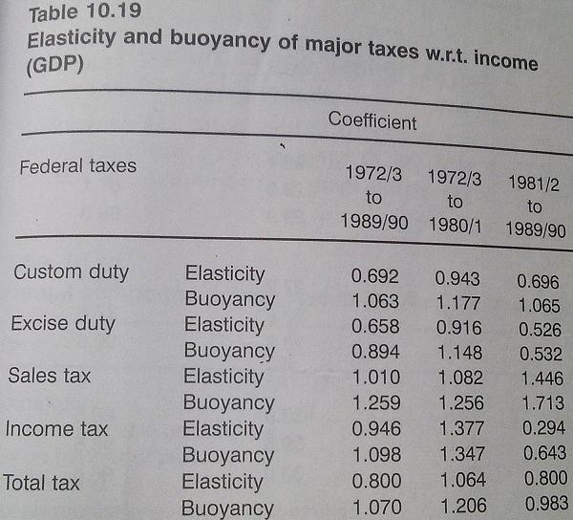

Slide 5
Cont…
In most of the cases, a elasticity less than one shows that a one percent increase in income has a smaller effect on revenue
Less than one Buoyancy shows the same effect but considering all the discretionary measures by the government.
Might be due to
  presence of a large unofficial sector
  Wide array of tax exemptions
  Poor tax administration
Moving on to provincial efforts…..

Slide 6
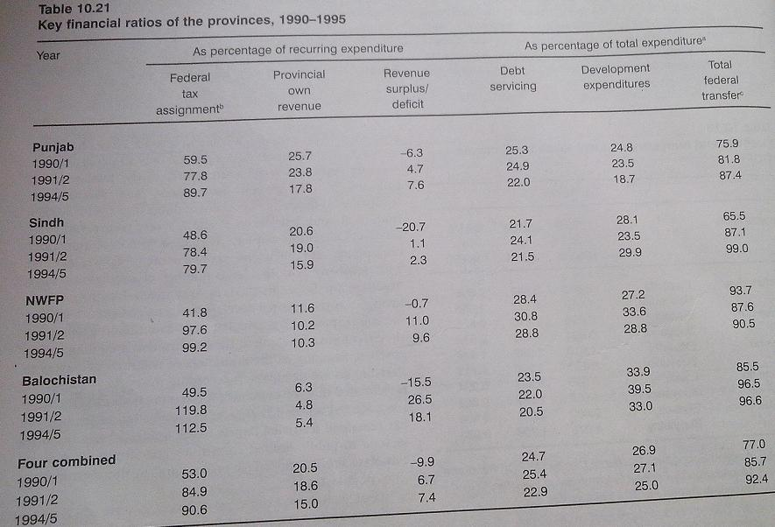

Slide 7
Cont…
1991 NFC award placed provinces into a surplus position
Provinces own revenue effort fell appreciably after 1990/1, and development expenditures, which were mainly the responsibility of the provinces (see table 10.22)
  either decreased, as in the case of Punjab, or did not show much improvement, in the other three provinces.
Education, health and water supply and sanitation are the main sectors where the provincial Govt’s. dominate, and overall 64 % of expenditures on the social sector is incurred at the provincial level.

Slide 8
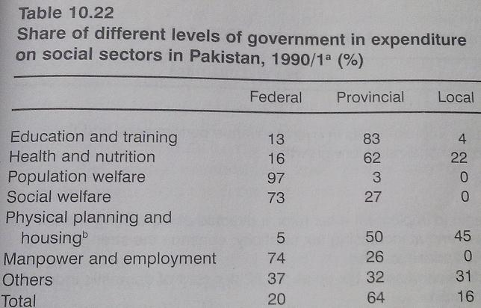
Notes:
Keynes posited that in good economic times, the government should run a budget surplus and pay off the deficits that were run up in bad economic times. This part of Keynes’s prescription was never incorporated into Keynesian theory.

Slide 9
Important Issues in Public Finance and Revenue Mobilization
Federal Taxes
Problems of the Federal tax system are as follows:
  1st. Overall level of fiscal effort is low and the tax-to-GDP ratio has remained, more or less, stagnant at between 12 to 13 %.
  This is the main reason for high budget deficit.

Slide 10
Cont…
  2nd. There is overdependence on indirect taxes, which until recently accounted for a share in revenues of over 80%.
    This has imposed a higher excess burden of taxation.
  3rd. Within indirect taxes there is domination of taxes on international trade, which has promoted inefficiency, distorted the allocation of resources and encouraged illicit trade.

Slide 11
Cont…
  4th. The effective tax bases of most taxes is narrow due to wide ranging exemptions and concessions and rampant tax evasion.
  5th. Tax administration is characterized by primitive and out-moded procedures, complex laws and considerable arbitrariness and discretion.
    The common perception is one of high levels of corruption and inefficiency.

Slide 12
Cont…
World Banks recommendations prior to commencement of structural adjustment programs:
  Low income elasticity because of narrow tax base
  Agri income for taxation
  A general consumption type tax (VAT) as an extension of sales tax
    Which doesn’t differentiate between imported and local goods
Proper documentation of the economy
Removing unnecessary exemptions
Reform of the tax administration

Slide 13
Vested Interests and the taxation structure
Taxation structure needs to be seen in the context of different interest groups active in the economy.
The failure of Govt. to broaden the base of direct taxes by reducing tax expenditures leads to the identification of a number of factors which mitigate against success of reform initiatives as follows.
1. Lack of commitment to the reform by agents of the state, arising from a perception that the reform may damage vital national interests like food production, savings, exports etc.

Slide 14
Cont…
2. State capture by special interest groups like the traditional feudal elite, bureaucracy and the emerging corporate business interest.
3. Wrong strategy of implementation of reforms. By first reducing tax rates the opportunity which existed for bargaining with (and compensating) losers was lost.

Slide 15
Resource Mobilization at the Provincial Level
Almost 90% of revenue is collected at the federal level and the remaining 10% distributed between the two lower tiers of Govt.
The role played by both Provincial and local governments play in the delivery of services is often critical.
Social services, in particular, such as education, health and water supply and sanitation are provided by provincial and local governments.

Slide 16
Cont…
Problems in the provincial resource mobilization structure are as follows:
  1. Limited scope of resource mobilization as the large and relatively buoyant taxes, such as import duties, income and corporate tax, excise duties and sales tax, are with the federal
  2. The Islamization process has caused loss of revenue from provincial excises, entertainment tax and land revenue.

Slide 17
Cont…
  3. Provincial governments have not been able to exploit the agricultural income tax, tax on value added in the services sector and capital gains on immovable properties.
  4. The elasticity of provincial taxes is low, which means low growth in tax revenues.
  5. Incentive environment prevalent in the country
    Access to ad hoc revenue deficit grant
  6. Poor tax administration.

Slide 18
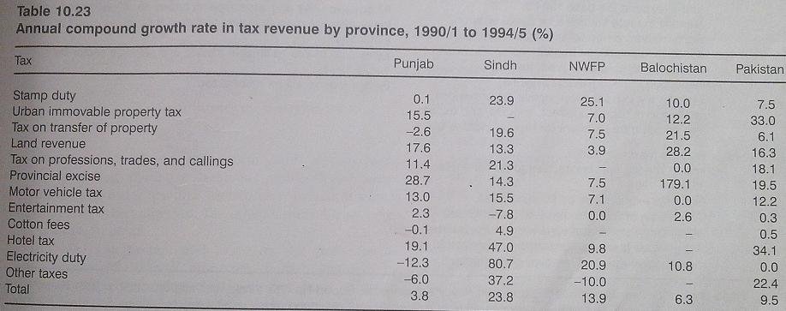

Slide 19
Local Government Revenues
Provincial Govt’s. are perceived to be the main providers of benefits to the people.
It is also assumed that they are also better at raising revenues.
However, the surprising evidence is that local Govt’s. in the earlier and now defunct system, especially in large cities, have been successful in increasing their contribution to total revenues and there has been an improvement in the revenue mobilization efforts of local Govt’s.

Slide 20
Cont…
In the 1980s, local taxes grew by an annual rate of 18 %, far higher than the growth in revenues at the federal or provincial level.
Current pattern of intergovernmental fiscal relations between the provincial and local Govt’s. in the country is such that the former is instrumental in retarding the development, in terms of expenditure growth, of the latter.
  This is the case because the provincial Govt substitute local Govt in the provision of some important local services.

Slide 21
Cont…
Buoyancy of Property tax depends on property value assessment
  Considerable effort but why should the province do it?
Current pattern of intergovernmental fiscal relations between the provincial and local Govt’s. in the country is such that the former is instrumental in retarding the development, in terms of expenditure growth, of the latter.
  This is the case because the provincial Govt substitute local Govt in the provision of some important local services.

Slide 22
Cont…
Applied Economic Research Center (AERC) reports on local Govt’s decentralization argued that its is justified on
  Economic Ground
    Reduction in cost or improvement in quality of services
  Political ground
    Sense of participation at grass root level
    Local representatives have better knowledge of local problems

Slide 23
The problems with local Govt’s.
Source: The Daily Times, Lahore, 15/12/2003
District nazims of the local Govt. system have held their convention in Islamabad with the chairman of the National Reconstruction Bureau (NRB), Mr. Daniyal Aziz, in attendance.
  Understandably, there was no dearth of complaints.
The chairman of mother organization ended up sending a warning to the bureaucrats in the provinces not to exacerbate the relationship between the local and provincial Govt’s.

Slide 24
Cont…
He said the provinces were reluctant to allow devolution of power to the elected local bodies because the centre had not devolved enough power to the provinces.
But the District nazims were mostly worried about the lack of portocol, and no clear power to hold the district bureaucracy to accountability through punitive measures.
It was obvious that not all the rules of business were in place for the smooth working of the new local Govt. system.

Slide 25
Is Local Govt. the Answer?
The Contribution of Municipal Govt in Development
The overall analysis of municipal, i.e. urban, local Govt’s. regarding the provision of services in the old system prior to 2000, suggest a number of conclusions.
Almost all councils in the large urban centers more or less restricted their role exclusively to the performance of some (or all) compulsory functions.
In small towns and cities, the financial and institutional capabilities of the councils restricted even the performance of compulsory functions, leave alone those of an optional nature as well.

Slide 26
Potential for Development by Local Govt’s.
Urban local Govt’s. were specified a large and varied number of tasks and functions which they had to perform, and some which they may themselves have chosen to perform.
The scope of the statutes regarding the provision of services and facilities was broad enough to encourage major projects in the social sector which could have benefits underprivileged and vulnerable groups, especially women and children.

Slide 27
Cont…
Almost all major areas were covered in the statutes and very few more could have been added. Technically, provincial Govt’s. could delegate further responsibilities to the local governments as they deem it.
Constraints
  Financial
  Administrative
    Large corporations under provinces

Slide 28
Is Local Govt. the Answer?
It seems quite clear that the existing structure of Govt. of Pakistan does still not permit any meaningful role to this important tier in the hierarchy.
Local Govt. with the exception of a few large city district Govt. has been reduced to an institution that pays recurring costs incurred by schemes often developed by other levels of Govt’s.
Furthermore, most, if not all, local Govt’s. face severe financial constraints and are not even in a position to pay the salaries of their employees.

Slide 29
Cont…
It would also be fair to say that local Governments are not solely responsible for the dire straits they are in. U
nless provincial and national governments practice better governance at all levels of the hierarchical structure, the status quo is unlikely to be changed.
Local governments are ineffective not so much due to their own faults, but due to the way they have been treated by the higher echelons of governments.
For local governments to work more effectively, higher tiers of governments must have more confidence in them and must relinquish effective control.

Slide 30
The nature of Public debt and the Fiscal Deficit: a Preliminary Introduction
If one single factor were to be identified on which the entire structural adjustment programs from 1988 to 2004 were based, it would have to be the fiscal deficit.
The reduction of the adjustment programmes, and most other measures seem to revolve around this objective.
High fiscal deficits would ultimately undermine growth and inflation objectives and put pressure on imports, worsening the current account deficit position.

Slide 31
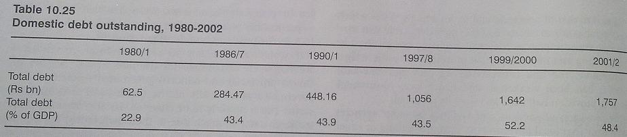
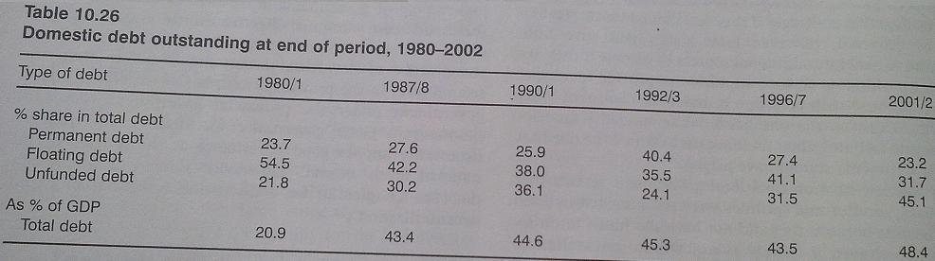
Notes:
Keynes posited that in good economic times, the government should run a budget surplus and pay off the deficits that were run up in bad economic times. This part of Keynes’s prescription was never incorporated into Keynesian theory.

Slide 32
