Slide 1
Public Finance
(MPA405)
Dr. Khurrum S. Mughal

Slide 2
Public Finance I: Resource Mobilization and the Structure of Taxation

Slide 3
Overall Evaluation of the Intergovernmental Transfer System
The intergovernmental transfer arrangements in Pakistan, which include shared taxes based on population, straight transfers based on collection origin and various grants, have been criticized by experts for several reasons.
The straight transfers component (12% of total transfer revenue) returns selected resources revenues (oil, gas excise and royalties, and hydroelectric profits) to the point of collection.
These arrangements are criticized for having no particular economic justifications.

Slide 4
Cont…
On the other hand, they do benefit the smaller and less wealthy provinces, but this creates some major resentment.
Large, wealthy provinces are now seeking similar resources treatment for their agricultural commodities.
However, given the distribution of natural resources and current political environment, it may be advisable to continue with the present system of straight transfers as they provide some resources to backward provinces.

Slide 5
Fiscal Issues under the new District Government System
With current Govt. system, imposition of a new tax by a local government, without any corresponding levy by other similar governments, can make mobile taxed resources move out of the taxed jurisdiction to other locations.
This discriminates against the more backward jurisdictions, where the revenue needs are highest, but where, due lack of infrastructure and other amenities, economic activities are already limited.

Slide 6
Cont…
Local Govt. employed a variety of new revenue measures to meet their expenditure needs, with no consideration given to the viability, efficacy or sustainability of these measures.
For example:
A tehsil in Khairpur district decide to use its development funds to establish public real estate, which could yield a future stream of rental income for the TMA.

Slide 7
Public Finance: The Basic Facts
Main source of revenue has historically been from customs duties, i.e. taxation on trade.
With high tariff barriers and imports substituting industrialization, this is a logical outcome.
Taxes from imports were, until recently, the main source of revenue for the exchequer.

Slide 8
Cont…
Despite the impressive industrialization and dynamic economic growth that took place in the 1960s, the contribution of income and corporate taxes actually declined as a percentage of total revenue receipts for United Pakistan (Pakistan + Bangladesh).
On expenditure side, Pakistan was with more than half of the total expenditure being spent on defense from 1947 to at least 1970/1.
In 1970/1, 53 % of total expenditure was on defense.

Slide 9
Cont…
In 1962/3, for example, of the total resources available to spend in Pakistan, as much as 73 % were external funds; in 1966/7, this was 74 %.

Slide 10
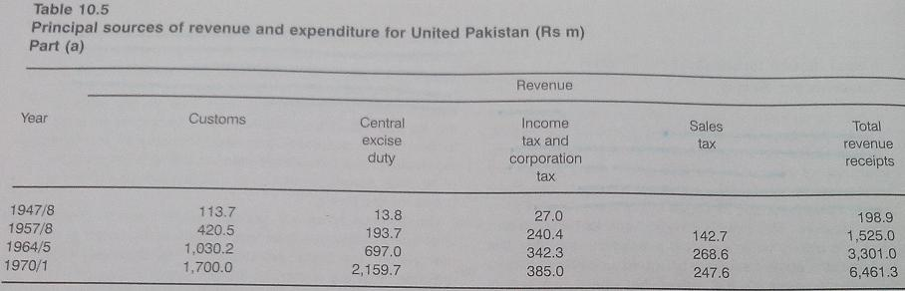

Slide 11
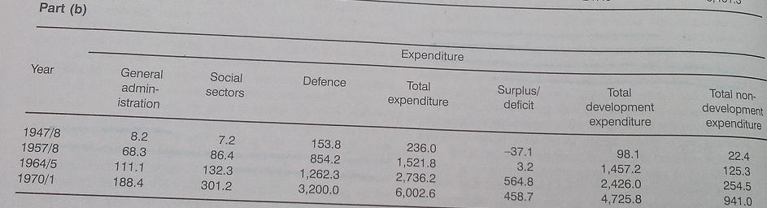

Slide 12
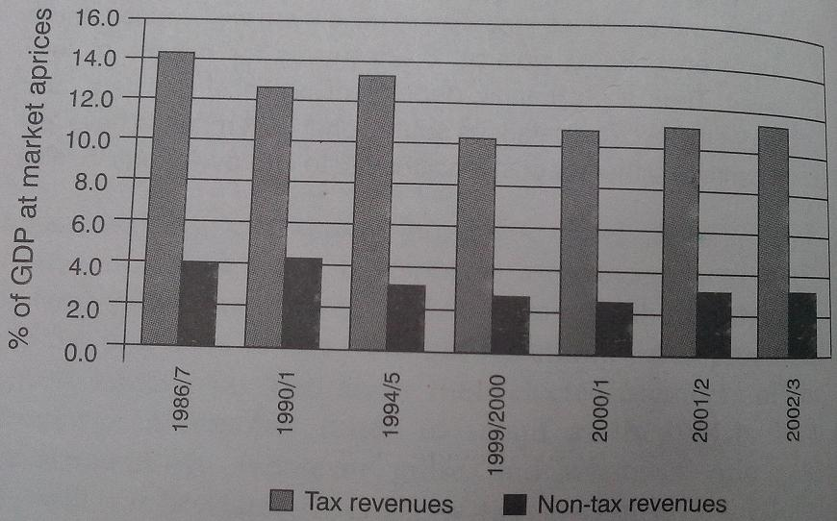

Slide 13
Cont…
Pakistan’s economy was highly dependent on aid and that much of the industrialization boom of the decade of development was foreign funded.
The interesting fact is that even after 16 years of structural reforms, very little has changed, and in fact, in the case of tax revenues as a per cent of GDP, there is much deterioration, presented in next table 10.6.
Tables 10.7 and 10.8 then break down the revenue and expenditure statements of the Govt. in greater detail.

Slide 14
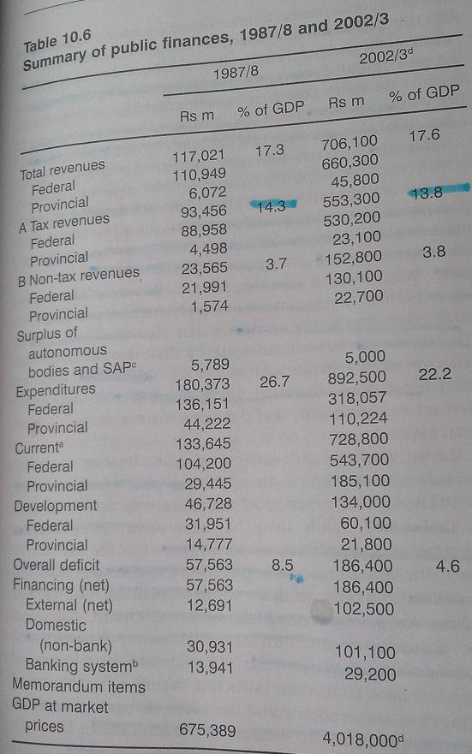

Slide 15
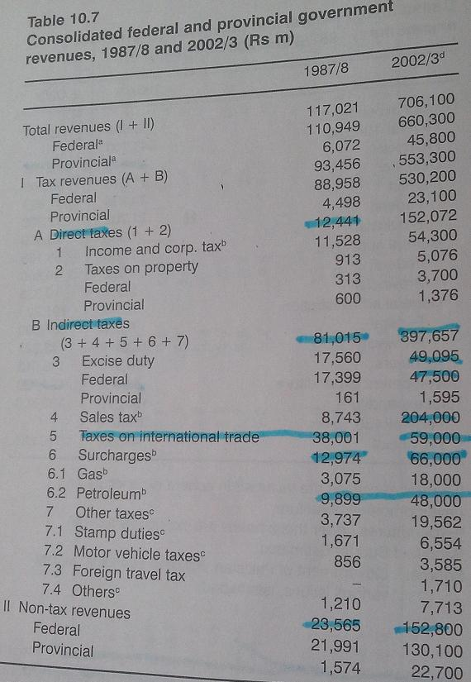

Slide 16
Cont…
In table 10.7, revenue from taxation is far greater than that from non-tax revenue, and that indirect taxes are many times as large as direct taxes.
In indirect tax category, import duties used to dominate by far, and provided the largest source of income to the Govt.
This has all changed and has been one of the most significant changes in Pakistan’s economy as a result of lowering tariffs and overall reforms.

Slide 17
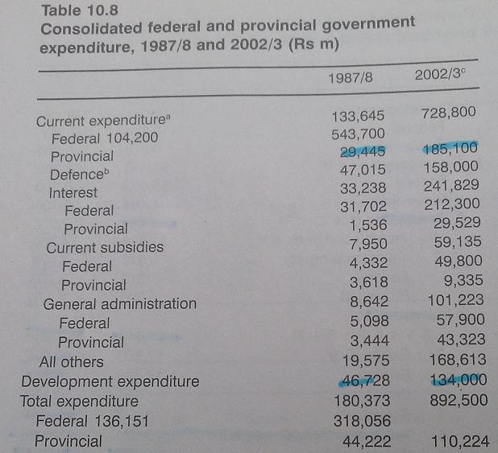

Slide 18
Cont…
Data for 2002/3 also show that defense and interest payments accounts for more than half of all Govt. expenditures.
This issue is the key importance to the economy and politics.
Development expenditure is far less than current or non-development expenditure, and in 2002/3 was less than 19% of total provincial and federal current expenditures.

Slide 19
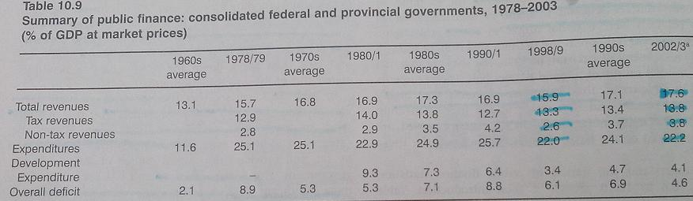

Slide 20
Cont…
Table 10.9, shows that total revenue has not grown substantially over the last decade and range around 17 or 18 % of the GDP.
Tax revenue is only around 13 % and is cause for serious concern.

Slide 21
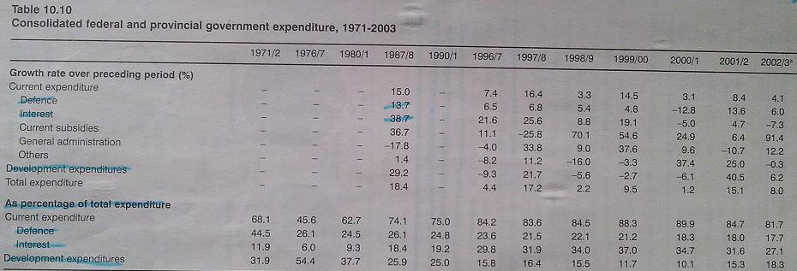

Slide 22
Cont…
Table 10.10, shows how Govt. expenditures have grown over a time and the extent of allocation to different expenditure heads.
Defense and interest payments have shown only positive, at times dramatic, increases over the previous year.
Development expenditure have been cut, by equal dramatic amounts, in some years.

Slide 23
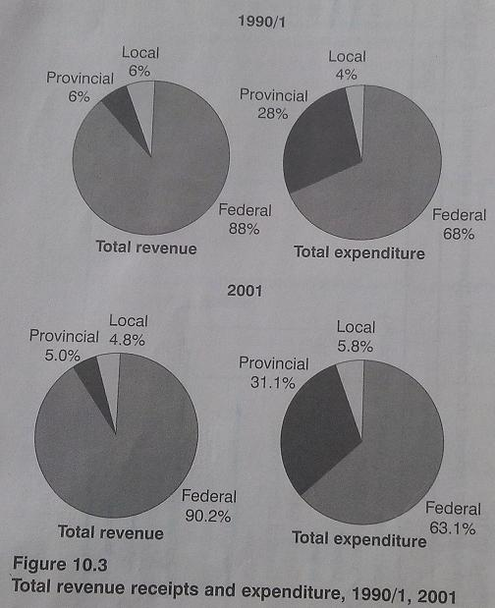

Slide 24
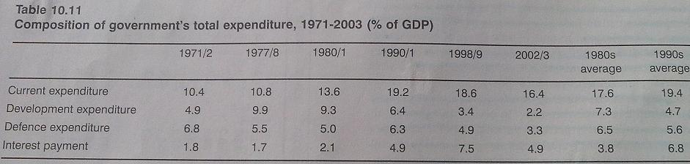

Slide 25
Cont…
Table 10.11, looks at these expenditure figures as a proportion of GDP, and shows that interest payments and defense consume almost half of the total expenditures.
Know we will examine some of key public finance ratios in Pakistan over a period of about thirty years as shown in table 10.12.
Table 10.13 to 10.20 are presented in next slides.

Slide 26
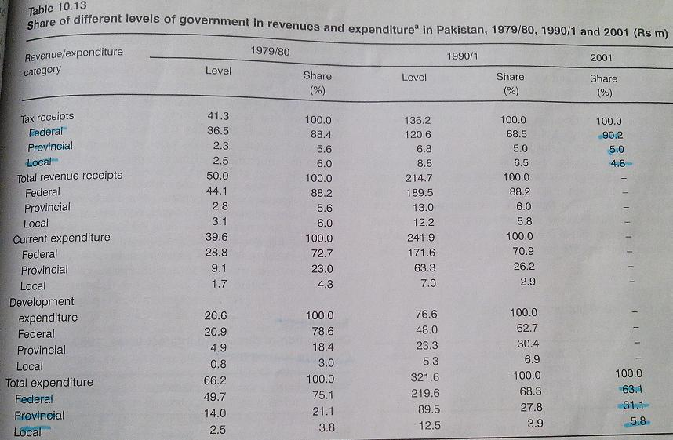

Slide 27
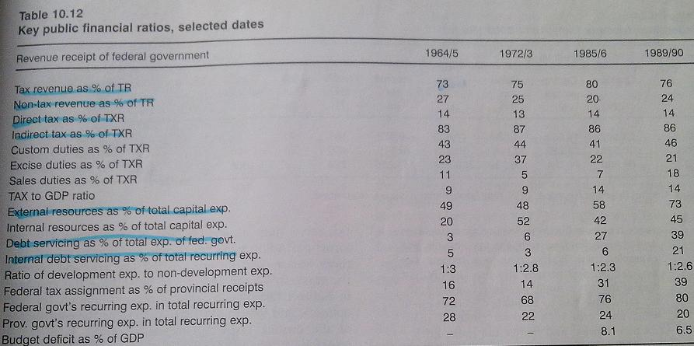

Slide 28
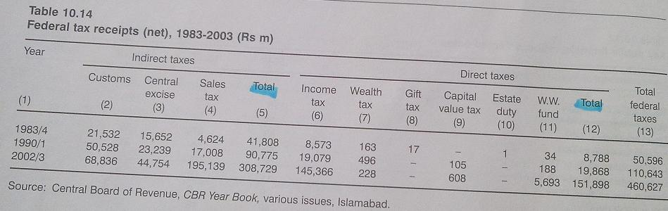

Slide 29
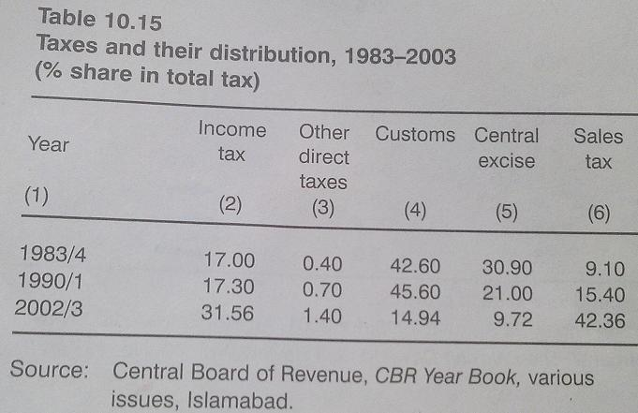

Slide 30
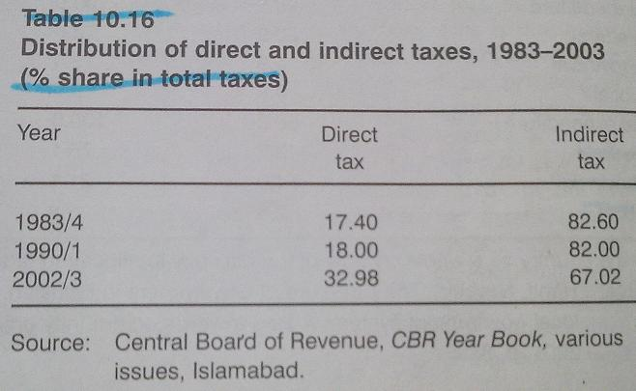

Slide 31
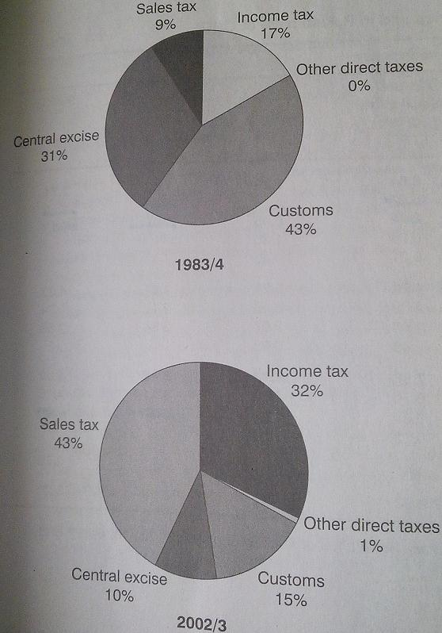

Slide 32
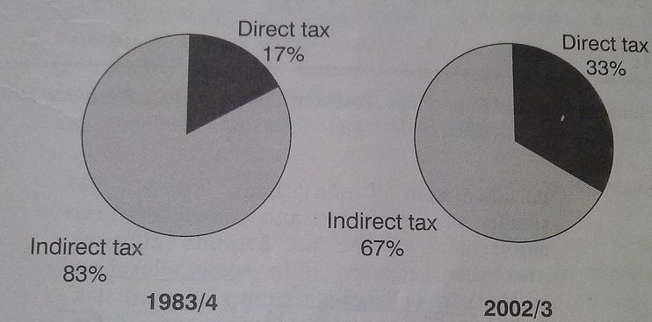

Slide 33
