Slide 1
Public Finance
(MPA405)
Dr. Khurrum S. Mughal

Slide 2
Public Finance I: Resource Mobilization and the Structure of Taxation

Slide 3
General Musharaf’s Govt. introduced local Govt. plan since in 2000 and more specially Provincial Govt. Ordinance 2001 were promulgated under which local Govt. elections were held across Pakistan.
All military Govt’s. established their own form of local Govt.
Ayub Khan | Basic Democracies
Zia Ul Haq | Local Bodies
Pervez Musharraf | District Governments

Slide 4
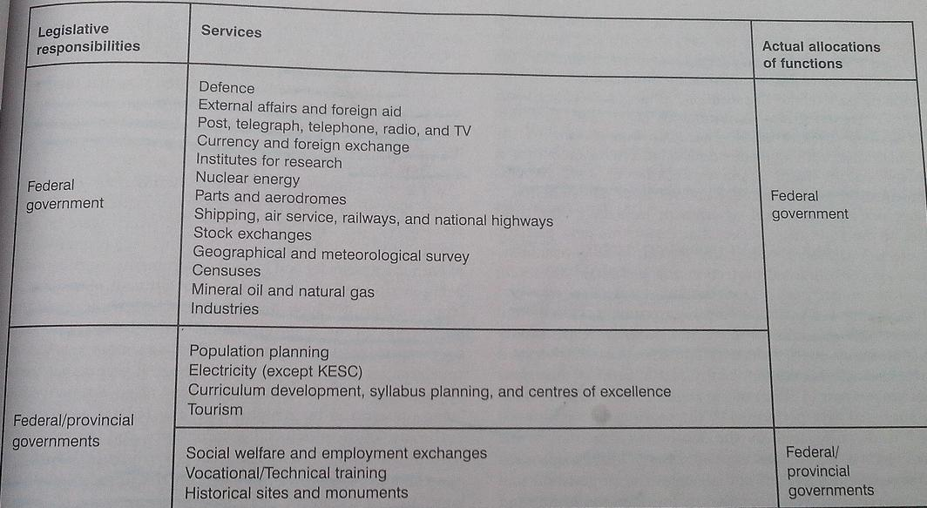
Structure of Govt. and Taxation
Federation of Pakistan is governed by constitution of 1973 all its amendments.

Slide 5
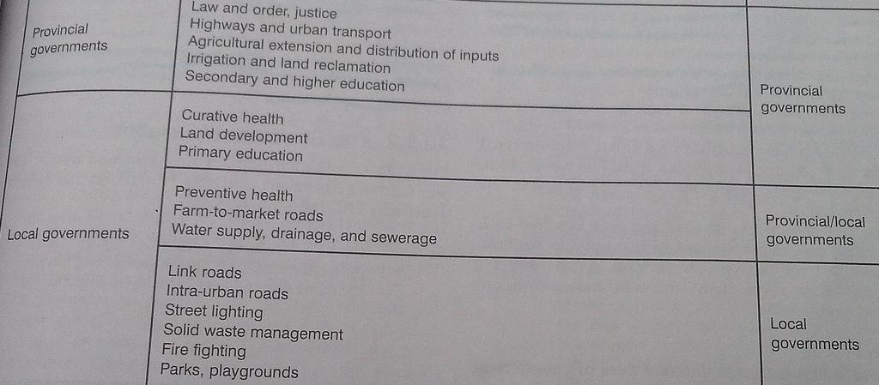
Cont…

Slide 6
Cont…
Article 140A states: ‘Each Province shall, by Law, establish a local Govt. system and devolve political, administrative and financial responsibility and authority to the elected representatives of the local governments’- LFO 2002.

Slide 7
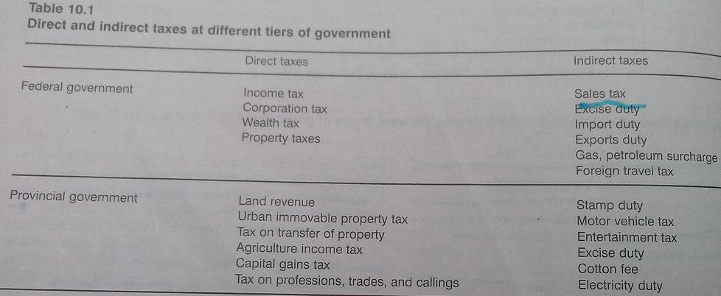
Structure of Taxation
The 1973 constitution outlines the taxes and duties that Federal Govt. can collect based on the Federal Legislative List. These are as follows:

Slide 8
Cont…
Separate fiscal powers have been specified for local councils.
But!
Provincial Govt. has the overriding power to direct any local council within the province either to levy any tax or to increase or reduce or to suspend or abolish the levy of any such tax.

Slide 9
Inter Govt. Fiscal Relations
1. Provincial and Local Governments
Before the implementation of District Govt. system in 2001, Local Govt’s were extensions of Provincial Govt. and the former acted on behalf of the later.
Therefore, there was a great deal of overlap between these tiers of Govt.

Slide 10
Cont…
Provincial Govt. received revenue from the Federal Govt. on the basis of population and the local Govt. received revenue on the basis of collection.
The tendency of Provincial Govt. to ride on the back of the Local Govt. is a unique feature of the public finance structure of Pakistan.

Slide 11
Cont…
2. Federal and Provincial Governments
Federal Govt. is required to transfer revenues from taxes, as may be specified from time to time, to the provincial Govt’s.
Taxes to be included in the divisible pool and the share to be given to each province is determined various awards/commission.

Slide 12
Cont…
National Finance Commission (NFC) is a body constituted by President of Pakistan which is meant to divide the revenue-sharing formula for the divisible pool, from Federal to Provincial Govt’s.
NFC is supposed to announced an award every 5 years.

Slide 13
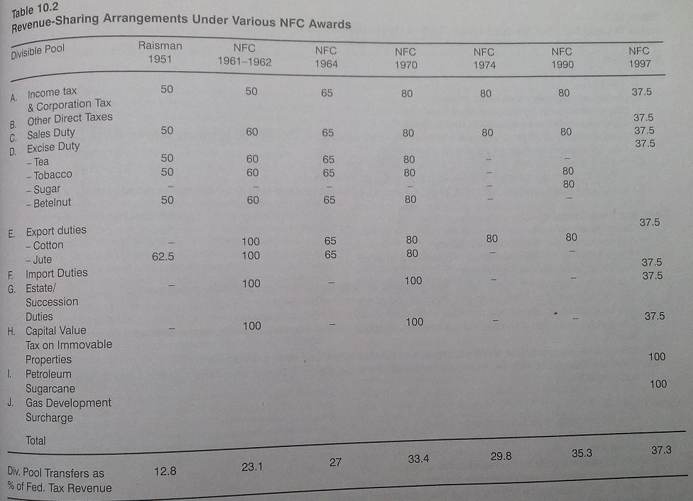

Slide 14
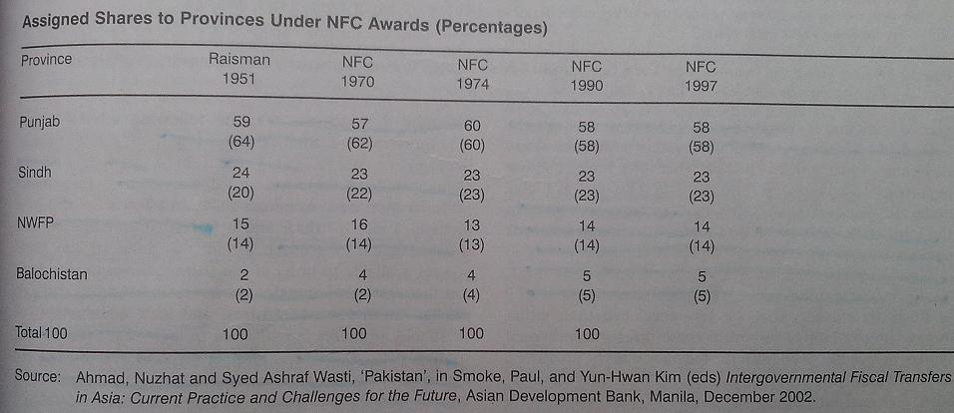

Slide 15
Cont…
Important difference between Provincial and Local Govt’s. is that Provincial Govt’s. have resource to interest-bearing loans from the Federal Govt., which Local Govt. do not.

Slide 16
The District Govt. System: Fiscal Issues
Under the financial and fiscal powers available to units of the District Govt., there is a formula based transfer system to the districts through the Provincial Finance Awards, and local Govt’s. of all shapes and sizes.

Slide 17
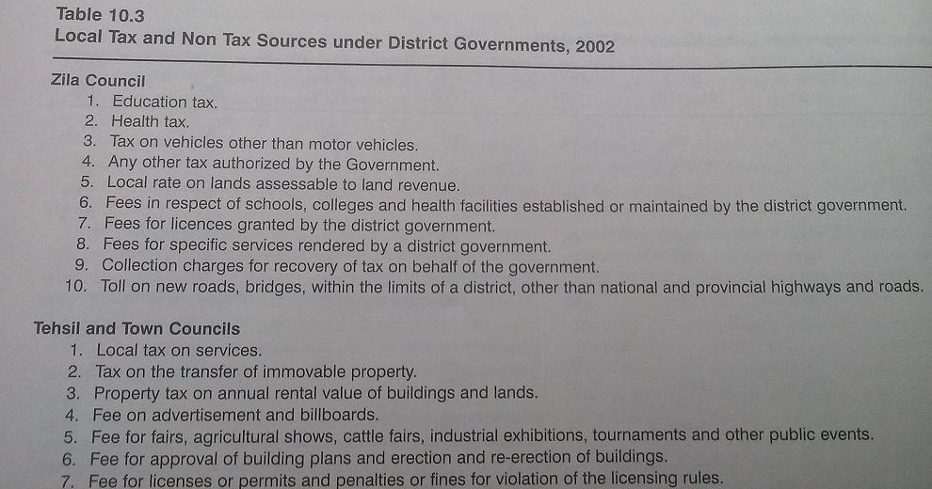

Slide 18
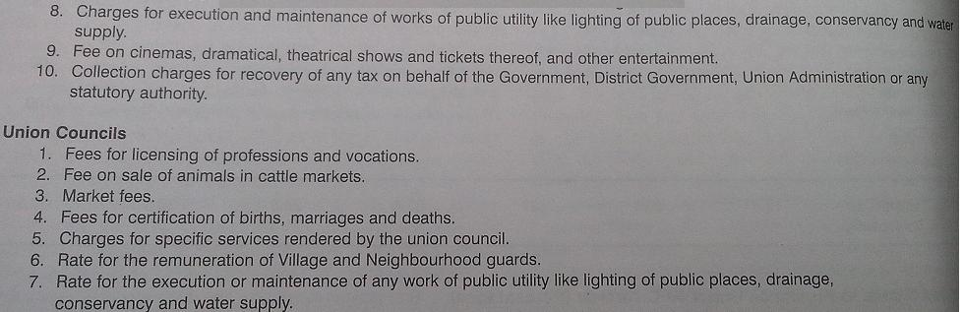
Cont…

Slide 19
