Slide 1
Public Finance
(MPA405)
Dr. Khurrum S. Mughal

Slide 2
Lecture 15: Government Subsidies and Income Support for the Poor
Public Finance

Slide 3
Poverty
It breeds crime and social unrest
Can the charitable institutions be trusted?
  Not sustainable
  What about recessions
Welfare Trap

Slide 4
USA Poverty in 1998
34.5 million
13% of the population classified as poor

Slide 5
Poverty in the United States
Poverty threshold or poverty line in 1999
Family Structure
Threshold
Single
$8,667
One Adult-Two Children
$13,410
Two Adults-Two Children
$16,600

Slide 6
Poverty line
The Poverty Line was originally created by the Social Security Administration as three times the cost of a nutritionally adequate diet
It is updated annually for inflation using the CPI

Slide 7
Poverty Rate 1960-1998
Numbers in millions, rates in percent
Recession
45
40
35
Number in poverty
32.3 million
30
25
20
15
10
Poverty rate
11.8 percent
5
0
1959
1964
1969
1974
1979
1984
1989
1994
1999
Note: The data points represent the midpoints of the respective years.
The latest recession began in July 1990 and ended in March 1991.
Source: U.S. Census Bureau, Current Population Survey, March 1960-2000.

Slide 8
Changing the Poverty Line
A new definition proposed during the Clinton Administration would have included child care and other expenses and would raise the threshold to almost $20,000.

Slide 9
Why We Have Government Programs to Aid the Poor
Market outcomes may result in earnings less that minimum required.
  Considered unacceptable by many citizens
  Support for Safety net
Disagreement on minimum requirement for survival
Policies that would consider would require equity in distribution.
  Belief that reward according to ability

Slide 10
Why We Have Government Programs to Aid the Poor
Earning according to work but provide minimal support
  Coupled with equal opportunities in the labor markets
We are concerned about Equity-Efficiency Trade-Offs.
Pragmatic approach:
  Needs to alter income distribution for Poverty Alleviation
  Effect on efficiency

Slide 11
Why We Have Government Programs to Aid the Poor
If net benefits from resource use is less, ultimately everyone would be worst off (Size of the pie should not decrease)
  Losses in efficiency reduces the economy’s potential for jobs and more production
Increased efficiency increases Job creation
  Question: How many people are poor just because they cannot work?

Slide 12
Why We Have Government Programs to Aid the Poor
It creates the Positive Externality of Social Stability.
Many citizens support because benefits emerge that can be collectively enjoyed
  Safety nets can help
Out of genuine compassion
  Feels satisfaction
Poverty breeds unrest

Slide 13
Why We Have Government Programs to Aid the Poor
Government vs Charity
Programs as Public Good
  Not enough resources with private sector
  Free Rider Problem
Uniform standards of distribution
  Might not be fair but the cost has to be borne

Slide 14
Entitlement Programs
Government programs that guarantee recipients benefits as long as they meet eligibility tests.
Status Tests are typically disability, children, and age criteria that must be met to be eligible for a program.
  Reformed system – find job and get training
  Limited time period
Means Tests are typically income and wealth criteria that must be met to be eligible for a program.

Slide 15
Cash Programs
TANF: Temporary Aid to Needy Families
  The program most identified with a welfare check. Also may provide for child-care expenses or job retraining.
SSI: Supplemental Security Income
  The program that provides a cash payment to the widowed, orphaned and disabled.
EITC: Earned Income Tax Credit
  A program that increases the take-home pay of the working poor. As much as $3888 in 2000 for a family with two children.

Slide 16
In-Kind Programs
Food Stamps are vouchers that enable a broad class of the poor to purchase a wide variety of food products.
WIC vouchers enable poor pregnant and post-natal women to purchase a narrow variety of food products.
Medicaid is a federal and state funded program that provides health care services to the poor.
The Children’s Health Insurance Program is a federal program that subsidizes health insurance coverage for the working poor.

Slide 17
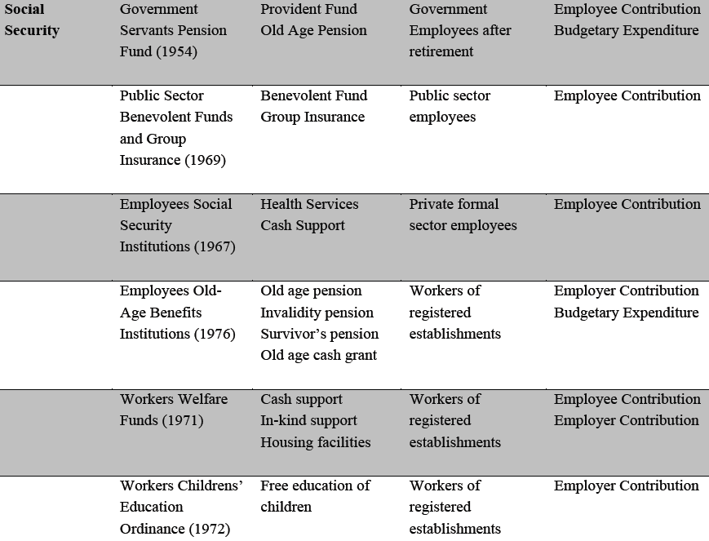
Welfare Programs in Pakistan

Slide 18
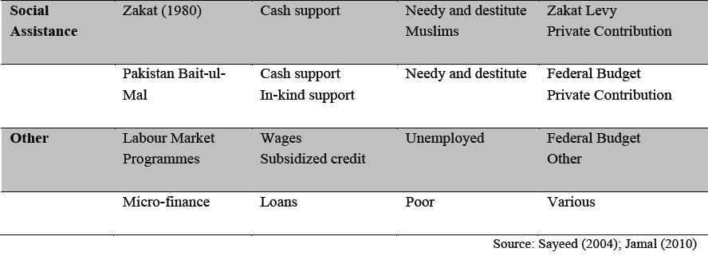
Welfare Programs in Pakistan

