Slide 1
Public Finance
(MPA405)
Dr. Khurrum S. Mughal

Slide 2
Lecture 13: Cost-Benefit Analysis and Government Investments
Public Finance

Slide 3
Cost-Benefit Analysis
Three main steps:
  Enumerate all costs and benefits of a proposed project
  Evaluate all costs and benefits in dollar terms
  Discount future net benefits

Slide 4
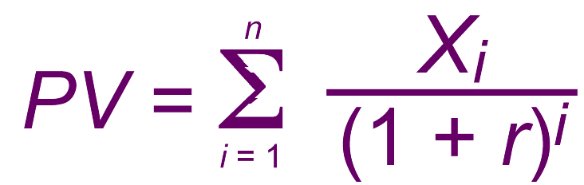
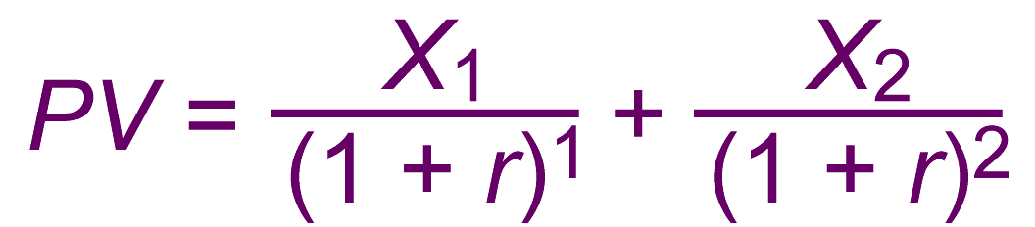
Discounting Payment Streams

Slide 5
Illustrating the Effect of Interest Rate Changes on Present Value
Project 1 yields $90 in net benefits immediately.
Project 2 yields $100 two years from now.
Results
  At 0% interest $100 two years from now is worth $100 so project 2 is better than project 1.
  At 5% interest $100 two years from now is worth $90.7 so project 2 is better than project 1.
  At 10% interest $100 two years from now is worth $82.6 so project 1 is better than project 2.

Slide 6
Illustrating the Effect of Interest Rate Changes on Present Value
Lower discount rate tends to favor future returns
Higher discount rate favors current returns
  Higher discount rate represents higher opportunity cost of Government Investment

Slide 7
Choosing the Social Rate of Discount
Social Discount Rate represents the return earned when resources are employed in alternate private use
  No misallocation of resources
If the private sector interest rate is r then the social rate of discount must be at least that because of the distortions in the market caused by government taxation.
The rate must also account for the taxation on investment returns.

Slide 8
Figure 6.2 A Tax on Investment Income and the Social Opportunity Cost of Capital
S
20 = r_{G}
E
16
Return (Percent)
D = Gross Return
I = 10 = r_{N}
E’
D’ = Net Return After Taxes
Funds Invested and Saved per Year

Slide 9
Choosing the Social Rate of Discount
If the Government Project displaces investment
  20%
If the government project displaces consumption
  10%
Techniques is to ascertain the kind of private activities being displaced
  Use average of all the rates

Slide 10
Weighting Net Benefits
It also matters who gets the benefits and who pays the costs.
Benefits accruing to and cost borne by various classes of income
  Or geographical location
Formal weighing might confuse efficiency with distribution

Slide 11
Treatment of Inflation
If all dollar figures are nominal then interest rates must be nominal and account for inflation. Alternatively, all accounting can be done with real dollars and real interest rates.

Slide 12
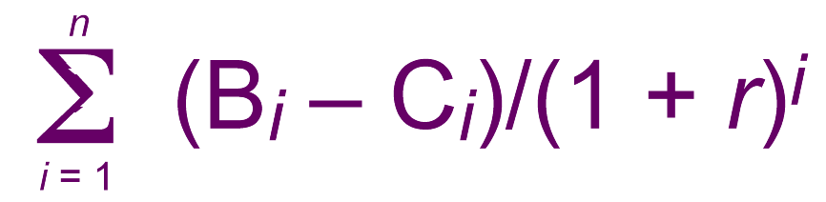
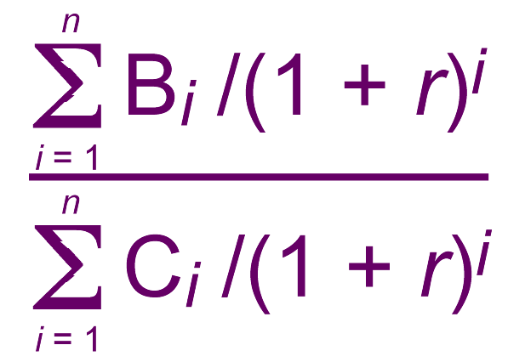
Ranking Projects
Net Benefit Criterion: Rank according to the highest net benefits
Benefit-Cost Ratio Criterion: Rank according to the highest ratio

Slide 13
Figure 6.3 Cost-Benefit Analysis and Efficiency
Net Social Gain
from ΔQ₁
MSC
A
B
G
Marginal Social Cost and Benefit
F
Net Social Loss
E
from Δ
Q₂
C
D
J
H
MSB
ΔQ₁
ΔQ₂
0
Q₁
Q₂
Q*
Q₃
Q₄
Miles of Highway per Year

Slide 14
Cost-Benefit Analysis in Practice
Infrastructure Analysis
Roads
Bridges
Dams
Levies

Slide 15
Government Infrastructure Investment in LDC’s
LDC’s have invested considerable sums in agricultural infrastructure because of a 17% estimated project rate of return.
Projects (such as the creation of large water reservoirs) typically displace locals and these costs must also be accounted for.
Projects have been shown to help the poor by adding substantially to their ability to produce crops for sale.

