Slide 1
Public Policy Analysis
MPA 404 Lecture 4

Slide 2
Brief Summary of previous Lecture
Article on Iran-Pakistan gas pipeline
Discussed in brief the models of Public policy
We discussed four models in a bit of detail, namely Institutionalism, Process, Rationalism and Incrementalism

Slide 3
Group Theory
About groups that seek to maximize their gain. But in maximizing their gain, they trample upon the rights of other people and leave them more miserable.
These groups are domestic as well as international. Their concentration is usually on large scale projects, where there is quiet a substantial profit margin to be had.
They seek out direct relations with power brokers or those who have the power to affect the course of things. These relations are normally based on the principle of financial profit sharing, or some future benefit.
Some examples of internal and external pressure groups:
a) The exporter lobby
b) The landed lobby
c) The price support lobby
d) The oil company lobby

Slide 4
Elite Theory
Remember what we discussed about a policy being demand oriented. In other words, there is a demand for specific action by the people which resultantly leads to a policy.
But in reality some policies are specifically designed to benefit a certain group of individuals, known as the elite. In other words, policies are not designed from the perspective of ordinary people but from the needs of elite people.
A relevant question: Why do elite need policies for themselves only? Financial motive aside, its a lot about maintaining the status quo and preserving their own culture. Thus, its evolutionary in nature.
Elites are not all alike, but they share similarities.
Some examples:
a) Haliburton group in USA
b) Major party heads in Pakistan
c) Switzerland’s Davos forum of business

Slide 5
Public Choice Theory
More about self-interested individuals.
They can make decisions collectively or alone depending upon the situation and opportunity to make personal gains.
More to do with economics, where it is now taught as a sub-fields and has vast applications.
The self-interested individual who benefits the society > this thought goes back to Adam Smith. He stated that when individuals pursue their own self-interest, it ends up helping the society. He gave the example of a butcher, who sells meat not out of intuition or a charity motive but out of self interest. He knows there is demand for meat, and he sells meat to fulfill the demand. So people get meat, and he gets money in return. Thus there is general satisfaction.
Where things differ from public policy theory is that its not necessarily demand that participants fulfill, but rather their own motives that have nothing to do with demand of the populace.

Slide 6
A lot of the public choice theory is about the government and its people that find certain opportunities to pursue their self-interest.
We have discussed before that a government has the legitimacy to do certain stuff (like raising revenues through taxes), and that its presence also owes to private sector limitations.
When government gets involved, you can bet there will be opportunities. This is where the public officials find opportunities to curry a favor for their own self-interest. For example, government gives billions of rupees in subsidies every year. For those who have the power to release money, this is a good chance to gain a favor.
Read ‘Contractors Reap $138 billion from Iraq War’ @http://leaksource.info/2013/04/08/contractors-reap-138-billion-from-iraq-war-cheneys-halliburton-1-with-39-5-billion/

Slide 7
Game Theory
Oscar Morgensten and Jon Von Neuman came up with strategy for games at the time of Second World War. Later it developed into a whole field known as the Game Theory.
It is used in many circumstances and in various fields. For example, it is used in conflict studies, diplomatic studies, economics and such sciences where there is more than one player and they are strategizing for a better outcome.
In economics, it forms a part of study of duopoly, a situation where two or more firms/organizations/setups are dominant and have a monopoly.
The participants of the game are dubbed ‘players’. The players of the game are busy in forming a strategy against their opponent, and constantly changing it in lieu of the changes made by opponents. Thus, the situation in the games do not remain constant. Until all the players have reached a set decision, it continues on.
There are various forms of games, and different games apply to different circumstances.

Slide 8
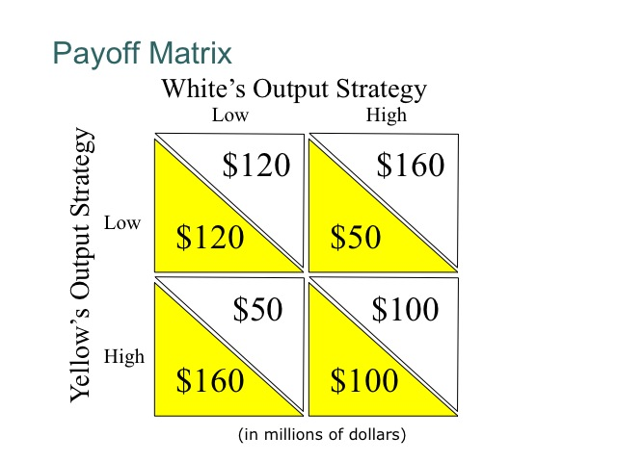
Consider a specific form of the game, called game of ‘brinksmanship’. This kind of game is usually relevant to international or diplomatic relation, saber rattling between nations and where there is a probability of conflict.
Prime example: The Cuban Missile Crisis (1962)
What does a typical game situation look like?

