Slide 1

The Consumer Audience
(Continued)
Lecture 8

Slide 2
Recap
Chapter Key Points
How Does Consumer Behavior Work?
Cultural and Social Influences on Consumer Decisions

Slide 3
Chapter Outline
Chapter Key Points
How Does Consumer Behavior Work?
Cultural and Social Influences on Consumer Decisions
Psychological Influences that Motivate Consumers
Behavioral Influences on Consumer Decisions
The Consumer Decision Process
Segmenting and Targeting

Slide 4
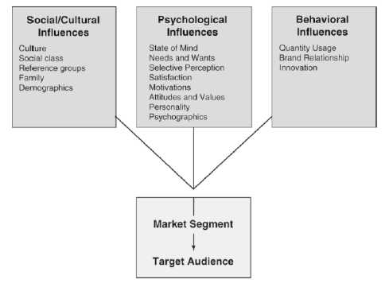
Influences on Consumer Decision Making

Slide 5
Psychological Influences
Perception/State of Mind
Affects how people perceive information as well as determines the particular pattern of consumer behavior
Mental states such as anger, hunger, fatigue, excitement, etc. affect our behavior.

Slide 6
Psychological Influences
Needs and Wants
Include primary and secondary needs.

Slide 7




Slide 8
Play…
Drink Milk - lustige Werbung
Survival of the Fittest Pterodactyls
Olpers Ramadan 2010 TVC

Slide 9

Psychological Influences
Selective Perception
- Selective exposure
- Selective distortion
- Selective retention

Slide 10



Slide 11


Psychological Influences
Satisfaction
- Cognitive Dissonance

Slide 12
Psychological Influences
Motivations
Internal forces that stimulate people to behave in a particular manner
Produced by the tension caused by an unfulfilled need

Slide 13



Slide 14

Psychological Influences
Attitudes and Values
Attitudes impact motivations
Influence how consumers evaluate products, institutions, retail stores, and advertising

Slide 15
Psychological Influences
Personality
Distinctive characteristics that make people or brands individual
Brand personalities make them distinctive from their competitors

Slide 16



Slide 17
Psychological Influences
Psychographic Influences
Lifestyle and psychological characteristics that have a bearing on how people make decisions
Psychographics
Lifestyles
  Looks at the ways people allocate time, energy, and money
The VALS system
  Lifestyle profiles that collectively reflect a whole culture
Trends

Slide 18
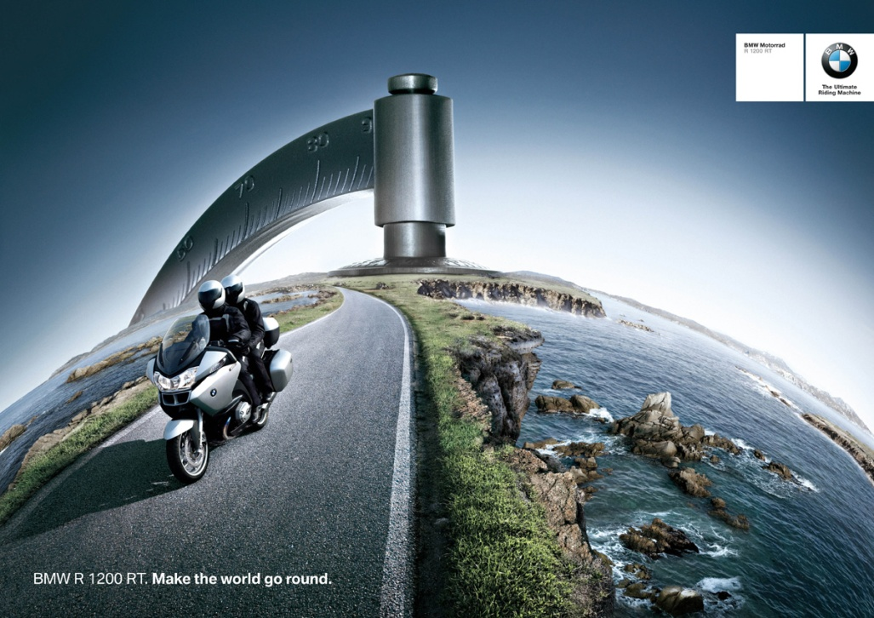
Psychological Influences
Life Style
- Ways people allocate time, energy and money.

Slide 19
Play…
Ford Flex Family Car Commercial
Bear Grylls Nissan X-TRAIL Commercial

Slide 20
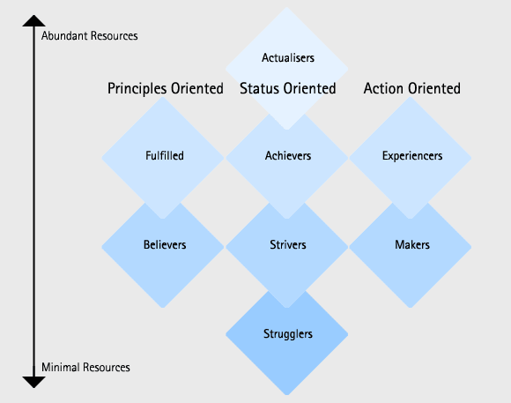
Psychological Influences
VALs System

Slide 21
Influences on Consumer Decision Making

Slide 22

Behavioral Influences
Usage behavior
  How much of a product category or brand customers buy
  Usage rate and Brand relationship

Slide 23
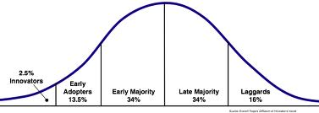
Behavioral Influences
Innovation and adoption
  How willing people are to be innovative and try something new

Slide 24

The Consumer Decision Process
Need recognition
Information search
Evaluation of alternatives
Purchase decision
Postpurchase evaluation
The consumer recognizes the need for a product
Advertising should activate or stimulate this need

Slide 25
The Consumer Decision Process
Need recognition
Information search
Evaluation of alternatives
Purchase decision
Postpurchase evaluation
Can be casual or formal
Advertising helps the search process by providing information and making it easy to find, as well as remember

Slide 26
The Consumer Decision Process
Need recognition
Information search
Evaluation of alternatives
Purchase decision
Postpurchase evaluation
Consumers compare various products and reduce the list of options
Advertising helps sort out products on the basis of tangible and intangible features

Slide 27
The Consumer Decision Process
Need recognition
Information search
Evaluation of alternatives
Purchase decision
Postpurchase evaluation
Often a two-part decision
  Select the brand
  Select the outlet from which to purchase
In-store promotions affect these choices

Slide 28
The Consumer Decision Process
Need recognition
Information search
Evaluation of alternatives
Purchase decision
Postpurchase evaluation
The customer reconsiders and justifies the purchase
Determines whether the customer will keep the product, return it, or refuse to buy the product again

Slide 29
Segmenting and Targeting
Segmenting
  Dividing the market into groups of people who have similar characteristics in certain key product-related areas
Targeting
  Identifying the group that might be the most profitable audience

Slide 30
Segmenting and Targeting
Market aggregation strategy
  When planners purposefully use one marketing strategy that will appeal to as many audiences as possible
Market segmentation
  Assumes that the best way to sell is to recognize differences within the broad market and adjust strategies and messages accordingly

Slide 31
Segmenting and Targeting
Types of segmentation
  Demographic segmentation
  Geographic segmentation
  Psychographic segmentation
  Behavioral segmentation
  Benefits segmentation
Sociodemographic segments
Niche markets
  Defined by some distinctive trait

Slide 32
Segmenting and Targeting
Targeting the right audience
  The target is described using the variables that separate this prospective consumer group from others who are not in the market
Profiling the target audience
  Describing the target audience as if they are people you know
  Used in developing media and message decisions

Slide 33
Summary
Psychological Influences that Motivate Consumers
Behavioral Influences on Consumer Decisions
The Consumer Decision Process
Segmenting and Targeting

Slide 34
References
Wells, W., Burnett, J. and Moriarty, S. (2006), Advertising Principles and Practice, Prentice-Hall, New Delhi, ND.

