Slide 1
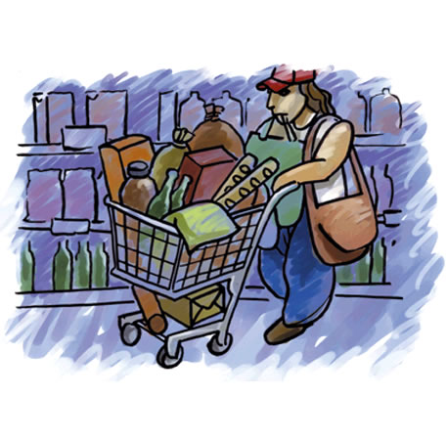
The Consumer Audience
Lecture 7

Slide 2
Recap
Cognition
The Affective or Emotional Response
Association
Persuasion
Behavior

Slide 3
Chapter Outline
Chapter Key Points
How Does Consumer Behavior Work?
Cultural and Social Influences on Consumer Decisions
Psychological Influences that Motivate Consumers
Behavioral Influences on Consumer Decisions
The Consumer Decision Process
Segmenting and Targeting

Slide 4
Key Points
Assess cultural and social influences on consumer responses
Demonstrate how psychological influences motivate customers
Explain the behavioral characteristics that describe consumer responses
Describe how the consumer decision process works
Differentiate between segmenting and targeting and trace these tools to their sources

Slide 5

How Does Consumer Behavior Work?
Consumer behavior
  Describes how individuals or groups select, purchase, use, or dispose of products – as well as describing the needs that motivate these behaviors
Consumer audience
  People who buy or use products to satisfy their needs and wants
Customers
  People who buy a particular brand or patronize a specific store

Slide 6
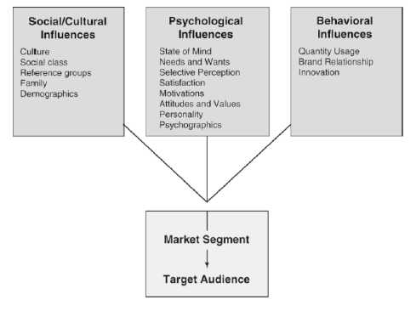
Influences on Consumer Decision Making

Slide 7
Social and Cultural Influences
Culture
Tangible items and intangible concepts that together define a group of people or a way of life
  Norm: rules that are learnt through social interaction that specify and prohibit certain behaviour.
  Values: represent our belief system.
  Subcultures

Slide 8





Slide 9
Play…
Haleeb Ahtaram-e-Ramadan Ad

Slide 10
Social and Cultural Influences
Social Class
The position a person and his/her family hold within society

Slide 11
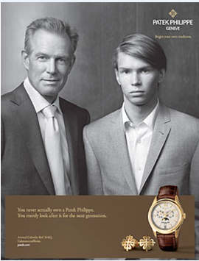
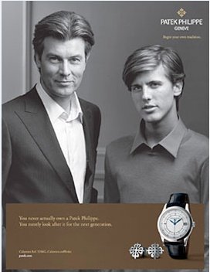

Slide 12
Play…
Unbreakable by Toyota Hilux

Slide 13
Social and Cultural Influences
Reference Groups
A group of people who are used as a guide for behavior in specific situations
  Inner directed vs outer directed
Functions: Provide information, means of comparison, and offer guidance.

Slide 14



Slide 15
Play…
The World of Rolex

Slide 16

Social and Cultural Influences
Family
Two or more people who are related by blood, marriage, or adoption and live in the same household

Slide 17
Social and Cultural Influences
Demographics
The statistical, personal, social, and economic characteristics that describe a population
Characteristics
Age
Gender
Race and ethnicity
Education
Occupation
Income
Geography

Slide 18

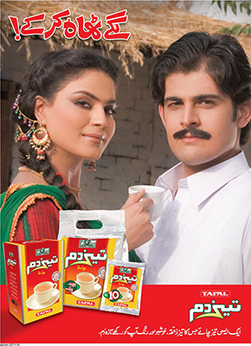



Slide 19
Play…
Expensive by TMF From Daily Videos

Slide 20
Summary
Chapter Key Points
How Does Consumer Behavior Work?
Cultural and Social Influences on Consumer Decisions

