Slide 1
How Advertising Works
(Continued)
Lecture 6

Slide 2
Recap
How Advertising Works as Communication
The Effects Behind Advertising Effectiveness
Perception

Slide 3
Chapter Outline
Chapter Key Points
How Advertising Works as Communication
The Effects Behind Advertising Effectiveness
Perception
Cognition
The Affective or Emotional Response
Association
Persuasion
Behavior

Slide 4
Cognition
How consumers respond to information, learn, and understand something
Needs
The cognitive impact of an advertising message
A cognitive ad explains how a product works and what it can do for the consumer

Slide 5
Cognition
Information
Facts about product performance and features
Particularly important for products that are complex, have a high price, or are high risk
Cognitive Learning
When a presentation of facts, information, and explanations leads to understanding
Used by consumers who want to learn everything about a product before they buy it

Slide 6
Cognition
Differentiation
Occurs when consumers understand the explanation of a competitive advantage
A consumer has to understand the features of a brand and be able to compare competing products
Recall
When the consumer remembers seeing the advertisements and remembers the copy points
Ads use jingles, slogans, catchy headlines, intriguing visuals, and key visuals

Slide 7



Slide 8
Play…
Cognition

Slide 9
The Affective or Emotional Response
Mirrors a person’s feelings about something
  Stimulates wants
  Touches the emotions
  Creates feelings
Wants
Influenced more by emotion or desire
Desire is based on wishes, longings, and cravings
Emotions
Agitates passions or feelings

Slide 10
The Affective or Emotional Response
Liking
Liking a brand or ad is one of the best predictors of consumer behavior
If a consumer likes the ad, the positive feeling will transfer to the brand
Resonance
Help the consumer identify with the brand on a personal level
Stronger than liking because it involves an element of self-identification

Slide 11

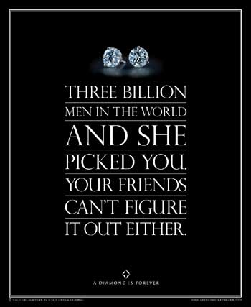

Slide 12
Play…
Rue Faubourg Coco by Chanel Vanessa Paradis Ad Jean Paul Goude Commercial

Slide 13
Association
The process of making symbolic connections between a brand and characteristics that represent the brand’s image and personality
Symbolism
The brand stands for a certain quality
A bond or relationship is created based on these meanings
Conditioned Learning
The way association implants an idea in a consumer’s mind

Slide 14
Association
Brand Transformation
A brand takes on meaning when it is transformed from a product into something special
Differentiated from other products in the category by virtue of its image and identity
Brand Communication
Brand identity
Brand position
Brand personality
Brand image
Brand promise
Brand loyalty

Slide 15



Slide 16
Persuasion
The conscious intent on the part of the source to influence the receiver of a message to believe or do something
Attitudes
Mental readiness to react to a situation in a given way
Arguments
Uses logic, reasons, and proofs to make a point and build conviction

Slide 17
Persuasion
Motivation
When something prompts a person to act in a certain way
Marketing communications uses incentives to encourage response
Conviction/Preference
Conviction
  Consumers believe something to be true
Preference
  An intention to try or buy a product
Source credibility

Slide 18
Persuasion
Loyalty
Measured both as an attitude and by repeat purchases
Built on customer satisfaction
Involvement’s Role
The degree to which a consumer is engrossed in attending to an ad or making a product decision
  High involvement
  Low involvement

Slide 19
Play…
Tezdum
Tapal Danedar

Slide 20
Behavior
The action response
Effectiveness is measured in terms of its ability to motivate people to do something
Try and Buy
Initiating action through trial
Trial is important because it lets a customer use the product without investing in its purchase

Slide 21
Behavior
Contact
Making contact with the advertiser can be an important sign of effectiveness
Prevention
Involves counter-arguing by presenting negative messages about an unwanted behavior

Slide 22
Play…
Think UK - Road Safety Ad

Slide 23
Summary
Cognition
The Affective or Emotional Response
Association
Persuasion
Behavior

