Slide 1
Recap
Discuss the shape-versus-mirror debate
Analyze the legal topics that guide advertising practice
List the key regulatory agencies and their responsibilities
Critique the key ethical issues that challenge the practice of advertising
Outline three ways to determine if an advertising decision is ethical

Slide 2
How Advertising Works
Lecture 5

Slide 3
Chapter Outline
Chapter Key Points
How Advertising Works as Communication
The Effects Behind Advertising Effectiveness
Perception
Cognition
The Affective or Emotional Response
Association
Persuasion
Behavior

Slide 4
Key Points
Demonstrate why communication is a key factor in advertising effectiveness
Explain the Facets Model of Advertising Effects to show how brand advertising works
List the six key effects that govern consumer response to advertising messages

Slide 5
How Advertising Works as Communication
The communication model
Advertising as communication
Adding interaction to advertising
Mass communication is generally a one-way process
Feedback is obtained by monitoring the response of the receiver to the message

Slide 6
How Advertising Works as Communication
The communication model
Advertising as communication
Adding interaction to advertising
The advertiser and the agency determine message objectives
Objectives predict the impact the message will have on the consumer
Noise hinders the consumer’s reception of the message

Slide 7
How Advertising Works as Communication
The communication model
Advertising as communication
Adding interaction to advertising
Feedback occurs in an environment of give-and-take communication
Achieved by using more interactive forms of marketing communication

Slide 8

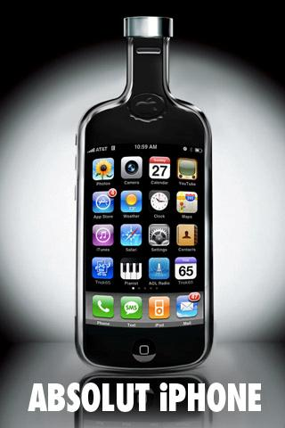


Slide 9
Play…
The Force Volkswagen Commercial
Audi 2012 Game Day Commercial - Vampire Party

Slide 10
The Effects Behind Advertising Effectiveness
AIDA (attention, interest, desire, action)
- Works for rational decisions
- What about emotional or impulse purchases?

Slide 11
The Effects Behind Advertising Effectiveness
Think-feel-do Model
- Can take any form e.g.
Think-feel-do: For products such as computer games, CD and DVD.
Feel-think-do: For needs such as a new suite, a bike, etc.
Feel-do-think: For wants such as cosmetics and fashion, etc.
Do-feel-think: For impulse buying such as candy bars and soft drink.
Do-think-feel: For habitual purchases such as cereal and shampoo.

Slide 12
Play…
Pepsi World Cup 2011 Ad
Coca Cola Super Bowl Ad 2011

Slide 13
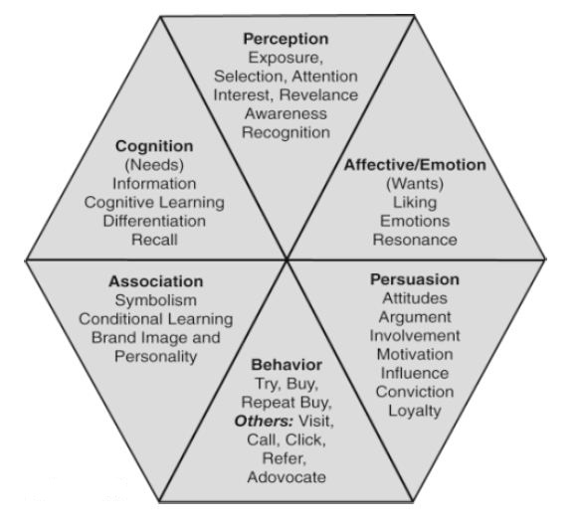
Facets Model of Effective Advertising

Slide 14
Perception
The process by which we receive information through our five senses and assign meaning to it
Exposure
Being seen or heard
Media planners try to find the best way to expose the target audience to the message
IMC planners consider all contacts a consumer has with a company or brand

Slide 15
Perception
Selection and Attention
The ability to draw attention, to bring visibility
One of advertising’s greatest strengths
Interest and Relevance
Interest
  The receiver of the message has become mentally engaged with the ad and the product
Relevance
  The message connects on some personal level

Slide 16
Perception
Awareness
Results when an ad initially makes an impression
Most evaluations of advertising effectiveness include a measure of awareness as an indicator of perception
Recognition
Memory
Recognition
Recall

Slide 17
Play…
Best Gift Ever by Chevrolet Camaro

Slide 18
The Subliminal Issue
Subliminal effects are message cues given below the threshold of perception
Critics claim that advertising can manipulate people subconsciously and cause them to buy things they don’t want or need
Professionals and educators believe there is no real support for subliminal advertising

Slide 19
Summary
Chapter Key Points
How Advertising Works as Communication
The Effects Behind Advertising Effectiveness
Perception

