Slide 1
Advertising Role in Society
Lecture 4

Slide 2
Recap
The Marketing Process
How Agencies Work
International Marketing
The Dynamics of Modern Marketing
Discuss the shape-versus-mirror debate
Analyze the legal topics that guide advertising practice
List the key regulatory agencies and their responsibilities

Slide 3
Chapter Outline
Chapter Key Points
Advertising’s Social Role
Review and Regulation of Advertising
Advertising Ethics
Determining What is Ethical

Slide 4
Advertising Ethics
A set of moral principles that guide actions and create a sense of responsible behavior
Six key issues
  Subliminal Messages
  Poor taste and offensive advertising
  Stereotyping
  Body and self image
  Targeting children
  Misleading claims and other message strategies
  Controversial products

Slide 5
Advertising Ethics
Subliminal perception occurs when an individual is exposed to a stimulus which is too weak or too brief to be consciously seen/heard but strong enough to be picked up by receptor cells
Subliminal Advertising
      Intentional created advertising with controversial message hidden in the illustrations just below the perceptual threshold of receiver.

Slide 6
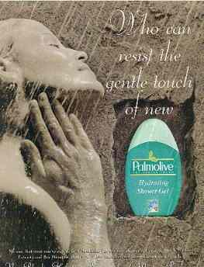
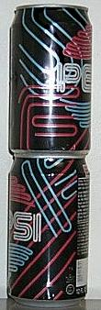
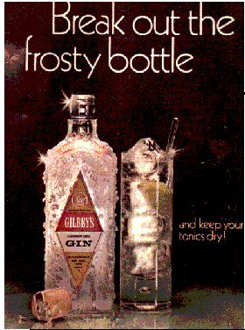
Subliminal Advertising

Slide 7
Advertising Ethics
Poor Taste/Offensive
Advertisers and media outlets must try to be sensitive to consumer objections
Creating guidelines for good taste is difficult
Sex in advertising

Slide 8
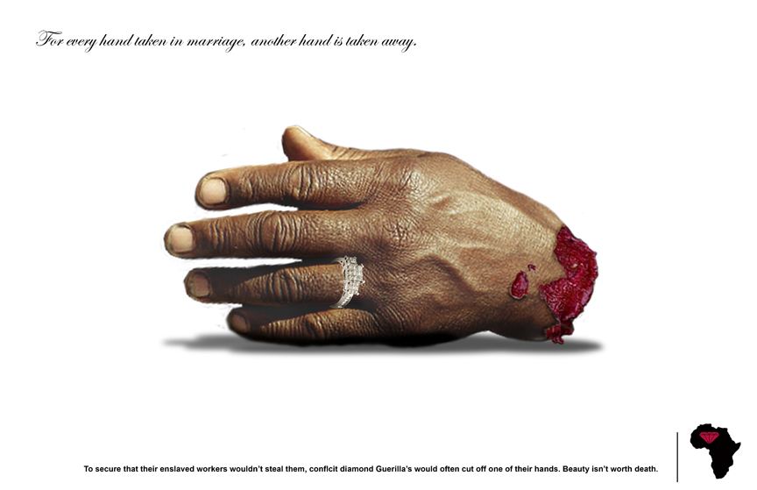
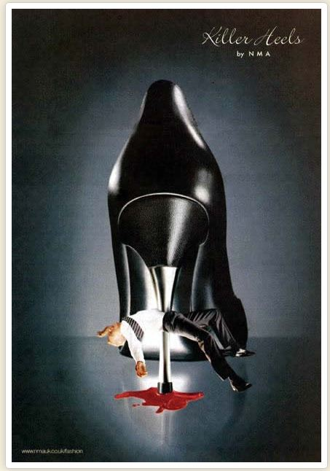
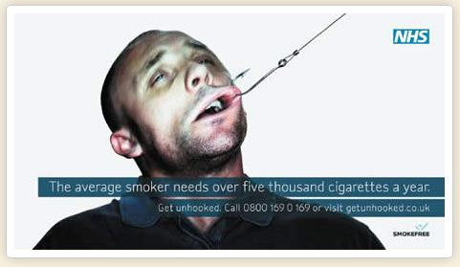

Slide 9
Play…
Hulu From Daily Video

Slide 10
Advertising Ethics
Reinforcing Stereotypes
Diversity Issues
Gender Roles
Racial and Ethnic Stereotypes
Senior Citizens

Slide 11

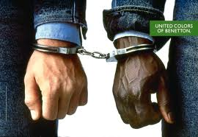
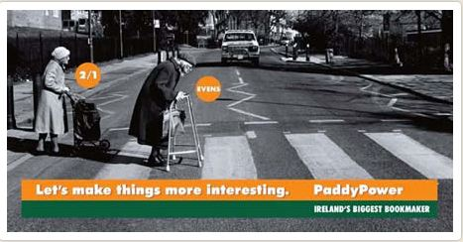
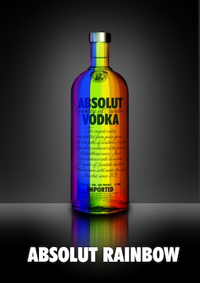

Slide 12
Play…
A Man in the Kitchen
Heniken
Just For Feet Kenya Mission 1999

Slide 13
Advertising Ethics
Body and Self Image
Self-image advertising can contribute to self-improvement
Can also lead to dangerous practices
Advertising mirrors and shapes the standard of attractiveness

Slide 14
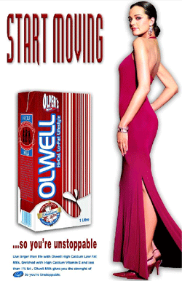


Slide 15
Play…
John Abraham Garnier Deo Tvc.

Slide 16
Advertising Ethics
Children
One of the most controversial topics in the industry
Children are unable to evaluate advertising messages and make purchasing decisions

Slide 17
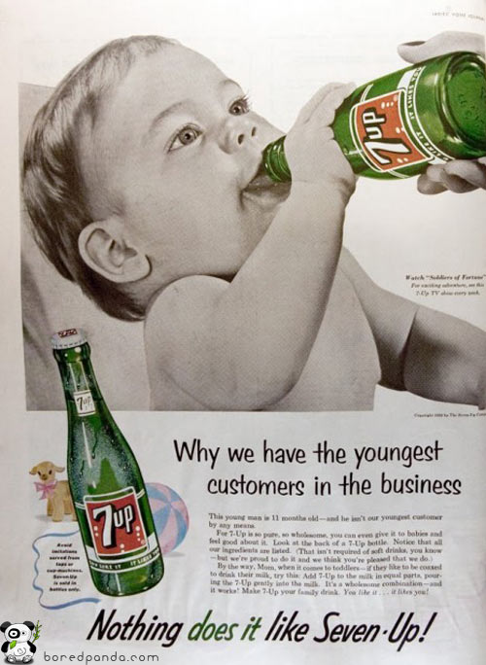


Slide 18
Play…
Baby suv
crying kid

Slide 19
Advertising Ethics
Misleading Claims
Advertising claims are unethical if they are false, misleading, or deceptive
Includes manipulative advertising, puffery, comparative advertising, endorsements and demonstrations.

Slide 20

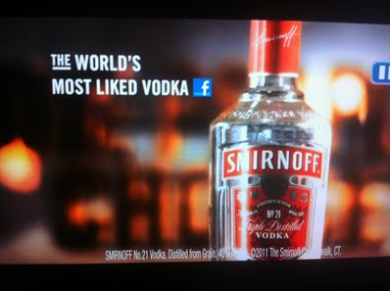
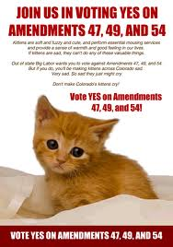


Slide 21
Play…
Fair and Handsome
Compartive ad NIKE

Slide 22
Advertising Ethics
Controversial Products
Though it is acceptable to advertise these products, it is still offensive to some.

Slide 23
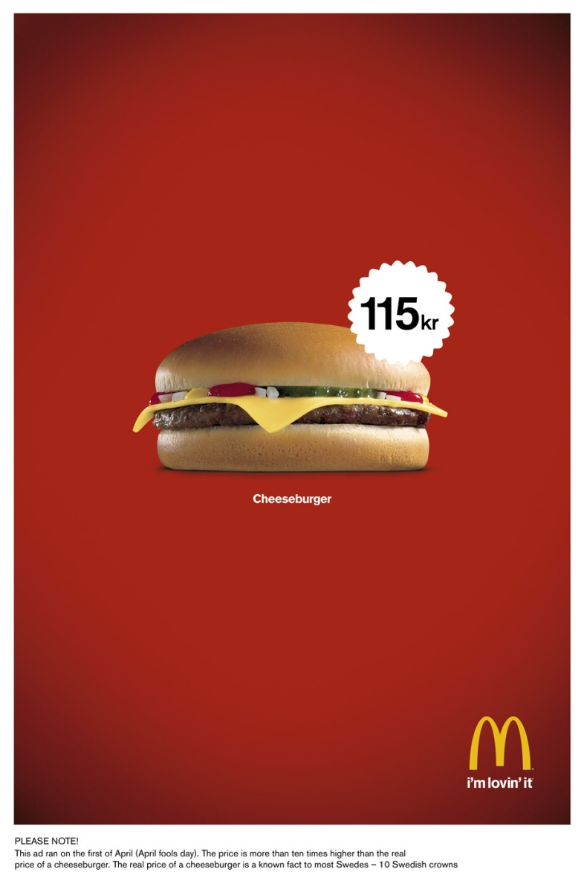
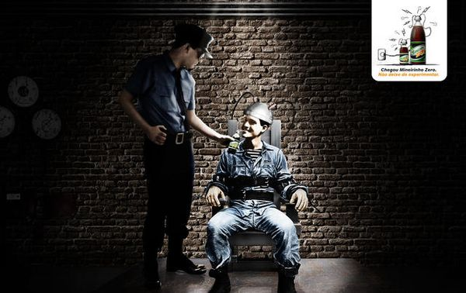

Slide 24
Play…
Coke-Honest Branding

Slide 25
Determining What is Ethical
The social ethic
The professional ethic
The personal ethic
The “Golden Rule”
Social responsibility motivates a business to make a positive impact on society

Slide 26
Determining What is Ethical
The social ethic
The professional ethic
The personal ethic
Industry standards help with a decision about what is ethically correct
A code of standards identifies how professionals should respond when facing an ethical dilemma

Slide 27
Determining What is Ethical
The social ethic
The professional ethic
The personal ethic
Personal judgment and moral reasoning rests on an intuitive sense of right and wrong
Advertising professionals must be aware of industry standards as well as ethical questions

Slide 28
Summary
Critique the key ethical issues that challenge the practice of advertising
Outline three ways to determine if an advertising decision is ethical

Slide 29
References
Wells, W., Burnett, J. and Moriarty, S. (2006), Advertising Principles and Practice, Prentice-Hall, New Delhi, ND.

