Slide 1
Advertising’s Role in Marketing
LECTURE 03

Slide 2
Recap
What is marketing?
Key players in market.
Key concepts in marketing.
Types of markets.

Slide 3
The Marketing Process
Conduct research and develop a situation analysis
Set objectives for the marketing effort
Assess consumer needs and wants
Differentiate and position the product
Develop the marketing mix strategy
Evaluate the effectiveness of the strategy

Slide 4
Marketing Mix Strategies
Product
Place
Price
Promotion
The product is both the object of the advertising and the reason for marketing
Product category
  A class of similar products

Slide 5
Marketing Mix Strategies
Product
Place
Price
Promotion
The channels used in moving the product from manufacturer to buyer

Slide 6
Marketing Mix Strategies
Product
Place
Price
Promotion
Based on the cost of making and marketing the product and on expected profit
  Customary
  Psychological

Slide 7
Marketing Mix Strategies
Product
Place
Price
Promotion
Use face-to-face contact between marketer and prospective customer
Used to create immediate sales

Slide 8
How Agencies Work
Full-Service Agencies
Include the four major staff functions
  Account management
  Creative services
  Media planning and buying
  Account planning
Also have accounting, traffic, production, and HR departments
Specialized Agencies
Specialize in certain functions, audiences, industries or markets
  Creative boutique
  Media-buying services

Slide 9
How Agencies Work
Account Management
Acts as a liaison between the client and the agency
Responsible for interpreting the client’s marketing strategy
Creative Development
People who write
People who design ideas for ads and commercials
People who convert these ideas into commercials

Slide 10
How Agencies Work
Media Planning/Buying
Recommends to the client the most efficient means of delivering the message
Responsible for buying, planning, and research
Account Planning
Gathers all information on the market and consumers and acts as the voice of the consumer
Prepares comprehensive recommendations

Slide 11
How Agencies Work
Internal Agency Services
Traffic department
Print production department
Revenues and Profits
Commission
Fee
Retainer

Slide 12
International Marketing
An international brand is available virtually anywhere in the world
The shift requires new tools for advertisers, including one language, one control mechanism, and one strategic plan
The choice of an agency depends on the decision to standardize messages or localize them to accommodate local cultures

Slide 13
The Dynamics of Modern Marketing
Integrated marketing
  All areas of the marketing mix work closely together to present the brand in a coherent and consistent way
Relationship marketing
  Marketing that considers all the firm’s stakeholders
Permission marketing
  Inviting prospective customers to self-select into a brand’s target market in order to receive marketing communication

Slide 14
Advertising Role in Society

Slide 15
Chapter Outline
Chapter Key Points
Advertising’s Social Role
Review and Regulation of Advertising
Advertising Ethics
Determining What is Ethical

Slide 16
Key Points
Discuss the shape-versus-mirror debate
Analyze the legal topics that guide advertising practice
List the key regulatory agencies and their responsibilities
Critique the key ethical issues that challenge the practice of advertising
Outline three ways to determine if an advertising decision is ethical

Slide 17
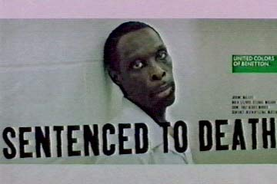
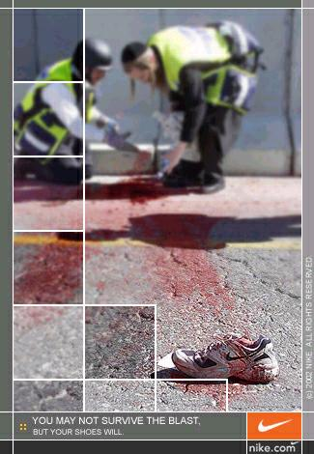
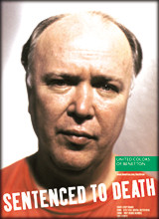

Slide 18
Advertising’s Societal Role
Does advertising create a materialistic culture or does it simply reflect it?
  Critics believe that advertising has the power to shape social trends and the way people think and act
  Advertising professionals believe advertising mirrors values rather than sets them
Advertising can potentially shape and mirror values

Slide 19


Advertising’s Societal Role

Slide 20
Play…
Tang Pakistan
Walls Badami (New) - Colourful Pakistan (Punjabi) Culture - Pakistani TV Commercials
Pakistani Girls Dance (Moves) - Omore Uth - Pakistani TV Commercials

Slide 21
Advertising Regulations in Pakistan
The Code of Advertising Standards and Practice (1985)
PEMRA Ordinance 2002(amended in 2007)

Slide 22
Salient Laws....
Tobacco advertisement is restricted in Pakistan.
In case of food and beverages nutritional values must not be exaggerated.
Special care should be given to representation of children in ads.
Emphasis should be on product rather than female model.
Subliminal advertising is not allowed.

Slide 23
Summary
The Marketing Process
How Agencies Work
International Marketing
The Dynamics of Modern Marketing
Discuss the shape-versus-mirror debate
Analyze the legal topics that guide advertising practice
List the key regulatory agencies and their responsibilities

