Slide 1

Print and Out-of-Home Media
(Continued)
Lecture 20

Slide 2
Recap
Chapter Key Points
The Media Industry
Basic Media Concepts
Print Media
Newspapers

Slide 3
Magazines
Most magazines today are special interest publications aimed at narrower target markets
Specialty magazines seem to have an edge over more general publications in terms of maintaining growth
Upscale magazines provide an ideal place for the image advertising of luxury products

Slide 4

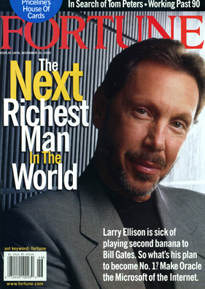
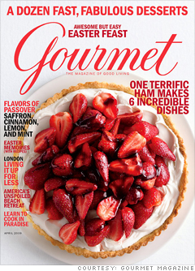



Slide 5
Types of Magazines
Audience focus
Consumer magazines
Business magazines
Farm magazines

Slide 6
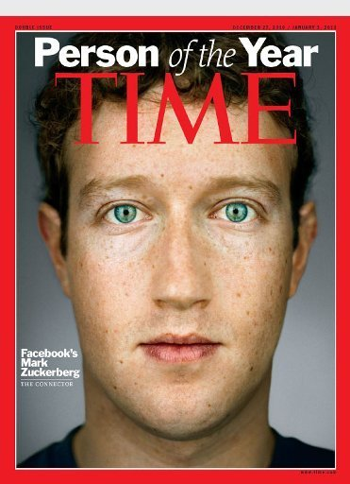


Types of Magazines

Slide 7
Types of Magazines
Other classifications
Geography
Demographics
Editorial content
Physical characteristics
Ownership

Slide 8

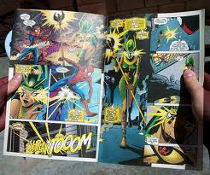
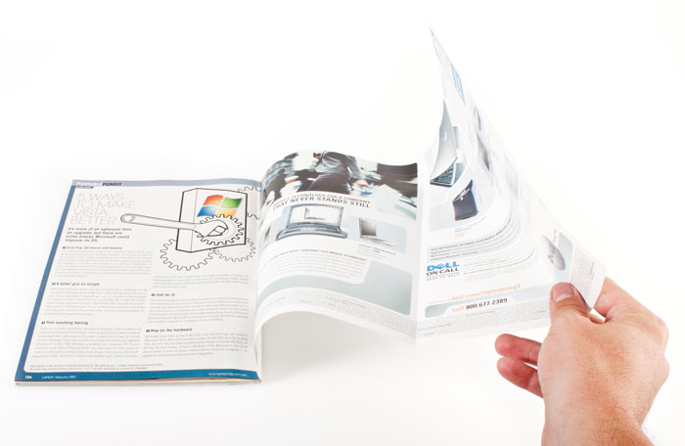

Slide 9
Distribution and Circulation
Traditional delivery
  Through newsstand purchases or home delivery
Nontraditional delivery (controlled circulation)
  Hanging bagged copies on doorknobs
  Inserting magazines in newspapers
  Delivering through professionals
  Direct delivery

Slide 10
Magazine Advertising
Format
Double-page spread
Gutter
Bleed page
Gatefold
Photo essay ad
Technology
Has enabled magazines to distinguish themselves from one another

Slide 11


Slide 12

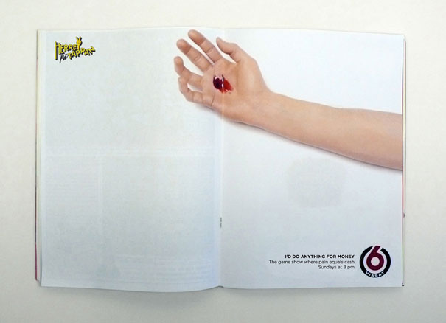

Slide 13
Readership Measurement
Magazine rates
  Based on circulation that a publisher promises to provide
Magazine circulation
  The number of copies of an issue sold
MediaMark
  Measures readership for many popular magazines
Simmons Market Research Bureau
  Provides psychographic data on who reads which magazines and which products readers buy and consume

Slide 14
Magazine Advertising
Advantages
Target audience
Audience receptivity
Long life span
Format
Visual quality
Sales promotions
Disadvantages
Limited flexibility
Lack of immediacy
High cost
Distribution

Slide 15
Packaging
Both a container and a communication vehicle
The last ad a customer sees before making the decision to buy
Constant brand reminder once on the shelf at home or in the office

Slide 16


Slide 17



Slide 18
Out-of-Home Advertising
Outdoor advertising
  Billboards and posters in public locations
Size and format
Printed posters
Painted bulletin
Buying Outdoor
Showings
Traffic count

Slide 19
Out-of-Home Advertising
Advantages
High impact medium
Larger-than-life visuals
Hard to ignore structure
Least expensive
Disadvantages
Message could fail to be seen or have impact
Passive medium
Extensive regulation

Slide 20
Out-of-Home Advertising
On-Premise Signs
  Retail signs that identify stores
Posters
  Used on the sides of buildings and vehicles, as well as on bulletin boards and kiosks
Kiosks
  Designed for public posting of notices and advertising posters
Transit advertising
  Includes posters in bus, train, airport, and subway stations

Slide 21
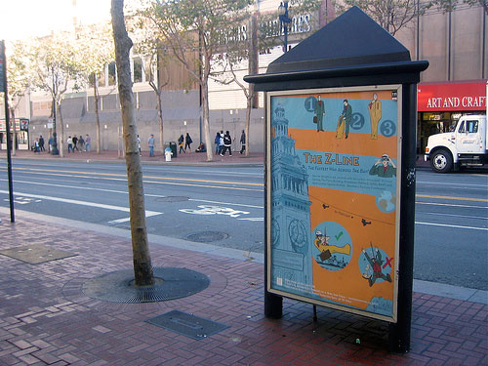
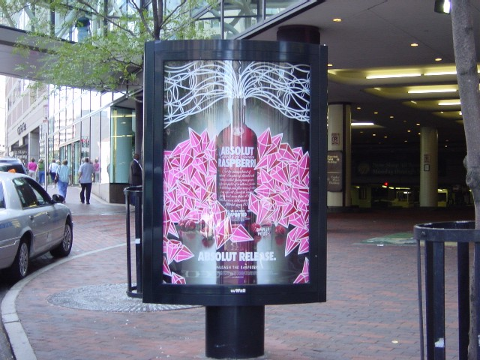
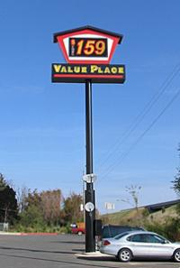
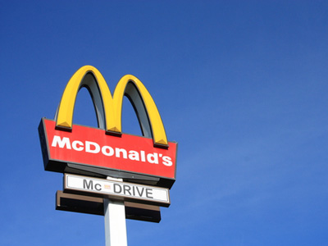

Slide 22
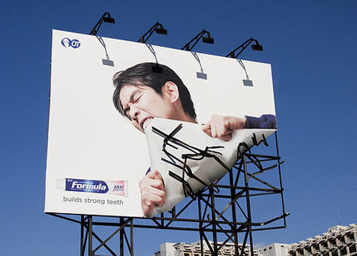
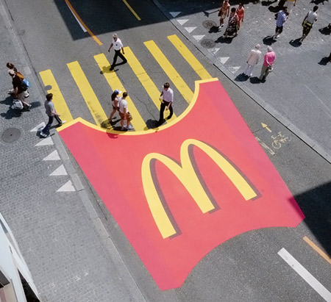
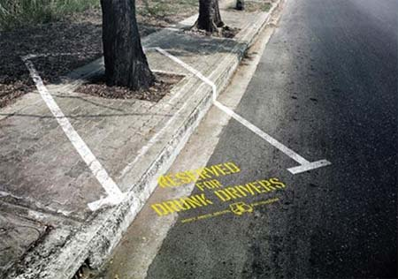
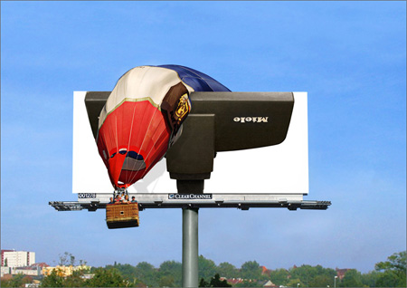

Slide 23
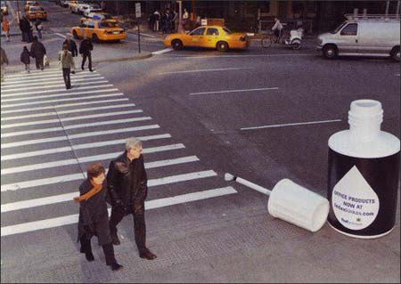

Slide 24
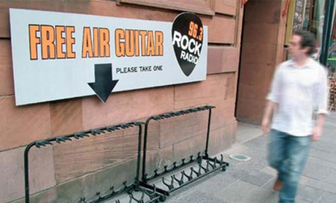
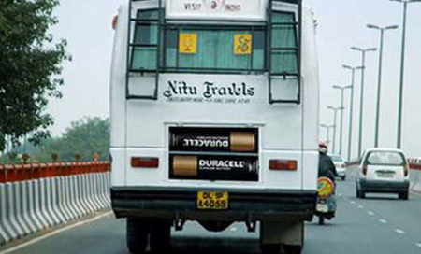

Slide 25
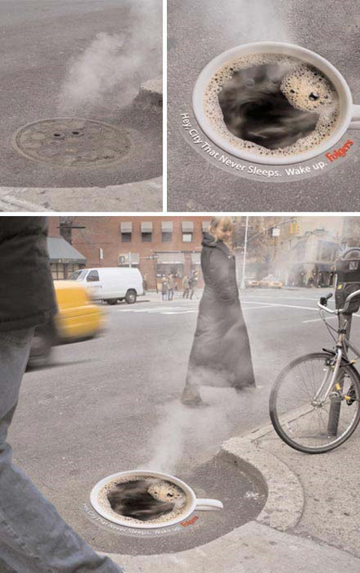

Slide 26
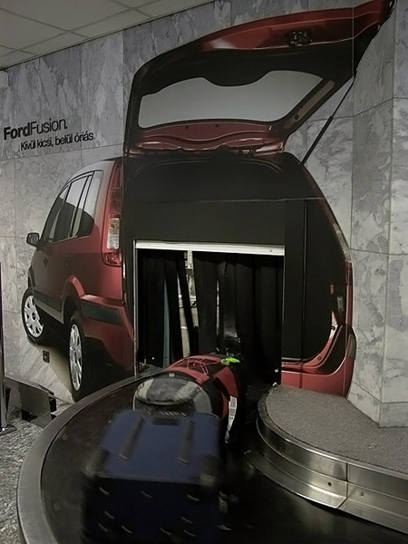
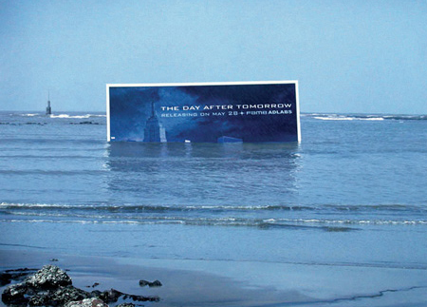
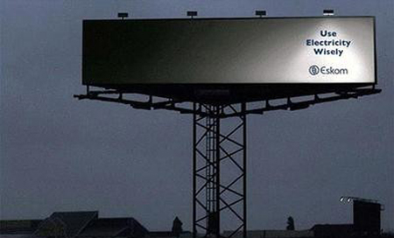

Slide 27
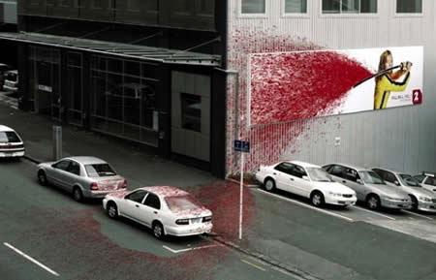
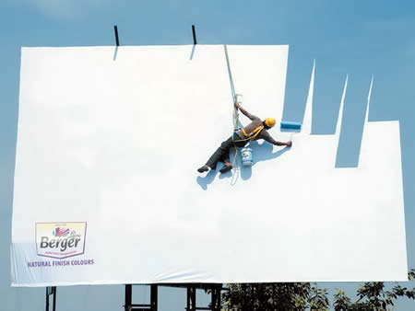
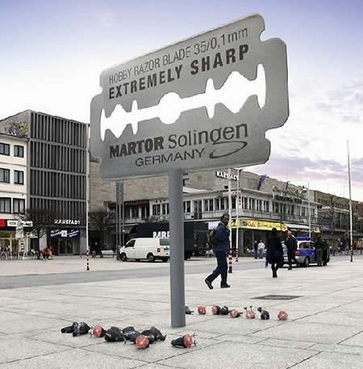
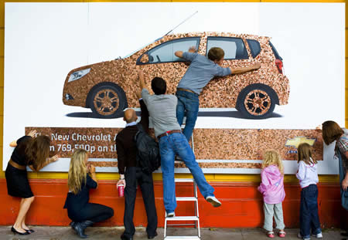

Slide 28
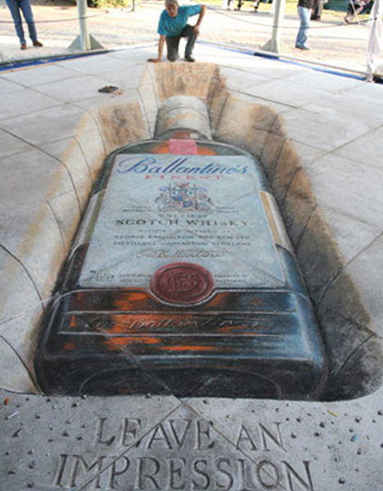

Slide 29
Directory Advertising
Books that list names, phone numbers, and addresses of people or companies
Tells people where to go to get the product or service they want
Reaching an audience already in need of something
  Yellow Pages
  Other Directories

Slide 30
Directory Advertising
Advantages
Consumers initiate the search process
Inexpensive (1:15 ROI)
Flexibility
Long life
Disadvantages
Competitive clutter
Consumers who cannot easily use directories

Slide 31
Using Print Advertising
Use Newspapers If…
You are a local business
Desire extensive market coverage
Product is consumed in a predictable manner
No need to demonstrate the product
Moderate to large budget
Use Magazines If…
Well-defined target audience
Want to reinforce or remind audience
Product must be shown accurately and beautifully
Need to relate moderate to extensive information
Moderate to large budget

Slide 32
Using Print Advertising
Use Out-of-Home If…
Local business that wants to sell locally
Regional or national business that wants to remind or reinforce
Product requires little information and little demonstration
Small to moderate budget
Use Directories If…
Local business or can serve local customers
Want to create action
Want to allow comparisons or provide basic inquiry and purchase information
Small to moderate budget

Slide 33
Summary
Magazines
Out of home advertising
Directories

Slide 34
Reference
Wells, W., Burnett, J. and Moriarty, S. (2006), Advertising Principles and Practice, Prentice-Hall, New Delhi, ND.

