Slide 1

Print and Out-of-Home Media
Lecture 19

Slide 2
Recap
Television
Film and Video
Product Placement
Using Broadcast Advertising Effectively

Slide 3
Chapter Outline
Chapter Key Points
The Media Industry
Basic Media Concepts
Print Media
Newspapers
Magazines
Packaging
Out-of-Home Advertising
Directory Advertising
Using Print Advertising

Slide 4
Key Points
Explain the key concepts of media planning and buying
Identify the strengths and weaknesses of newspapers
Describe the key factors that advertisers should know to make effective decisions about advertising in magazines
Analyze why packaging is such an important advertising opportunity
Discuss factors that advertisers should consider in making out-of-home media decisions
Outline the factors that advertisers use to make decisions about using directory advertising

Slide 5
The Media Industry
Media-delivered news, information, and advertising make the news and information possible
Advertising media is a huge industry with almost $195 billion in spending

Slide 6
Basic Media Concepts
Media mix
  The way various types of media are strategically combined in an advertising plan
Media vehicle
  A specific TV program, newspaper, magazine, or radio station or program

Slide 7
Basic Media Concepts
Planning and Buying
Reach and Frequency
Impressions
Media Key Players
Media planning
  The way advertisers identify and select media options
Media buying
  Identifying specific vehicles, negotiating the costs to advertise in them, and handling billing and payment

Slide 8
Basic Media Concepts
Planning and Buying
Reach and Frequency
Impressions
Media Key Players
Reach
  The percentage of the media audience exposed to the advertiser’s message during a specific time frame
Frequency
  The number of times a person is exposed to the advertisement

Slide 9
Basic Media Concepts
Planning and Buying
Reach and Frequency
Impressions
Media Key Players
The opportunity for one person to be exposed one time to an ad
In print, impressions estimate the actual readership
In broadcast, impression estimates viewers for TV and listeners for radio

Slide 10
Basic Media Concepts
Planning and Buying
Reach and Frequency
Impressions
Media Key Players
Media salespeople work for a medium
Media reps are people or companies that sell space or time for a variety of media
Media planners, media buyers, media researchers

Slide 11
Print Media
Print advertising includes printed advertisements in newspapers, magazines, brochures, posters, and outdoor boards
Print provides more detailed information, rich imagery, and a longer message life

Slide 12
Newspapers
Used by advertisers trying to reach a local market
Primary function is to carry news
Market selectivity allows newspapers to target specific consumer groups

Slide 13
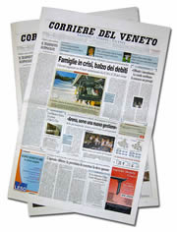
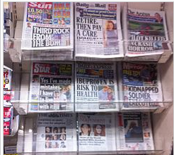
Structure of the Newspaper Industry
Frequency of publication
Format and size
Circulation

Slide 14

Types of Newspaper Advertising
Classified
Display
Supplements
Notes:
Run of paper rate and preferred position rate
For supplement free standing insert

Slide 15
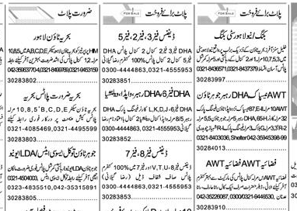

Classified

Slide 16
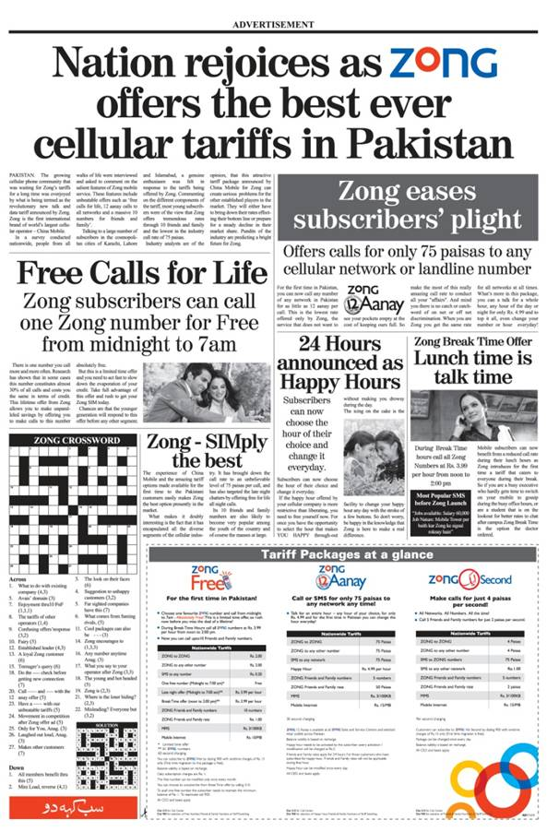
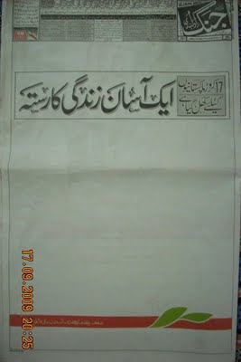
Display

Slide 17
Newspaper Readership
Tends to be highest among older people and people with a higher educational level
Measuring the newspaper audience

Slide 18
Newspaper Advertising
Advantages
Range of market coverage
Comparison shopping
Positive consumer attitudes
Flexibility
Interaction of national and local
Disadvantages
Short life span
Clutter
Limited coverage of certain groups
Poor reproduction

Slide 19
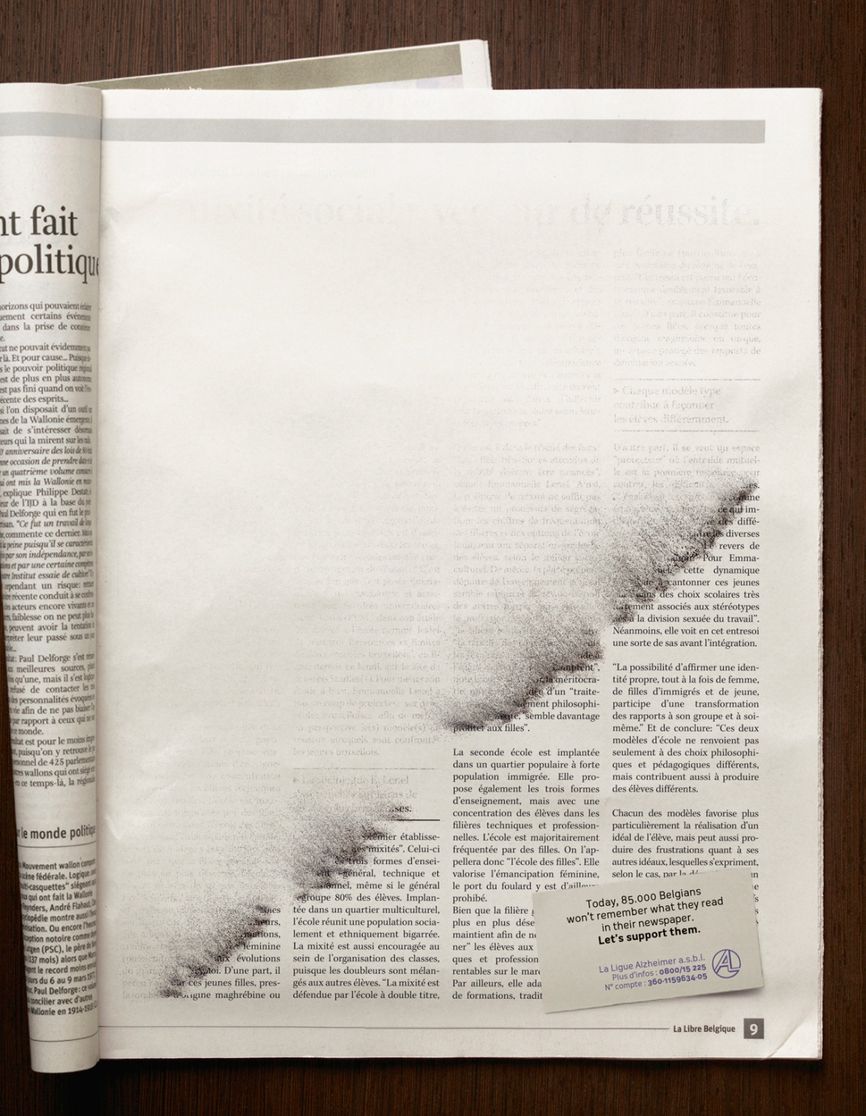

Slide 20
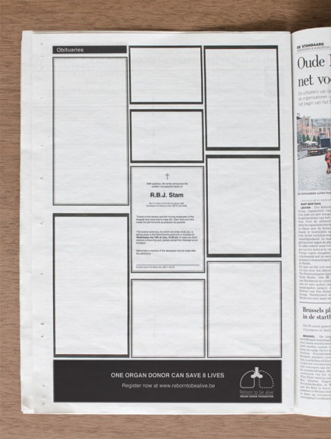

Slide 21
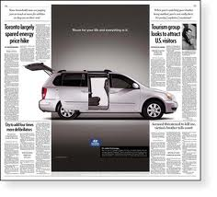

Slide 22
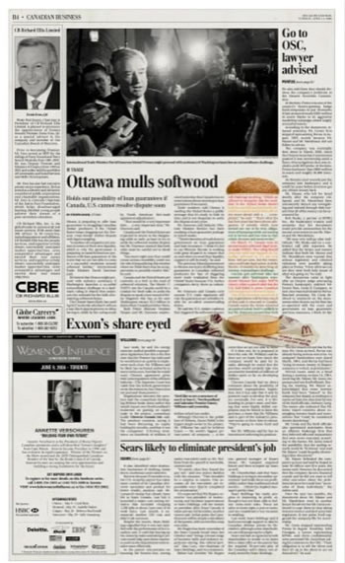

Slide 23
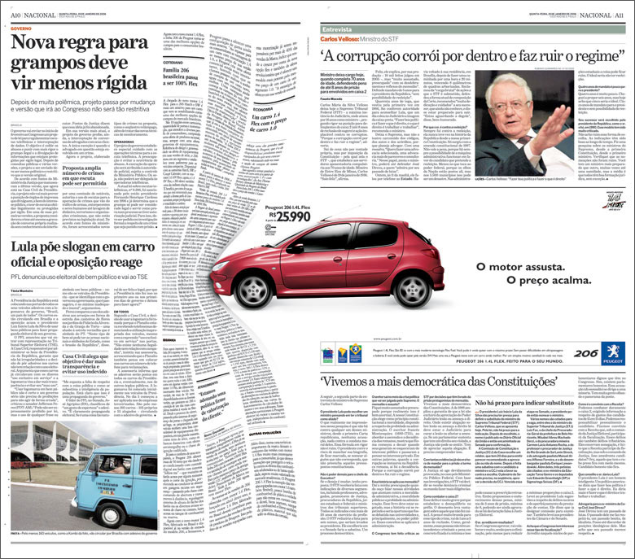

Slide 24
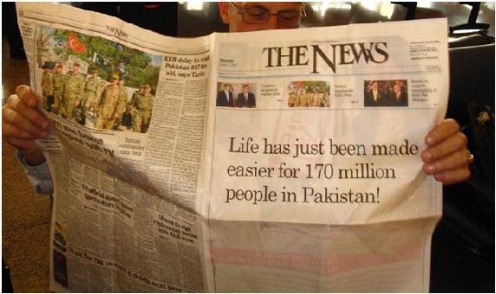

Slide 25
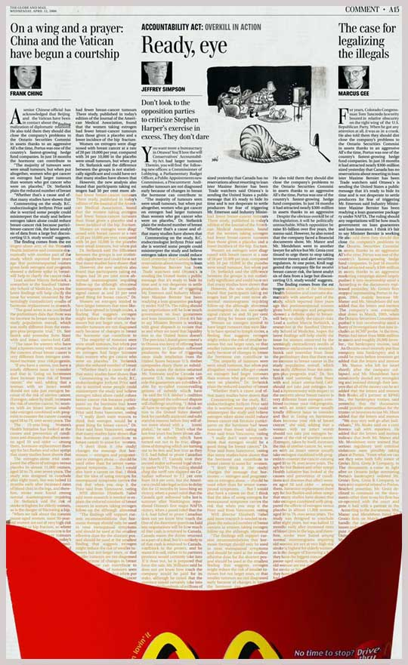

Slide 26
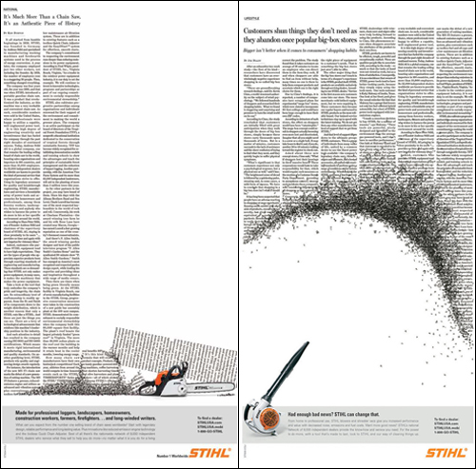

Slide 27
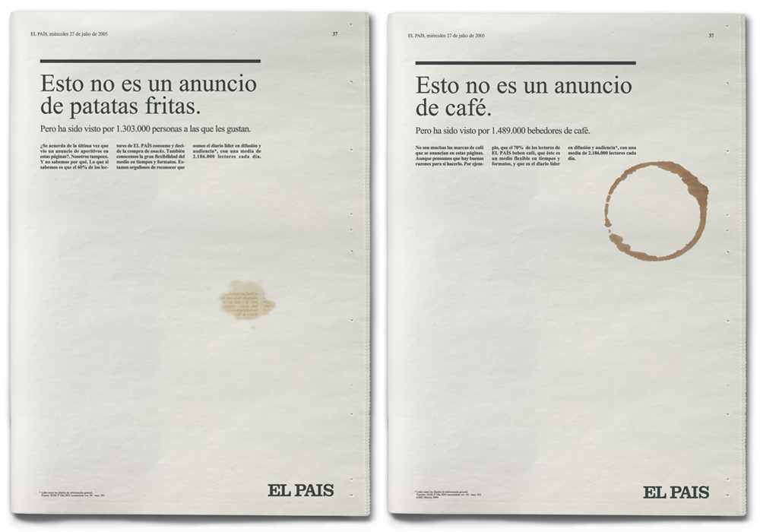

Slide 28
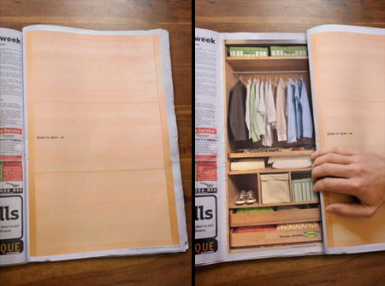

Slide 29
Summary
Chapter Key Points
The Media Industry
Basic Media Concepts
Print Media
Newspapers

Slide 30
Reference
Wells, W., Burnett, J. and Moriarty, S. (2006), Advertising Principles and Practice, Prentice-Hall, New Delhi, ND.

