Slide 1
Selecting Message Appeals and Picking Endorsers
(Continued)
Lecture 16

Slide 2
Recap
Types of Endorsers
Endorser Attributes

Slide 3
Advertising Appeals
An appeal is central idea of an advertisement.
An appeal is the approach to attract the audience.
Its purpose is to influence consumers’ attitude towards the product, service or concept.

Slide 4
Types of Advertising Appeal
There are several types of advertising appeals. Few of them are as follow;
Rational Appeal
Emotional Appeal
Humour Appeal
Fear Appeal
Guilt Appeal
Sex Appeal

Slide 5
Humour Appeal
Advertisers turn to humor in order to gain attention, guiding customer comprehension of product claims, influencing attitudes, enhancing recall of advertised claims and creating customer action.
Humor advertisements generally involve incongruity resolution.

Slide 6
Humour Appeal
Humor appeal
Incongruity
Struggle to understand
Feeling of surprise
Meaning determined
Humorous Response
Positive attitude towards the
Brand or advertisement

Slide 7
Humour Appeal
An effective method for attracting attention.
Enhances liking of both advertisement and brand.
May increase memory of advertising claims if humor is relevant.
It does not have an advantage on nonhumor in terms of persuasion.
It does not enhance source credibility.
Suitable for low involvement products.

Slide 8
Humor Appeal
Advertiser should be careful while using this appeal. They have to take following variables into consideration:
Audience characteristics
Culture
Distraction

Slide 9
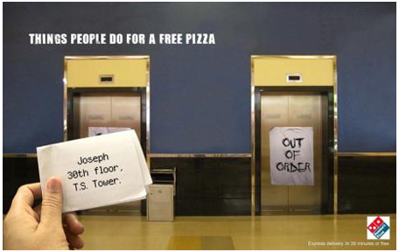
Humour Appeal

Slide 10

Humour Appeal

Slide 11

Humour Appeal

Slide 12

Humour Appeal

Slide 13
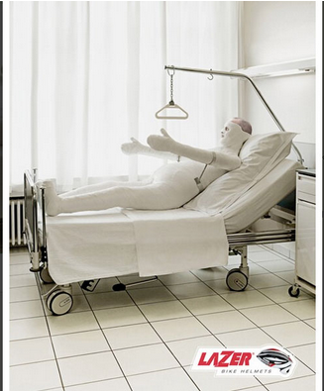
Humour Appeal

Slide 14
Play...
hair cut advertisement India, funny ads, India advertisement
MnM
Nike - Hotdog Stand
Camlin

Slide 15
Fear Appeal
Appeals to fear in advertising identify negative consequences of either:
Not using the advertised brand
Engaging in unsafe behaviour such as drinking and driving, smoking, etc.

Slide 16
Fear Appeal
Appeals to consumer fear stimulates audience involvement with the message and promote acceptance of argument.
Fear appeal can take two forms:
Social disapproval: e.g. Mouthwash, deodorants, etc.
Physical danger: e.g. Driving under influence of alcohol or drugs.

Slide 17
Fear Appeal
Intensity of Fear Appeal:
More an audience experiences fear from an advertised threat, the more likely it is that they will be persuaded to take recommended action.
Level of threat in an ad should be according to relevance of an issue i.e. More relevant issues need little threat and vice versa.

Slide 18
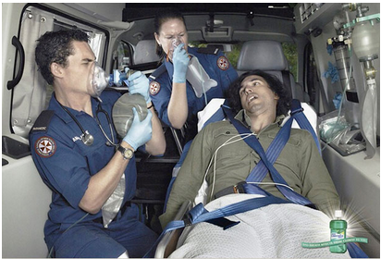
Fear Appeal

Slide 19
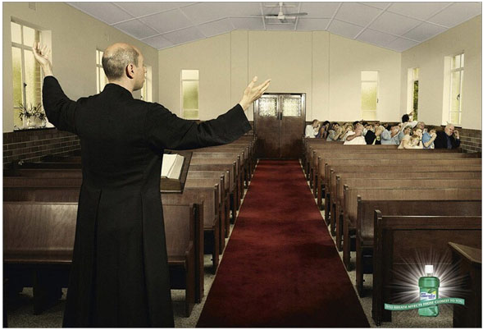
Fear Appeal

Slide 20

Fear Appeal

Slide 21
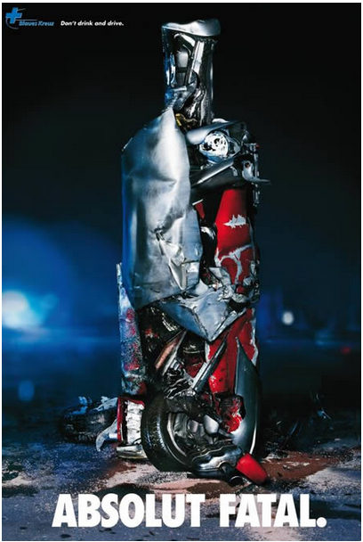
Fear Appeal

Slide 22
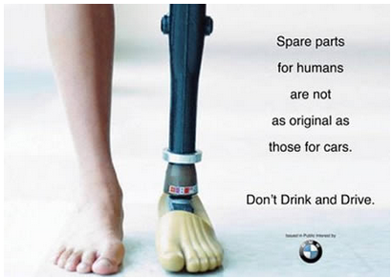
Fear Appeal

Slide 23
Play...
Embrace Life - always wear your seat belt
Michelin Tires commercial
Plus White Toothpaste

Slide 24
Sex Appeal
Sex in advertising play several roles such as:
Attracts and holds attention for longer period
Enhances recall of message points
Evokes emotions responses such as feeling of arousal and lust.

Slide 25
Sex Appeal
Effectiveness of sex appeal depends on its relevance to advertised product and advertisement’s primary selling point.

Slide 26
Downside of Sex Appeal
It interferes with consumer’s processing of message arguments and reduces comprehension.
Many people are offended by advertisements which portray women and men as brainless sex objects.

Slide 27
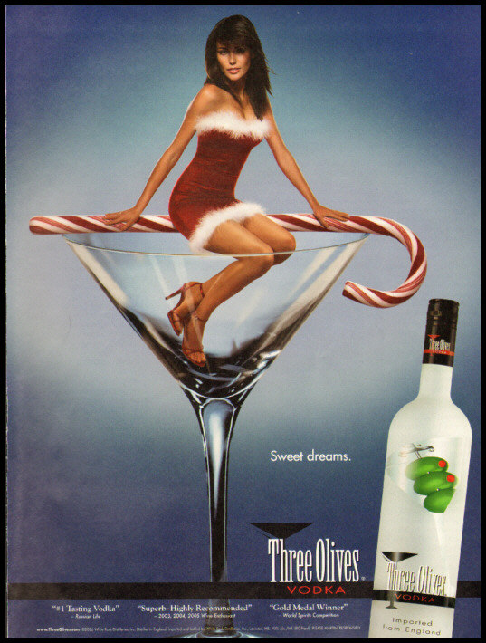
Sex Appeal

Slide 28
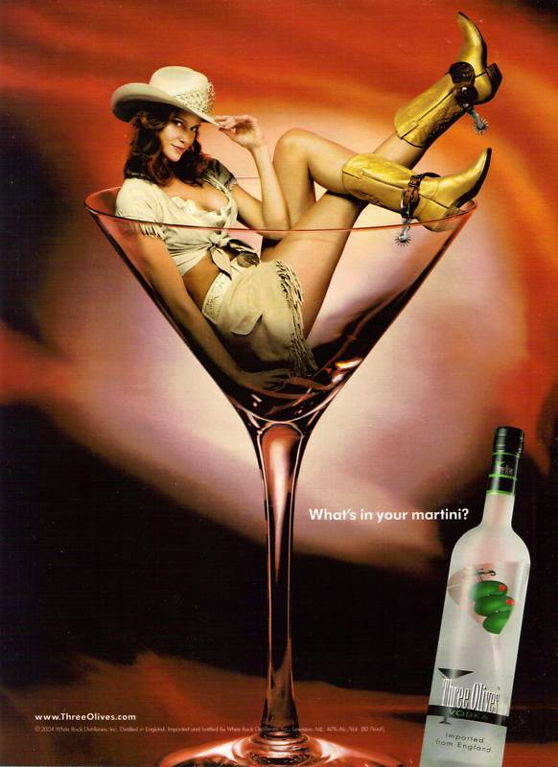
Sex Appeal

Slide 29
Play...
Diet Coke-Diet Coke Break
Pipe by Other
Train by Heineken

Slide 30
Other Appeals
Scarcity Appeal:
Things are shown rare or in short supply but in great demand. Advertiser encourage immediate response with appeals such as “ only a few are left” , etc.
Guilt Appeal:
People feel guilty when they break rule, violate their own standards or beliefs, or behave irresponsibly. Guilt appeals motivates to take responsible action to reduce level of guilt.

Slide 31
Summary
Advertising Appeals

Slide 32
References
Shimp T, 2010, Advertising, Promotion and other Aspects of Marketing Communications, 8th edition, South-Western.

