Slide 1
Selecting Message Appeals and Picking Endorsers
Lecture 15

Slide 2
Recap
Facets of Creative Strategy
Planning and Managing Creative Strategy

Slide 3
Chapter Key Points
Types of Endorsers
Endorser Attributes
Advertising Appeals

Slide 4
Types of Endorsers
Celebrity Endorser
Typical-Person Endorser

Slide 5
Celebrity Endorser
Includes TV stars, Movie actors, famous athletes, etc.
Advertisers and their agencies pay huge sums of money to celebrities who are liked and respected by target audience and influence consumers’ attitude and behaviour towards the endorsed brands.

Slide 6
Typical-Person
Some ads show regular i.e. noncelebrities using or endorsing products.
Using ordinary people increases the degree of credibility.
Many ads use multiple people rather than a single individual as it increases message involvement resulting into more elaboration.

Slide 7
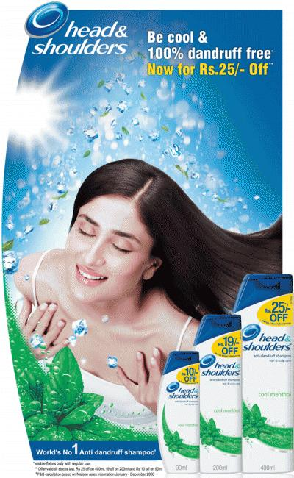
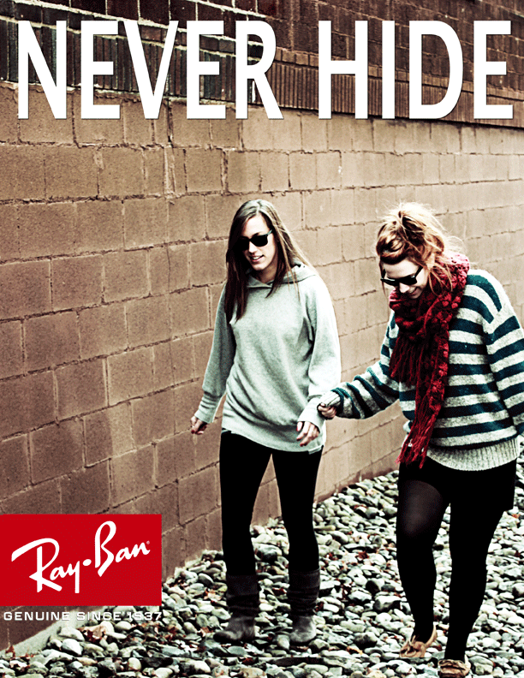

Slide 8
Endorser Attributes: The TEARS Model
T: Trust
E: Expertise
A: Attractiveness
R: Respect
S : Similarity
Credibility
General Concepts of Attractiveness

Slide 9
1. Trust
Refers to honesty, integrity and believability of a source.
An endoreser’s trustworthiness rests on the audience’s perception of his/her endorsement motivations.
Trust is won by the life endorser lives professionally and personally.
Endorsers should sound objective and should match audience in terms of distinct characteristics such as gender and ethnicity.

Slide 10
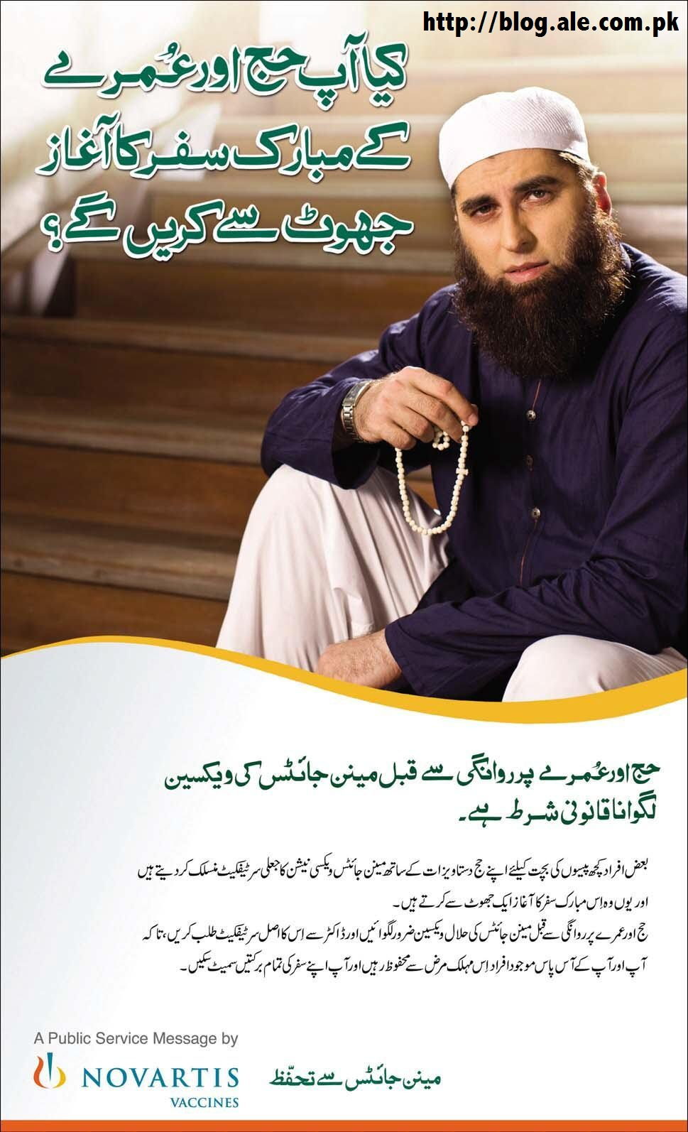

Slide 11
2. Expertise
Refers to knowledge, experience, or skills possessed by endorser as they relate to the endorsed brands.
Expertise is a perceived rather than an absolute phenomenon.
An endorser who is perceived an expert can change audience’s attitude pertaining to his area of expertise than an endorser who is not perceived as an expert.

Slide 12
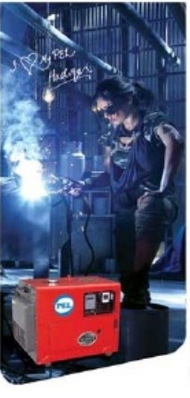
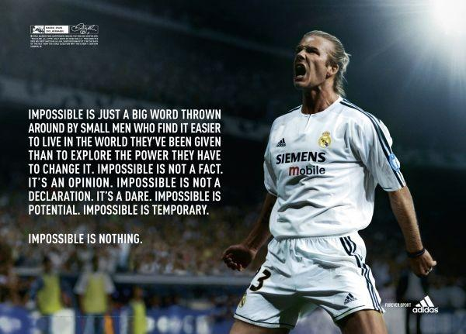

Slide 13
3. Attractiveness
Attractiveness refers to physical attractiveness, intellectual skills, personality properties, life style characteristics, athletic prowess, etc.
The « A » of TEARS model refers to only physical attarctivenss.
Physical attractive endorsers produce more favorable evaluations of ads and advertised brands than do less attractive communicators.

Slide 14
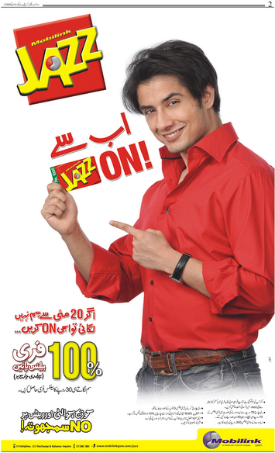
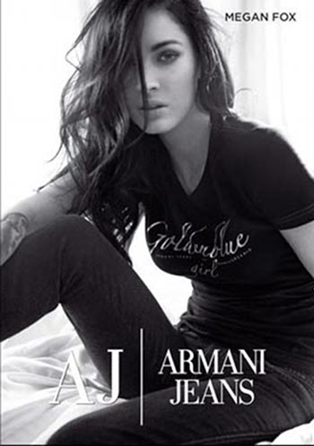

Slide 15
4. Respect
It is the second component of overall attractiveness.
It is the quality of being admired or even esteemed due to one’s personal qualities and accomplishments.
Celebrities are respected for their acting ability, athletic prowess, appealing personalities, their stand in important societal issues, etc.

Slide 16
5. Similarity
The third attractiveness component and the « S » in the TEARS model.
It represents the degree to which an endorser matches an audience in terms of characteristics such as age, gender, ethnicity and so on.
People like individuals who share their common features or traits.

Slide 17
Endorser Selection Considerations: The ‘’ No Tears’’ Approach
Celebrity and Audience Matchup
Celebrity and Brand Matchup
Celebrity Credibility
Celebrity Attractiveness
Cost Considerations
Working Ease or Difficulty Factor
Saturation Factor
The Trouble Factor

Slide 18
Summary
Types of Endorsers
Endorser Attributes

Slide 19
References
Shimp T, 2010, Advertising, Promotion and other Aspects of Marketing Communications, 8th edition, South-Western.

