Slide 1
The Creative Side and Message Strategy
(Continued)
Lecture 14

Slide 2
Recap
Chapter Key Points
The Art and Science of Creative Advertising
Creative Strategy

Slide 3
Chapter Outline
Chapter Key Points
The Art and Science of Creative Advertising
Creative Strategy
Facets of Creative Strategy
Planning and Managing Creative Strategy

Slide 4
Facets of Creative Strategy
Messages that Drive Perception
Messages that Drive Cognition
Messages that Touch Emotions
Messages that Persuade
Messages that Transform Product into a Brand
Messages that Drive Action

Slide 5
Messages that Drive Perception
Attention and awareness
Interest
Memory

Slide 6

Attention and Awareness

Slide 7

Attention and Awareness

Slide 8
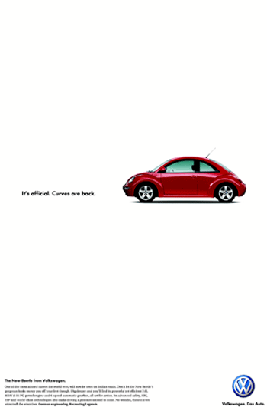
Attention and Awareness

Slide 9
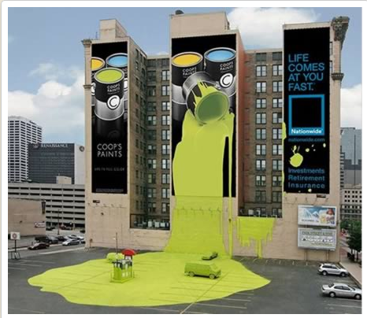
Attention and Awareness

Slide 10

Attention and Awareness

Slide 11
Play…
Bangkok Insurance - Tire
I am Mumbai

Slide 12

Interest

Slide 13

Interest

Slide 14

Interest

Slide 15
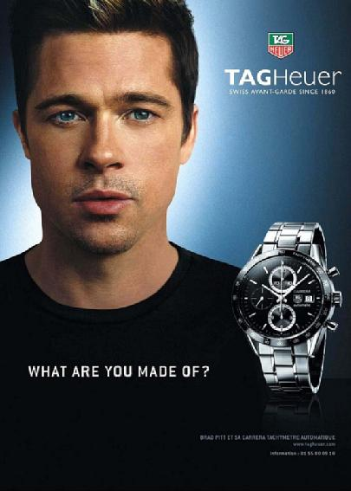
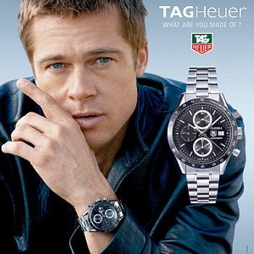
Memory
Repitition

Slide 16
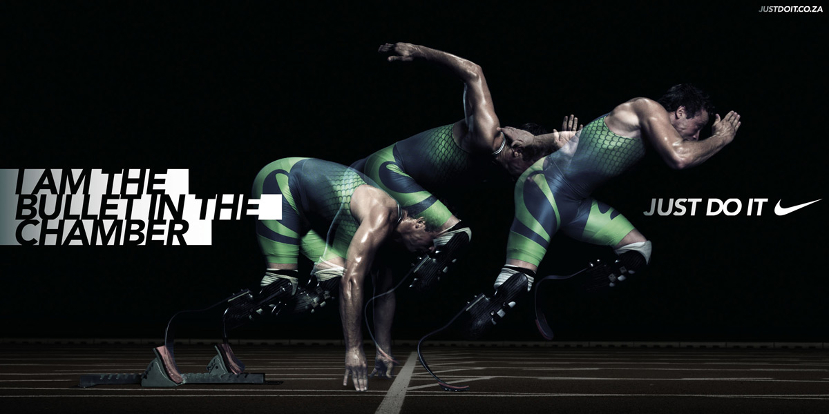
Memory
Tag lines

Slide 17

Memory

Slide 18


Memory
Shape

Slide 19
Play…
Nike Commercial - HD 2011
Orbit - Ultimate Clean Up w Snoop Dogg
Orbit Gum Wedding Reception Commercial

Slide 20
Messages that Drive Cognition
Features
Point of Differentiation
Claim

Slide 21
Messages that Touch Emotions
Highlight psychological attraction of the product to the target audience through emotional responses

Slide 22
Messages that Persuade
Appeal
Selling premises
Conviction

Slide 23
Play…
2010 Toyota Prius Harmony TV Commercial

Slide 24
Messages that Transform a Product into a Brand
Branding
Image advertising is used to create a representation in the customer’s mind
Associations

Slide 25
Play…
THE SKINNY COW Feel the Love Perfect Cups Vide0
Liberation - Harley-Davidson Commercial

Slide 26
Messages that Drive Actions
A signature that serves to identify the company or brand
Also serves as a call to action if it gives direction to the consumer about how to respond
Viral Marketing or Buzz Marketing.

Slide 27
Message Approaches
Straightforward
Demonstration
Comparison
Problem solving/Problem avoidance
Humor
Slice of Life
Spokesperson
Teasers
Shockvertising

Slide 28
Styles of Creative Advertising
Functional Needs: Needs associated with current consumption related problem e.g. Convenience, safety, good health, cleanliness, etc.
Symbolic Needs: Positioning in terms of symbolic needs associates brand with desired group, role or self-image. Personal beauty products, alcoholic beverages, cigarettes and jewellery usually appeal to symbolic needs.

Slide 29
Styles of Creative Advertising
Experiential Needs: Refers to need for sensory pleasure, variety and in some cases cognitive stimulation. Sensory pleasure brings joy to senses such as looking elegent, feeling good, tasty, smelling good, sounding divine, etc. Experiences rich in Cognitive stimulation are exciting, entertaining, mentally challenging, etc.

Slide 30
Styles of Creative Advertising
Unique Selling Proposition Creative Style
- an advertiser makes a superiority claim based on a unique product attribute that represents a meaningful, distinctive consumer benefit.
Brand Image Creative Style
- an advertiser attempts to develop an image or identity for a brand by associating the brand with symbols.

Slide 31
Styles of Creative Advertising
3. Resonance Creative Style
- an advertiser resonates or patterns the audience’s life experiences and prevailing life style of target market.
Emotional Creative Advertising
- an advertiser aims to reach the consumer through the use of emotional strategy.

Slide 32
Styles of Creative Advertising
Generic Creative Style
- an advertiser makes no attempt to differentiate its brand from competitive offerings or to claim superiority.
Preemptive Creative Style
- an advertiser makes a generic-type claim but does so with an assertion of superiority.

Slide 33
Summary
Facets of Creative Strategy
Planning and Managing Creative Strategy

Slide 34
References
Wells, W., Burnett, J. and Moriarty, S. (2006), Advertising Principles and Practice, Prentice-Hall, New Delhi, ND.
Shimp T, 2010, Advertising, Promotion and other Aspects of Marketing Communications, 8th edition, South-Western.

