Slide 1
The Creative Side and Message Strategy
Lecture 13

Slide 2
Recap
Account Planning: What Is It?
Planning for IMC
Creative Brief

Slide 3
Chapter Outline
Chapter Key Points
The Art and Science of Creative Advertising
Creative Strategy
Facets of Creative Strategy
Planning and Managing Creative Strategy

Slide 4
Key Points
Define creative advertising and explain how it leads to a Big Idea
Describe the characteristics of creative people and their creative process
Discuss key creative strategy approaches
Outline the key parts of a creative brief

Slide 5
The Role of Creativity
Creative ads share two features:
Originality
Appropriateness

Slide 6
Play…
Honda - The Cog
Ipod Ad
Sparkling Happydent

Slide 7
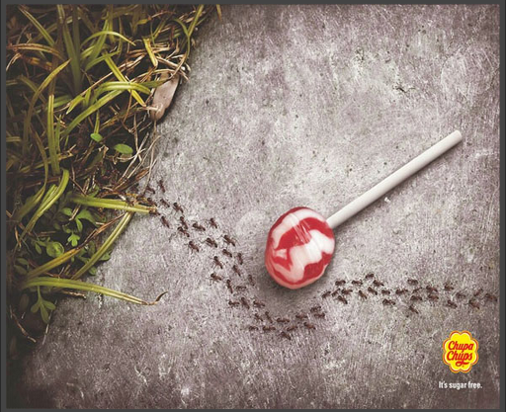

Slide 8
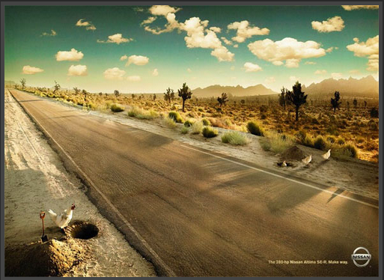

Slide 9
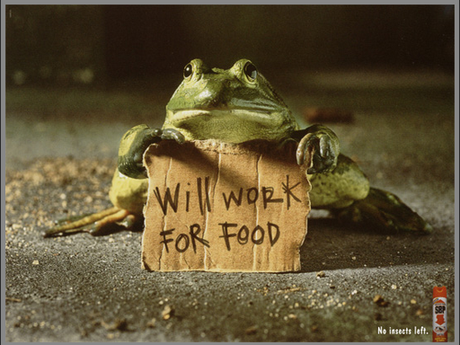

Slide 10
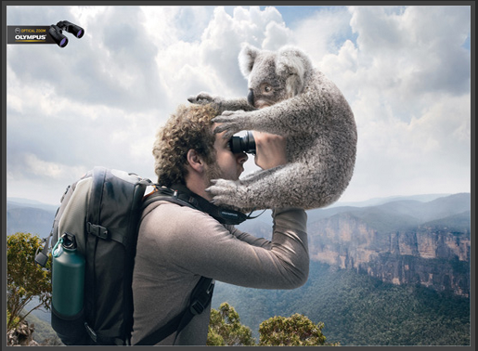

Slide 11
The Art and Science of
Creative Advertising
The ROI of effective advertising
The Big Idea
The Creative Leap

Slide 12
Play…
Most Clever Interactive Billboards (interactive ads, funny billboards)1
Most Clever Interactive Billboards (interactive ads, funny billboards)2
Most Clever Interactive Billboards (interactive ads, funny billboards)3

Slide 13
Play…
Most Clever Interactive Billboards (interactive ads, funny billboards)4
Most Clever Interactive Billboards (interactive ads, funny billboards)5

Slide 14
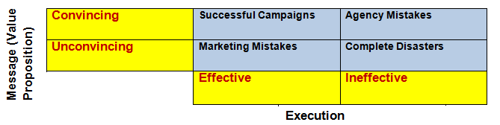
Advertising Successes and Mistakes

Slide 15
Creative Thinking
Free association
  Creates the juxtaposition of two seemingly unrelated thoughts
Divergent thinking
  Uses exploration to search for all possible alternatives
Analogies and metaphors
  Used to see new patterns or relationships
Right-brain thinking
  Intuitive, nonverbal, and emotion-based thinking

Slide 16
Creative Thinking
Creative Roles
  Copywriters and art directors develop the creative concept and draft the execution of the advertising idea
The Creative Person
  In advertising, creativity is both a job description and a goal
Creative Characteristics
Problem solving
Ability to visualize
Openness to new experiences
Conceptual thinking

Slide 17
The Creative Process: How to get an idea.
Steps and Stages:
Step 1: Immersion
Step 2: Ideation
Step 3: Brainfog
Step 4: Incubation
Step 5: Illumination
Step 6: Evaluation
Brainstorming

Slide 18
Simile vs. Metaphor vs. Allegory
Simile: A simile is a figure of speech that directly compares two different things in order to create a new meaning, usually by employing the words "like" or "as”.
He fights like a lion.
He runs like a cheetah.
He was as tough as a bull.
She walks as gracefully as a cat.
Brand xyz makes teeth as white as pearls.

Slide 19
Simile vs. Metaphor vs. Allegory
A metaphor is a literary figure of speech that describes a subject by asserting that it is, on some point of comparison, the same as another otherwise unrelated object. Metaphor is a type of analogy and is closely related to other rhetorical figures of speech that achieve their effects via association, comparison or resemblance.

Slide 20
Simile vs. Metaphor vs. Allegory
All the world’s a stage.
A simile states that A is like B, a metaphor states that A is B or substitutes B for A.
You are a couch potato. This refers to someone who sits and does nothing.
He’s a diamond in the rough. This means he is better than he appears and maybe needs more experiences or training to show his true nature.

Slide 21
Simile vs. Metaphor vs. Allegory
Simile: Your eyes are like sunshine. Metaphor: You are my sunshine.
Simile: He eats like a pig. Metaphor: He is a pig.
Simile: You are like a rock. Metaphor: You are a rock.
Simile: You are as happy as a clown. Metaphor: You are a clown.
Simile: He is as stubborn as a mule. Metaphor: He is a mule.
Simile: The world is like a stage. Metaphor: The world is a stage.
Simile: The noise is like music to my ears. Metaphor: The noise is music to my ears
Simile: Her heart is like gold. Metaphor: Her heart is gold.
Similie: Your thoughts are like a storm. Metaphor: Your thoughts are a storm.

Slide 22
Simile vs. Metaphor vs. Allegory
Allegory representation of abstract ideas or principles by characters, figures, or events in narrative, dramatic, or pictorial form.
Examples:"There are obvious layers of allegory in the movie Avatar. The Pandora woods is a lot like the Amazon rainforest (the movie stops in its tracks for a heavy ecological speech or two), and the attempt to get the Na'vi to 'cooperate' carries overtones of the U.S. involvement in Iraq and Afghanistan."
(Owen Gleiberman, review of Avatar. Entertainment Weekly, Dec. 30, 2009)

Slide 23

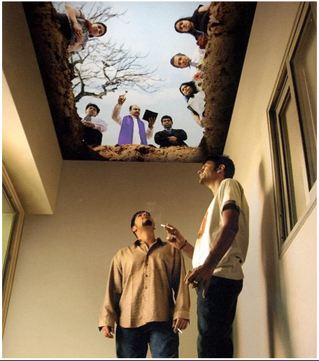
Simile vs. Metaphor vs. Allegory

Slide 24
Creative Strategy
A big idea must be creative and strategic. Advertising creativity is about coming up with a novel idea that solves a communication problem in an original way.
Head and Heart Strategies
Hard and Soft-Sell Strategies
Lectures and Dramas

Slide 25

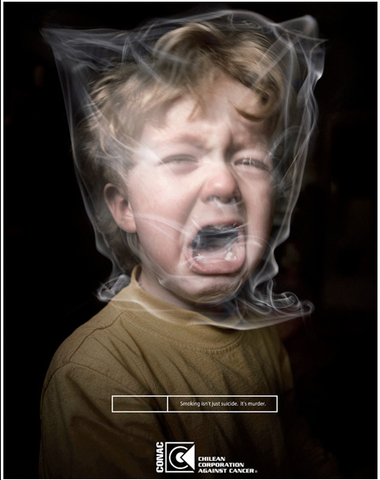
1. Head and Heart Strategies

Slide 26
2. Hard and Soft-sell Strategies
Gas Station by Chevrolet Volt
Motorcycle by Old Spice

Slide 27
3. Lectures and Dramas
Lectures: Serious instructions given verbally, uses evidence and arguments to persuade audience, makes points explicitly.
Drama: Relies on viewers to make inferences, are like movies, novels, tales and can be funny or serious.

Slide 28
Zong Commercial(TV AD)
Tata Sky Aamir Khan Saloon ad

Slide 29
Summary
Chapter Key Points
The Art and Science of Creative Advertising
Creative Strategy

Slide 30
References
Wells, W., Burnett, J. and Moriarty, S. (2006), Advertising Principles and Practice, Prentice-Hall, New Delhi, ND.
Shimp T, 2010, Advertising, Promotion and other Aspects of Marketing Communications, 8th edition, South-Western.

