Slide 1
Advertising and Public Relations
Muhammad Waqas

Slide 2
Learning Outcomes
By the end of the module students will be able to:
Appreciate the diversity of marketing communications activities and understand the concept and process of advertising.
Understand differing approaches to theorising advertising and their contributions to the conceptualisation of advertising strategies and tactics.
Demonstrate comprehensive understanding of varied advertising tools.
Analyse and critically evaluate national, international and cross-cultural advertising strategies and campaigns.
Critically discuss the ethical issues encompassing advertising.

Slide 3
Learning Outcomes
(Continued)
Demonstrate awareness of the interrelationships between advertising, culture and society.
Demonstrate awareness of interrelationships between various public relations tools.

Slide 4
Approach to Teaching
The module adopts a student-oriented approach using a variety of teaching methods to accommodate multiple learning styles.
Students are responsible for their learning, therefore are expected to read the prescribed reading before each.

Slide 5
Teaching and Learning Approach
Lectures : Formal presentation of theories, concepts and their applicability using relevant examples, and exercises.

Slide 6
Reading
Main Text Book
Advertising Principles and Practice
By William Wells, John Burnett, Sandra Moriarty
[7th Edition] Prentice Hall
Other Books
Advertising, Promotion and other Aspects of Integrated Marketing Communications
By Terence A. Shimp
[7th Edition] Thomson
Contemporary Advertising
By William F. Arens
[Latest Edition] McGraw Hill

Slide 7
Some useful information about the module
Slides are only starting point for discussion in lecture. Students have to use multiple resources (journal articles and books).
Focusing only on the slides for their revision might find it difficult to have high achievement.
Often older editions of books have been used to develop some of the slides used in class.

Slide 8
Introduction to Advertising
First Session

Slide 9
Lecture Objectives
Define advertising and explain its key components
Discuss the roles and functions of advertising within society and business
Identify the key players and their roles in creating advertising
Explain the different types of advertising
Summarize the characteristics of effective advertising and explain why it is always goal directed
Analyze the changes affecting the advertising industry

Slide 10

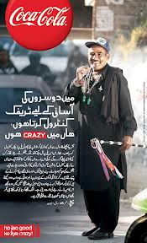







Slide 11

Ho Jao Good k Liye Crazy - Pappu Sergeant

Slide 12
What Is Advertising?
“Advertising is the structured and composed non personal communication of information, usually persuasive in nature, about products (goods, services and ideas) by identified sponsors through various media” (Arens, 2004, p. 07).
Five basic components:
  Paid communication
  Sponsor is identified
  Tries to persuade or influence
  Reaches a large audience
  Conveyed through impersonal mass media

Slide 13
Key Concepts of Advertising
Strategy
Creative idea
Execution
Media
The logic and planning behind the ad
Advertisers develop ads to meet objectives
Advertisers direct ads to identified audiences
Advertisers create messages that speak to the audience’s concerns
Advertisers run ads in the most effective media

Slide 14
Key Concepts of Advertising
Strategy
Creative idea
Execution
Media
The central idea that grabs the consumer’s attention
Creativity drives the entire field of advertising

Slide 15
Key Concepts of Advertising
Strategy
Creative idea
Execution
Media
Effective ads adhere to the highest production values in the industry
Clients demand the best production the budget allows

Slide 16
Key Concepts of Advertising
Strategy
Creative idea
Execution
Media
Communication channels that reach a broad audience
How to deliver the message is just as important coming up with the creative idea of the message

Slide 17


Roles of Advertising
Hard-Sell Approach
Soft-Sell Approach

Slide 18
Roles of Advertising
Marketing
Communication
Economic
Societal
The process a business uses to satisfy consumer needs by providing goods and services
  Product category
  Target market
  Marketing mix
  Brand

Slide 19
Roles of Advertising
Marketing
Communication
Economic
Societal
Can reach a mass audience
Introduces products
Explains important changes
Reminds and reinforces
Persuades

Slide 20
Roles of Advertising
Marketing
Communication
Economic
Societal
Moves from being informational to creating demand
Advertising is an objective means for providing price-value information, thereby creating a more rational economy

Slide 21
Roles of Advertising
Marketing
Communication
Economic
Societal
Informs consumers about innovations and issues
Mirrors fashion and design trends
Teaches consumers about new products
Helps shape consumer self-image
Perpetuates self-expression

Slide 22
The Functions of Advertising
Builds awareness of products and brands
Creates a brand image
Provides product and brand information
Persuades people
Provides incentives to take action
Provides brand reminders
Reinforces past purchases and brand experiences

Slide 23
The Key Players
Advertiser (client)
Agency
Media
Supplier
Audience
Uses advertising to send out a message about its products
Initiates the advertising effort by identifying a marketing problem
Approves audience, plan and budget
Hires the advertising agency

Slide 24
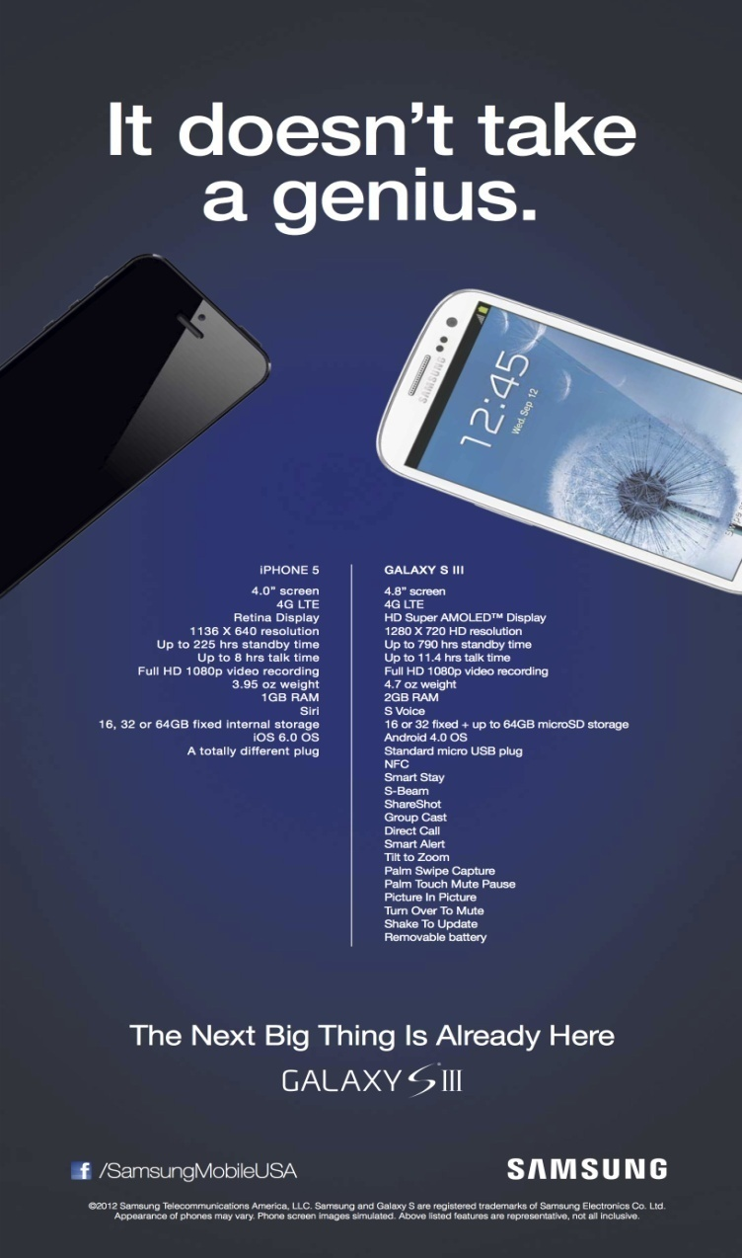

Advertiser

Slide 25
The Key Players
Advertiser (client)
Agency
Media
Supplier
Audience
Has strategic and creative expertise, media knowledge, workforce talent, and negotiating abilities
  Advertising department
  In-house agency

Slide 26
Agency
Orient McCann-Erickson
Synergy Advertising
JWT
Interflow Communications
Evernew Entertainment
The Circuit
Midas

Slide 27
The Key Players
Advertiser (client)
Agency
Media
Supplier
Audience
The channels of communication that carry the message to the audience
Are also companies or huge conglomerates
Mass media advertising can be cost effective because the costs are spread over the large number of people the ad reaches

Slide 28


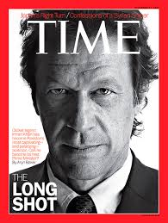
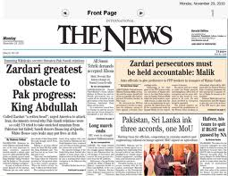

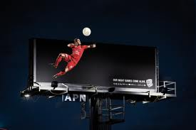
Media

Slide 29
The Key Players
Advertiser (client)
Agency
Media
Supplier
Audience
Assist advertisers, agencies, and the media in creating and placing the ads
Vendor services are often cheaper than those in-house

Slide 30





Supplier

Slide 31
The Key Players
Advertiser (client)
Agency
Media
Supplier
Audience
The desired audience for the advertising message
Data-gathering technology improves accuracy of information about customers
Advertisers must recognize the various target audiences they are talking to and know as much about them as possible

Slide 32
Types of Advertising
Brand advertising
Retail or Local advertising
Direct-Response advertising
Business-to-Business advertising
Institutional advertising
Nonprofit advertising
Public Service advertising

Slide 33
An Effective Ad
If it creates an impression for a product or brand
If it influences people to respond in some way
If it separates the product or brand from the competition in the mind of the consumer

Slide 34
The Evolution of Advertising
Age of Print
Industrial Revolution and Emergence of Consumer Society
Modern Advertising Era
Accountability Era

Slide 35
The Current Advertising Scene
Expanded view
Integrated Marketing Communication
Globalization
Electronic media are changing the media landscape
New media are more personal and interactive

Slide 36
The Current Advertising Scene
Expanded view
Integrated Marketing Communication
Globalization
The practice of unifying all marketing communication tools so they send a consistent, persuasive message
Coordination of IMC tools creates synergy

Slide 37
The Current Advertising Scene
Expanded view
Integrated Marketing Communication
Globalization
Increasing globalization of marketing programs
Advertisers are moving into global markets and agencies are forming huge multinational operations

Slide 38
BMW Films-Ambush

Slide 39
References
Wells, W., Burnett, J. and Moriarty, S. (2006), Advertising Principles and Practice, Prentice-Hall, New Delhi, ND.

Slide 40
Next Session
Session 2: Advertising Role in Marketing

