Slide 1
From Identity to Reality
Corner No. 1: Ideology
Zeenat Jabbar

Slide 2
Aspects of Brand
BRAND IMAGE
  How the brand is now perceived
BRAND IDENTITY
  How strategists want the brand to be perceived
BRAND POSITION
  The part of the brand identity and value proposition to be actively communicated to a target audience

Slide 3
Brand Identity System
A brand’s identity can be viewed from four
perspectives:
  brand as product
  brand as organization
  brand as person
  brand as symbol
When we view a brand from all these
perspectives, it is easier to develop/reinforce
a Value Proposition, Credibility and,
ultimately, a Relationship with the customer.

Slide 4
Brand Name
Awareness
BRAND EQUITY IS …
Brand
Loyalty
Perceived
Quality
Brand
Associations

Slide 5
TAPAL

Slide 6
Brand Identity Planning
Extended
core
Brand As Product
Product Scope
Product Attributes
Quality/Value
Uses
Users
Country
Brand as Organization
Organizational Attributes
Local vs. Global
Brand As Person
Personality
Brand-customer relationship
Brand As Symbol
Visual Imagery and metaphors
Brand Hreritage

Slide 7
Brand Identity System
Brand Identity
Brand as
Product
Brand as
Organization
Brand as
Person
Brand as
Symbol
Value Proposition
Credibility
Brand-Customer Relationship

Slide 8
CADBURY

Slide 9
Six Facets of Brand Identity
1. A brand has physical qualities or a ‘physique’
  What does it do?
  What does it look like?
2. A brand has its own personality
  Spokesperson or figurehead role
What brand would be if it were a person
3. A brand has its own culture
  Set of values feeding the brand’s inspiration
Country of origin
4. A brand has its own relationship
  Exchanges between people and brand
  Service sectors and retailers

Slide 10
5. A brand is a reflection
  Produces a reflection or image of the buyer or user
  Different from target the describes brand’s potential buyer or user
  Customer is reflected as s/he wishes to be seen from using the brand
  Consumers use brands to built their own identities
6. A brand speaks to our self image
  Self image is the target’s own internal mirror
  Attitude toward the brand fosters an inner relationship with self

Slide 11
The Kapferer Brand Identity Prism
PICTURE OF SENDER
Physique
Personality
EXTERNALISATION
INTERNALISATION
Relationship
Culture
Reflection
Self-Image
PICTURE OF RECIPIENT

Slide 12
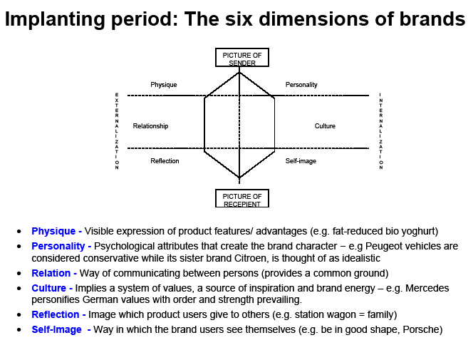

Slide 13
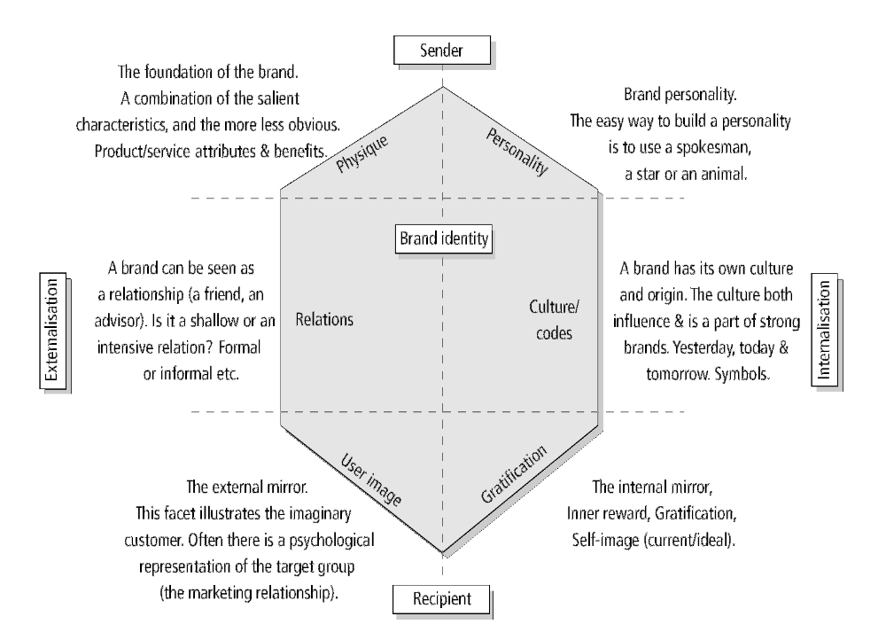

Slide 14
UFONE

Slide 15
Brand Equity
Combination of Assets and Liabilities associated with a brand.
It enhances or depreciate the value of brand.
Brand equity is the added value endowed on products and services, which may be reflected in the way consumers think, feel, and act with respect to the brand.

Slide 16
Five Major determinants- Brand Equity
Awareness
Quality
Perception
Loyalty
Patents and trademark

Slide 17
FAYSAL BANK

Slide 18
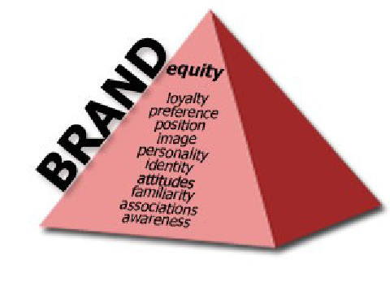
Pyramid Of Brand Equity

Slide 19
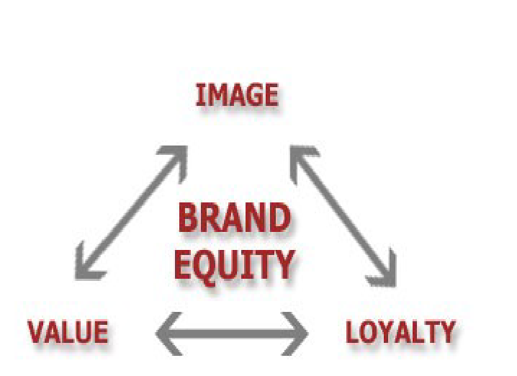
Process of Brand Equity

