Slide 1

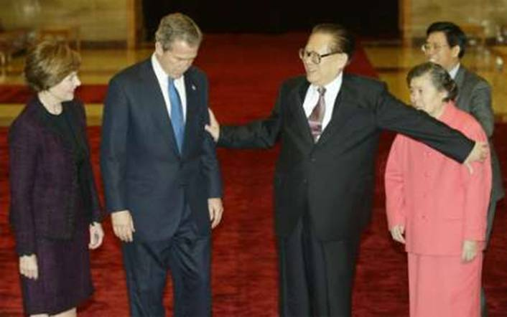
Understanding Cultures

Slide 2
In case you needed further proof that the human race is doomed through stupidity, here are some actual label instructions on consumer goods:
1. On Sears hairdryer: "Do not use while sleeping". [Gee, that's the only time I have to work on my hair]
2. On a bag of Fritos: "You could be winner! No purchase necessary. Details inside". [Evidently, the shoplifter special]
3. On a bar of Dial soap: "Directions: Use like regular soap." [And that would be how...?]
4. On some Swanson frozen dinners: "Serving suggestions: Defrost." [But it's *just* a suggestion]
5. On Tesco's Tiramisu dessert (printed on bottom of box): "Do not turn upside down". [Oops, too late!]
6. On Marks & Spencer Bread Pudding: "Product will be hot after heating". [As sure as night follows the day...]
7. On packaging for a Rowenta iron: "Do not iron clothes on body". [But wouldn't this save even more time?]
8. On Boot's Children's Cough Medicine: "Do not drive a car or operate machinery after taking this medication". [We could do a lot to reduce the rate of construction accidents, if we could just get those 5-year-olds with head-colds off those forklifts.]
9. On Nytol Sleep Aid: "Warning: May cause drowsiness". [One would hope]
10. On most brands of Christmas lights: "For indoor or outdoor use only". [As opposed to what?]
11. On a Japanese food processor: "Not to be used for the other use". [I gotta admit, I'm curious]
12. On Sainsbury's peanuts: "Warning: Contains nuts". [NEWS FLASH]
13. On an American Airlines packet of nuts: "Instructions: open packet, eat nuts." [Step 3: Fly Delta]
14. On a child's Superman costume: Wearing of this garment does not enable you to fly". [I don't blame the company. I do blame parents for this]

Slide 3
How Much Money Will Be Spent
Social Class
How Money Will Be Spent
Social Class is Determined by a Complex Set of Variables, Including: Income, Family Background, and Occupation.
Social Class Influences:
Access to Resources Such as Education, Housing,
and Consumer Goods
Taste and Lifestyles

Slide 4
Social Stratification
Social Stratification Refers to the Creation of Artificial Divisions In a Society by:
Achieved Status
Earned Through Hard Work
Ascribed Status
Obtained Through Luck or Inheritance
Status
Hierarchy
Some Members Are
Somehow Better Off
Than Others

Slide 5
Upper-Upper
0.3%
Lower-Upper
1.2%
Class Structure
Upper-Middle
12.5%
Middle Class
32%
Working Class
38%
Lower But Not Lowest
9%
Access to Resources Such As Money,
Education, and Luxury Goods
Real Lower-Lower
7%

Slide 6
Social Mobility
Social Mobility Refers to the Passage of Individuals From One Social Class to Another.
Upward Mobility
Horizontal Mobility
Downward
Mobility

Slide 7
Components of Social Class
Occupational
Prestige
Income
Educational
Attainment

Slide 8
Does it Fit With Basic Lifestyle Changes?
What are the Benefits?
Fad or Trend?
Can it be Personalized?
Is it a Trend or a Side Effect?
Questions to Ask to Determine if a Trend, Which Lasts for Some Time, is Occurring Include:
What Other Changes Have Occurred in the Market?
Who Has Adopted the Change?

Slide 9
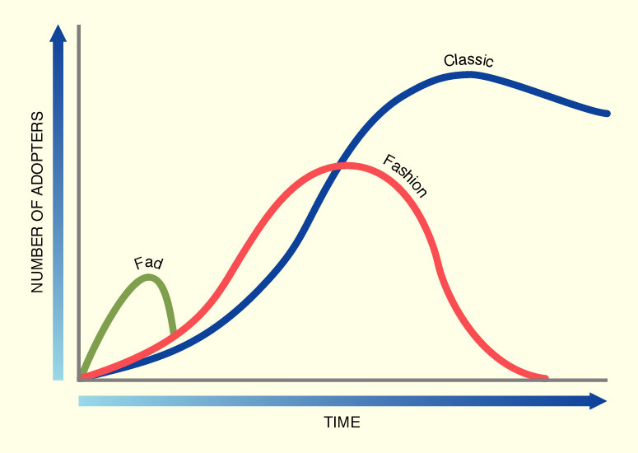
Fads, Fashions and Classics

Slide 10
Defining The Modern Family
Extended
Family
Nuclear
Family
Family
Household

Slide 11
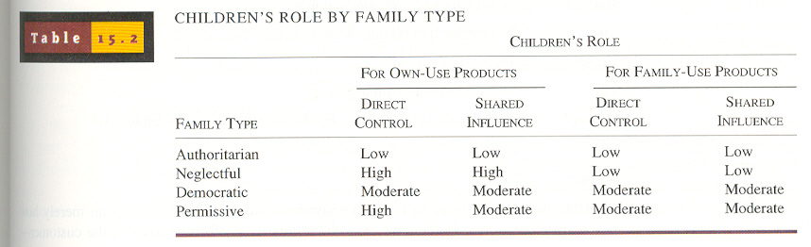

Slide 12
Effects of Family Structure on
Consumption
The Family Life Cycle (FLC) Combines Trends in Income and Family Composition With the Changes in Demands Placed Upon This Income.
Four Variables are Necessary to Describe These Changes:
Age
Marital Status
Presence or Absence of Children
in the Home
Children’s Ages (if any)

Slide 13
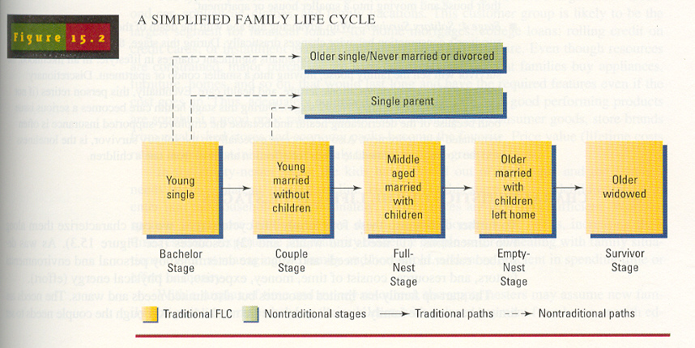

Slide 14
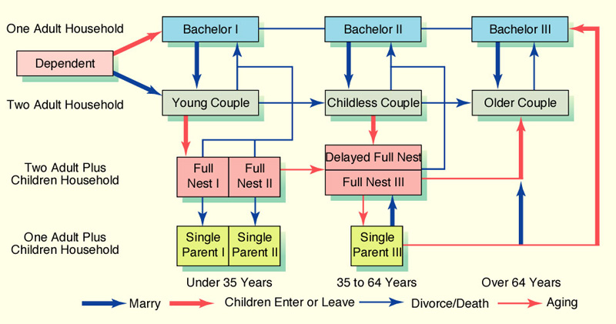
Family Life Cycle

Slide 15
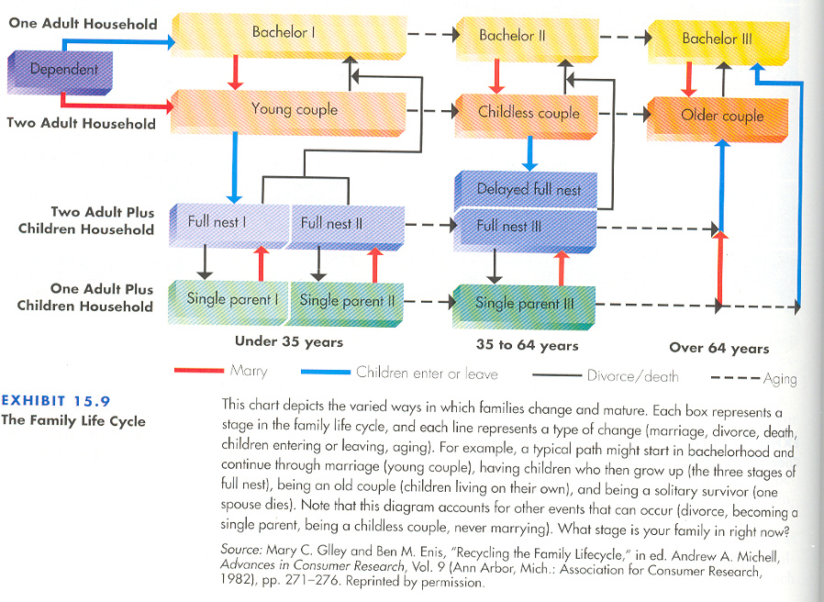

Slide 16
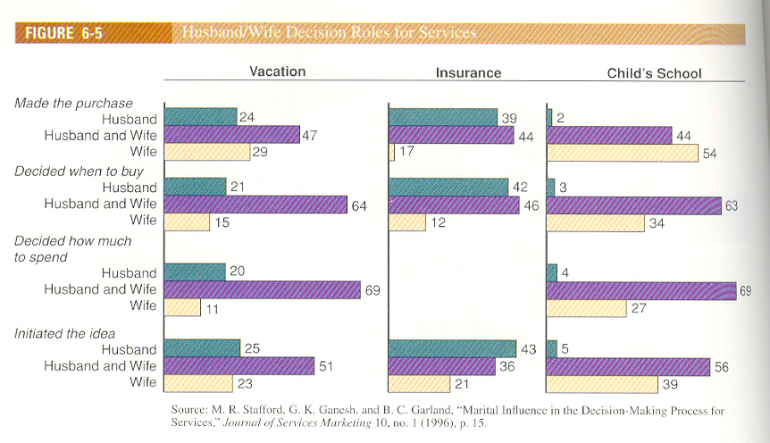

Slide 17
Types of Purchase Decisions
Made by Families
Family Decision Making
Accommodative
Group Members Have Different
Preferences and Can’t Agree
on a Purchase That
Will Satisfy Everyone.
Consensual
Group Agrees on the Desired
Purchase, Differing Only in
Terms of How It Will
Be Achieved.

Slide 18
Consumer Socialization
Influence of
Parents
Influence of
Media
Authoritarian
E-Babysitter
Neglected
Indulgent

Slide 19
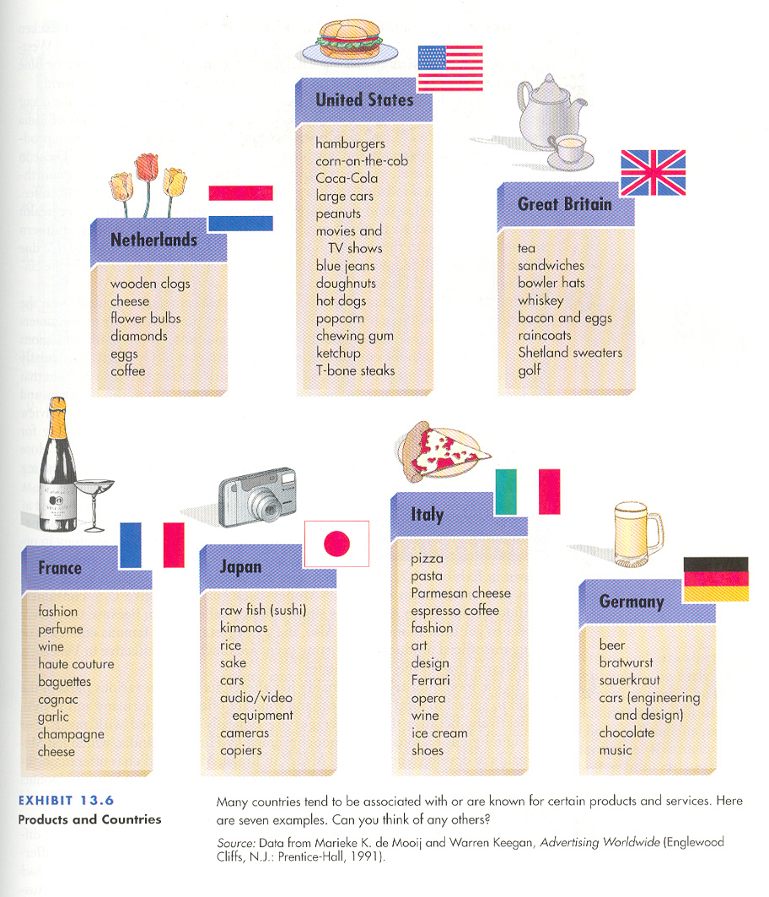

Slide 20
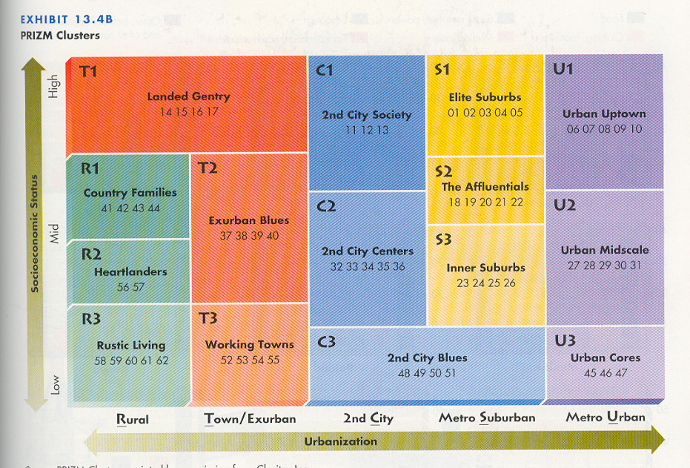

Slide 21
What is Culture?
Culture includes the entire heritage of a society transmitted by word, literature, or any other form. It includes all tradition, habits, religion, art, and language. Culture affects the human aspect of a person’s environment: it consists of beliefs, morals, customs and habits learned from others

Slide 22
Cultural Influences

Slide 23
Low Context
Swiss German
German
Scandinavian
United States
French
English
Italian
Spanish
Greek
Arab
Chinese
Japanese
High Context

