Slide 1
Group Influence and
Opinion Leadership

Slide 2
Reference Groups
A Reference Group is an Actual or Imaginary Individual or Group Conceived of Having Significant Relevance Upon an Individual’s Evaluations, Aspirations, or Behavior.
Reference Groups Influence Consumers in Three Ways:
Informational
Value-Expressive
Utilitarian

Slide 3
KITKAT

Slide 4
Influence and Types of
Reference Groups
Normative Influence
  The social power of reward and punishment that produces behavioral compliance but may not produce any private acceptance of the position advocated.
Comparative Influence
  The group does not attempt to set, or enforce, rules for your behavior, but only serves as a standard you choose for comparison.
Formal Versus Informal Groups
  Small, informal groups are more common and important to us because of their high Normative Influence.
  Larger, formal groups tend to be higher in Comparative Influence.

Slide 5
LITTER

Slide 6
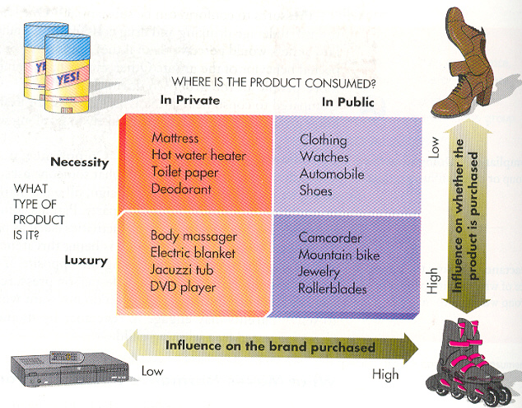

Slide 7
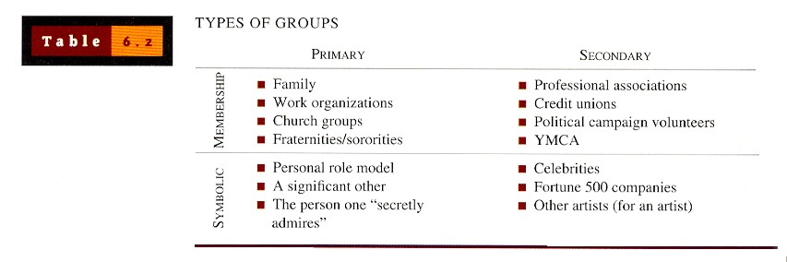

Slide 8
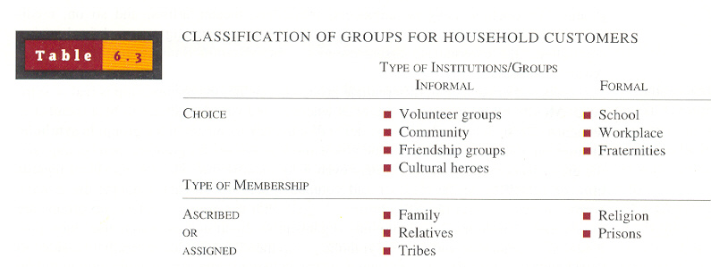

Slide 9
The Power of Reference Groups
Coercive
Power
Social
Power
Reward
Power
Referent
Power
Types of Reference Group Power
Expert
Power
Information
Power
Legitimate
Power

Slide 10
NESPRAY

Slide 11
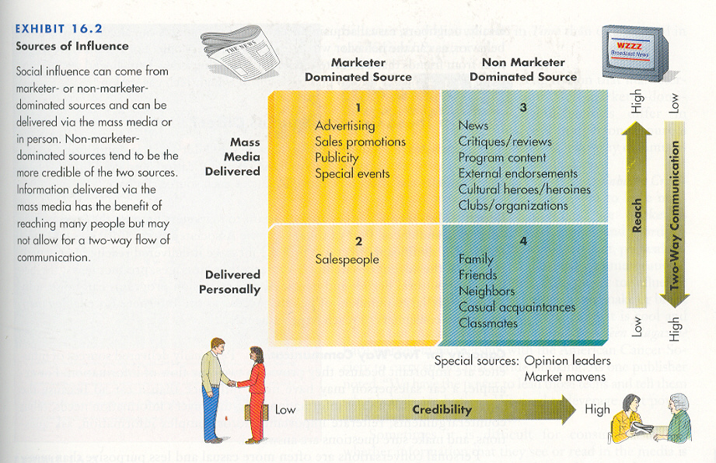

Slide 12
Types of Social Influence
Conformity
Conformity Refers to a Change in Beliefs or Actions as a Reaction to Real or Imagined Group Pressure.
Norms Refer to Informal Rules That Governs Behavior
Normative
Person Conforms to Meet
the Expectations of a
Person or Group.
Informational
Conformity That Occurs Because
the Group’s Behavior is Taken
as Evidence About Reality.

Slide 13
Cultural Pressures
Factors Affecting the Likelihood
of Conformity
Fear of Deviance
Commitment
Group Dynamics
Susceptibility to
Interpersonal Influences

Slide 14
HOLDEN

Slide 15
Compliance and Obedience
Foot-in-the-Door
The Way a Request for Compliance is Phrased or Structured Can Make a Difference in Acceptance.
Low-Ball Technique
Make a Small Request First, Then Make a Larger One Later.
Person is Asked for a Small Favor That Turns Out to Be Costly.
Door-in-the-Face
Make an Extreme Request First, Then a Reasonable Request Later.

Slide 16
Person is Highly Involved With the Product
Word-of-Mouth Communication
Person is Highly Knowledgeable About the Product
Much Information About Products and Services is Actually Conveyed by Individuals on an Informal Basis called Word-of-Mouth Communication (WOM).
Factors That Encourage WOM Are:
Person Has a Genuine Concern for Someone Else
Person May be Uncertain About a Recent Purchase

Slide 17
Negative Word-of-Mouth
Negative Word-of-Mouth:
  Is weighted more heavily by consumers than positive comments.
  Has been shown to reduce the credibility of a firm’s advertising.
  May influence consumers’ attitudes toward a product as well as their intention to buy it.
Rumors are the chief form of negative WOM.
  Rumors often result in Boycotts of products, companies, or services.

Slide 18
Opinion Leaders
An Opinion Leader is Someone Who is Knowledgeable About Products and Whose Advice is Taken Seriously By Others
Are Often Among
the First to Buy
New Products
Are Technically
Competent and Have Expert Power
Opinion
Leaders
Are Similar to
the Consumer in
Values and Beliefs
Have Prescreened,
Evaluated, and
Synthesized
Product Information
Are Socially
Active in
Their Community

Slide 19
Extent of An Opinion Leader’s
Influence
Very few people are Generalized Opinion Leaders, someone whose recommendations are sought for all types of purchases.
More likely, opinion leaders are either:
  Monomorphic, or an expert in a limited field.
  Polymorphic, or an expert in several fields.
Even opinion leaders who are Polymorphic, tend to concentrate on one broad domain, such as electronics or fashion.

Slide 20
Characteristics of Opinion
Leaders
Innovators
Are Opinion
Seekers
Key
Characteristics
of
Opinion
Leaders
Innovative
Communicators
Market
Maven

Slide 21
PEPSI

Slide 22
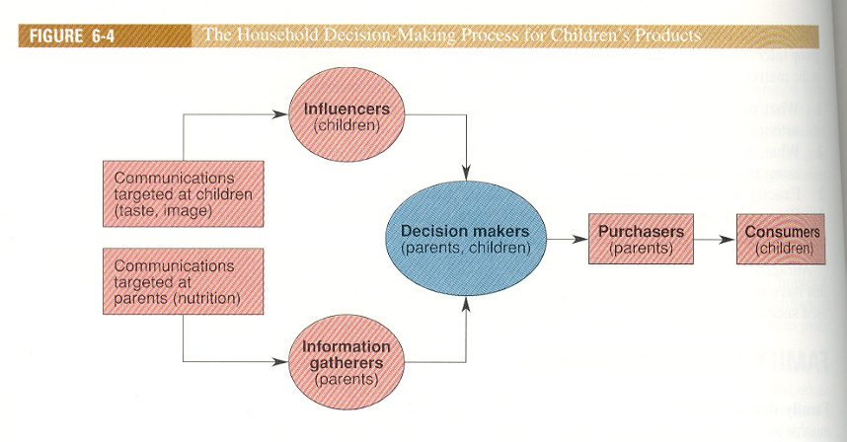

Slide 23
TELENOR

Slide 24
AL-KARAM

Slide 25
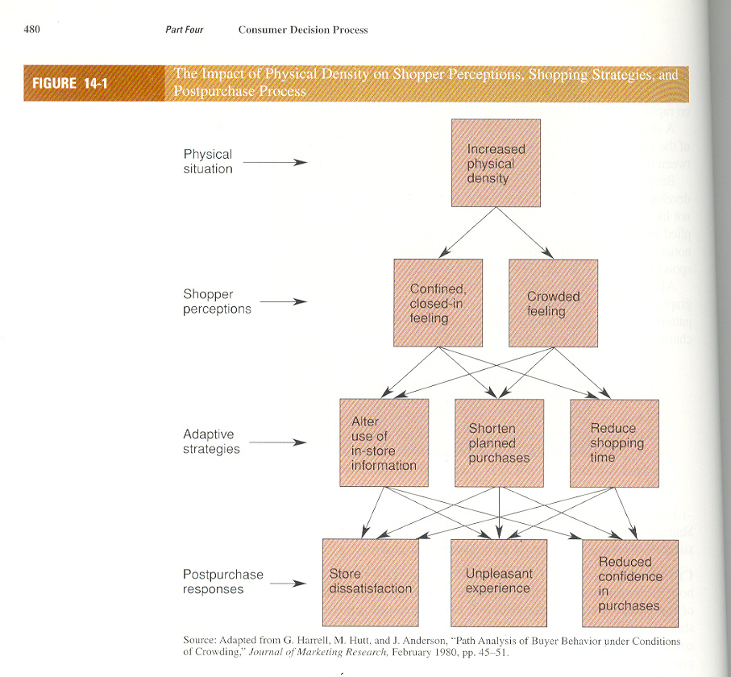

Slide 26
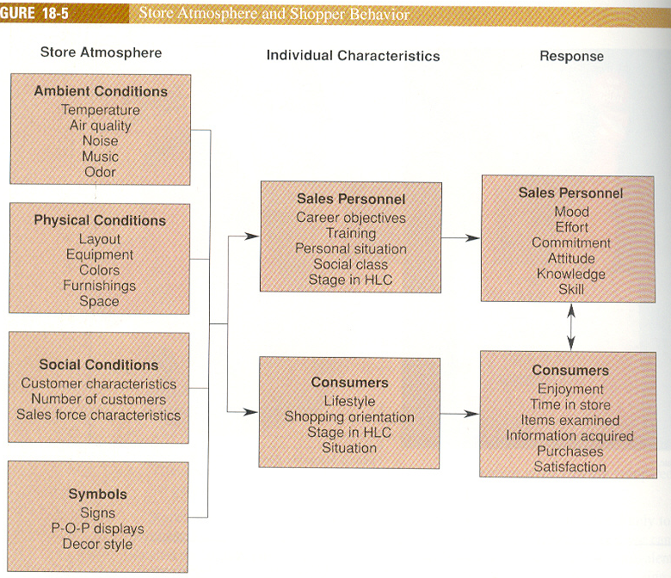

Slide 27
