Slide 1
Consumer Behaviour
…… An Introduction

Slide 2
What is Consumer Behavior?
Consumer Behavior investigates the manner that people interact with products and their marketing environment. This can include the purchase of products (a new stereo), the consumption of services (Disneyland), or the disposal of goods (eBay). Since we are all consumers in the market place in some form consumer behavior can also tell us something about ourselves. As a result, I think, consumer behavior (or CB) is one of the most interesting topics in Marketing. Understanding consumers enables marketers to more effectively meet the needs of buyers in the market, and be more successful in the market.

Slide 3
During this course we will explore, many social, cultural and marketing factors that influence the selection and usage of products and services. To understand this process, you will be exposed to perspectives on consumer behavior from marketing, psychology, sociology and anthropology. You will also learn about, and try to use, some of the techniques that marketers use to understand and influences consumers, and how these techniques contribute to our daily lives and the culture in which we live.

Slide 4
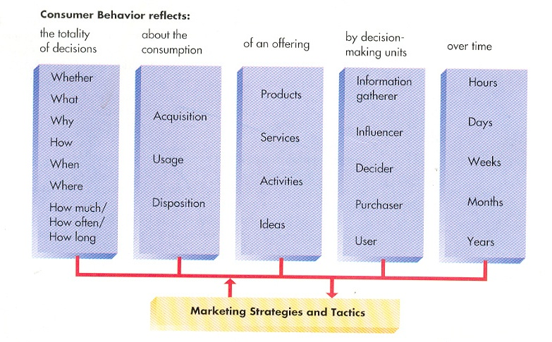

Slide 5
What Drive
Consumers’ Attitudes
Towards Brands?

Slide 6
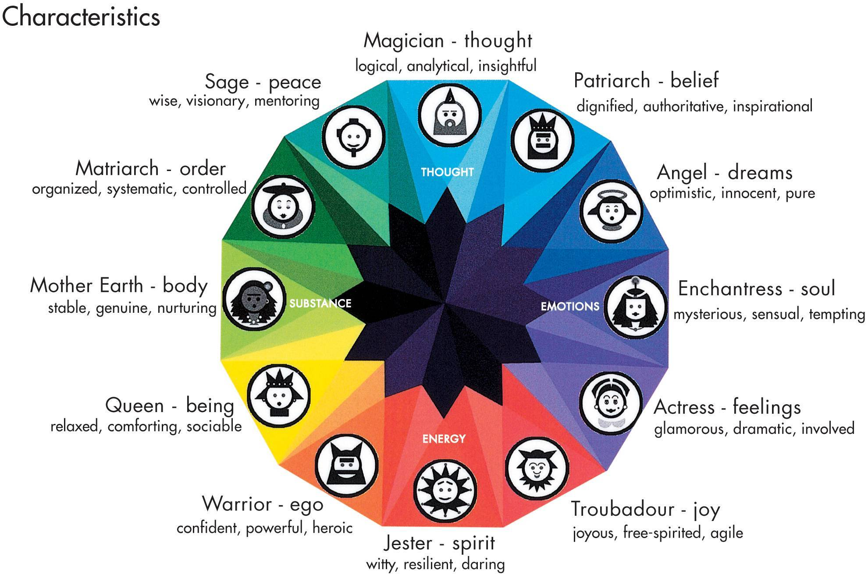

Slide 7
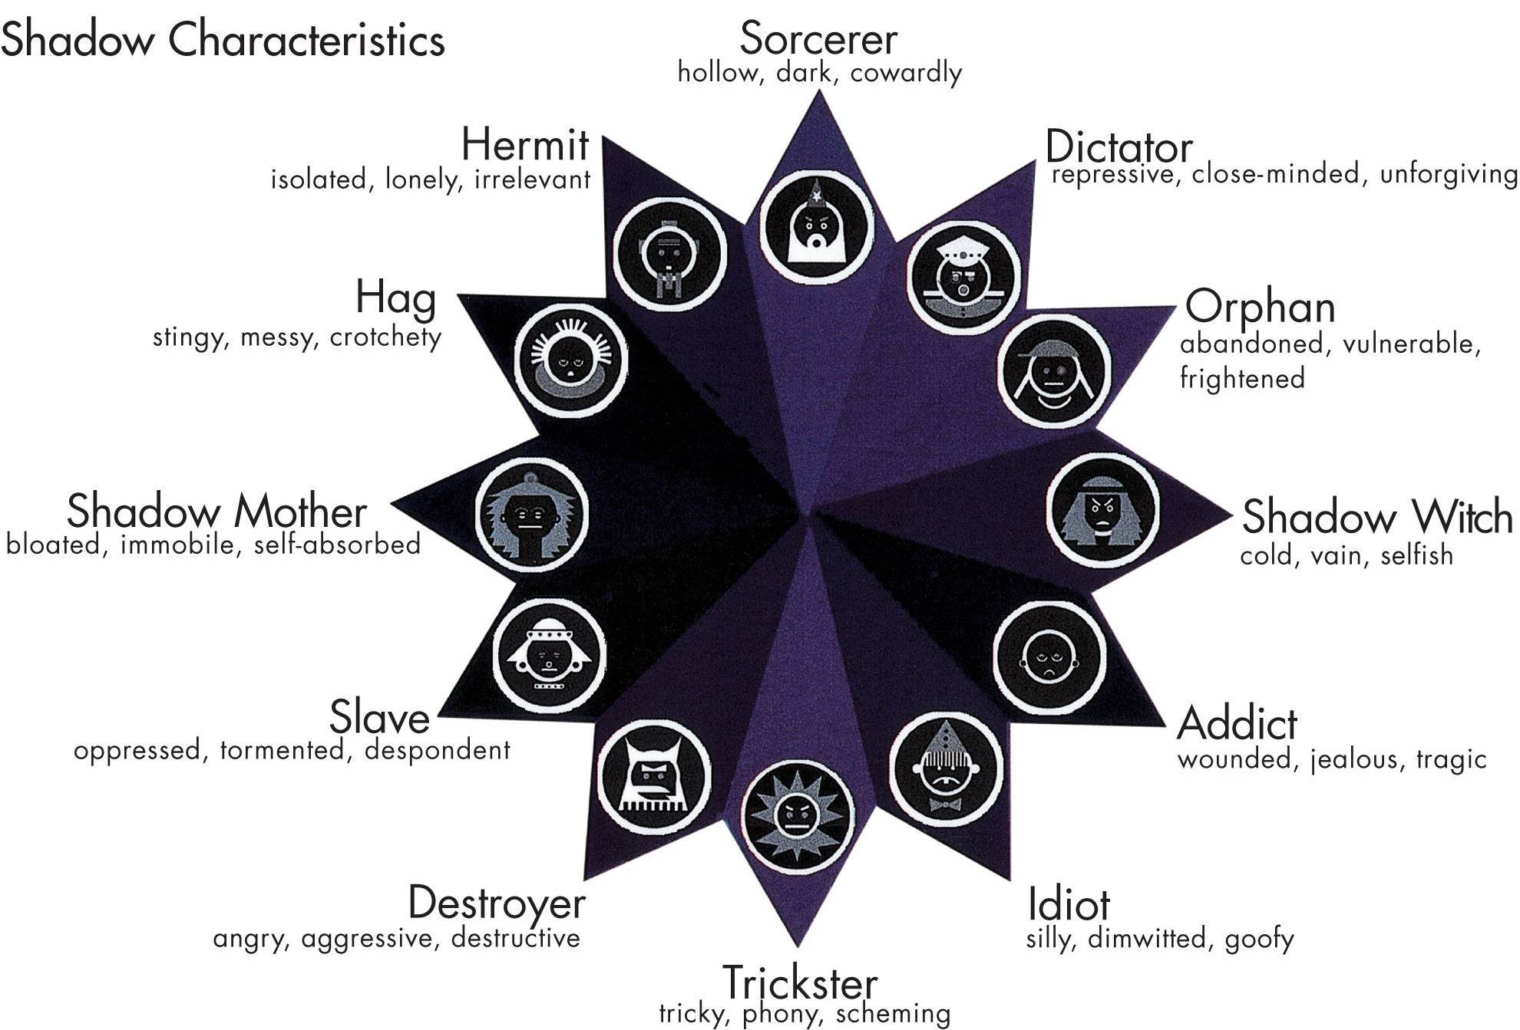

Slide 8
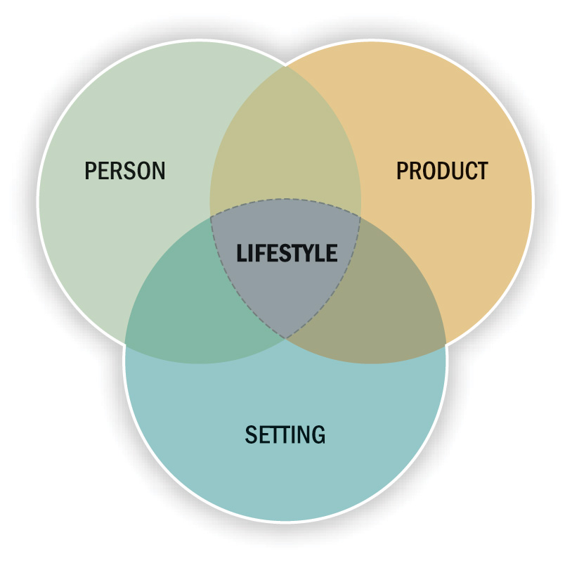
Linking Products to Lifestyles

Slide 9
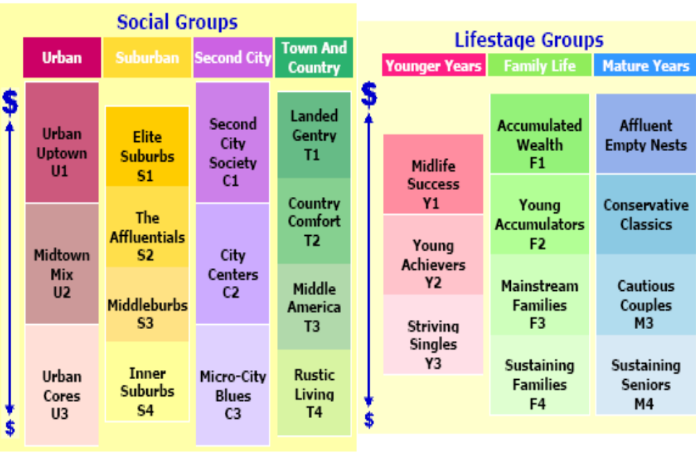

Slide 10
Personality, Segmentation
&
Lifestyles

Slide 11
Personality refers to a person’s unique psychological makeup and how it consistently influences the way a person responds to his or her environment.
Most now agree that both personality and situational factors play a role in determining people’s behavior.
Personality is usually involved, along with:
  A person’s choices of leisure activities, political outlook, aesthetic tastes, and
  Other individual factors to segment customers in terms of Lifestyles.

Slide 12
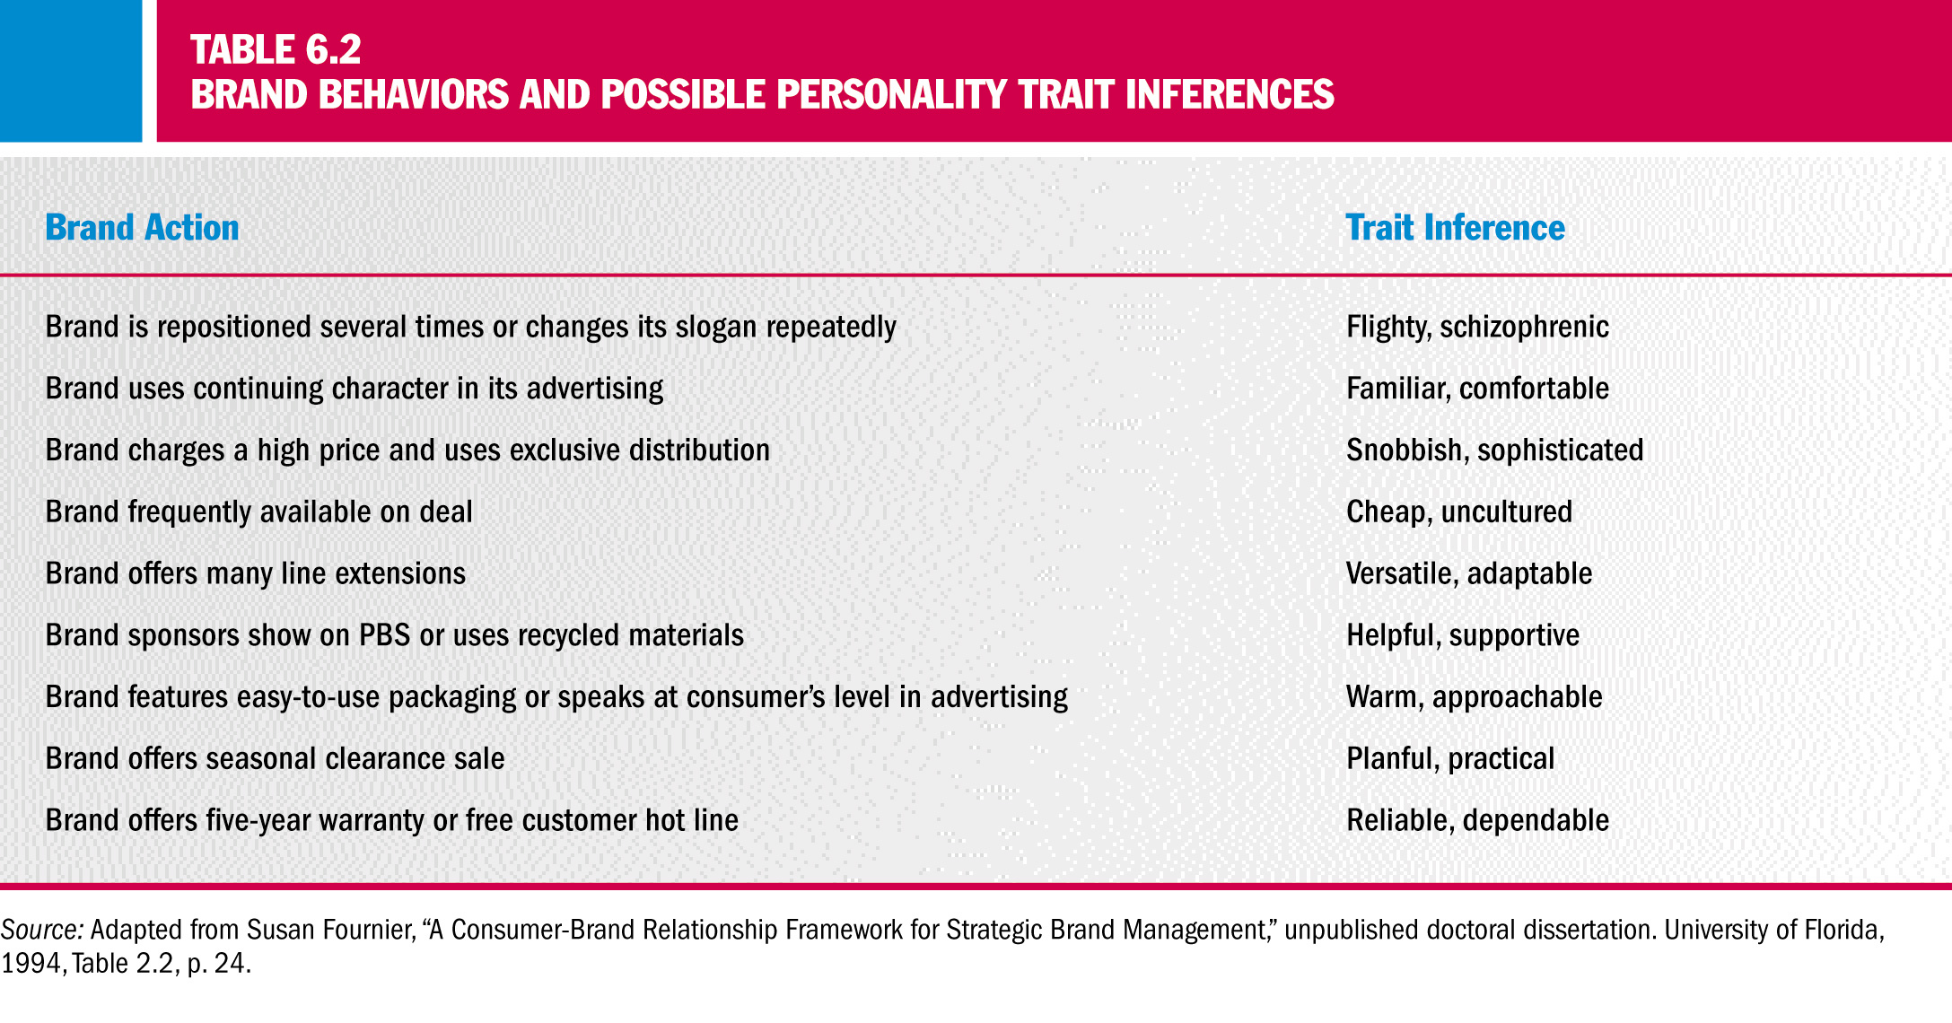

Slide 13
Group Influence and
Opinion Leadership

Slide 14
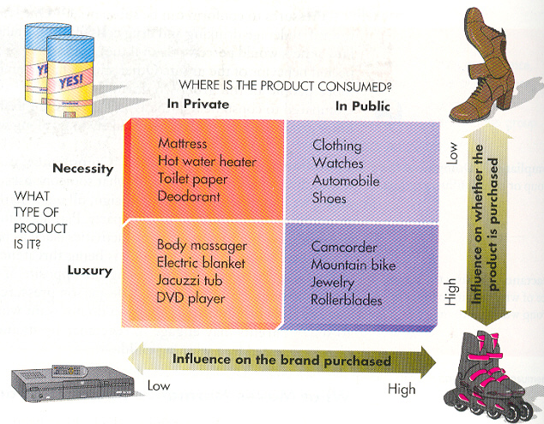

Slide 15
Understanding Cultures

Slide 16
How Much Money Will Be Spent
How Money Will Be Spent
Social Class is Determined by a Complex Set of Variables, Including: Income, Family Background, and Occupation.
Social Class Influences:
Access to Resources Such as Education, Housing,
and Consumer Goods
Taste and Lifestyles

Slide 17
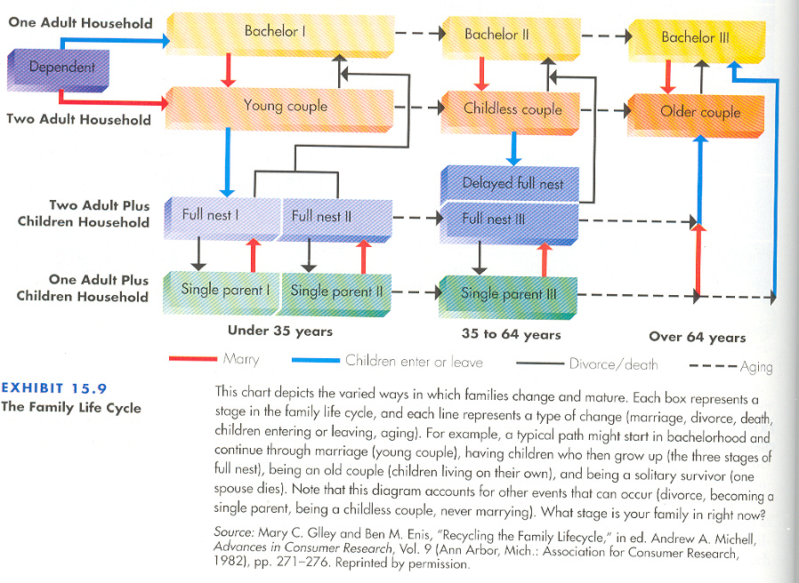

Slide 18
BRAND ICONS

Slide 19
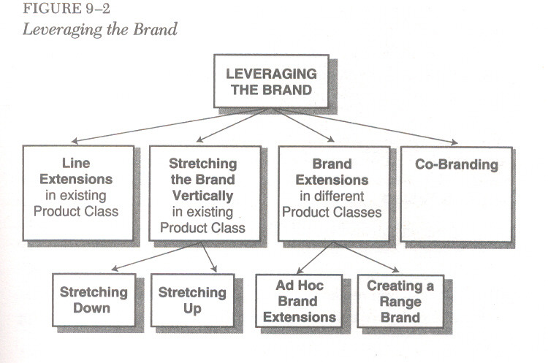

Slide 20
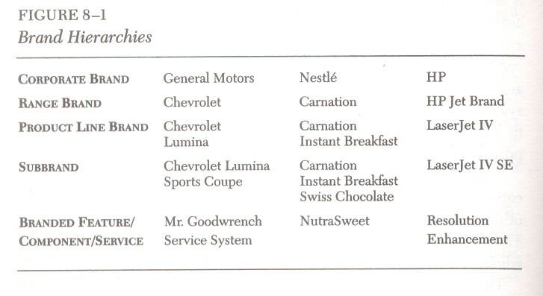

Slide 21
From Identity to Reality
Corner No. 1: Ideology

Slide 22
BRAND IMAGE
  How the brand is now perceived
BRAND IDENTITY
  How strategists want the brand to be perceived
BRAND POSITION
  The part of the brand identity and value proposition to be actively communicated to a target audience

Slide 23
Brand Identity System
A brand’s identity can be viewed from four
perspectives:
  brand as product
  brand as organization
  brand as person
  brand as symbol
When we view a brand from all these
perspectives, it is easier to develop/reinforce
a Value Proposition, Credibility and,
ultimately, a Relationship with the customer.

Slide 24
PRODUCT MEANING & DESIGN

Slide 25
Building Customer-Based Brand Equity
BRAND BUILDING TOOLS AND OBJECTIVES CONSUMER KNOWLEDGE EFFECTS BRANDING BENEFITS
Choosing Brand Elements
Brand name Memorability
Logo Meaningfulness
Symbol Appeal
Character Transferability
Packaging Adaptability
Slogan Protectability
Brand Awareness
Depth
Breadth
Possible Outcomes
Greater loyalty
Less vulnerability to competitive marketing actions and crises
Larger margins
More elastic response to price decreases
More inelastic response to price increases
Greater trade cooperation and support
Increased marketing communication efficiency and effectiveness
Possible licensing opportunities
More favorable brand extension evaluations
Recall
Recognition
Purchase
Consumption
Developing Marketing Programs
Product Tangible and intangible benefits
Price Value perceptions
Distribution channels Integrate”push” and “pull”
Communications Mix and match options
Brand Associations
Strong
Favorable
Unique
Relevance
Consistency
Desirable
Deliverable
Point-of-parity
Point-of-difference
Brand Activation
Company
Country of origin
Channel of distribution
Other brands
Endorsor
Event
Awareness
Meaningfulness
Transferability

Slide 26
Customer Brand Knowledge Structures
THOUGHTS
FEELINGS
IMAGES
PERCEPTIONS

Slide 27
Buying and
Disposing

Slide 28
Economic Shopper
Rational, Goal-Oriented, Maximize Value of Their Dollar
Personalized Shopper
Forms Strong Attachments to Store Personnel
Ethical Shopper
Supports Locally Owned Stores Rather Than Big Chains
Apathetic Shopper
Doesn’t Like to Shop, a Necessary But Unpleasant Chore
Recreational Shopper
Views Shopping as a Fun, Social Activity

Slide 29
Attitude Change and Interactive Communications

Slide 30
Communication and Consumer Behavior

Slide 31
COMMUNICATION
DESIGN

Slide 32
Individual Decision Making

Slide 33
Purchase Process

Slide 34
Personality and Lifestyles

Slide 35
Advertising and Consumer Behaviour

