Slide 1
Trademarks and Packaging

Slide 2
Learning Objectives
Explain what a trademark is.
Discuss protecting the trademark.
Discuss forms of trademarks.
Explain general trademark rules.
Explain the process for developing memorable names.
Discuss packaging and marketing.
Discuss packaging and research.

Slide 3
Common Forms of Online Brand Abuses
Unauthorized use of logos and images
Use of company’s name on competitor’s site
Unauthorized framing, in which a website appears within another site
Domain abuse and parody sites
Unauthorized use of a company’s name or product in metatags
Diverting users away from a website by hiding key words in background text

Slide 4
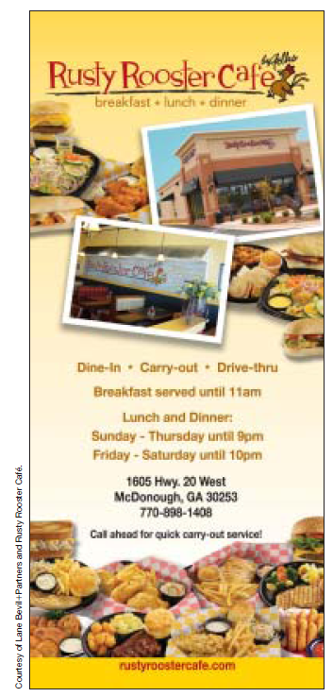
Exhibit 21.1
Logo Reflects Name and Identity

Slide 5
Components of a Brand
Company’s name
Trademarks
Tagline
Logo
Communication vehicles
Imagery
Typography
Design
Color
Message

Slide 6
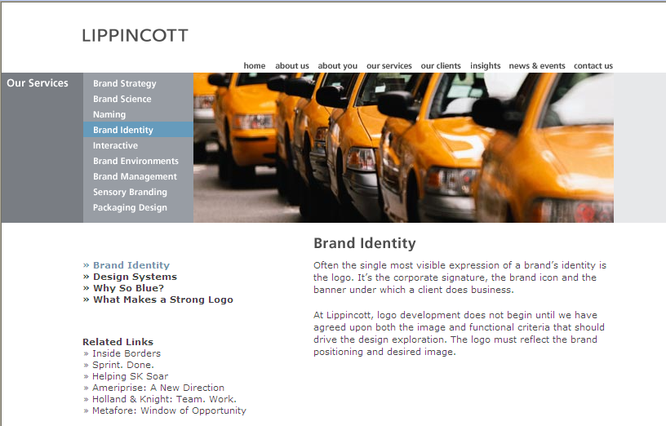
Brand Identity:
An Important Corporate Asset

Slide 7
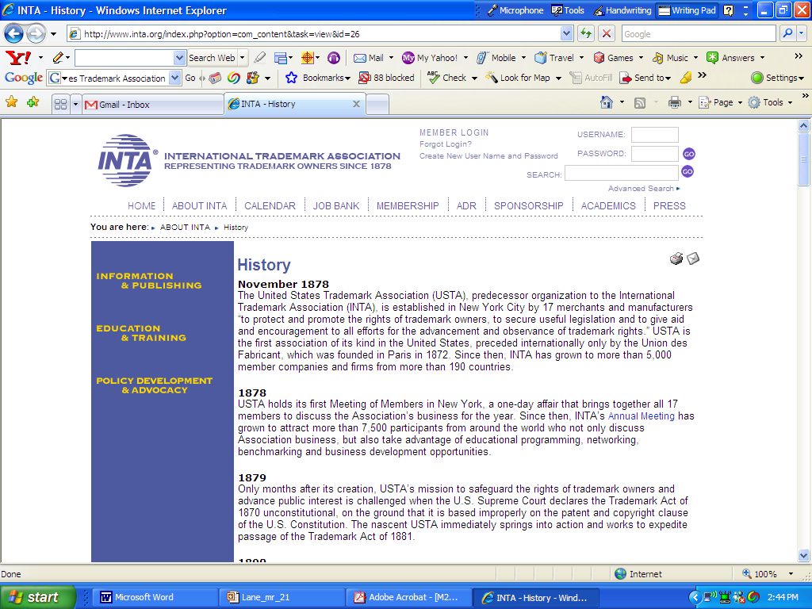
History of Trademarks
The Lanham Act lead to the creation of the U.S. Trademark Association.

Slide 8
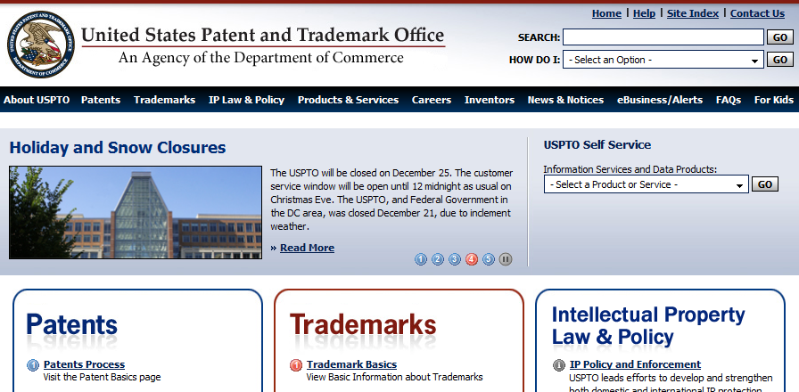
USPTO Manages Trademark Applications

Slide 9
Advantages of Trademark Registration
Constructive notice to the public of registrant’s claim of mark ownership
Registrant’s exclusive right to use mark
Ability to bring an action concerning the mark in federal court
Use of U.S. registration as a basis to obtain registration in foreign countries
Ability to file U.S. registration with U.S. Customs Service to prevent importation of infringing foreign goods

Slide 10

What is a Trademark?
A trademark is any device or word that identifies the origin of a product; it may be embodied in a logo, a form of distinctive lettering, or design.

Slide 11
GE’s Trademark Development Steps
1. Pick a name
2. Create a memorable trademark
3. Make a promise
4. Effectively communicate the process
5. Be consistent
6. Don’t get bored

Slide 12
Criteria for
Legal Protection of Trademarks
Mark must be used in conjunction with actual product
Mark must not be confusingly similar to other marks on comparable goods
Consumers must not be confused, mistaken, or deceived as to whose product they are buying
Mark must not be deceptive
Mark must not be merely descriptive

Slide 13
Factors Considered for
Cases of Trademark Infringement
Distinctiveness of complainant’s mark
Similarity of marks
Proximity of parties’ product
Likelihood of the complainant’s bridging the gap between noncompeting products
Similarity of the parties’ trade channels and advertising methods
Quality of the alleged infringer’s products
Sophistication of the particular customers

Slide 14
Trademark Loss
These words were once protected trademarks!
Aspirin
Yo-yo
Cornflakes
Nylon
Thermos
Raisin bran
Linoleum

Slide 15
Selecting a Brand Name
The name should differentiate the product
The name should describe the product
The product and the name should be compatible
The name should be memorable, easy to pronounce
The name should be short, simple, speakable
The name should be unique and alliterative

Slide 16

Exhibit 21.5 The Name Supports the Product Offering

Slide 17
Forms of Trademarks
Dictionary words
Coined words
Personal names
Geographical names
Initials and numbers

Slide 18
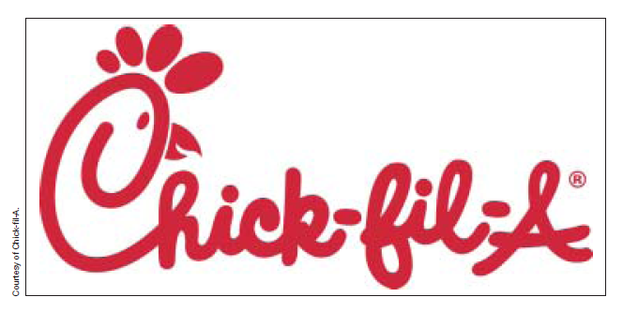
Coined Words as Brand Names
Infiniti
Kleenex,
Norelco,
Häagen-Dazs
Google
FedEx
Exxon
Chick-fil-A

Slide 19
General Trademark Rules
Set the name in distinctive type (e.g., KLEENEX)
Follow the mark with the generic name of the product or by using the word brand after the name (e.g., KLEENEX brand tissues)
Do not speak of the trademark name in the plural (e.g., three Kleenex tissues)
Do not use the name in possessive form (e.g., the features of Kleenex tissues)

Slide 20
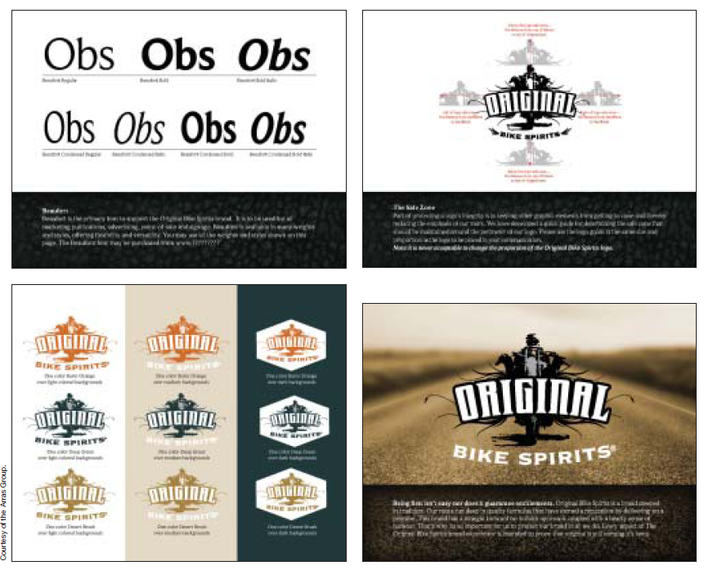
Exhibit 21.9 A Branding Use Guide

Slide 21
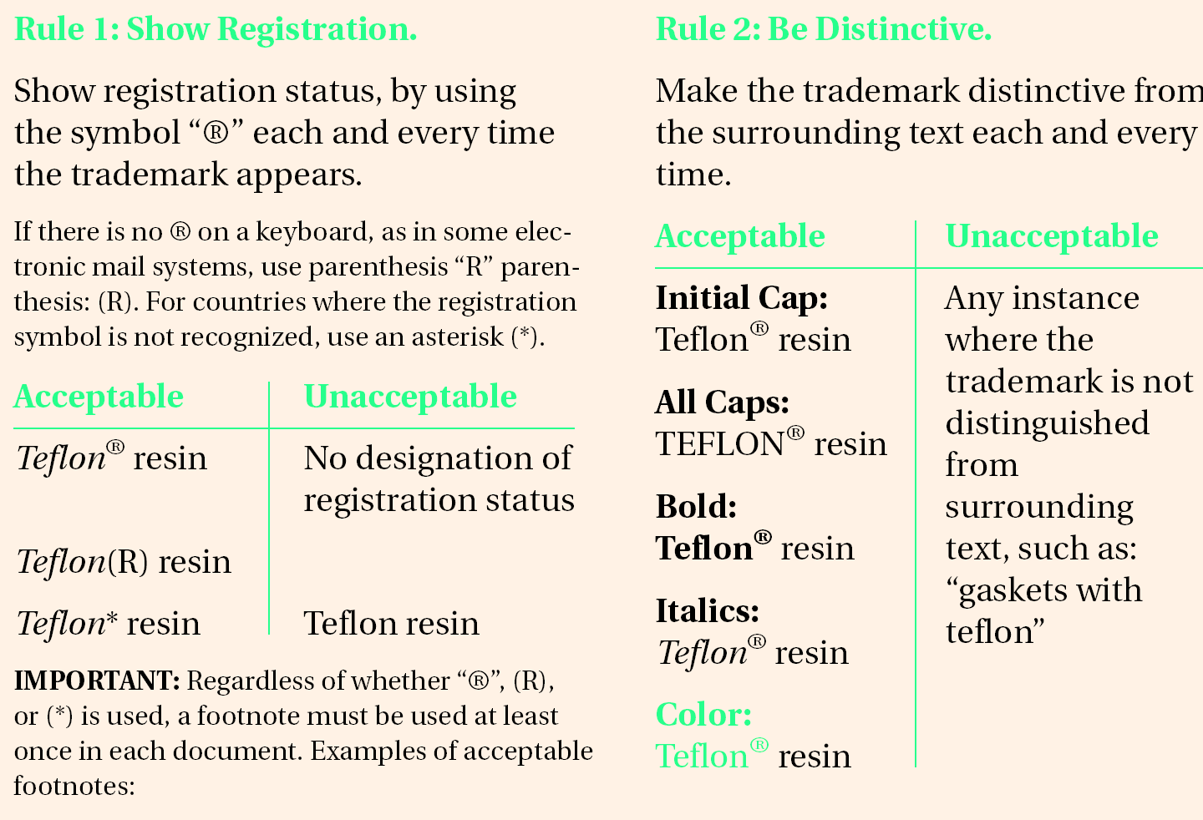
Exhibit 21.10 Guidelines for Using the Teflon Trademark

Slide 22
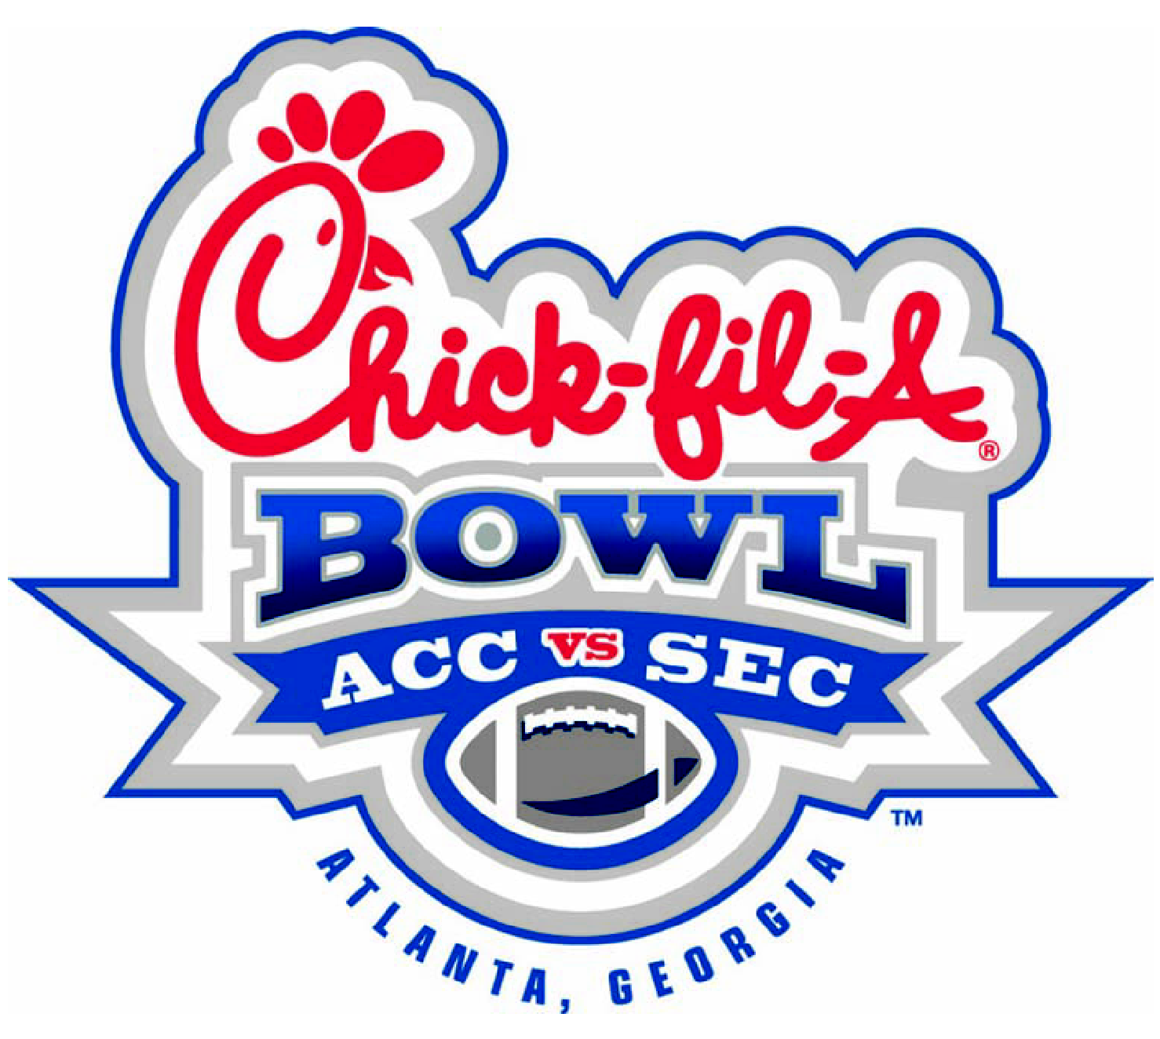
Exhibit 21.11 Use of TM

Slide 23
Common Ways of Indicating
Trademark Registration
The “®” symbol after the trademark as a superscript
A footnote referenced by an asterisk in the text
A notation of the registration in the text or as a footnote on the same page
If a trademark is repeated frequently in an ad, registration notice may be only on the first use
Unregistered but claimed words and/or symbols denoted by using the “TM” symbol

Slide 24
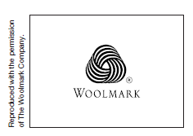
Other Marks
Certification mark: a firm certifies that a user of its identifying device is doing so properly
Service mark: name used in the sale of services to identify the services of a firm and distinguish them from others
A Certification Mark

Slide 25
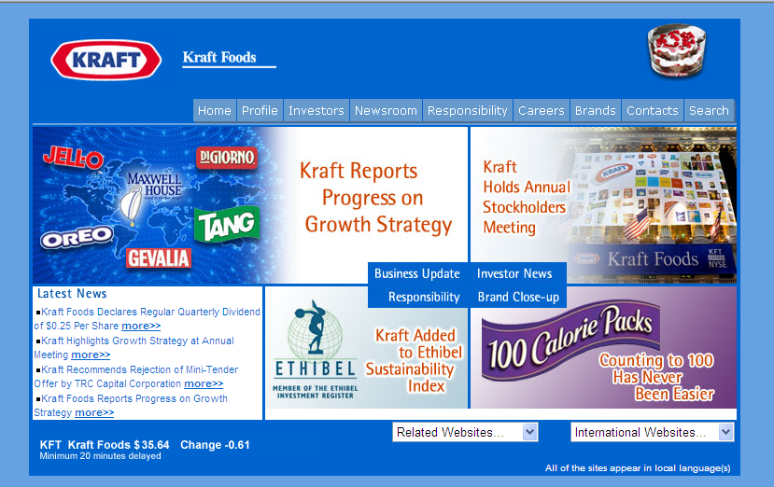
Kraft is a House Mark

Slide 26
The Process for
Developing Memorable Names
Describe what you are naming.
Summarize what you want your name to do.
Describe the target market.
List names that you like and dislike.
Build a list of new name ideas.
Combine name parts and words.
Pick your favorites.
Conduct a trademark search.
Test your name before using it.

Slide 27
Approaches to Using Packaging as a Marketing Tool
Type of product and function of the package
Type of marketing channels to be used for product
Prime prospects for product
Promotion and advertising for the product and its package
Relationship to other packages in product line
Typical consumer use of product

Slide 28
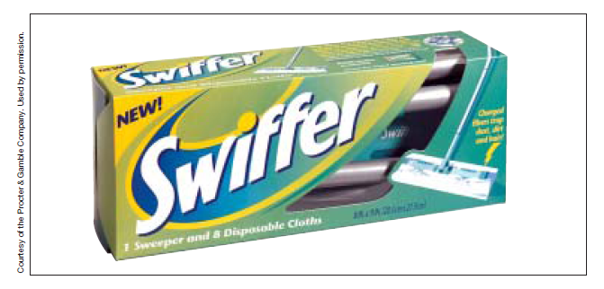
Exhibit 21.15 Packaging

Slide 29
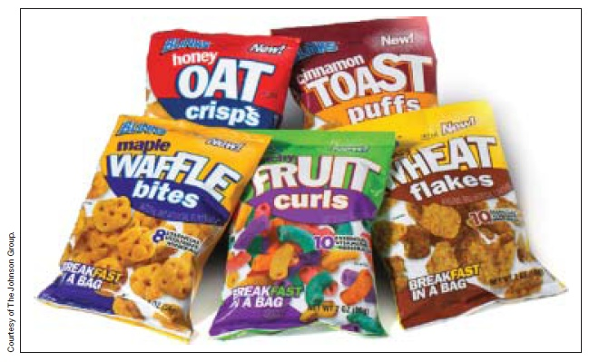
Exhibit 21.16 This Packaging Uses Color to Stand Out

Slide 30
The Meaning of Color

Slide 31
Assessing Package Design
Recognition
Imagery
Structure
Behavior

Slide 32
For Discussion
What is a trademark? What is a service mark?
What are the steps to putting a lock on the ownership of a trademark?
What marketing issues are related to packaging?

