Slide 1
Personality, Segmentation
&
Lifestyles

Slide 2
The Structure of Emotions
Ten Fundamental Emotions People Experience:
  Disgust Interest
  Joy Surprise
  Sadness Anger
  Fear Contempt
  Shame Guilt

Slide 3
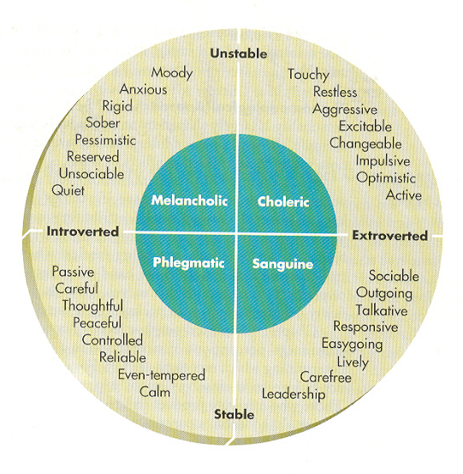

Slide 4
What is Personality?
The inner psychological characteristics that both determine and reflect how a person responds to his or her environment.

Slide 5
Personality refers to a person’s unique psychological makeup and how it consistently influences the way a person responds to his or her environment.
Most now agree that both personality and situational factors play a role in determining people’s behavior.
Personality is usually involved, along with:
  A person’s choices of leisure activities, political outlook, aesthetic tastes, and
  Other individual factors to segment customers in terms of Lifestyles.

Slide 6
Nature of Personality
Personality reflects individual differences
Personality is consistent and enduring
Personality can change

Slide 7
Close-up

Slide 8
Horney’s cad personality
COMPLIANT PERSONALITY
One who desires to be loved, appreciated, & wanted by others
AGGRESIVE PERSONALITY
One who competes with others, desires to excel & win admiration.
DETACHED PERSONALITY
One who desires independence, self-sufficiency, & freedom from obligations.

Slide 9
PERSONALITY TRAITS & CONSUMER INNOVATIVENESS
Innovativeness
Dogmatism
Social Character
Need for uniqueness
Optimum stimulation level
Variety-novelty seeking

Slide 10
A conceptual framework
Brand Personality
Sincerity
Sincerity
Excitement
Excitement
Competence
Competence
Sophistication
Sophistication
Ruggedness
Ruggedness
Down-to-earth
Honest
Wholesome
Cheerful
Daring
Spirited
Imaginative
Up-to-date
Reliable
Intelligent
Successful
Upper class
Charming
Outdoorsy
Tough

Slide 11
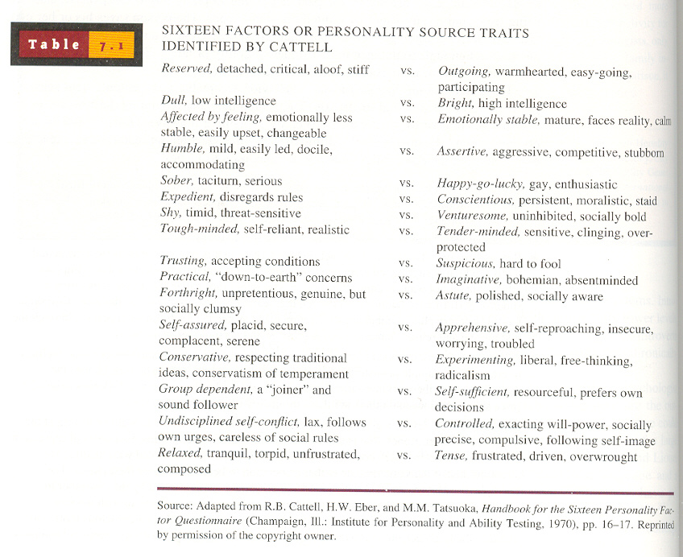

Slide 12
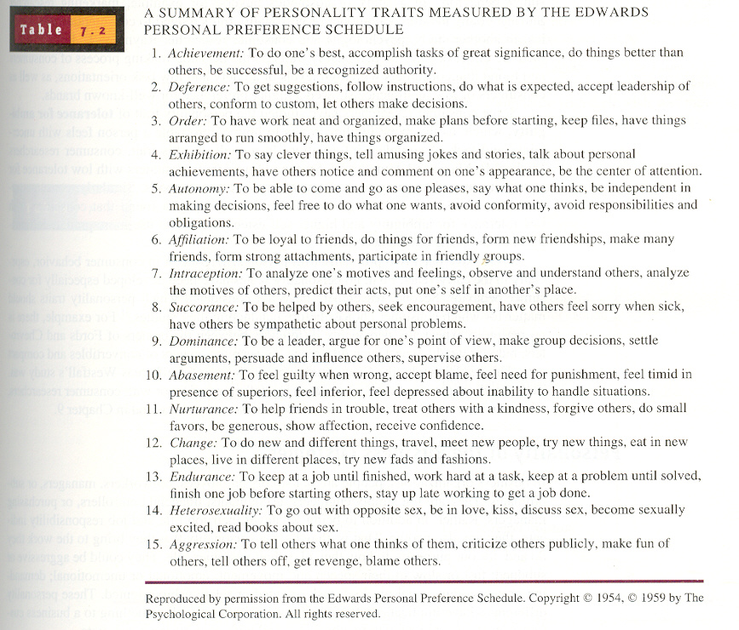

Slide 13
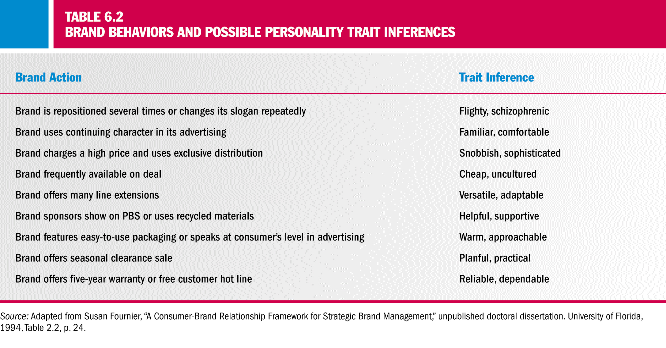
BRANDS & TRAIT INFERENCES

Slide 14
PERSONALITY ASSOCIATIONS WITH SELECTED COLOURS
BLUE
Commands respect, authority
America’s favored color
IBM holds the title to blue
Associated with club soda
Men seek products packaged in blue
Houses painted blue are avoided
Low-calorie, skim milk
Coffee in a blue can be perceived as “mild”
YELLOW
Caution, novelty, temporary, warmth
Eyes register it faster
Coffee in yellow can be perceived as “weak”
Stops traffic
Sells a house
GREEN
Secure, natural, relaxed or easy going, living things
Good work environment
Associated with vegetables and chewing gum
Canada Dry ginger ale sales increased when it changed sugar-free package from red to green and white

Slide 15
RED
Human, exciting, hot, passionate, strong
Makes food “smell” better
Coffee in a red can be perceived as “rich”
Women have a preference for bluish red
Men have a preference for yellowish red
Coca-Cola “owns” red
ORANGE
Powerful, affordable, informal
Draws attention quickly
BROWN
Informal and relaxed, masculine, nature
Coffee in a dark-brown can was “too strong”
Men seek products packaged in brown
WHITE
Goodness, purity, chastity, cleanliness, delicacy, refinement, formality
Suggests reduced calories
Pure and wholesome food
Clean, bath products, feminine
BLACK
Sophistication, power, authority, mystery
Powerful clothing
High-tech electronics
SILVER, GOLD
Regal, wealthy, stately
Suggests premium price

Slide 16
COKE

Slide 17
COKE’S BRAND PERSONALITY
Coca-Cola is a well established person, someone who is the epitome of triumph and success. He is someone who encapsulates the vitality of life beautifully and redefines the collage of life for himself in his own tones
He is an astounding showcase of modernity and progression but at the same time his roots are grounded well in traditions and the montage of culture and values. Wherever he is, he easily meshes in the social fabric.
He loves the time spent with family and friends. He values the existence of close knit unit, be it his friends or his family. He loves to paint the traditional customs and events with his vibrancy.
He is omnipresent, ubiquitous and all pervading

Slide 18
Surf Excel

Slide 19
Airtel

Slide 20
Merc

Slide 21
Nissan

