Slide 1
AVOIDING GAPS
Zeenat Jabbar

Slide 2

Zeenat Jabbar

Slide 3
Communication Process
Sender
Encoding
Transmission device
Decoding
Receiver
Noise
Clutter
Zeenat Jabbar

Slide 4
The Communication Model
Mass communication is generally a one-way process with the message moving from sender to receiver.
  Feedback is obtained by monitoring the receiver’s response to the message.
Interactive communication is two-way—a dialogue—and is where marketing communication is headed.
  The source and receiver change positions as the message bounces back and forth between them.
Zeenat Jabbar

Slide 5
Integrated Marketing Communications is the coordination and integration of all marketing communication tools, avenues and sources within a company into a seamless program which maximizes the impact on consumers and other end-users at a minimal cost. The IMC includes all business-to-business, channel, customer, external communications and internal communications
Zeenat Jabbar

Slide 6
Communication Mix
Traditional
  Price, Product, Distribution, Promotion
Promotion
  Advertising
  Sales promotions
  Personal selling
Additional components
  Database marketing
  Direct marketing
  Sponsorship marketing
  Internet marketing
  Guerilla marketing
  Alternative marketing
Zeenat Jabbar

Slide 7
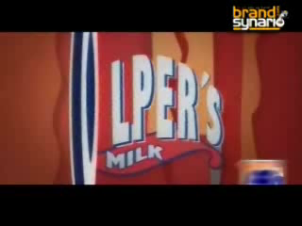
Zeenat Jabbar

Slide 8
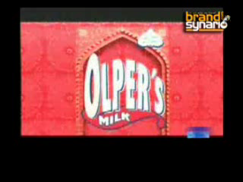
Zeenat Jabbar

Slide 9

Zeenat Jabbar

Slide 10
THE EFFECTS BEHIND ADVERTISING EFFECTIVENESS
Traditional Approaches
AIDA (Attention, Interest, Desire, Action)
  Assumes a predictable set of steps.
Think-Feel-Do
  Think about the message, feel something about the brand, then do something like try it.
Domains
  Messages have various impacts on consumers simultaneously (perception, learning, and persuasion).
Problems with Traditional Approaches
  They presume a predictable set of steps.
  Some effects are missing—brand linkage and motivation.
  Brand communication is the most important.
Zeenat Jabbar

Slide 11
NEW APPROACH: THE FACETS MODEL OF EFFECTS
The Facets Model of Effects
Does a more complete job of explaining how advertising creates consumer responses.
Useful in both setting objectives and evaluating advertising effectiveness
The six facets come together to make up a unique customer response to an advertising message.
  See/Hear: the Perception Facet
  Feel: the Affective or Emotional Facet
  Understand: the Cognitive Facet
  Connect: the Association Facet
  Believe: the Persuasion Facet
  Act: the Behavior Facet
Zeenat Jabbar

Slide 12

Zeenat Jabbar

Slide 13
NEW APPROACH: THE FACETS MODEL OF EFFECTS
See/Hear: Perception Facet
Perception: The process by which we receive information through our five senses and assign meaning to it.
Selective perception: Consumers select messages to which they pay attention.
For an advertisement to be effective, it first has to get noticed or at least register on some minimal level on our senses.
Zeenat Jabbar

Slide 14
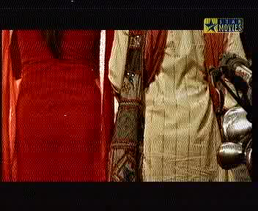
Zeenat Jabbar

Slide 15
NEW APPROACH: THE FACETS MODEL OF EFFECTS
See/Hear: Perception Facet
Key Factors Driving Perception
Exposure
  Media planners want consumers to see or hear the message.
Selection and attention
  Selective attention: consumers choose to attend to the message.
Interest and relevance
  Interest: receiver mentally engages with the ad or product.
  Relevance: message connects on some personal level.
Awareness
  An ad makes an impression; it registers with the consumer.
Recognition
  Recognition: people remember the ad.
  Recall: people remember what the ad said.
Zeenat Jabbar

Slide 16

Zeenat Jabbar

Slide 17
NEW APPROACH: THE FACETS MODEL OF EFFECTS
Feel: Affective or Emotional Facet
Affective responses mirror our feelings about something.
“Affective” describes something that stimulates wants, touches the emotions, and elicits feelings.
Subliminal effects are message cues given below the threshold of perception.
Zeenat Jabbar

Slide 18

Zeenat Jabbar

Slide 19
NEW APPROACH: THE FACETS MODEL OF EFFECTS
Feel: Affective or Emotional Facet
Factors Driving the Affective Response
Wants
  Driven by emotions; based on desires, wishes, longings, cravings.
Feelings
  Emotional appeals based on humor, love, or fear.
Liking (the brand and the ad)
  If you like the ad, those positive feelings transfer to the brand.
Resonate
  A feeling that the message rings true.
  Consumer identifies with the brand on a personal level.
Zeenat Jabbar

Slide 20

Zeenat Jabbar

Slide 21
NEW APPROACH: THE FACETS MODEL OF EFFECTS
Understand: Cognitive Facet
Cognition: how consumers search for and respond to information; learn and understand something..
It’s a rational, “left-brain” approach.
Zeenat Jabbar

Slide 22
NEW APPROACH: THE FACETS MODEL OF EFFECTS
Understand: Cognitive Facet
Factors Driving Cognitive Response
Need
  Something you think about.
  Ad messages describe something missing in consumer’s lives .
Cognitive Learning
  Presenting facts, information, and explanations leads to understanding.
  Comprehension: process by which we understand, make sense of things, or acquire knowledge.
Differentiation
  The consumer’s ability to separate one brand from another, based on an understanding of a competitive advantage.
Recall
  A measure of learning or understanding.
  You remember the ad, the brand, and the copy points.
Zeenat Jabbar

Slide 23

Zeenat Jabbar

Slide 24
NEW APPROACH: THE FACETS MODEL OF EFFECTS
Connect: Association Facet
Association: using symbols to communicate.
The primary tool used in brand communication.
Brand linkage reflects the degree to which the associations presented in the message, as well as the consumer's interest, are connected to the brand.
Zeenat Jabbar

Slide 25

Zeenat Jabbar

Slide 26
NEW APPROACH: THE FACETS MODEL OF EFFECTS
Connect: Association Facet
Factors Driving Association
Symbolism
  A brand takes on a symbolic meaning.
  It stands for certain, usually abstract, qualities.
Conditional Learning
  Thoughts and feelings associated with the brand.
  Beer is about sporting events, beach parties, and pretty women.
Transformation
  A product is transformed into something special, differentiated by its brand image symbolism and personality..
Zeenat Jabbar

Slide 27

Zeenat Jabbar

Slide 28
NEW APPROACH: THE FACETS MODEL OF EFFECTS
Believe: Persuasion Facet
Persuasion: influencing or motivating the receiver of a message to believe or do something
Attitude: an inclination to react in a given way.
Attitudes become beliefs when people are convinced.
Zeenat Jabbar

Slide 29
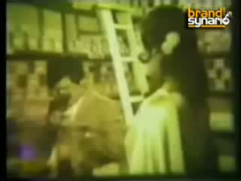
Zeenat Jabbar

Slide 30
NEW APPROACH: THE FACETS MODEL OF EFFECTS
Believe: Persuasion Facet
Factors Driving Persuasion
Motivation
  Something (e.g. hunger) prompts one to act in a certain way.
Influence
  Opinion leaders may influence other peoples’ attitudes.
  Bandwagon appeals, messages say “everyone is doing it.”
  Word of mouth is created by strategies that engage influencers.
Involvement
  How engaged you are in paying attention?
  The process you go through in responding to a message and making a product decision.
  High involvement vs. low involvement.
Zeenat Jabbar

Slide 31

Zeenat Jabbar

Slide 32
NEW APPROACH: THE FACETS MODEL OF EFFECTS
Believe: Persuasion Facet
Factors Driving Persuasion (cont.)
Conviction
  Consumers agree with a message and achieve a state of certainty—a belief—about a brand.
Loyalty
  Brand loyalty is both attitude (liking, respect, preference) and action (repeat purchases).
  It’s built on customer satisfaction.
Believability and Credibility
  Believability: the credibility of the arguments in a message.
  Credibility: indication of the trustworthiness of the source.
  Source credibility: the person delivering the message is respected, trusted, and believable.
Zeenat Jabbar

Slide 33

Zeenat Jabbar

Slide 34

Zeenat Jabbar

