Slide 1
LEVERAGING
THE
BRAND SYSTEMS

Slide 2
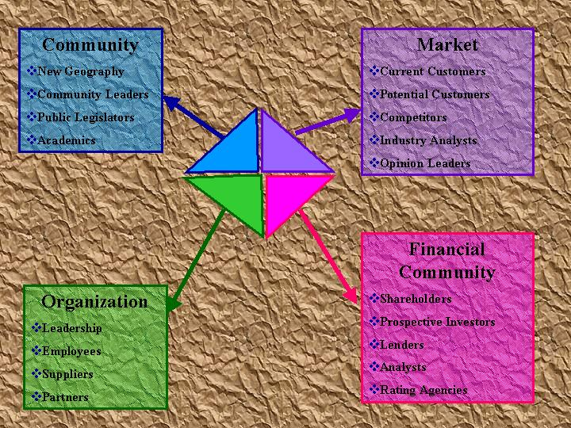
360-DEGREE AUDIENCE

Slide 3
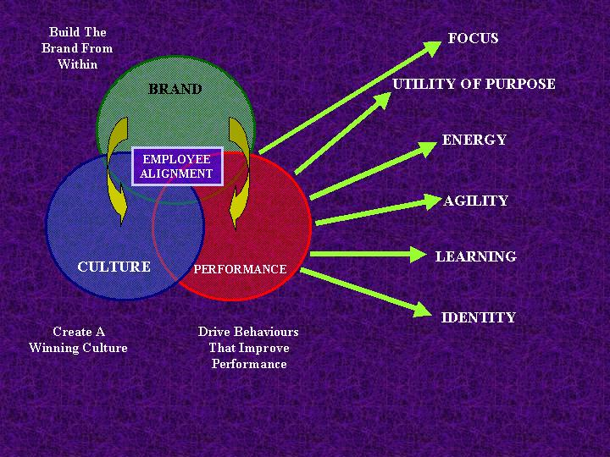
BRAND ORGANIZATION

Slide 4
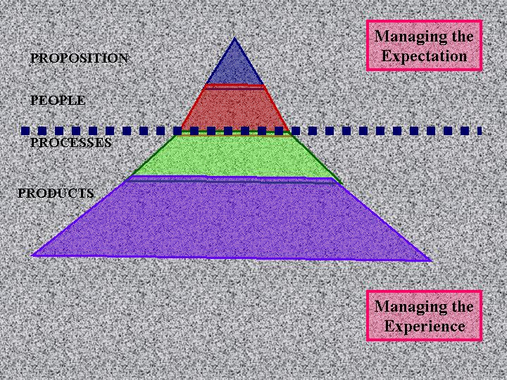
BRAND MANAGEMENT ICEBERG

Slide 5
Brand Hierarchy
CORPORATE BRAND
identifies the corporation behind the product or service offering
RANGE BRAND
a brand that ranges over several product classes
PRODUCT-LINE BRAND
These are the brands associated with the organizations specific products
SUB BRANDING
Basic product brands can be refined through sub. branding

Slide 6
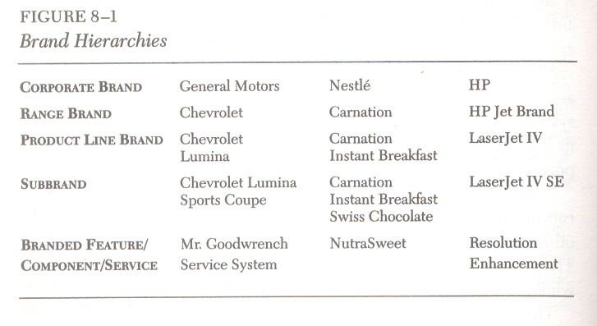

Slide 7


Slide 8
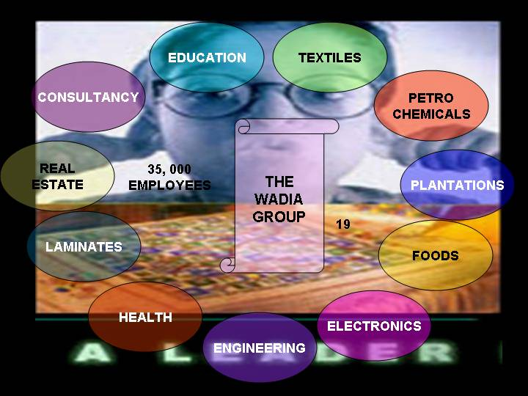

Slide 9
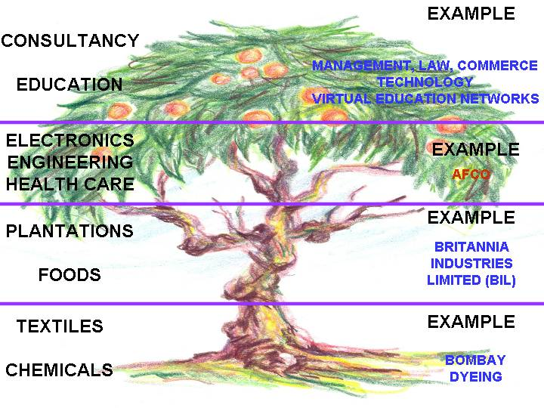
BRAND TREE: THE WADIA GROUP
© Copyright 2004 – ZJabbar (NUST)

Slide 10
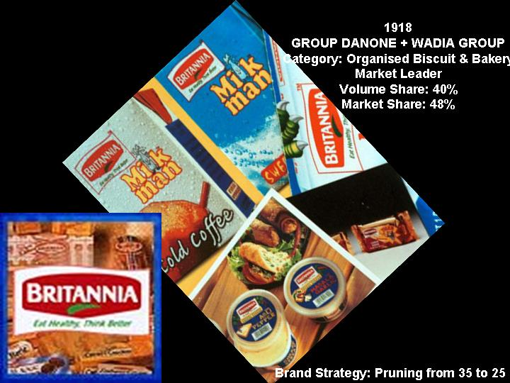

Slide 11
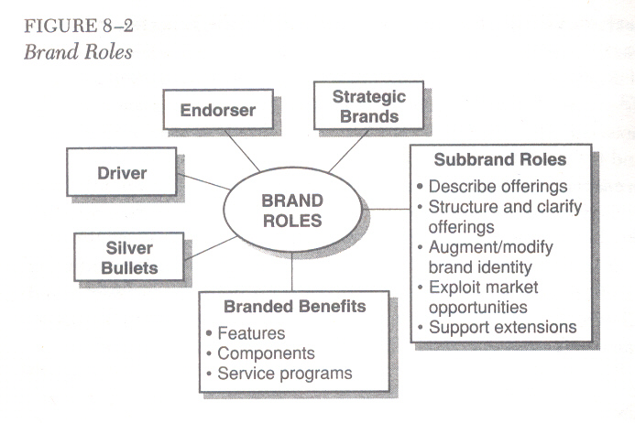
BRAND ROLES

Slide 12
A driver brand is a brand that drives the purchase decision;
Its identity represents what the customer primarily expects to receive from the purchase
The brand that plays the driver role represents the value proposition that is central to the purchase decision and use experience.
DRIVER BRAND

Slide 13
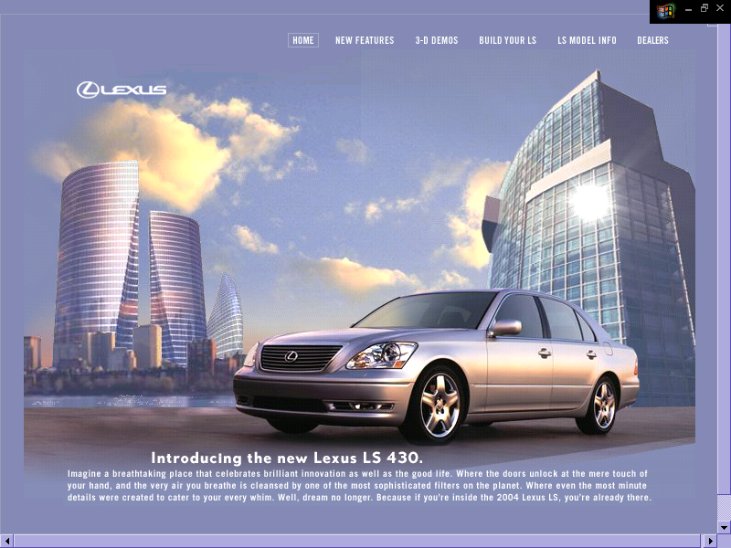

Slide 14
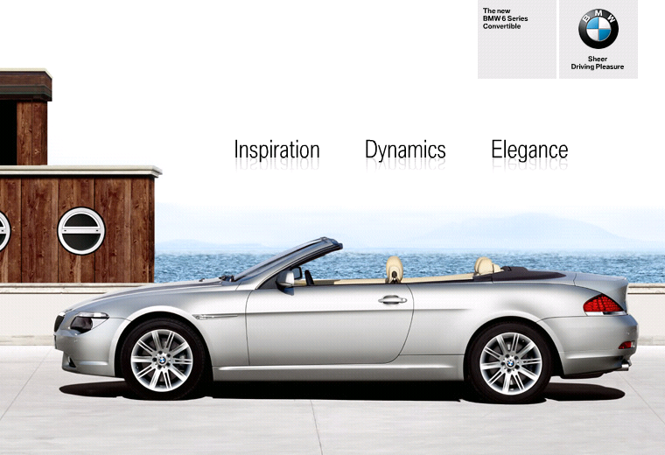

Slide 15


Slide 16
A brand provides support and credibility to the driver brand's claims.
Because the corporate brand usually represents an organization with people, culture, values and programs, it is well suited to support a driver brand, and thus it often plays the endorser role.
ENDORSER BRAND

Slide 17
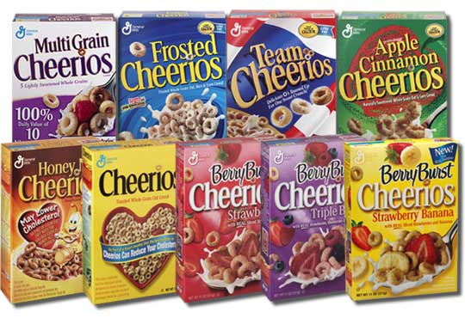

Slide 18
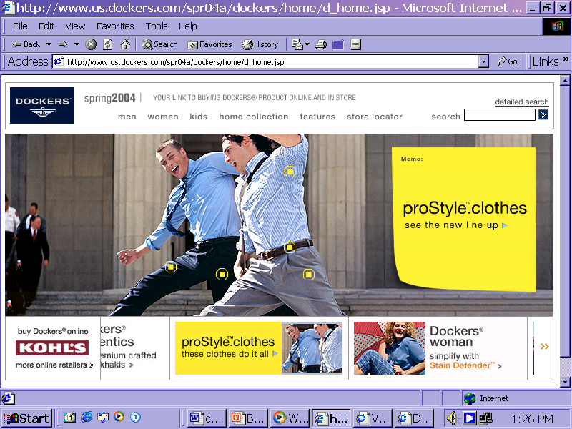
The primary role for these endorsers is to reassure the customer that the product will deliver the promised functional benefits because the company behind the brand is a substantial, successful organization that would only be associated with a strong product.
This reassurance is of particular importance when the product is new and untested. In fact, an endorser brand can sometimes fade after it provides this initial support.

Slide 19
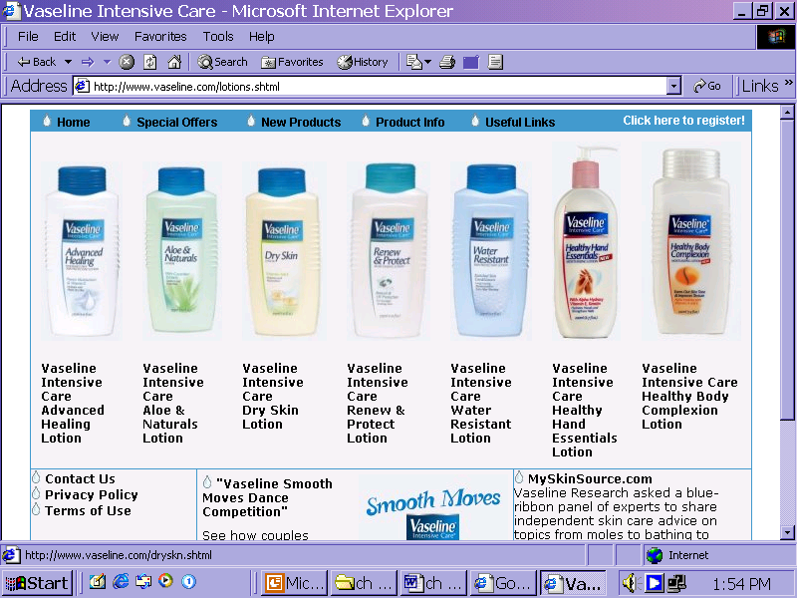
The Levi's Dockers case illustrates brand bridging, where an endorser brand is used at the outset but then is allowed to fade from view in favor of the product.l Perhaps there is an image mismatch as in 'the Dockers case or maybe the subbrand would have more potential if not tied to a parent.
BRAND-BRIDGING STRATEGY

Slide 20
Because the brand can be maintained with minimal support, it can provide a positive cash flow to fund other brands.
DIVESTMENT
CANDIDATE
A strategic brand is one that is important to the future performance of the organization.
MILKER
STRATEGIC
BRAND
A divestment candidate is a brand that faces an unattractive market with a weak brand position or that does not fit the future vision of the firm.
LINCHPIN

Slide 21
A silver bullet is a subbrand or branded benefit that is employed as a vehicle for changing or supporting the brand image of a parent brand.

Slide 22
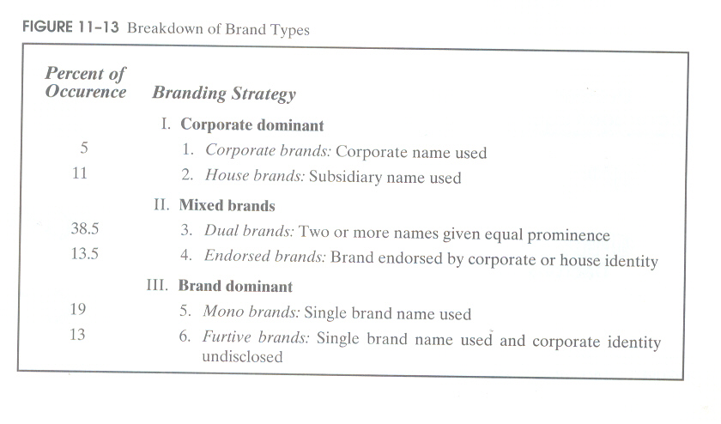

Slide 23
The Brand Value Chain

Slide 24


Slide 25
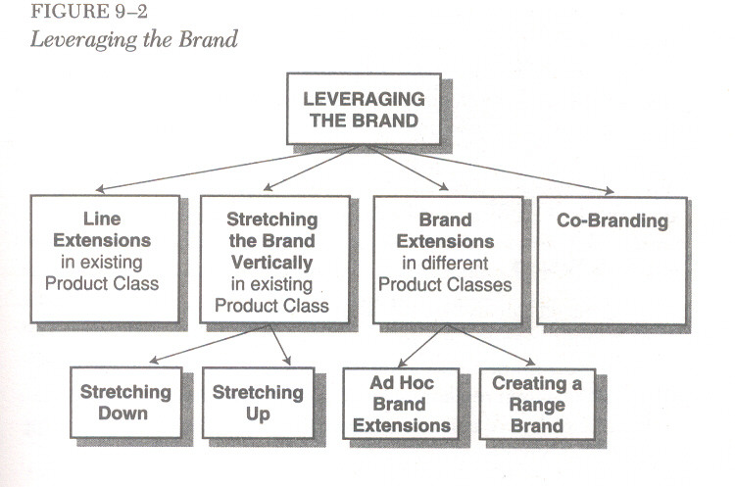

Slide 26
LINE EXTENSIONS
A line extension is a new version of the product within the same product class.
New flavors, new packaging options, or new sizes are all line extensions.
Line extensions can increase costs without compensating increases in volume and make the brand less focused and more difficult to communicate.
However, line extensions can also expand the user base, provide variety, energize the brand, manage innovation, and block or inhibit competitors.

Slide 27
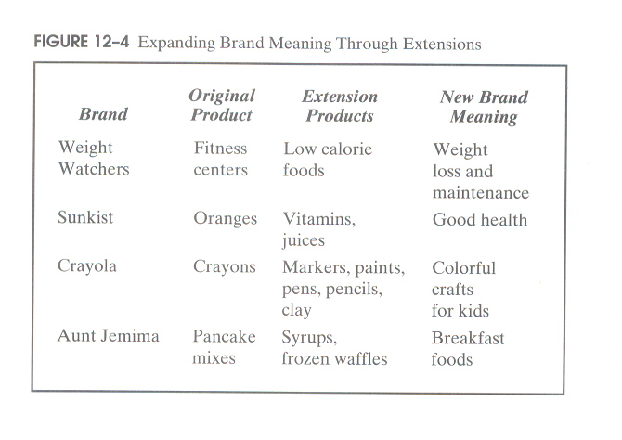

Slide 28
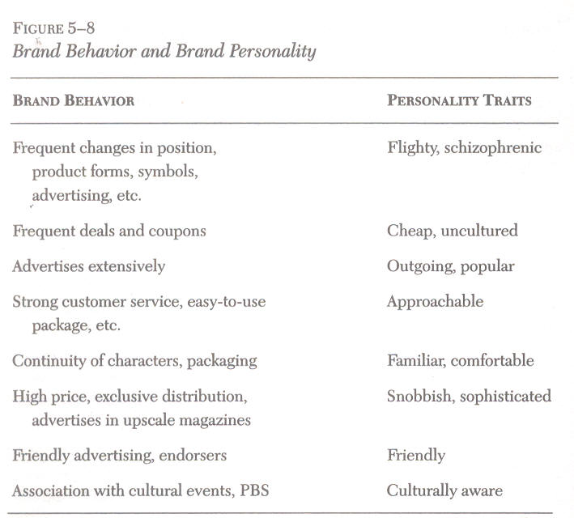

Slide 29
Examples of range brands at Kraft/General Foods include
Philadelphia (Regular, Herb, Salmon, Dip & Sauce, and others),
Kraft Slices-regular, flavored and others); and
Kraft Mayonnaise-(Real, Yogurt, Mayoliva, and others)

