Slide 1
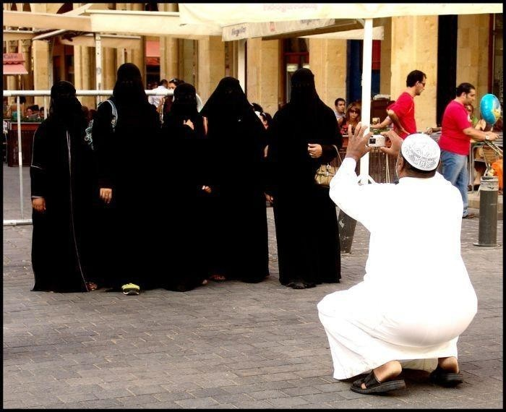
Managing CRM Across Cultures – A Marketing Perspective

Slide 2


Slide 3
CRM tasks
1. Setting Objectives and Targets
– Setting up CRM goals and objectives of a brand
2. Planning
– Organizing actions needed to achieve these goals
3. Organising
– allocating resources to accomplish targets
4. Directing
– leading the organization towards its goals
5. Controlling
– Monitoring performance of the brand

Slide 4
Effect of cultural values on marketing
The way tasks and responsibilities are performed will be examined in the light of key number of cultural values (model of culture).
These cultural values emerged from cultural dimensions found by scholars.
Eight cultural value orientations have a considerable influence on the way managers perform their activities.
These cultural value orientations will be examined together with their impact on the management activities.

Slide 5
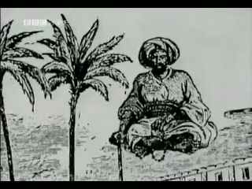

Slide 6
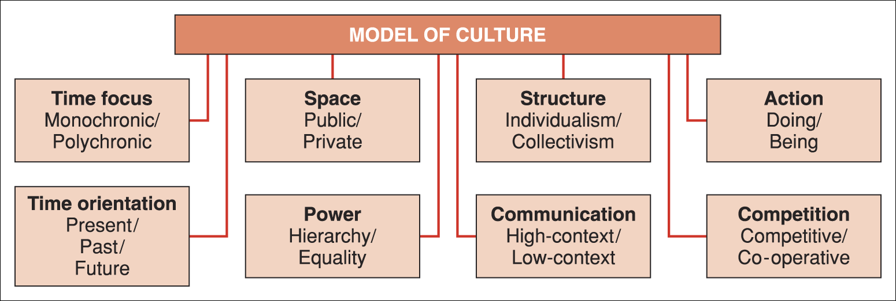
Model of culture
Source: Adapted from Doing Business Internationally, Participant Workbook: 2.3

Slide 7
Time focus
Different cultures have different perceptions of time according to their environment, history, traditions and general practices.
Hall and Hall (1990) distinguish two prominent time systems that are of particular relevance to management:
Monochronic
  time is used in a linear way: one activity at a time
Polychronic
  people tend to focus on multiple tasks.

Slide 8
Time focus and management tasks
Monochronic cultures
Making schedules
Linear and task-focused
Concerns focused on shorter term
Distribution of detailed information
Use control systems and strict deadlines
Polychronic cultures
Relationship in planning
More holistic and people-focused
Focus on longer term
Sharing of implicit knowledge/information
Flexible control systems involving people

Slide 9
Time orientation
Past, present, future
Cultures focused on the:
  Past: upholding tradition in line with the history of the company
  Present: quick results and short-term gain
  Future: plans are assessed in the light of expected future benefit.

Slide 10
Time orientation and management tasks
Past-oriented cultures
Building in long-term time frames
Past goals guide the process
Slower in adapting criteria by selection
Continuation of the company’s values
Develop performance in keeping customary goals
Future-oriented cultures
Long-term plans and results
Co-ordinated to meet longer-range goals
Selection to meet long-term business goals
Achieving long-term benefits
Develop objectives in the long-term context

Slide 11


Slide 12
Power
Power value orientation: the extent to which a society expect or accept that power is distributed unequally.
Hierarchy
  Level of power and authority are strictly marked
Equality
  Status and formal position have less influence.

Slide 13
Power and management tasks
Hierarchy
1.More autocratic or paternalistic planning
2. Organizational structure is tightly controlled
3. Subordinates expect bosses to take initiatives
4. Employees like being closely supervised
5. Employees prefer the personal control of superiors
Equality
More participative planning
Organizational structure encourages individual autonomy
Work relations should not be strictly prescribed
Managers exhibit consultative style
Subordinates develop performance objectives with their bosses

Slide 14


Slide 15
Competitiveness (Competition)
Competitive
When competitiveness is valued, the culture is focused on:
  acquiring wealth
  performing well
  achieving ambitions.
Co-operative
  Competition is not considered to be the main purpose of business
  Stress is on the quality of life, relationships and consensus.

Slide 16
Competition and management tasks
Competitive
1. Task performance when implementing plans.
2. Managers have more of a leadership role.
3. Selection of employees on ability to act independently.
4. The leader’s role is to track and reward achievement.
5. Preferred control systems are performance-based.
Co-operative
1. Maintaining relationships in plan implementation.
2. Managers have more of a facilitating role.
3. Employees elected on ability to work well in groups.
4. The leader’s role is to facilitate relationships.
5. Task performance is recognized as a standard for success.

Slide 17
Activity
Human expression as resulting in some form of activity:
Doing
The stress in doing cultures is placed on:
  action
  achieving personal goals.
Being
The stress is placed on:
  working for the moment
  living the experience.

Slide 18


Slide 19
Activity and management tasks
Doing cultures
Developing time-framed action steps.
Action-oriented documentation.
Ability to fulfil organizational tasks.
Expertise and competence.
The ways the tasks are done.
Being cultures
Strong focus on the vision.
Based on common vision and personal trust.
Career development based on personal or social criteria.
Personal philosophy, values and style.
Management of performance measurement less systematic.

Slide 20
Space
Private/Public
One aspect of space orientation is related to private or public space
Another aspect related to invisible boundary around every person
The concept of space can be seen in terms of personality.

Slide 21
Space and management tasks
Private
Forms of planning: individualistic or systematic.
More task-centred.
Explicit information about how staff are to be employed.
Managers and employees do not share the same office.
Explicit measures of performance.
Public
Group-oriented or authoritative forms.
Relationship-centred approaches.
Implicit information.
Size of the place where an employee works does not reflect the person’s rank.
Informal checks on performance.

Slide 22


Slide 23
Communication
Role of the context in the communication process (Hall & Hall, 1990) .
Context related to framework, background and surrounding circumstances.
High-context
  Information is ‘hidden’ in the context
  Situation carries most of the information
Low-context
  The messages are clear and explicit.

Slide 24
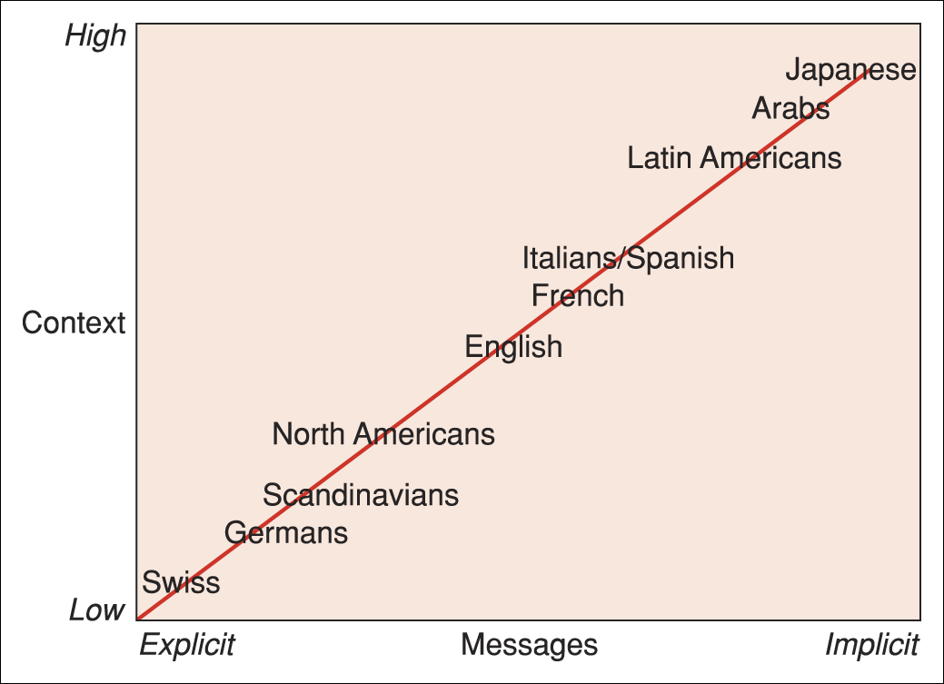
Messages and context
Messages and context (adapted from Hall)
Source: Usunier (1993: 103)

Slide 26
Structure
The term ‘structure’ refers in business to an organizational structure.
Value orientation concerns the relation between the individual and the group.
Individualism
  ‘I’ predominates over the ‘We’
Collectivism
  Interests of the group prevail over individuals.

Slide 27
Culture and context
Culture can be seen as a sharing of ‘patterns of meaning and interpretation’ resulting from interaction with others.
Multinational managers may relate to this idea, since their role is to ensure effective interaction between multicultural teams, rather than to deal with cultures in isolation.
Earley (2006) claims that ‘culture is not a value or set of values; culture is the meaning which we attach to aspects of the world around us’.

Slide 28


Slide 29
Culture as a psychological construct
Earley calls for a greater focus on meaning as culture. Values are only one element allowing meaning to be attached to the environment.
He proposes (more) research into culture as a psychological construct whereby an individual is subject to a number of influences.
Need to understand linkage among cultures, perceptions, actions, organizations etc.
Cultural intelligence: the extent to which individuals can adapt to cultural settings.

