Slide 1
CUSTOMER RELATIONSHIP
Zeenat Jabbar

Slide 2
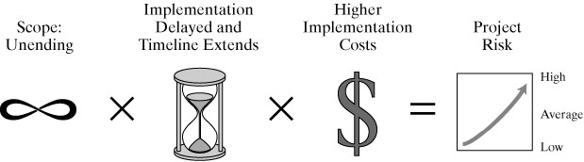

CRM means Dealing with the People Aspect of the Project
Zeenat Jabbar

Slide 3
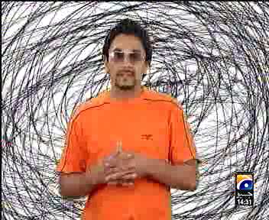
ULTA SEEDHA
Zeenat Jabbar

Slide 4
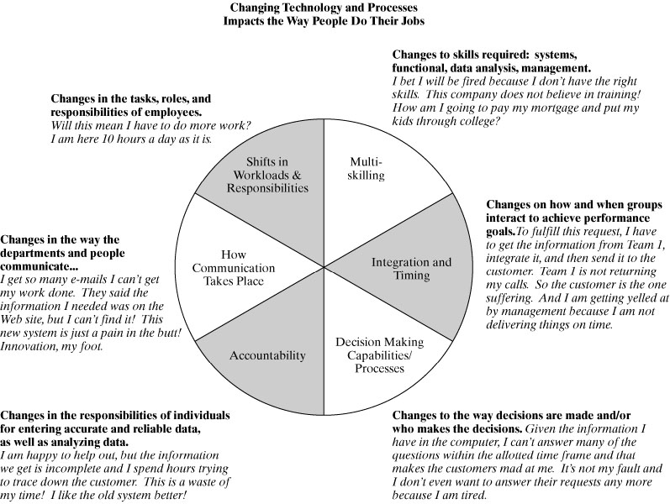

The Effect of Change on People
Zeenat Jabbar

Slide 5

ASIA 2
Zeenat Jabbar

Slide 6
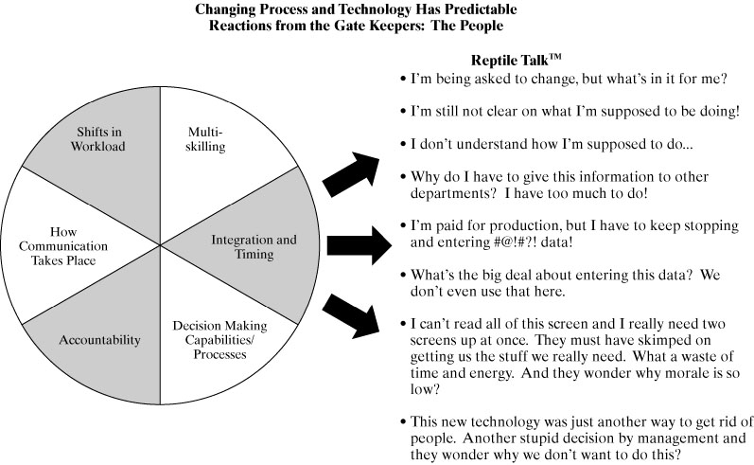
Reptile Talk™ of
People Going Through Change
Zeenat Jabbar

Slide 7
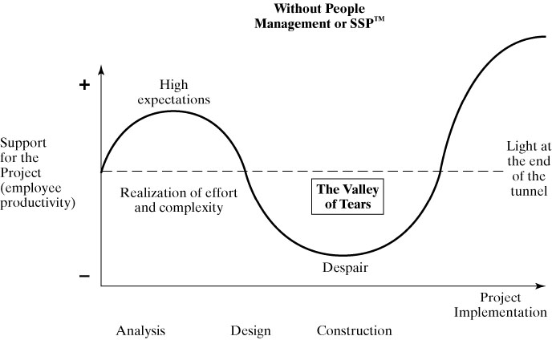
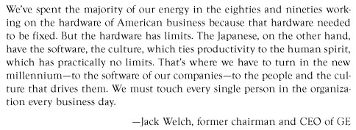
The Valley of Tears
Zeenat Jabbar

Slide 8

CAMLIN
Zeenat Jabbar

Slide 9
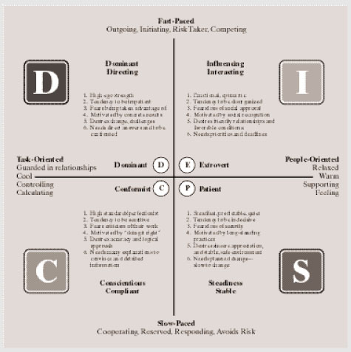
The Successful People Profile
Zeenat Jabbar

Slide 10
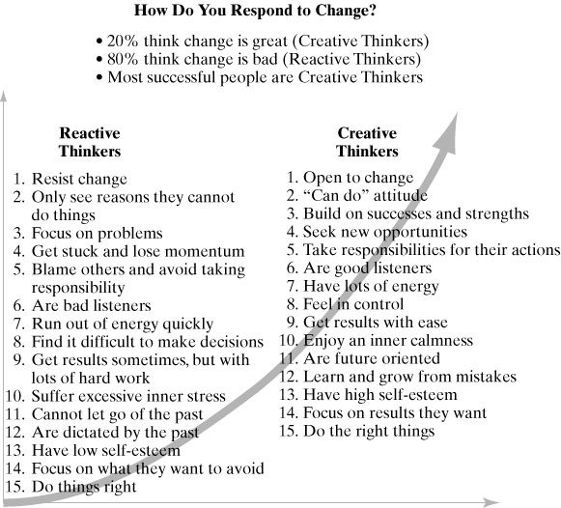
Reactive vs. Proactive Thinkers
Zeenat Jabbar

Slide 11

COKE
Zeenat Jabbar

Slide 12
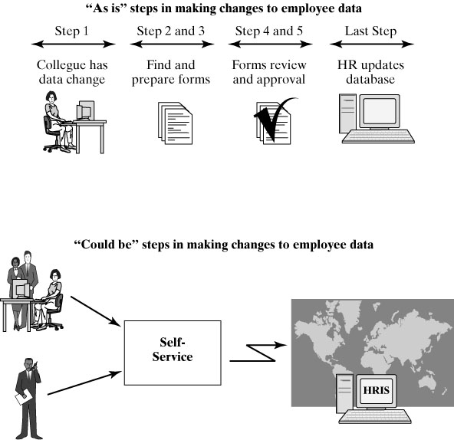
Business Process Mapping
Zeenat Jabbar

Slide 13
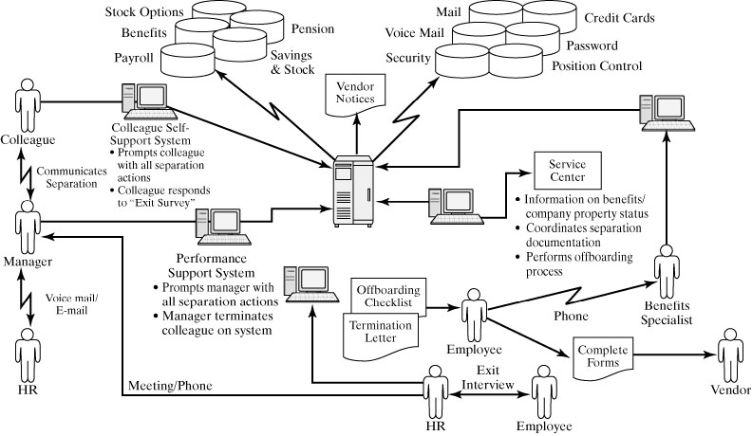
Business Process Mapping
Zeenat Jabbar

Slide 14
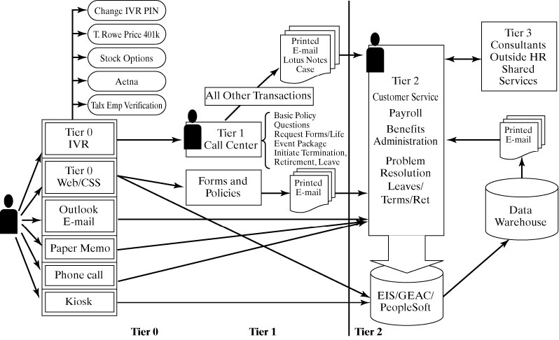
Business Process Mapping
Zeenat Jabbar

Slide 15
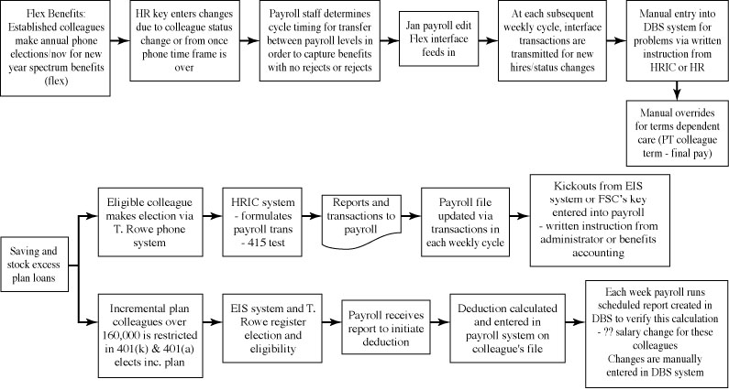
Business Process Mapping
Zeenat Jabbar

Slide 16

CLOSE UP
Zeenat Jabbar

Slide 17
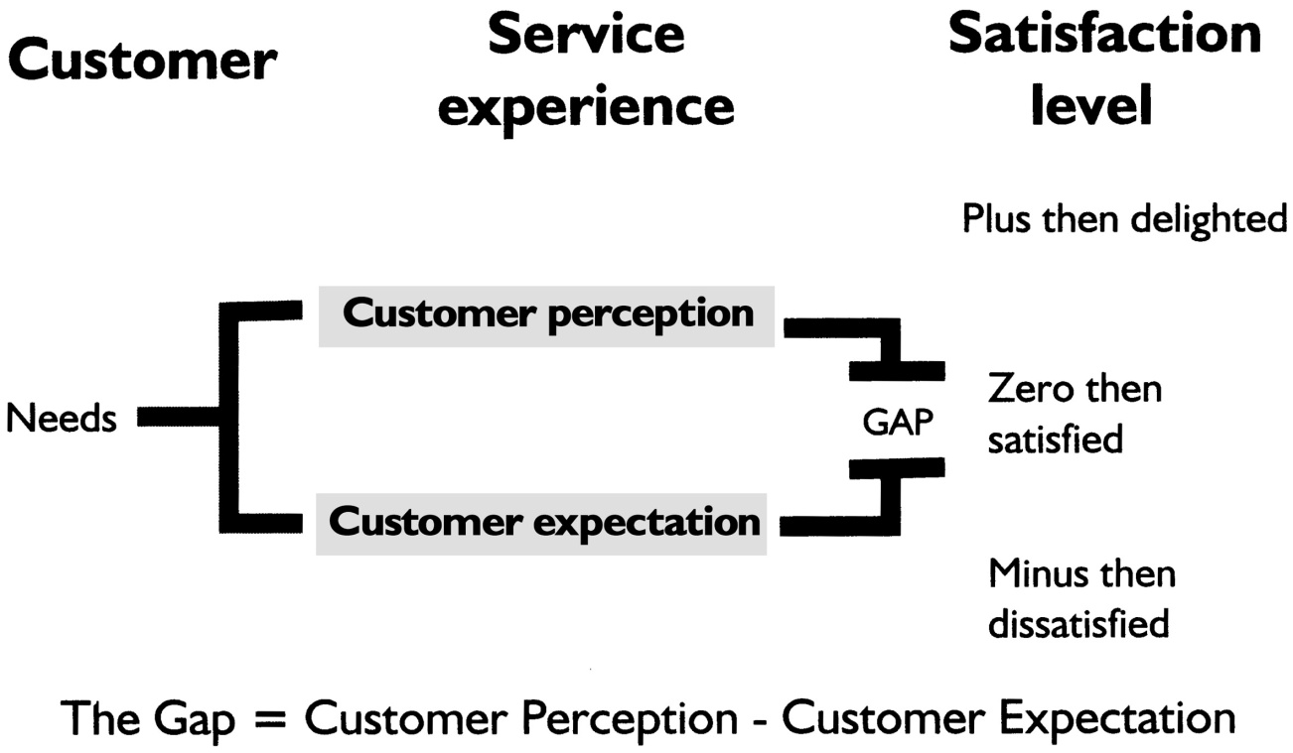
Customer’s Are People, Too!
They Have Needs
Zeenat Jabbar

Slide 18
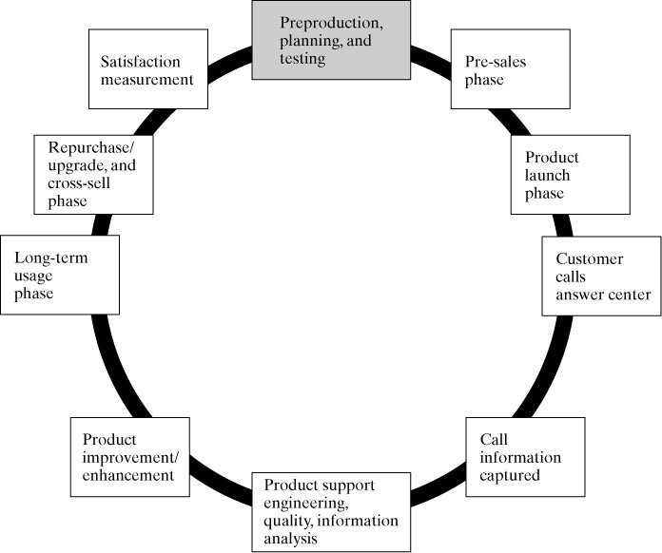
Customer Relationships
Zeenat Jabbar

Slide 19
A SIMPLIFIED MODEL OF CUSTOMER DECISION MAKING
STAGE ONE
The external factors which influence customers' behaviour
Marketing by organisations – the 4Ps
Customer's environment – culture, subcultures, groups
WHICH INFLUENCES
STAGE TWO
The customer decision making process
Recognition of needs, information search, alternative product
evaluation
+
Individual factors – motivation, attitudes, learning
+
Experience gained through life
WHICH LEADS TO
STAGE THREE
Purchase and post-purchase behaviour
Purchase then
Post-purchase evaluation and maybe
Repeat purchase
Zeenat Jabbar

Slide 20
Customer decision-making process
Problem Recognition
Information Search
Evaluation & Selection
Store Choice & Purchase
Post Purchase Processes
Zeenat Jabbar

Slide 21
COKE HAPINESS

Slide 22

UFONE LOCAL
Zeenat Jabbar

Slide 23
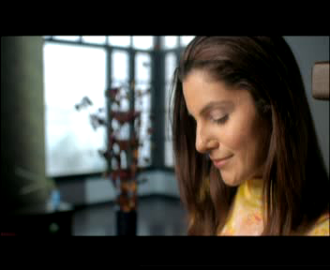
ZONG PAGAL
Zeenat Jabbar

Slide 24
Types of customer decision processes
INVOLVEMENT DECISION MAKING | HIGH INVOLVEMENT PURCHASE DECISION | LOW INVOLVEMENT PURCHASE DECISION
DECISION MAKING Information search Alternative evaluation etc. | COMPLEX DECISION MAKING Homes, cars, major appliances etc. | VARIETY SEEKING Cigarettes, chocolates, tea, etc
HABIT No information search, one brand only | BRAND LOYALTY Toothpaste, milk, etc. | INERTIA Toilet tissue, phenyl, etc
Zeenat Jabbar

Slide 25
Consumer decision processes for high and low involvement purchase decisions
 | Low involvement Purchase decisions | High involvement Purchase decisions
Problem recognition | Trivial to minor | Important & personally meaningful
Information search | Internal to limited external search | Extensive internal & external search
Alternative evaluation & selection | Few alternatives evaluated on few performance criteria | Many alternatives evaluated on many performance criteria
Store choice & purchase | One-stop shopping substitution very possible | Multiple store visits with substitution less likely
Postpurchase activities | Simple evaluation of performance | Extensive performance evaluation, use, and eventual disposal
Zeenat Jabbar

Slide 26
Steps in the
Market Segmentation Process
Segment your market
Target a segment
Position your product
Communicate your positioning
Zeenat Jabbar

Slide 27
Target Generations
Good warriors (1909-1928)
Matures (1929-1945)
Baby boomers (1946-1964)
Gen Xers (1965-1982)
Gen Yers (1983-2001)
Generation Zers (2002+)
Zeenat Jabbar

Slide 28
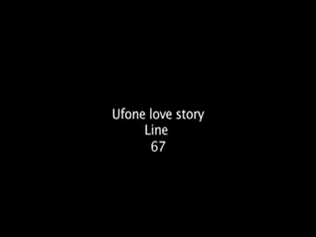
UFONE PREPAID
Zeenat Jabbar

Slide 29

JAZZ PREPAID
Zeenat Jabbar

Slide 30

UFONE UTH
Zeenat Jabbar

Slide 31
ADVERT1
MOBILINK LATEST
Zeenat Jabbar

Slide 32
ADVERT2
UFONE LATEST
Zeenat Jabbar

