Slide 1
Cultural Influences on
Consumer Behavior

Slide 2
Culture is the Accumulation of Shared Meanings, Rituals, Norms, and Traditions Among the Members of an Organization or Society and Determines:
Overall Priorities A Consumer Attaches
to Different Activities and Products
Success or Failure of Specific Products
and Services

Slide 3
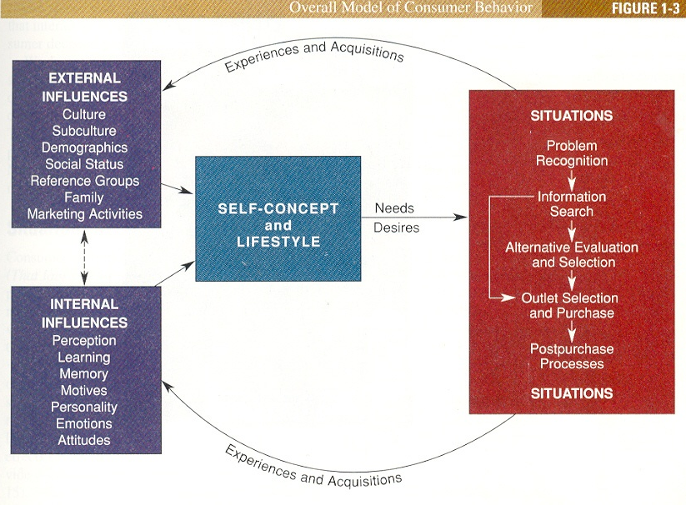

Slide 4
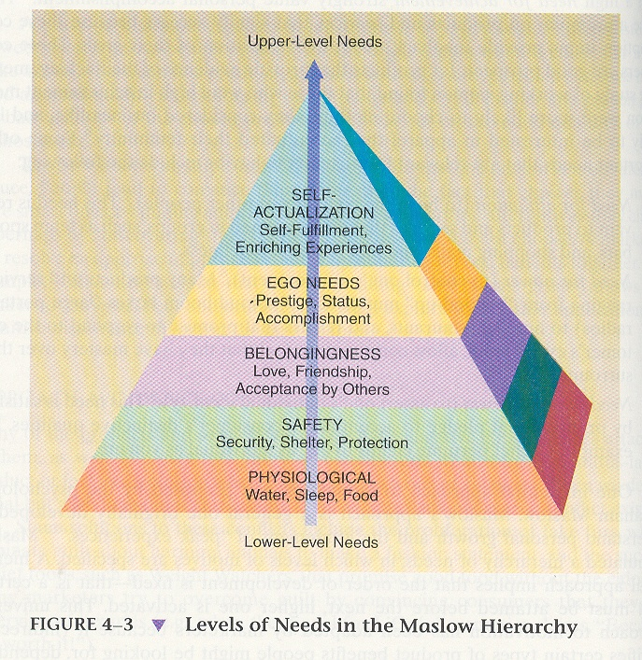

Slide 5
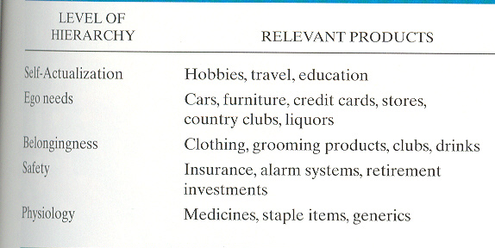

Slide 6
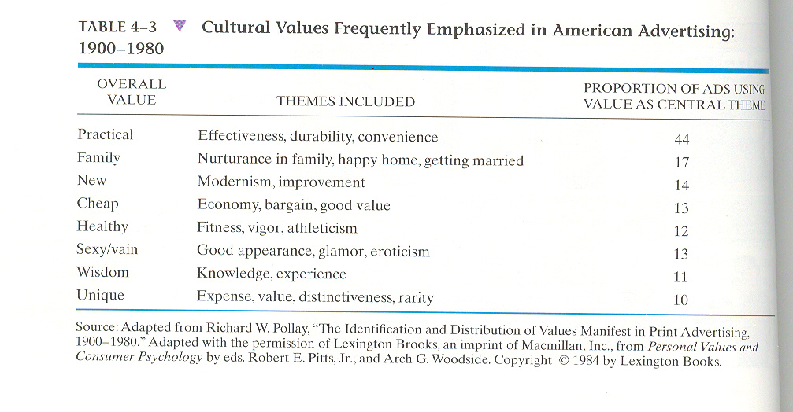

Slide 7
Aspects of Culture
A Cultural System Consists of 3 Functional Areas:
Social Structure
Way in Which Orderly
Social Life is
Maintained
Ecology
Way a System is
Adapted to
Its Habitat
Ideology
Way in Which People
Relate to Their
Environment and
Social Groups

Slide 8
Other Aspects of Culture
Although Every Culture is Different, 4 Dimensions Appear to Account for Much of This Variability.
Power Distance
Uncertainty Avoidance
How Interpersonal Relationships
Form When Power Differences
Exist.
Degree to Which People Feel
Threatened by Ambiguous
Situations.
Degree to Which Sex Roles Are
Clearly Delineated.
Extent to Which the Welfare of the
Individual Versus the Group is
Valued.
Masculinity/ Femininity
Individualism

Slide 9
UA versus PD

Slide 10
M versus I

Slide 11
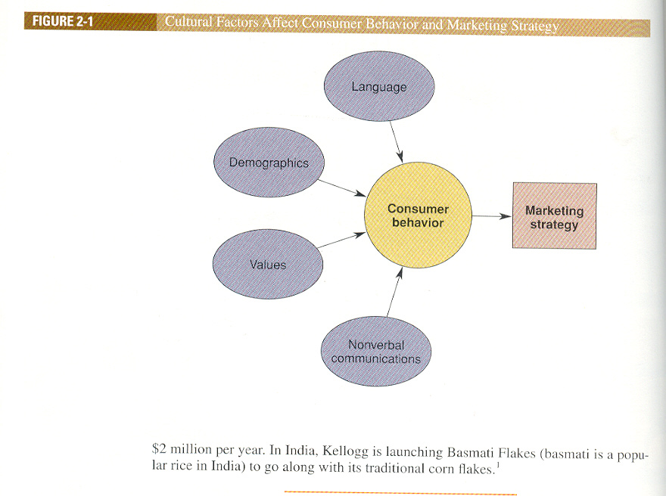

Slide 12
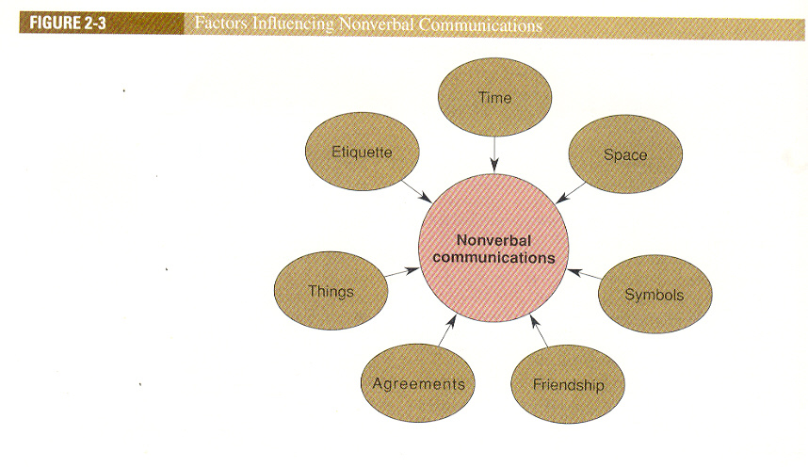

Slide 13
Values of a Culture
Values are Very General Ideas About Good and Bad Goals
Enacted Norms
Explicitly Decided On
Crescive Norms
Embedded in Culture
Customs
Mores
Conventions

Slide 14
Types of Ritual Experience
Religious
A Ritual is a Set of Multiple, Symbolic Behaviors That Occur in a Fixed Sequence and That Tend to Be Repeated Periodically.
Rites of Passage
Ritual Type
Examples
Baptism, Meditation, Mass
Group
Graduation, Marriage
Cultural
Festivals, Holidays
Family
Civic
Parades, Elections, Trials
Personal
Business Negotiations
Mealtimes, Birthdays
Grooming, Household

Slide 15
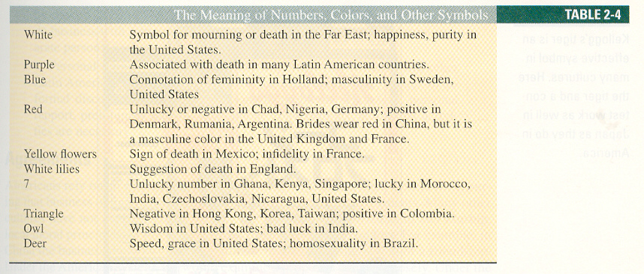

Slide 16
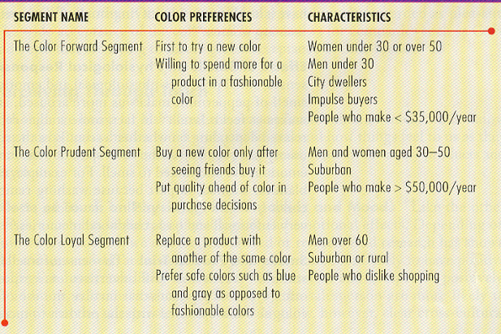

Slide 17
