Slide 1
Advertising and Consumer Behaviour

Slide 2
AMAN KI ASHA

Slide 3
Components of a Marketing Plan
Overall goal(s) of the plan
Marketing objectives
Marketing strategy
Situational analysis
Problems and opportunities
Financial plan
Research

Slide 4
FEVICOL

Slide 5
INDICA

Slide 6
NIRMA

Slide 7
Advertising Tasks
Related to Marketing Plan
Prospect identification
Consumer motivations
Advertising execution
Advertising budget and allocation

Slide 8
AZME ALISHAN I, II, III

Slide 9
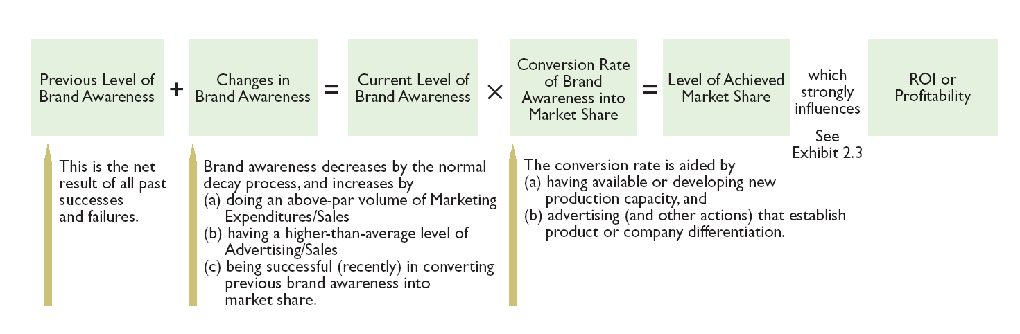
How Brand Awareness Aids Profitability

Slide 10
Integrated Marketing
Product
Personal selling
Price
Sales promotion
Distribution
Public relations
Communication
Advertising

Slide 11
Advertising and IMC Defined
Advertising consists of paid notices from identified sponsors normally offered through communication media.
Integrated marketing communication (IMC) is the joint planning, execution, and coordination of all areas of marketing communication.

Slide 12
Advertising to Diverse Stakeholders
Distribution channel
Employees
Customers
Stockholders
Community at large

