Slide 1
Buying and Disposing

Slide 2
Situational Effects on
Consumer Behavior
Consumption Situation:
  Factors beyond characteristics of the person and of the product that influence the buying and/or using of products and services
Situational Self-Image:
  The role a person plays at any one time.

Slide 3
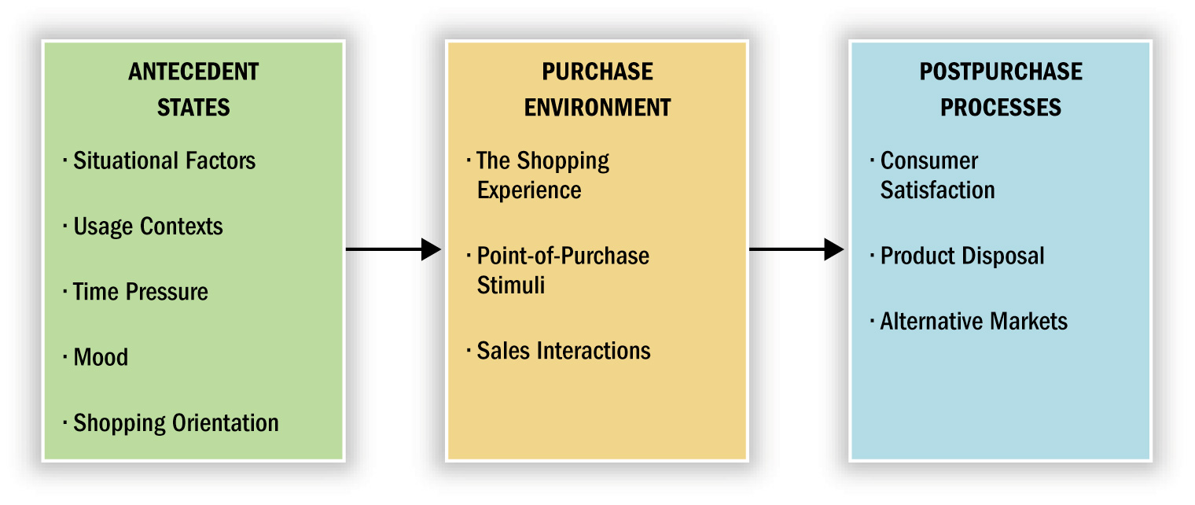
Purchase and Postpurchase Issues
Figure 10.1

Slide 4
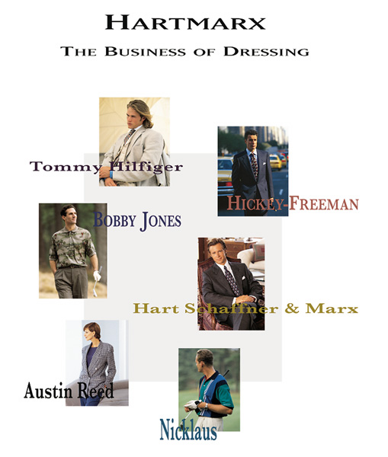
Situation Influences Choice
Clothing choices often are heavily influenced by the situation in which they need to be worn.

Slide 5
Social and Physical Surroundings
Co-consumers:
  Other patrons in the setting
Density
  The actual number of people occupying a space
Crowding:
  Exists only if a negative affective state occurs as a results of density
Temporal Factors:
  Time Poverty: A consumer’s feeling that he or she is pressed for time

Slide 6

Physical Environments
Many stores and services (like airlines) try to differentiate themselves in terms of the physical environments they offer, touting amenities such as comfort.

Slide 7
Temporal Factors
Economic Time:
  Time is an economic variable (i.e., it is a resource that must be allocated)
  Time Poverty: A consumer’s feeling that they are pressed for time
Psychological Time
  Time Categories
Flow Time Occasion Time Deadline Time | Leisure Time Time To Kill

Slide 8
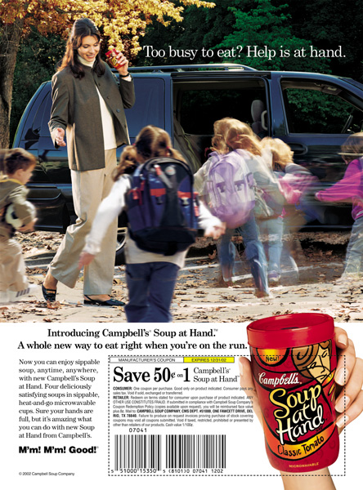
Time Poverty
Time poverty is creating opportunities for many new products (like portable soups) that let people multitask.

Slide 9
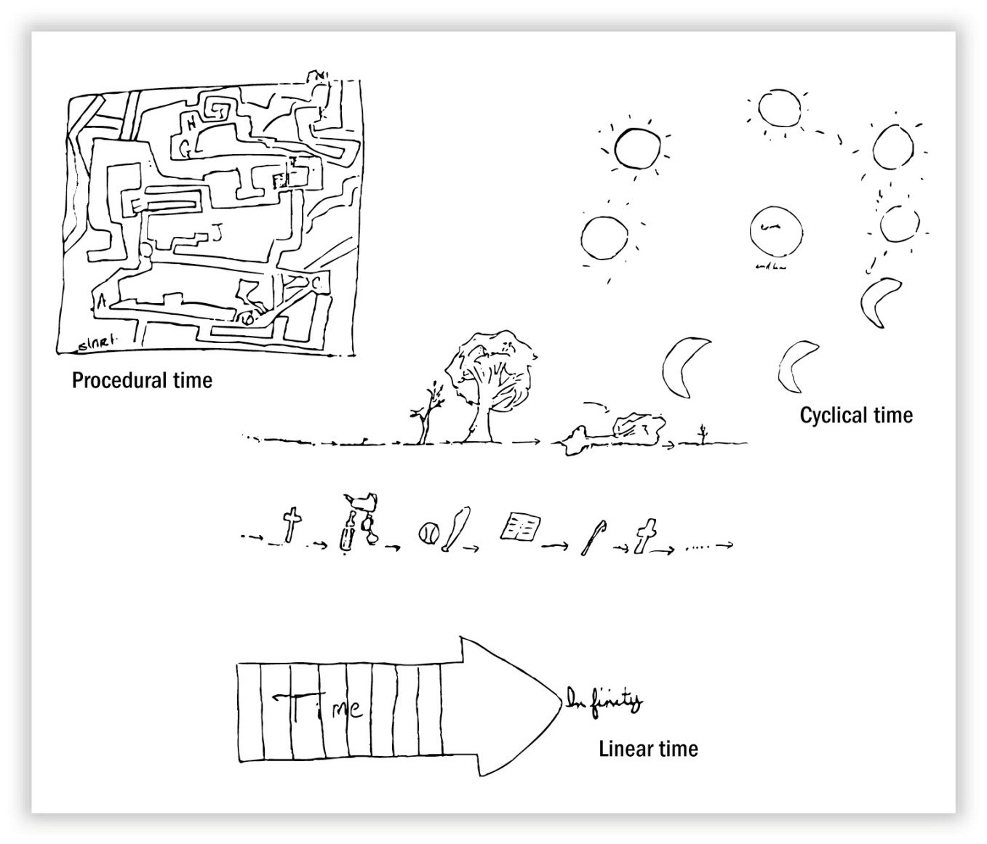
Drawings of Time
Figure 10.2

Slide 10
Psychological Time
Linear Separable Time:
  Events proceed in an orderly sequence and different times are well defined.
Procedural Time:
  When people ignore the clock and do things “when the time is right”
Circular or Cyclic Time
  Time is governed by natural cycles
Queuing Theory
  The mathematical study of waiting in lines

Slide 11
Antecedent States
If It Feels Good, Buy It…
Pleasure and Arousal:
  Two dimensions which determine if a shopper will react positively or negatively to a consumption environment
Mood:
  Some combination of pleasure and arousal
  Consumers give more positive evaluations when they are in a good mood
  Can be affected by store design, weather, or other factors specific to the consumer

Slide 12
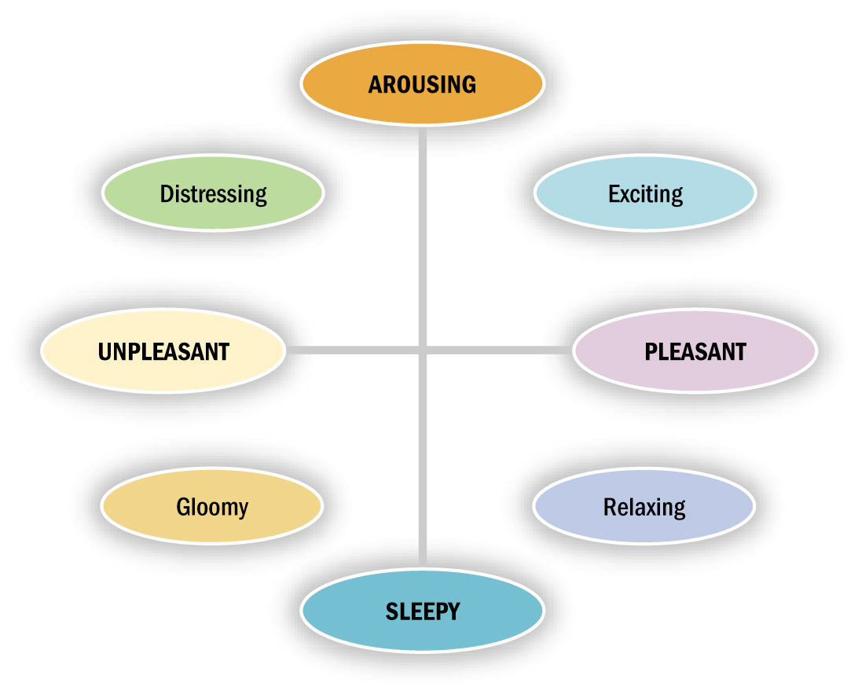
Dimensions of Emotional States
Figure 10.3

Slide 13
Shopping: A Job or An Adventure?
Reasons for Shopping:
  Shopping Orientation: General attitudes about shopping
  Hedonic Shopping Motives:
    Social Experiences
    Sharing of Common Interests
    Interpersonal Attraction
    Instant Status
    The Thrill of the Hunt
E-Commerce: Clicks Versus Bricks

Slide 14
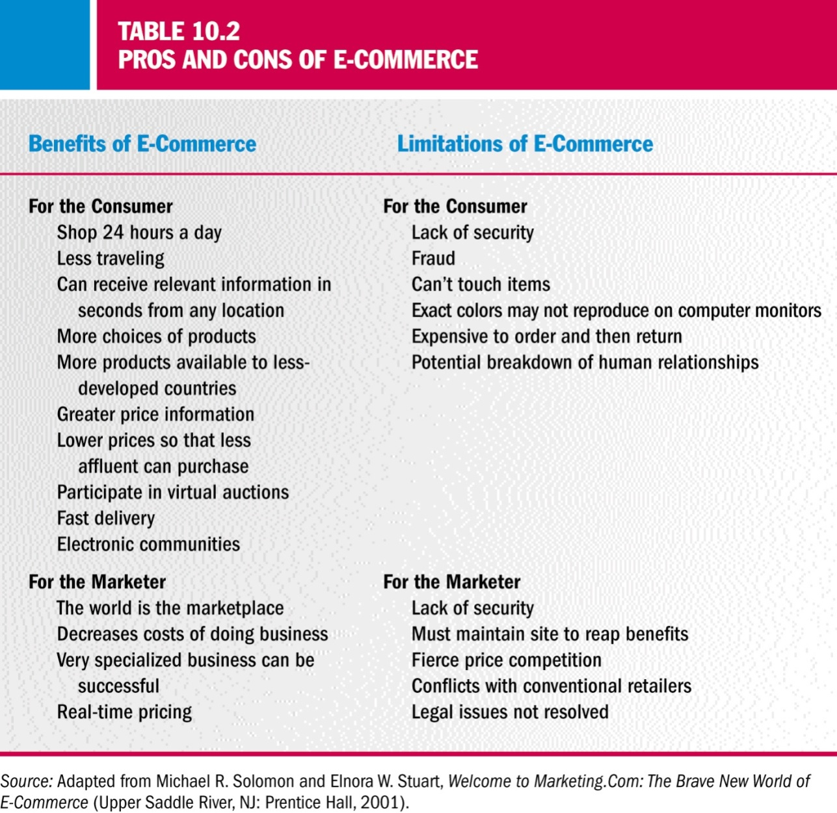
Pros and Cons of E-Commerce

Slide 15
Retailing as Theater
Retail Theming
  The strategy of creating imaginative environments that transport shoppers into fantasy worlds or providing other kinds of stimulation.
Landscape themes Marketspace themes | Cyberspace themes Mindscape themes
Store Image
  The personality of a store including the store’s location, merchandise suitability, and the knowledge and congeniality of its sales staff.
Atmospherics
  The “conscious designing of space and its various dimensions to evoke certain effects in buyers.”

Slide 16
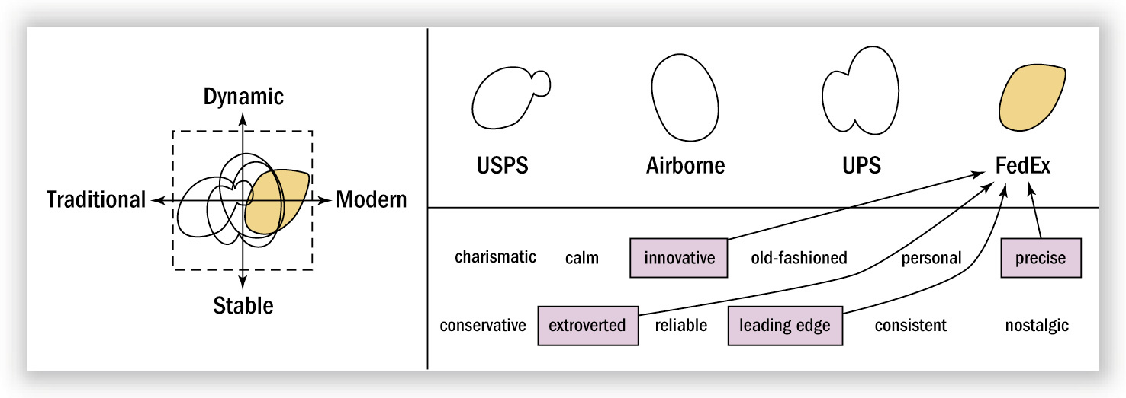
FedEx Brand Position
Figure 10.4

Slide 17
In-Store Decision Making
Spontaneous Shopping
  Unplanned buying: Occurs when a person is unfamiliar with a store’s layout or when under some time pressure; or, a person may be reminded to buy something by seeing it
  Impulse buying: Occurs when the person experiences a sudden urge that cannot be resisted
  Impulse items: Items conveniently placed near a checkout

Slide 18
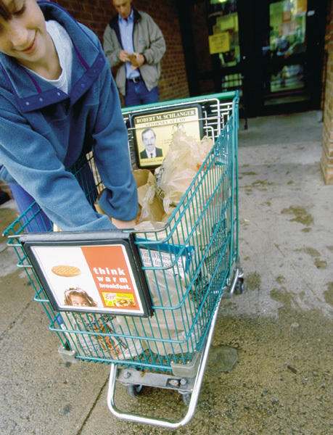
Spontaneous Shopping
Smart retailers recognize that many purchase decisions are made at the time the shopper is in the store. That’s one reason why grocery carts sometimes resemble billboards on wheels.

Slide 19
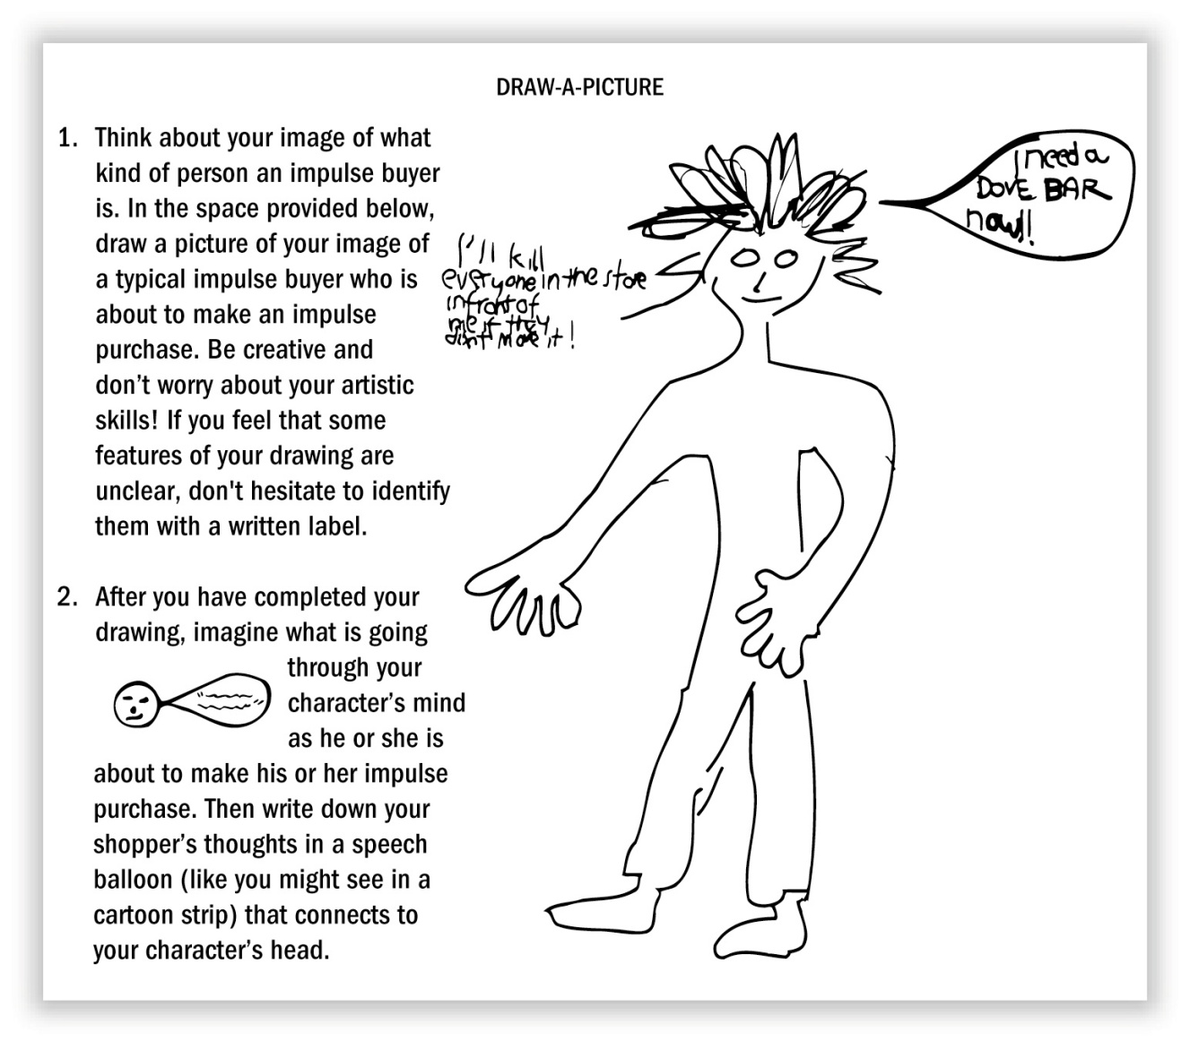
One Consumer’s Image of an Impulse Buyer
Figure 10.5

Slide 20
Categorizing Shoppers by Advance Planning
Planners
  Tend to know what products and specific brands they will buy beforehand.
Partial Planners
  Know they need certain products, but do not decide on a specific brand until they are in the store
Impulse Purchasers
  Do no advance planning

Slide 21
Point-of-Purchase Stimuli
Point-of-Purchase Stimuli (POP)
  An elaborate product display or demonstration, a coupon-dispensing machine, or someone giving out free samples
  Some more dramatic POP displays:
    Timex
    Kellogg’s Corn Flakes
    Elizabeth Allen
    Tower Records
    Trifari
    Charmin
    The Farnam Company

Slide 22
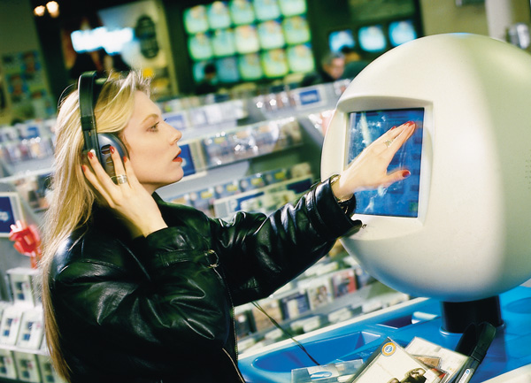
Music Samplers
Music samplers that allow shoppers to check out the latest music tunes before buying have become a fixture in many stores.

Slide 23
The Salesperson
Exchange Theory:
  Every interaction involves an exchange of value.
Commercial Friendships:
  When service personnel and customers form relationships
Identity Negotiation:
  A relationship in which some agreement must be reached about the roles of each participant
Interaction Styles:
  Salespeople can adapt their approach according to customer’s traits and preferences

Slide 24
Postpurchase Satisfaction
Consumer satisfaction/dissatisfaction (CS/D):
  Determined by the overall feelings, or attitude, a person has about a product after it has been purchased.
Perceptions of Product Quality:
  Consumers use a number of cues to infer quality
Quality Is What We Expect It To Be:
  Expectancy Disconfirmation Model: Consumers form beliefs about product performance based on prior experience with the product and/or communications about the product that imply a certain level of quality.
  Managing Expectations: Customer dissatisfaction is usually due to expectations exceeding the company’s ability to deliver.

Slide 25
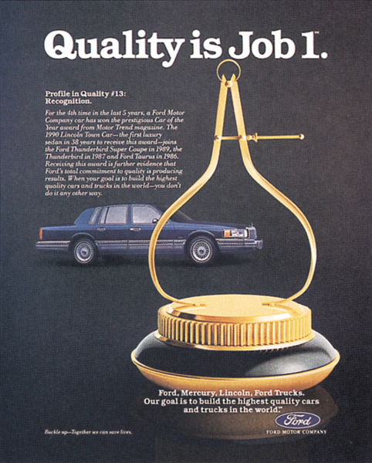
Quality Perceptions
This ad for Ford relies on a common claim about quality.

Slide 26
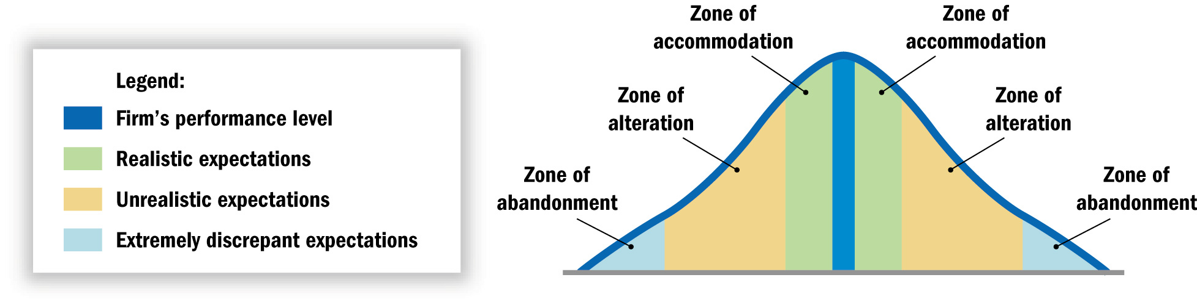
Customer Expectation Zones
Figure 10.6

Slide 27
Acting on Dissatisfaction
Three Possible Courses of Action
  Voice Response: The consumer can appeal directly to the retailer for redress.
  Private Response: Express dissatisfaction about the store or product to friends and/or boycott the store.
  Third-Party Response: The consumer can take legal action against the merchant, register a complaint with the Better Business Bureau, or write a letter to the newspaper.
TQM: Going to the Gemba
  Gemba: The one true source of information.

Slide 28
Product Disposal
Disposal Options:
  (1) Keep the item
  (2) Temporarily Dispose of it
  (3) Permanently dispose of it
Lateral Cycling: Junk Versus “Junque”
  Lateral Cycling: When already purchased objects are sold to others or exchanged for other things.
  Underground Economy: Secondary markets (e.g. eBay)

Slide 29
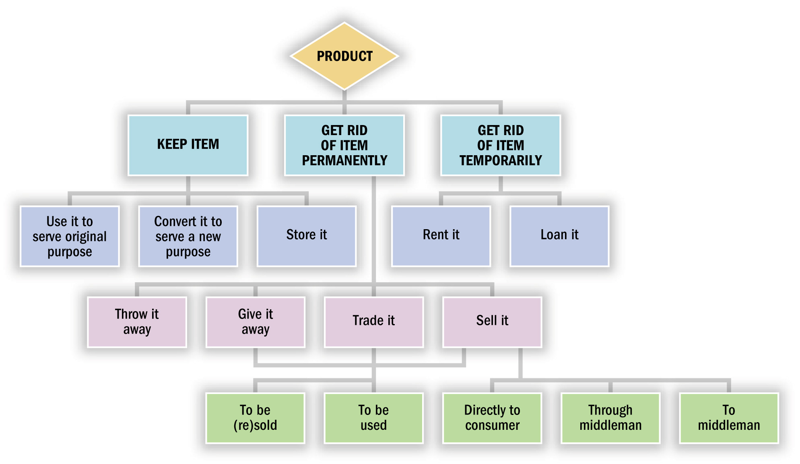
Consumers’ Disposal Options
Figure 10.8

Slide 30
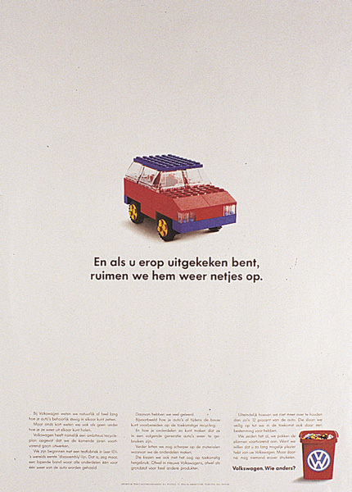
Volkswagen
This Dutch ad says, “And when you’ve had enough of it, we’ll clear it away nicely.”

