Slide 1
Individual Decision Making

Slide 2
Consumers As Problem Solvers
A consumer purchase is a response to a problem.
Steps in the decision process:
  (1) Problem recognition
  (2) Information search
  (3) Evaluation of alternatives
  (4) Product choice
Amount of effort put into a purchase decision differs with each purchase.

Slide 3
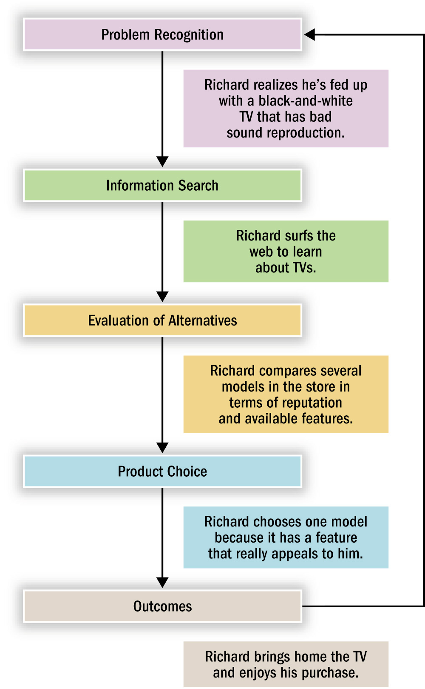
Stages in Consumer Decision Making
Figure 9.1

Slide 4
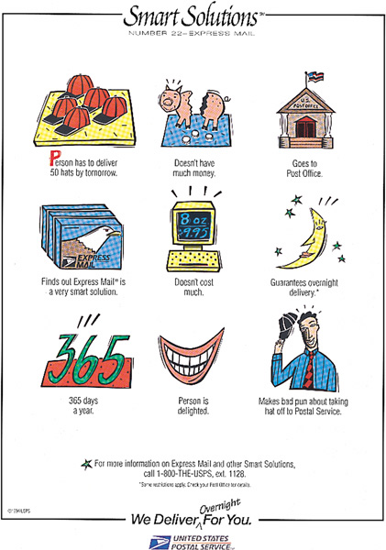
Illustrating the Decision-Making Process
This ad by the U.S. Postal Service presents a problem, illustrates the decision-making process, and offers a solution.

Slide 5
Perspectives on Decision Making
Rational Perspective:
  Consumers integrate as much info as possible, weigh pluses and minuses, arrive at a decision
  Purchase Momentum:
    Initial impulses increase the likelihood of buying more
  Constructive Processing:
    Sequence of events by which the consumer evaluates the effort needed to make a choice and then chooses a strategy based on the level of effort required
Behavioral Influence Perspective:
  Concentration on the types of decisions made under low involvement conditions
Experiential Perspective:
  Stresses the totality of the product or service

Slide 6
Types of Consumer Decisions
Extended Problem Solving:
  Corresponds to traditional decision-making perspective
Limited Problem Solving:
  People use simple decision rules to choose among alternatives
Habitual Decision Making:
  Choices made with little to no conscious effort
  Automaticity: Characteristic of choices made with minimal effort and without conscious control

Slide 7
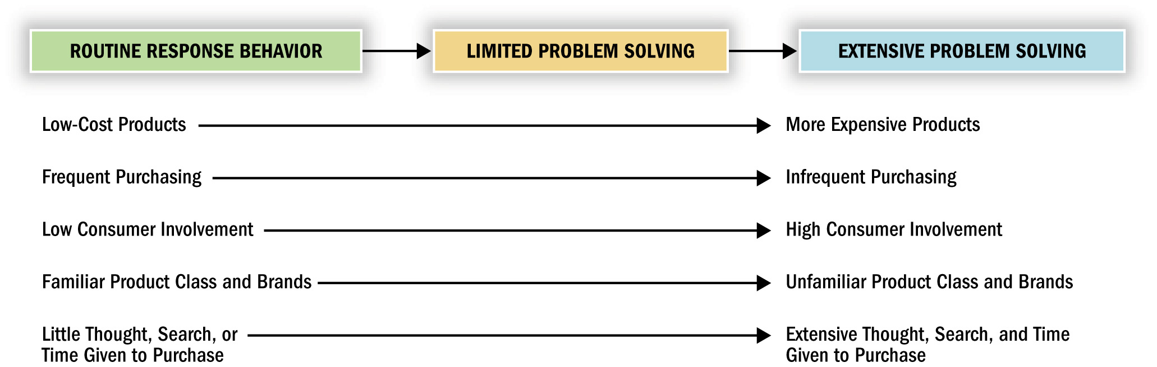
A Continuum of
Buying Decision Behavior
Figure 9.2

Slide 8
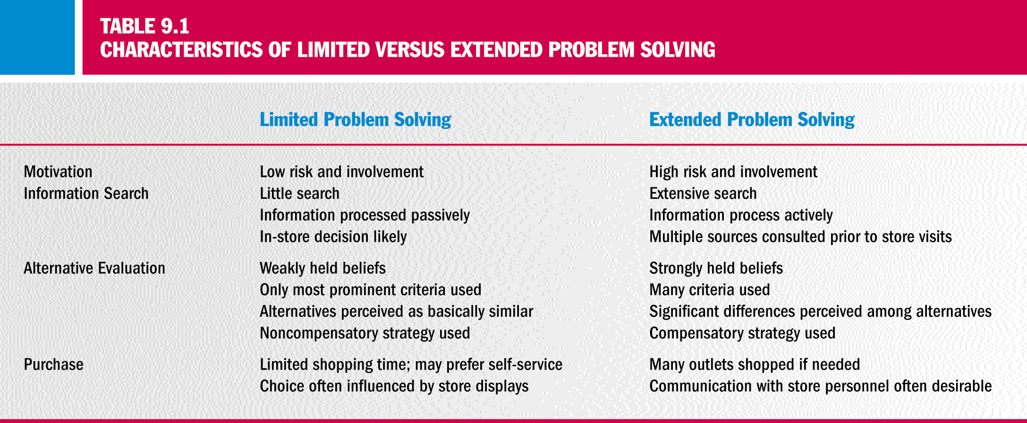
Limited vs. Extended Problem Solving

Slide 9
Problem Recognition
Problem recognition:
  Occurs whenever the consumer sees a significant difference between his or her current state of affairs and some desired or ideal state
    Need recognition: The quality of the consumer’s actual state moves downward
    Opportunity recognition: The consumer’s ideal state moves upward
  Primary demand: Consumers are encouraged to use a product or service regardless of the brand they choose
  Secondary demand: Consumers are encouraged to use a specific brand – can only occur if primary demand exists

Slide 10
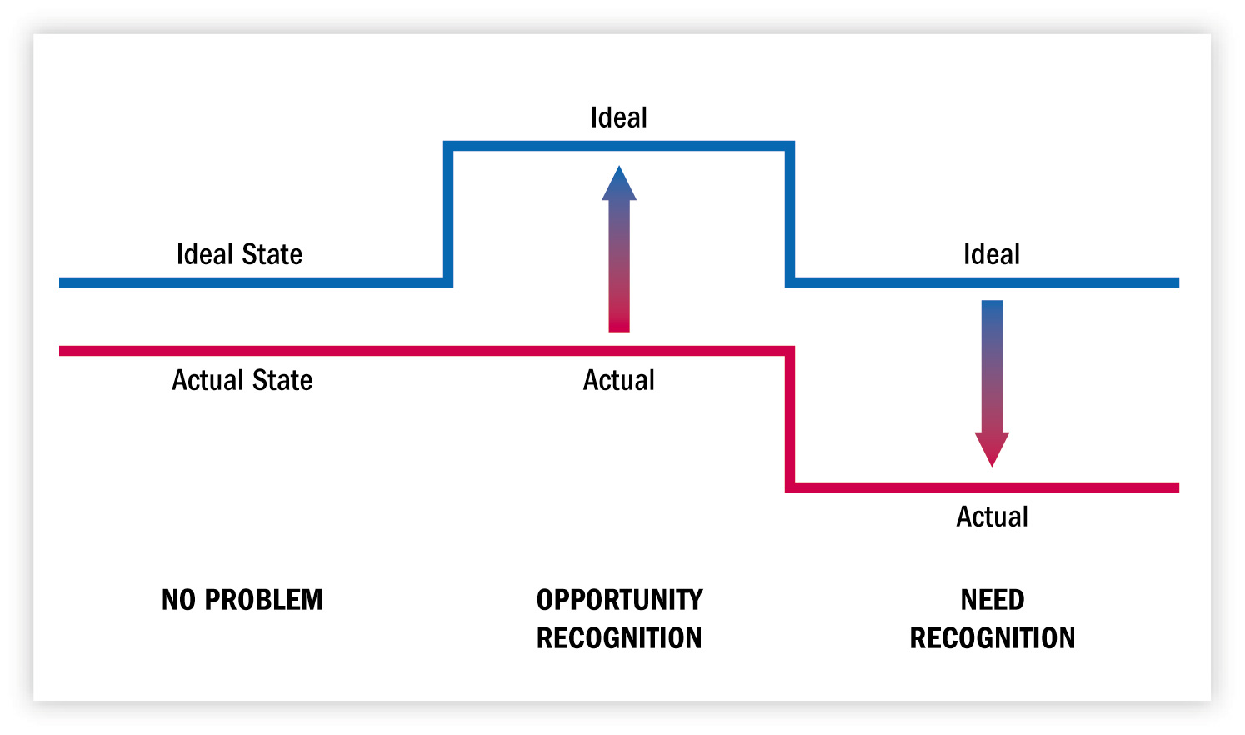
Problem Recognition:
Shifts in Actual or Ideal States
Figure 9.3

Slide 11
Information Search
Types of Information Search:
  Prepurchase search: Consumer recognizes a need and then searches the marketplace for specific information
  Ongoing search: Browsing for fun or staying up-to-date on what’s happening in the market
Internal Versus External Search:
  Internal search: Scanning our own memory banks for information about product alternatives
  External search: Obtaining product information from advertisements, friends, or by observing others

Slide 12
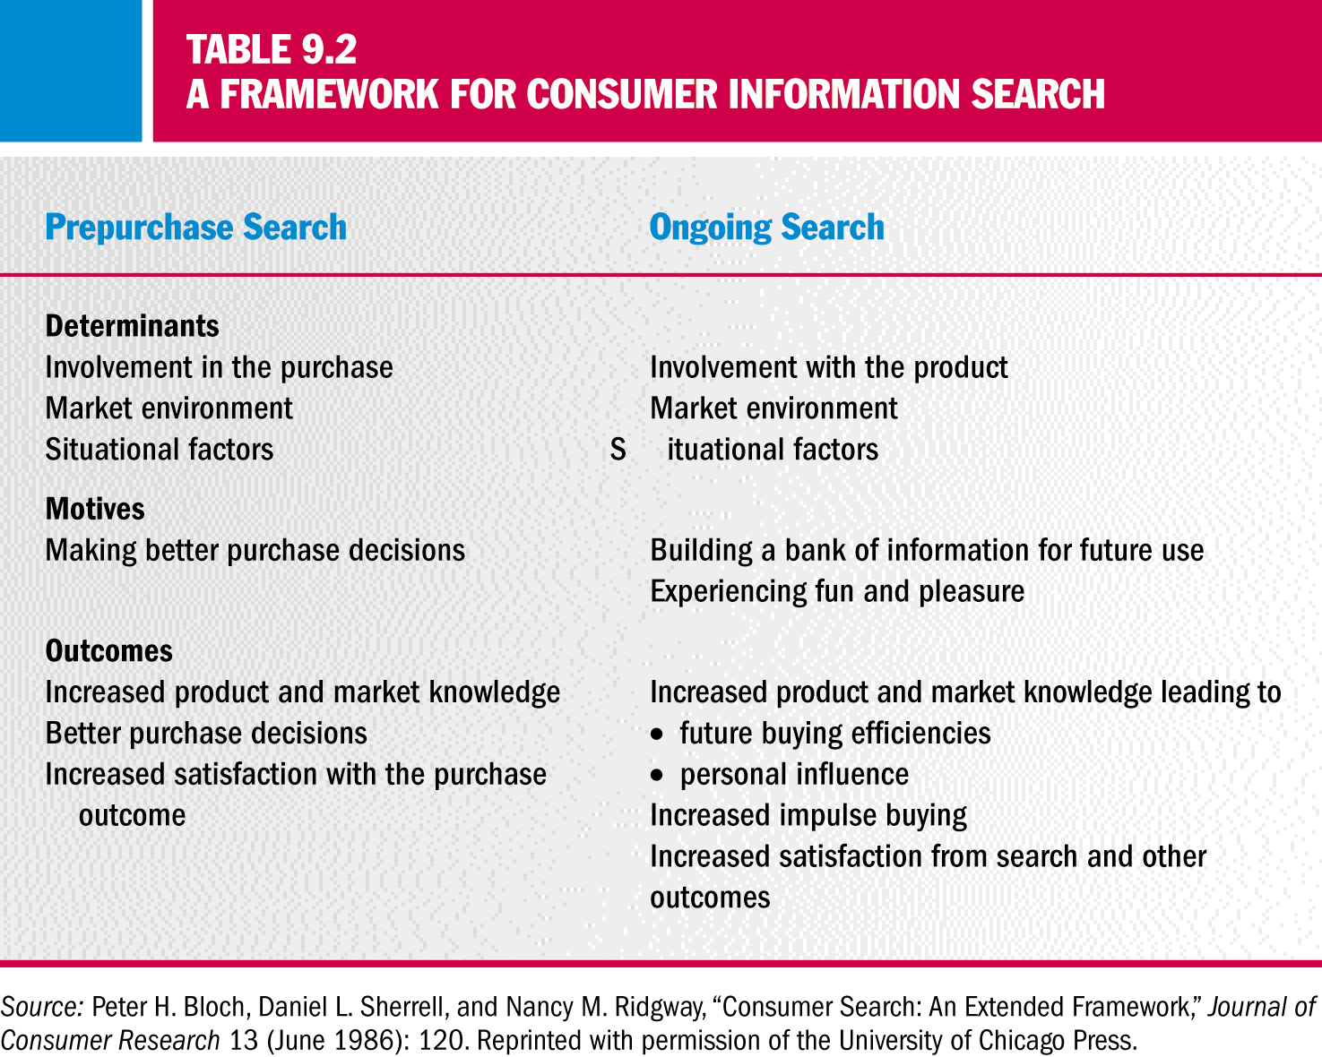
Consumer Information
Search Framework

Slide 13
Other Types of Information Search
Deliberate Versus “Accidental” Search:
  Directed Learning: Results from existing knowledge from previous active acquisition of information
  Incidental Learning: Passive acquisition of information through exposure to advertising, packaging, and sales promotion activities
The Economics of Information:
  Approach that assumes consumers will gather as much data as needed to make a decision
  Utility: Rewards of continued search
  Variety Seeking: Desire to choose new alternatives over familiar ones

Slide 14
Do Consumers Always Search Rationally?
Consumers don’t necessarily engage in a rational search process
Brand Switching:
  Changing brands even if the current brand satisfies the consumer’s needs
Sensory-specific satiety:
  A cause of variety seeking when there is relatively little stimulation in the consumer’s environment

Slide 15
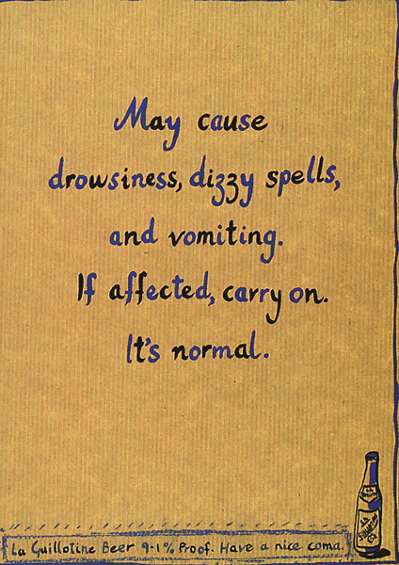
Rational Consumer?
This Singaporean beer ad reminds us that not all product decisions are made rationally.

Slide 16
Biases in the Decision-Making Process
Mental Accounting:
  Decisions are influenced by the way a problem is posed (framing)
Sunk-cost fallacy:
  Having paid for something makes the consumer reluctant to waste it
Loss Aversion:
  People place more emphasis on loss than gain
Prospect Theory:
  A descriptive model of how people make choices that finds that utility is a function of gains and losses

Slide 17
How Much Search Occurs?
Greater Search Activity When:
  The purchase is important
  There is a need to learn more about the purchase
  Relevant information is easily obtained and used
The Consumer’s Prior Expertise:
  Search tends to be the greatest among those consumers who are moderately knowledgeable about the product
  The type of search differs according to expertise
    Selective search: A more focused and efficient search which is typical of experts
    Novices are more likely to rely on the opinions of others

Slide 18
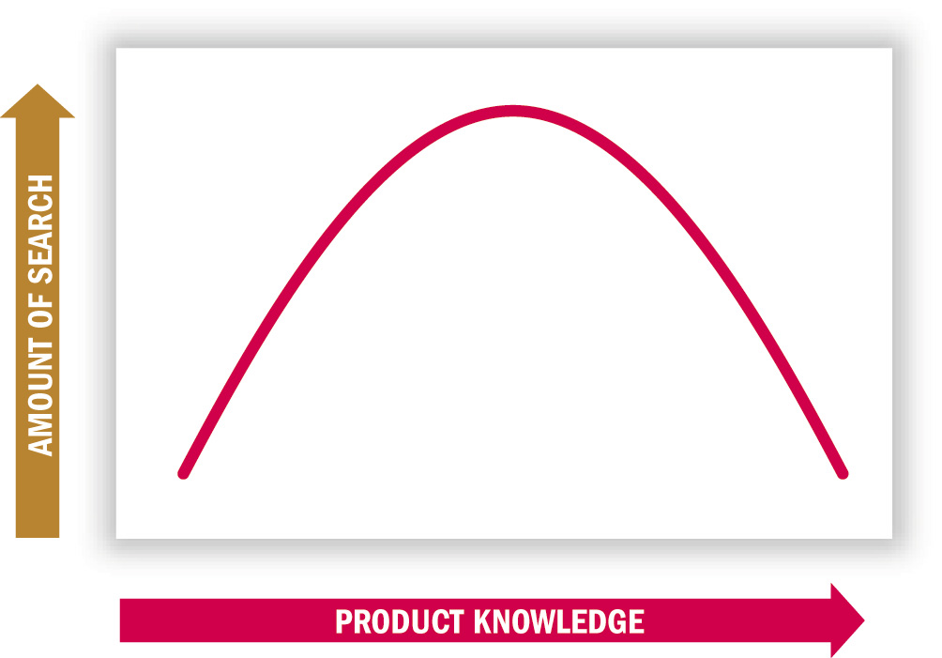
Information Search vs. Product Knowledge
Figure 9.5

Slide 19

Perceived Risk in Advertising
Minolta features a no-risk guarantee as a way to reduce the perceived risk in buying an office copier.

Slide 20
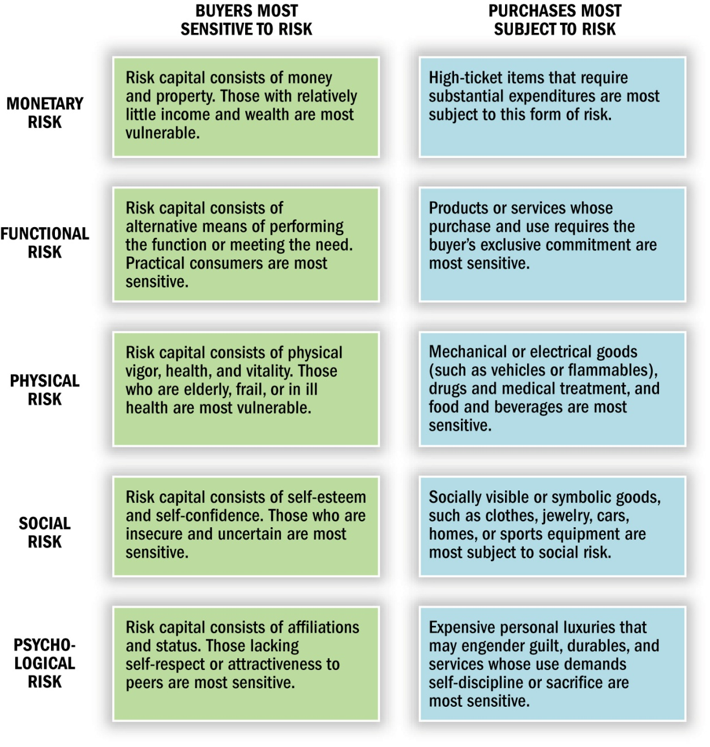
Perceived Risk
Purchase decisions that involve extensive search also entail some kind of perceived risk.
Figure 9.6

Slide 21
Evaluation of Alternatives
Identifying Alternatives:
  Evoked Set: Products already in memory (the retrieval set) plus those prominent in the retail environment
Product Categorization:
  Categorization: Mentally placing a product with a set of other comparable products
Levels of Categorization:
  Basic level category
  Superordinate category
  Subordinate category

Slide 22
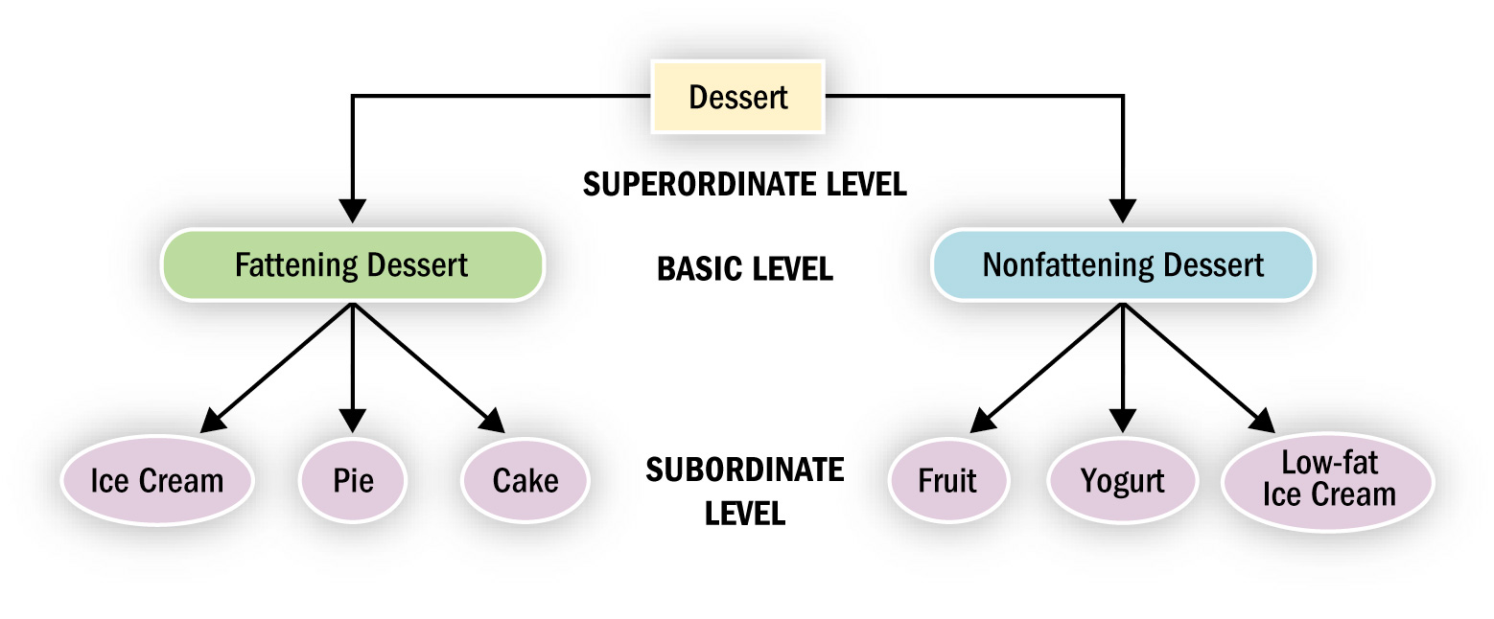
Levels of Abstraction in Dessert Categories
Figure 9.7

Slide 23
Strategic Implications of Product Categorization
Product Positioning:
  Success of a positioning strategy depends on convincing the consumer that the product should be considered in the category.
Identifying Competitors:
  Many products compete for membership in a category
Exemplar Products:
  Products which are a good example of a category
Locating Products:
  Categorization can affect consumers’ expectations of where the product can be located

Slide 24
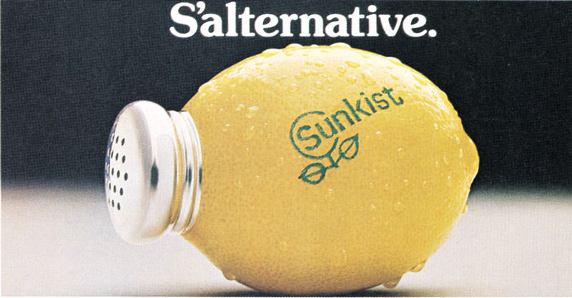
Product Positioning
This ad for Sunkist lemon juice attempts to establish a new category for the product by repositioning it as a salt substitute.

Slide 25
Product Choice:
Selecting Among Alternatives
Evaluative Criteria:
  Dimensions used to judge the merits of competing options
  Determinant Attributes: Attributes used to differentiate among choices
To recommend a new decision criteria, a communication should:
  Point out that there are significant differences among brands on the attribute
  Supply the consumer with a decision-making rule
  Convey a rule that can be integrated with how the person has made this decision in the past

Slide 26
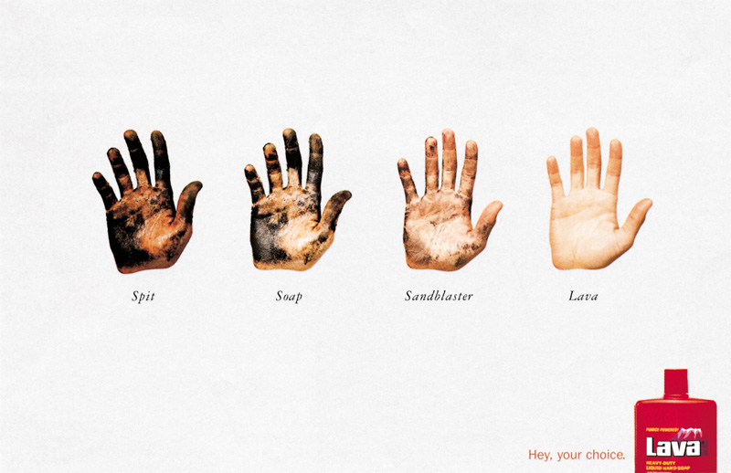
Choosing the Solution
Lava soap lays out the options and invites us to choose the solution.

Slide 27
Cybermediaries
Cybermediary:
  An intermediary that filters and organizes online marketing information to aid in evaluation of alternatives
Cybermediaries take different forms:
  Directories and portals (e.g. fashionmall.com)
  Web site evaluators (e.g. Point Communications)
  Forums, fan clubs, and user groups (e.g. about.com)
  Financial intermediaries (e.g. PayPal)
  Intelligent agents (e.g. mysimon.com)

Slide 28

Online Information Search
Search engines like Ask Jeeves simplify the process of online information search.

Slide 29
Heuristics: Mental Shortcuts
Heuristics:
  Mental rules-of-thumb that lead to a speedy decision
Relying on a Product Signal:
  Product signal: Aspect of an item that visibly communicates some underlying quality
  Covariation: Perceived associations among events that may or may not influence one another
Market Beliefs: Is It Better if I Pay More For It?
  Price-Quality Relationship: Pervasive market belief that higher price means higher quality

Slide 30
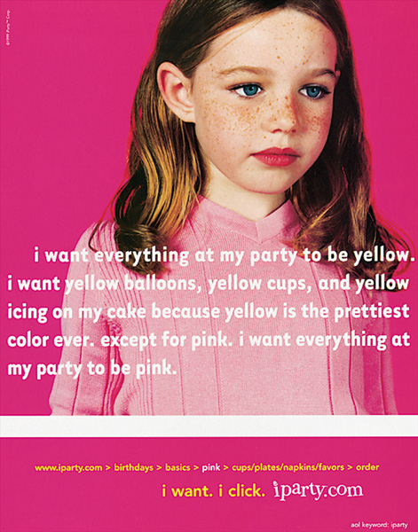
Heuristics Simplify Choices
Consumers often simplify choices by using heuristics such as automatically choosing a favorite color or brand.

Slide 31
Heuristics (cont.)
Country-of-Origin as a Product Signal
  Roper Starch Worldwide categorization of people’s level of cultural attachment
    Nationalists
    Internationalists
    Disengaged
  Country-of-origin: Can be an important piece of information in the decision-making process
  Stereotype: A knowledge structure based on inferences across products
  Ethnocentrism: Tendency to prefer products or people of one’s own culture.
  Consumer Ethnocentrism Scale (CETSCALE): Measures ethnocentrism

Slide 32

Country of Origin
A product’s country of origin is an important piece of information in the decision-making process.
Certain items are strongly associated with specific countries, and products from those countries often attempt to benefit from these linkages.

Slide 33

Macanudo Cigars
This advertisement positions the Macanudo cigar as part of Americana, even though it’s imported from the Dominican Republic.

Slide 34
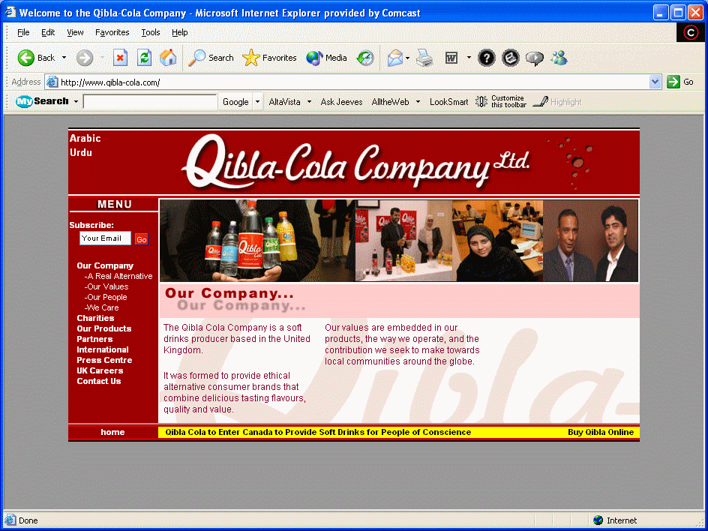

Qibla-Cola

Slide 35
Heuristics (conc.)
Choosing Familiar Brand Names: Loyalty or Habit?
  Brand loyalty is prized by marketers
Inertia: The Lazy Consumer:
  Inertia: A brand is bought out of habit because less effort is required
Brand Loyalty: A “Friend,” Tried-and-True:
  Brand parity: Consumers’ beliefs that there are no significant differences between brands

Slide 36
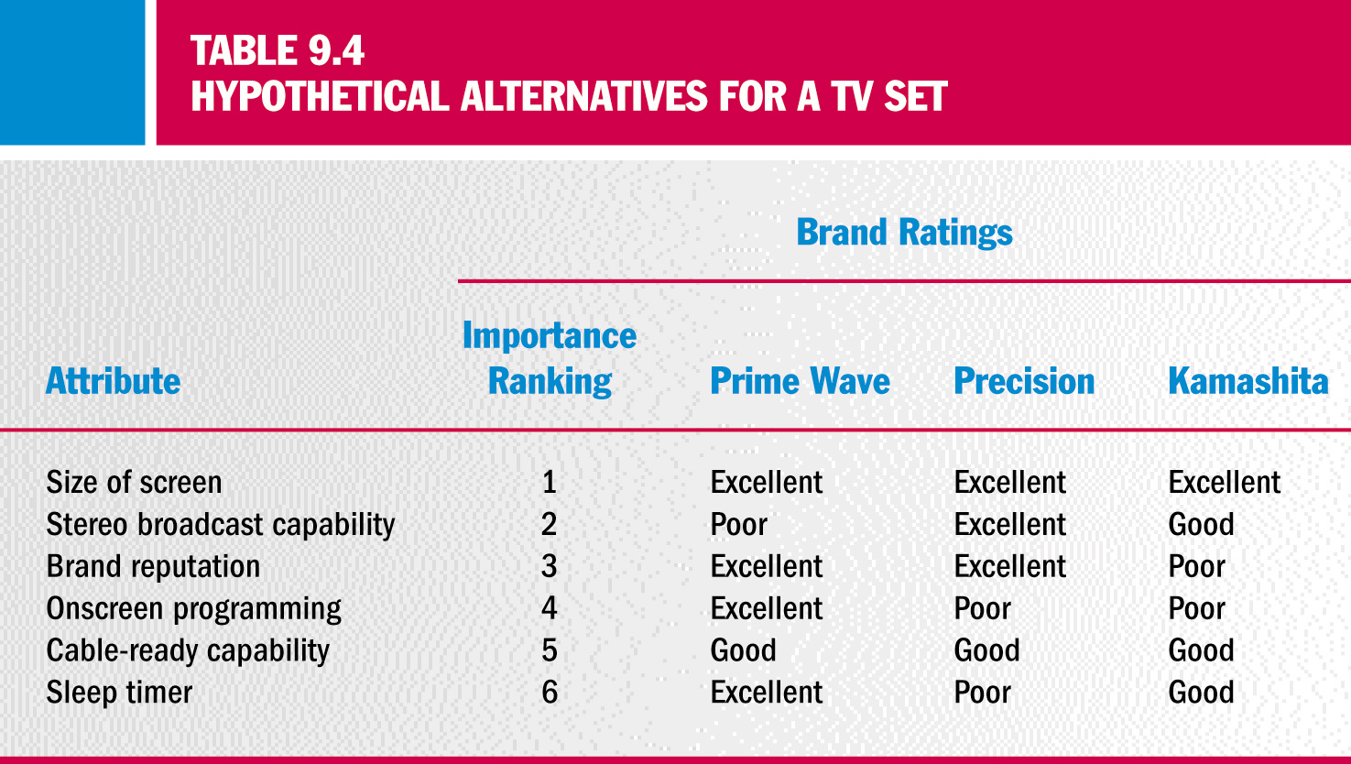
Hypothetical Alternatives for a TV Set

Slide 37
Decision Rules
Noncompensatory Decision Rules:
  Choice shortcuts where a product with a low standing on one attribute cannot compensate by being better on another attribute
    The Lexographic Rule
    The Elimination by Aspects Rule
    The Conjunctive Rule
Compensatory Decision Rules:
  Give a product a chance to make up for its shortcomings
    Simple Additive Rule
    Weighted Additive Rule

