Slide 1
Communication and Consumer Behavior

Slide 2
Figure 9.1 Basic Communication Model
Message
Channel
(Medium)
Sender
(Source)
Receiver
(Consumer)
Feedback

Slide 3
Elements of the
Communications Process
The Message Initiator (the Source)
The Sender
The Receiver
The Medium
The Message
The Target Audience (the Receivers)
Feedback - the Receiver’s Response

Slide 4
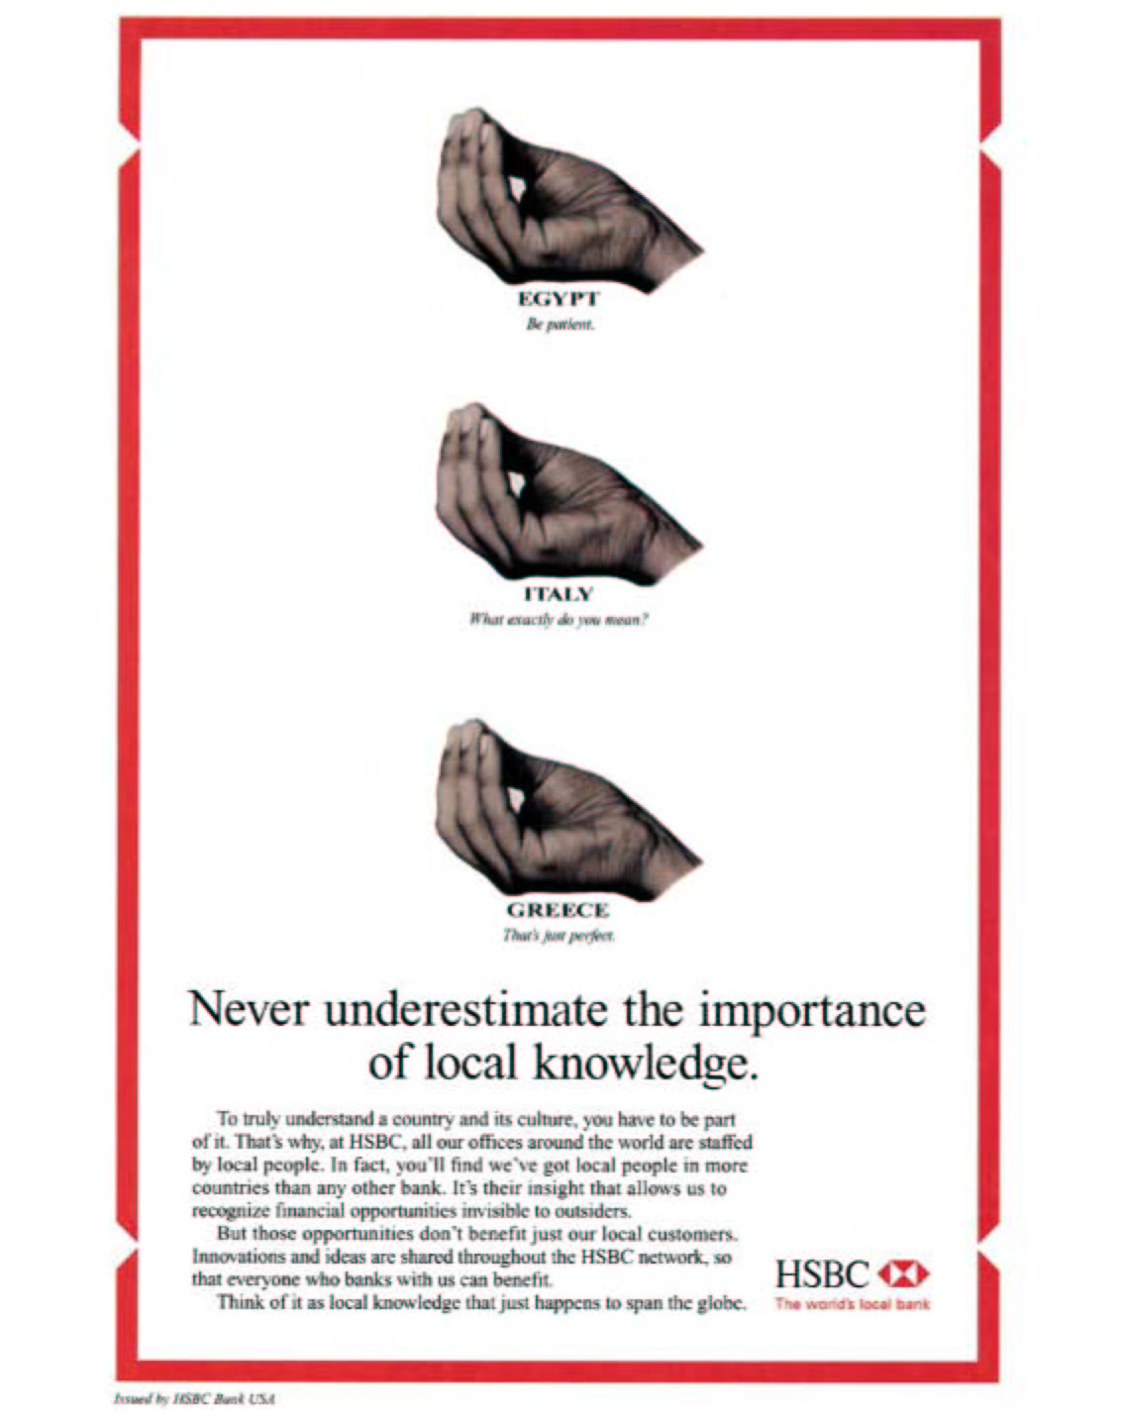
Figure 9.2 Ad Depicting Non-Verbal Communication

Slide 5
Issues in Credibility
Credibility of Informal Sources
Credibility of Formal Sources
Credibility of Spokespersons and Endorsers
Message Credibility

Slide 6
Endorser Credibility
Endorser credibility is important when message comprehension is low
Match must exist between product attributes and endorser attributes
Credibility is higher when endorser’s demographic characteristics are similar to those of target audience
Endorser credibility is not a substitute for corporate credibility

Slide 7
ENGRO RUPAYYA

Slide 8
Barriers to Communication
Selective Perception
  Wandering, Zapping, Zipping, and Channel Surfing
  Combat with Roadblocking
Psychological Noise
  Combat with repeated exposures, contrast in the copy, and teasers

Slide 9
Figure 9.3 Comprehensive Communication Model
Commercial
Non-Profit
Individual
Formal vs. Informal
Verbal vs. Nonverbal
1-sided vs. 2-sided
Factual vs. Emotional
Selective Exposure
Individuals
Target Audience
Intermediary Audience
Unintended Audiences
Mediated by: Involvement
Mood
Experience
Personal Charac.
Encodes
Message
Channel
(Medium)
Sender
(Source)
Receiver
(Consumer)
Decodes
Symbols
Pictures
Words
Images
Paid vs. Unpaid
Print, Broadcast, Electronic
Personal vs. Impersonal
Responds Appropriately?
Yes
No
Miscomprehends?
Yes
Pretests to Ensure Message Will be Received
Posttests to Ensure Message Was Received
No
Feedback

Slide 10
Issues in Designing Persuasive Communications
Communications strategy
Media strategy
Message strategy

Slide 11
Communications Strategy
Memory
Perceptions
Experience

Slide 12
VODAFONE BLACKBERRY
FACEBOOK#1

Slide 13
Figure 9.4 Perception/ Experience/ Memory Model of Advertising
Pre-experience Exposure
Post-experience Exposure
Framing
Perception
Enhancing
Experience
Organizing
Memory
Expectation
Anticipation
Interpretation
Sensory
Enhancement
Social
Enhancement
Cueing
Branding
Interpretation

Slide 14
UFONE
ZEENAT JABBAR PERMALINK

Slide 15
Media Strategy
Consumer profiles
Audience profiles
A cost-effective media choice is one
that closely matches the
advertiser’s consumer profile
with the medium’s audience profile.

Slide 16
Emotional Advertising Appeals
Fear
Humor
Amorous advertising
Audience participation

Slide 17
NATIONAL FOODS PROMOTES PAKISTAN

Slide 18
NATIONAL RECIPE MASALA

Slide 19

Figure 9.10 Humor to
Baby Boomers

Slide 20
Table 9.4 Impact of Humor on Advertising
Humor attracts attention.
Humor does not harm comprehension.
Humor is not more effective at increasing persuasion.
Humor does not enhance source credibility.
Humor enhances liking.
Humor that is relevant to the product is superior to humor that is unrelated to the product.
Audience demographic factors affect the response to humorous advertising appeals.
The nature of the product affects the appropriateness of a humorous treatment.
Humor is more effective with existing products than with new products.
Humor is more appropriate for low-involvement products and feeling-oriented products than for high-involvement products.

