Slide 1
Brand POSITIONING
&
CAPABILITY
Zeenat Jabbar

Slide 2
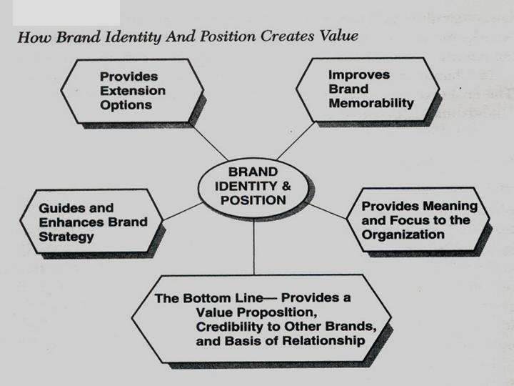

Slide 3
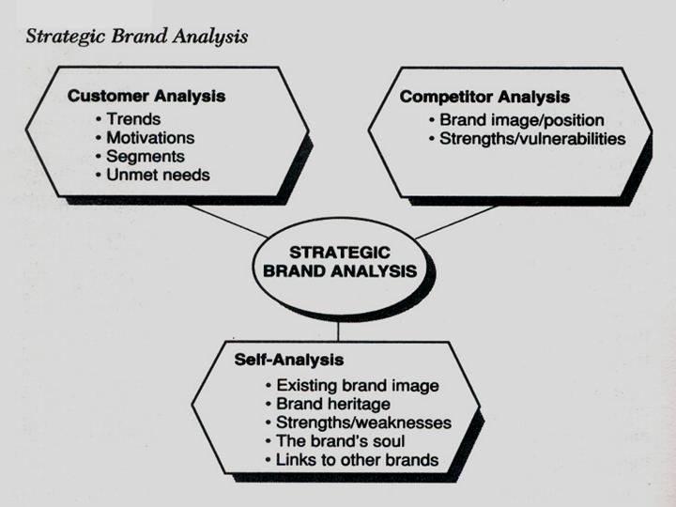

Slide 4
Mobilink Tribute

Slide 5
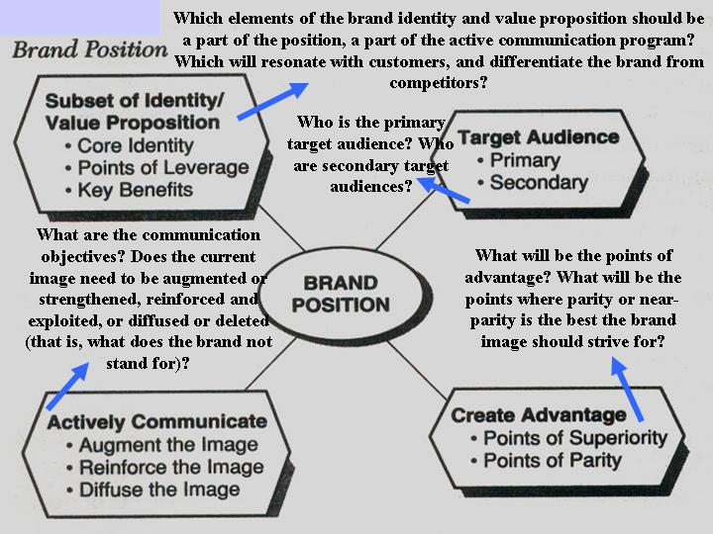

Slide 6
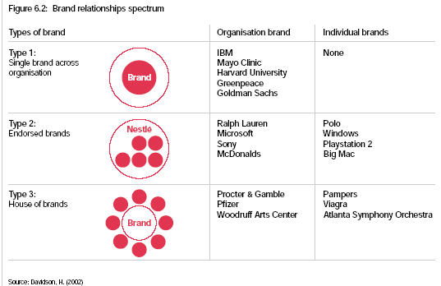
Ikea

Slide 7
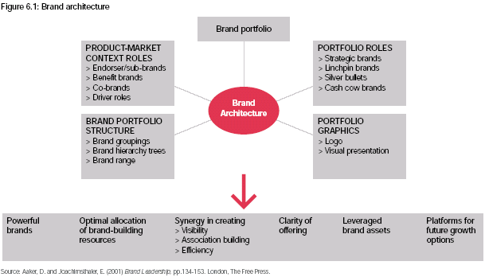

Slide 8
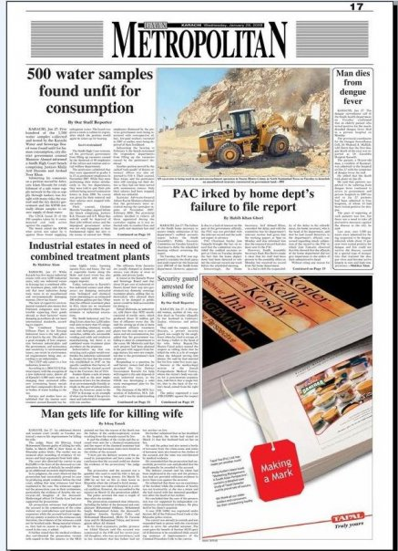

Slide 9


