Slide 1
COURSE SUMMARY
Zeenat Jabbar

Slide 2
LECTURE 1:
BRANDS & BRAND MANAGEMENT
What is a brand?
Brands vs. Products
Five Levels of Product
Importance of Brands to Consumers
Importance of Brands to Firms
Brand Equity Concept
Strategic Brand Management
Strategic Brand Management Process

Slide 3
Strategic Brand Management Process
Steps
Key Concepts
Mental maps
Competitive frame of reference
Points-of-parity and points-of-difference
Core brand values
Brand mantra
Identify and establish
brand positioning and values
Mixing and matching of brand elements
Integrating brand marketing activities
Leveraging of secondary associations
Plan and implement
brand marketing programs
Measure and interpret
brand performance
Brand value chain
Brand audits
Brand tracking
Brand equity management system
Brand-product matrix
Brand portfolios and hierarchies
Brand expansion strategies
Brand reinforcement and revitalization
Grow and sustain
brand equity

Slide 4
LECTURE 2:
CHOOSING BRAND ELEMENTS TO BUILD BRAND EQUITY
Criteria for Choosing Brand Elements
Memorability
Meaningfulness
Likability
Transferability
Adaptability
Protectability

Slide 5
Tactics for Brand Elements
A variety of brand elements can be chosen that inherently enhance brand awareness or facilitate the formation of strong, favorable, and unique brand associations.
  Brand names
  URLs
  Logos and symbols
  Characters
  Slogans
  Packaging

Slide 6
LECTURE 3:
MARKETING IMAGINATION & THE PASSIONPOINT
BRAND POSITIONING & VALUES
Brand Positioning
Is at the heart of the marketing strategy
“. . . the act of designing the company’s offer and image so that it occupies a distinct and valued place in the target customer’s minds.”
Philip Kotler

Slide 7
Determining a frame of reference
What are the ideal points-of-parity and points-of-difference brand associations vis-à-vis the competition?
Marketers need to know:
  Who the target consumer is
  Who the main competitors are
  How the brand is similar to these competitors
  How the brand is different from them

Slide 8
Target Market
A market is the set of all actual and potential buyers who have sufficient interest in, income for, and access to a product.
Market segmentation divides the market into distinct groups of homogeneous consumers who have similar needs and consumer behavior, and who thus require similar marketing mixes.
Market segmentation requires making tradeoffs between costs and benefits.

Slide 9
Criteria for Segmentation
Identifiability: Can we easily identify the segment?
Size: Is there adequate sales potential in the segment?
Accessibility: Are specialized distribution outlets and communication media available to reach the segment?
Responsiveness: How favorably will the segment respond to a tailored marketing program?

Slide 10
Brand Positioning Guidelines
Two key issues in arriving at the optimal competitive brand positioning are:
  Defining and communicating the competitive frame of reference
  Choosing and establishing points-of-parity and points-of-difference

Slide 11
LECTURE 4:
CREATING PASSIONBRANDS
JUST ANOTHER BRAND OR A PASSIONBRAND
Customer-Based Brand Equity
Differential effect
  Differences in consumer response
Brand knowledge
  A result of consumers’ knowledge about the brand
Consumer response to marketing
  Choice of a brand
  Recall of copy points from an ad
  Response to a sales promotion
  Evaluations of a proposed brand extension

Slide 12
Sources of Brand Equity
Brand awareness
  Brand recognition
  Brand recall
Brand image
  Strong, favorable, and unique brand associations

Slide 13
Customer-Based Brand Equity Pyramid
4. RELATIONSHIPS =
What about you and me?
4. RELATIONSHIPS =
What about you and me?
RESONANCE
3. RESPONSE =
What about you?
3. RESPONSE =
What about you?
JUDGMENTS
FEELINGS
2. MEANING =
What are you?
2. MEANING =
What are you?
PERFORMANCE
IMAGERY
1. IDENTITY =
Who are you?
1. IDENTITY =
Who are you?
SALIENCE

Slide 14
Sub-Dimensions of CBBE Pyramid
LOYALTY
ATTACHMENT
COMMUNITY
ENGAGEMENT
WARMTH
FUN
EXCITEMENT
SECURITY
SOCIAL APPROVAL
SELF-RESPECT
QUALITY CREDIBILITY
CONSIDERATION
SUPERIORITY
PRIMARY CHARACTERISTICS &
SECONDARY FEATURES
PRODUCT RELIABILITY, DURABILITY & SERVICEABILITY
SERVICE EFFECTIVENESS, EFFICIENCY & EMPATHY
STYLE AND DESIGN
PRICE
USER PROFILES
PURCHASE & USAGE SITUATIONS
PERSONALITY & VALUES
HISTORY, HERITAGE
& EXPERIENCES
CATEGORY IDENTIFICATION
NEEDS SATISFIED

Slide 15
Lecture 5: From Identity to Reality
Corner No. 1: Ideology
Aspects of Brand
BRAND IMAGE
  How the brand is now perceived
BRAND IDENTITY
  How strategists want the brand to be perceived
BRAND POSITION
  The part of the brand identity and value proposition to be actively communicated to a target audience

Slide 16
Brand Identity Planning
Extended
core
Brand As Product
Product Scope
Product Attributes
Quality/Value
Uses
Users
Country
Brand as Organization
Organizational Attributes
Local vs. Global
Brand As Person
Personality
Brand-customer relationship
Brand As Symbol
Visual Imagery and metaphors
Brand Hreritage

Slide 17
Brand Name
Awareness
BRAND EQUITY IS …
Brand
Loyalty
Perceived
Quality
Brand
Associations

Slide 18
The Kapferer Brand Identity Prism
PICTURE OF SENDER
Physique
Personality
EXTERNALISATION
INTERNALISATION
Relationship
Culture
Reflection
Self-Image
PICTURE OF RECIPIENT

Slide 19
LECTURE 6: THE BRAND EXPERIENCE

Slide 20
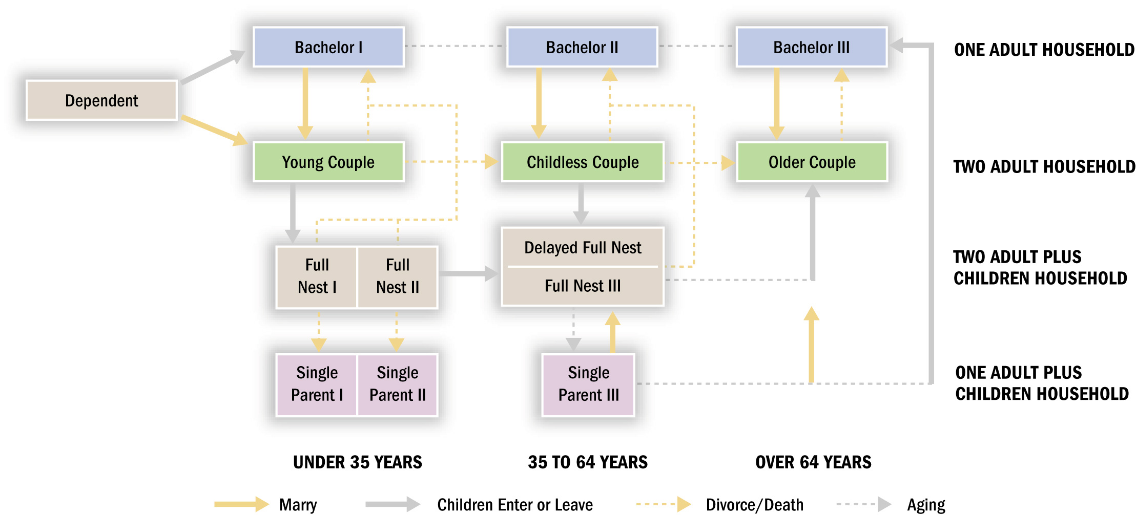
Family Life Cycle

Slide 21
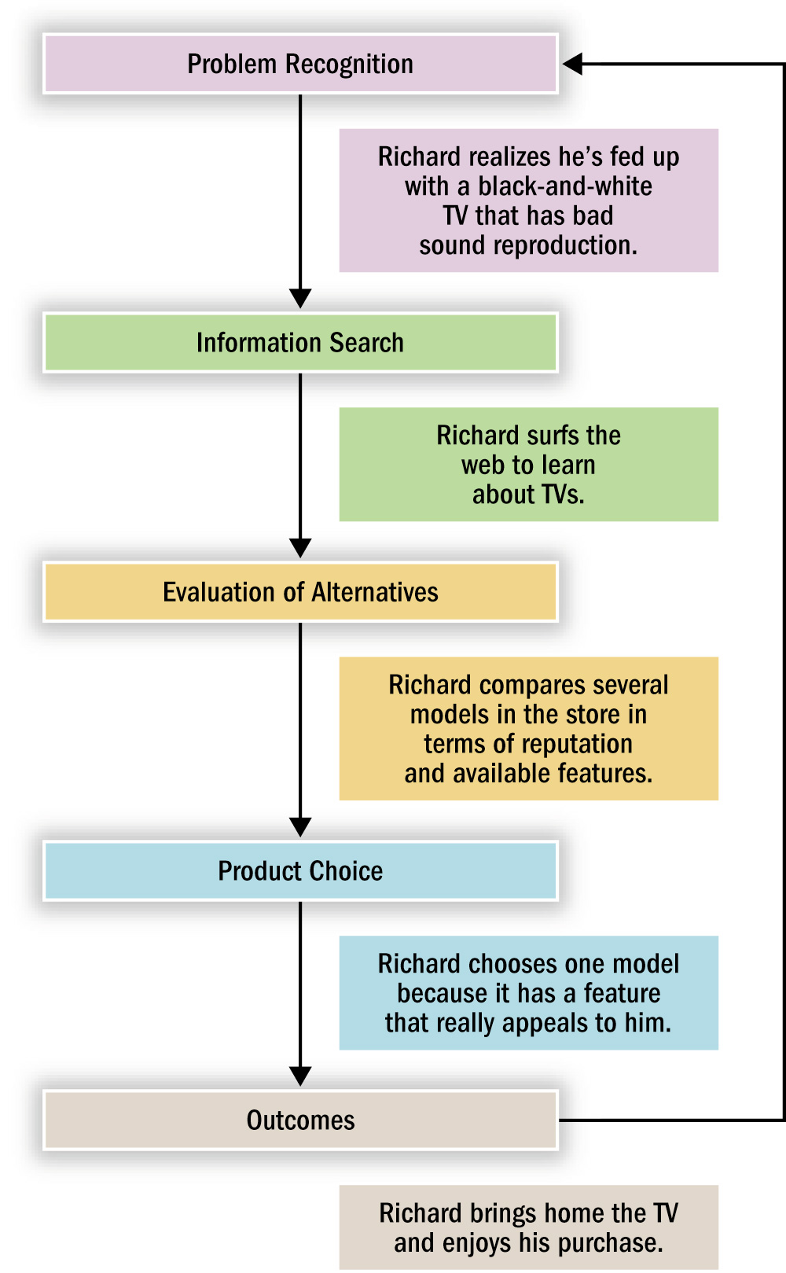
Stages in Consumer Decision Making

Slide 22
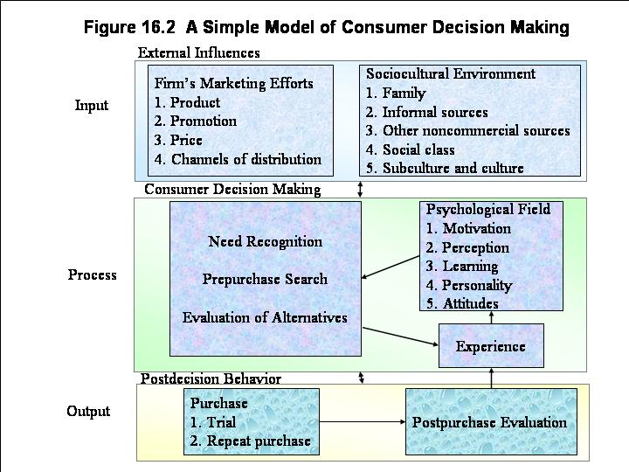

Slide 23
LECTURE 7:
Brand POSITIONING
&
CAPABILITY

Slide 24
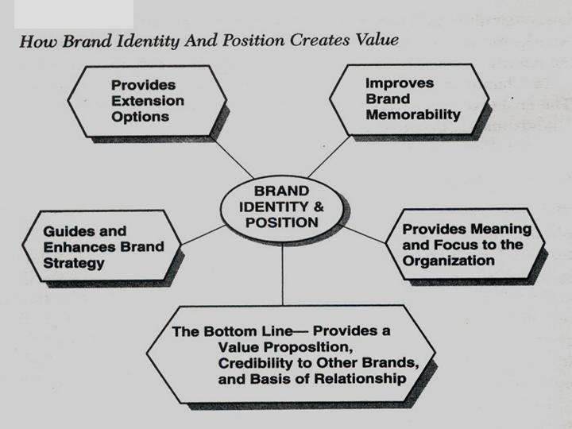

Slide 25
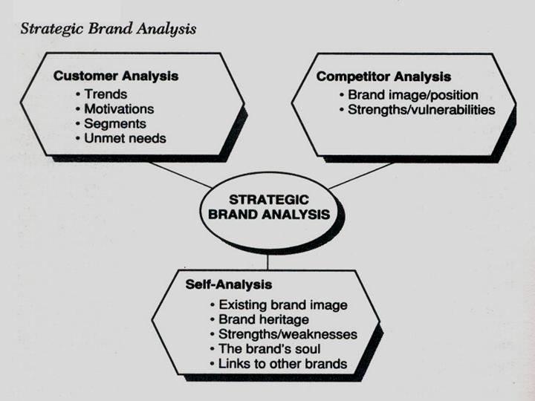

Slide 26
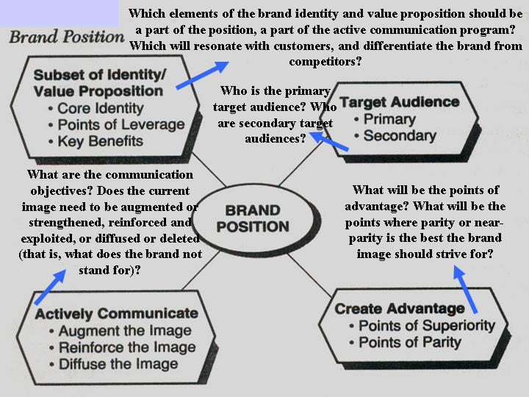

Slide 27
LECTURE 8: ENVIRONMENT

Slide 28
SOCIAL AND
GROUP FORCES
Culture
Subculture
Social class
Reference groups
Family and households
PSYCHOLOGICAL FORCES
Motivation
Perception
Learning
Personality
Attitude
INFORMATION
Commercial
sources
Social sources
BUYING-DECISION PROCESS
Need recognition
Identification of alternatives
Evaluation of alternatives
Purchase and related decisions
Postpurchase behavior
SITUATIONAL
FACTORS
When consumers buy
Where
consumers buy
Why consumers buy
Conditions
under which
consumers buy

Slide 29
Culture
Subculture
Social Class
Organi-
zations
Reference
Groups
Family
Media
Individual
Consumers

Slide 30
LECTURE 9: PRODUCT POSITIONING: ENVIRONMENT

Slide 31
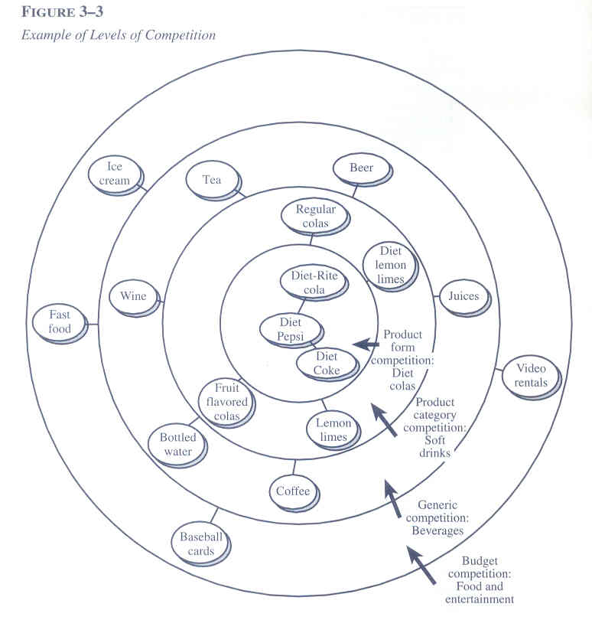
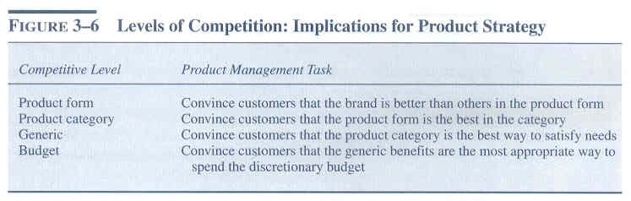

Slide 32
REFERENCE GROUP INFLUENCE MATRIX
NECESSITY
LUXURY
PUBLIC
PUBLIC
NECESSITY
PUBLIC
LUXURY
PRIVATE
PRIVATE
NECESSITY
PRIVATE
LUXURY

Slide 33
LECTURE 10: DESIGNING MARKETING PROGRAMS TO BUILD BRAND EQUITY
How do marketing activities in general—and product, pricing, and distribution strategies in particular—build brand equity?
How can marketers integrate these activities to enhance brand awareness, improve the brand image, elicit positive brand responses, and increase brand resonance?

Slide 34
Creative and original thinking is necessary to create fresh new marketing programs that break through the noise in the marketplace to connect with customers.
Marketers are increasingly trying a host of unconventional means of building brand equity.

Slide 35
LECTURE 11: DESIGNING AND IMPLEMENTING
BRANDING STRATEGIES
Branding strategy is critical because it is the means by which the firm can help consumers understand its products and services and organize them in their minds.
Two important strategic tools: The brand-product matrix and the brand hierarchy help to characterize and formulate branding strategies by defining various relationships among brands and products.

Slide 36
The branding strategy for a firm reflects the number and nature of common or distinctive brand elements applied to the different products sold by the firm.
  Which brand elements can be applied to which products and the nature of new and existing brand elements to be applied to new products

Slide 37
LECTURE 12: BRAND EXTENSIONS
When a firm uses an established brand name to introduce a new product
Brand extension classification
  Line extension
    Using a sub-brand to target a new market segment within the same product category
  Category extension
    Using the parent brand in a different product category

Slide 38
LECTURE 13: MANAGING BRANDS OVER TIME
Effective brand management requires taking a long-term view of marketing decisions
  Any action that a firm takes as part of its marketing program has the potential to change consumer knowledge about the brand.
  These changes in consumer brand knowledge from current marketing activity also will have an indirect effect on the success of future marketing activities.

Slide 39
LECTURE 14: MANAGING BRANDS OVER MARKET SEGMENTS
How valid is the mental map in the new market?
  What is the level of awareness?
  How valuable are the associations?
What changes need to be made to the mental map?
By what means should this new mental map be created?

Slide 40
LECTURE 15: BRAND EQUITY
Sources of Brand Equity
Visibility
Awareness
Relevance
Consistency

Slide 41
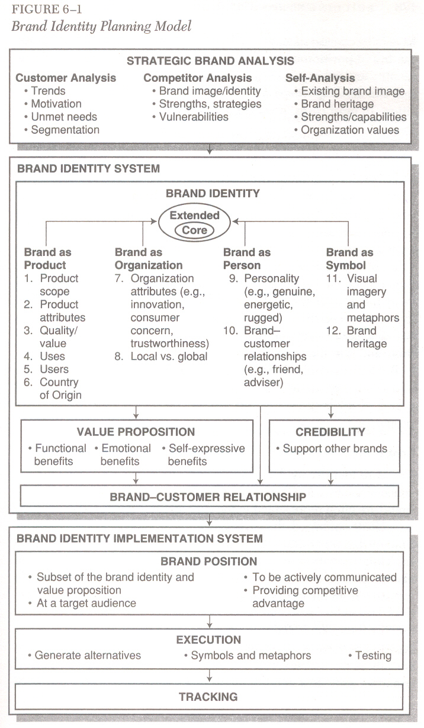

Slide 42
LECTURE 16: BRAND KNOWLEDGE STRUCTURES
Figure 2-9 Building Customer-Based Brand Equity
BRAND BUILDING TOOLS AND OBJECTIVES CONSUMER KNOWLEDGE EFFECTS BRANDING BENEFITS
Choosing Brand Elements
Brand name Memorability
Logo Meaningfulness
Symbol Appeal
Character Transferability
Packaging Adaptability
Slogan Protectability
Brand Awareness
Depth
Breadth
Possible Outcomes
Greater loyalty
Less vulnerability to competitive marketing actions and crises
Larger margins
More elastic response to price decreases
More inelastic response to price increases
Greater trade cooperation and support
Increased marketing communication efficiency and effectiveness
Possible licensing opportunities
More favorable brand extension evaluations
Recall
Recognition
Purchase
Consumption
Developing Marketing Programs
Product Tangible and intangible benefits
Price Value perceptions
Distribution channels Integrate”push” and “pull”
Communications Mix and match options
Brand Associations
Strong
Favorable
Unique
Relevance
Consistency
Desirable
Deliverable
Point-of-parity
Point-of-difference
Leverage of Secondary Associations
Company
Country of origin
Channel of distribution
Other brands
Endorsor
Event
Awareness
Meaningfulness
Transferability

Slide 43
LECTURE 17: MEASURING SOURCES OF BRAND EQUITY: CAPURING CUSTOMER MINDSET

Slide 44
LECTURE 18: BRAND EQUITY MEASUREMENT AND MANAGEMENT SYSTEM
Brand Value Chain
VALUE
STAGES
- Product
- Communications
Trade
Employee
- Other
- Awareness
- Associations
- Attitudes
- Attachment
- Activity
- Price premiums
- Price elasticity
- Market share
- Expansion success
- Cost structure
- Profitability
- Stock price
- P/E ratio
- Market capitalization
Program
Multiplier
Consumer
Multiplier
Market
Multiplier
FILTERS
Clarity
Relevance
- Distinctiveness
- Consistency
- Channel support
Consumer size and profile
Competitive reactions
Market dynamics
Growth potential
Risk profile
Brand contribution

Slide 45
LECTURE 19: MEASURING OUTCOMES OF BRAND EQUITY: CAPTURING MARKET PERFORMANCE

Slide 46
LECTURE 20: BRAND REPORT CARD

Slide 47
LECTURE 21: Brand Valuation
Through Brand Passion Strategy

Slide 48
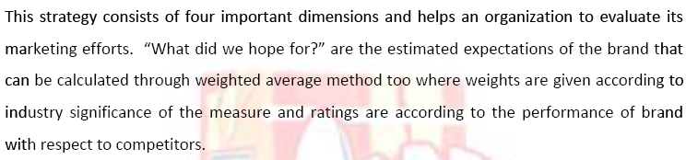
Passion Brand Strategy

Slide 49
Four Dimensions of
Passion Brand Strategy
Brand Performance
Brand Perception
Brand Inside
Brand Currency

Slide 50
LECTURE 22: INTEGRATING MARKETING COMMUNICATIONS TO BUILD BRAND EQUITY

Slide 51
Information Processing Model of Communications
Exposure
Attention
Comprehension
Yielding
Intentions
Behavior

Slide 52
LECTURE 23: BRANDS & BRANDING

Slide 53
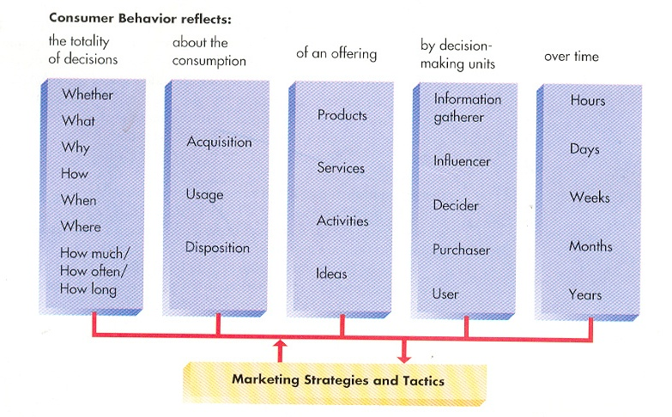

Slide 54
LECTURE 24: Building Brand Value

Slide 55
Motivation refers to the processes that cause people to behave as they do.
Once a need is aroused, a state of tension exists that drives the consumer to attempt to reduce or eliminate the need.
Needs can be:
  Utilitarian: a desire to achieve some functional or practical benefit.
  Hedonic: an experiential need, involving emotional responses or fantasies.

Slide 56
LECTURE 25: CUSTOMER-BASED BRAND EQUITY
Brand Knowledge Structure
Brand awareness, depth, and breadth
Brand associations

Slide 57
Summary of Customer-Based Brand Equity Framework
Sources of brand equity
  Strength
  Favorability
  Uniqueness
Outcomes of brand equity
  Greater loyalty
  Less vulnerability to competitive marketing actions
  Less vulnerability to marketing crises
  Larger margins
  More inelastic consumer response to price increases
  More elastic consumer response to price decreases
  Greater trade cooperation and support
  Increased marketing communication effectiveness
  Possible licensing opportunities
  Additional brand extension opportunities

Slide 58
LECTURE 26: BRAND PERSONALITY
Personality refers to a person’s unique psychological makeup and how it consistently influences the way a person responds to his or her environment.
Most now agree that both personality and situational factors play a role in determining people’s behavior.
Personality is usually involved, along with:
  A person’s choices of leisure activities, political outlook, aesthetic tastes, and
  Other individual factors to segment customers in terms of Lifestyles.

Slide 59
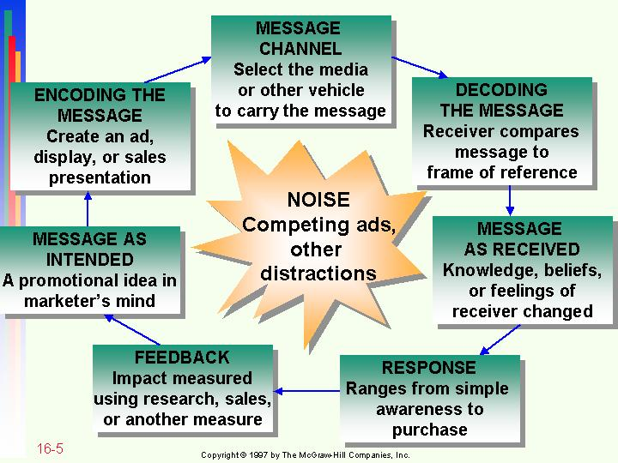
LECTURE 27: EMOTIONAL BRANDING

Slide 60
LECTURE 28: BRAND FOOTPRINTING
Awareness
of brand
Uniqueness or
differentiation of
brand
Positive feelings
towards brand
Relevance to key
decision
(e.g. purchase intent)

Slide 61
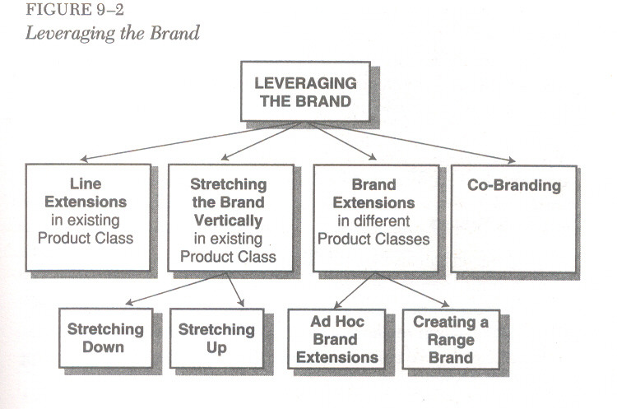

Slide 62
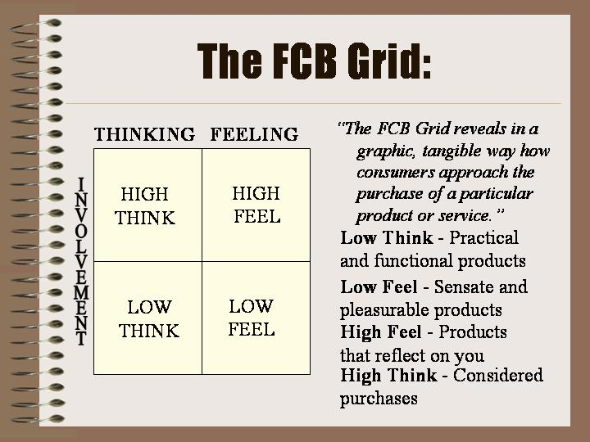
LECTURE 29: THE IBC STRATEGY ; PART I

Slide 63

THE IBC STRATEGY – PART II
PRIZM NE SEGMENTS

Slide 64
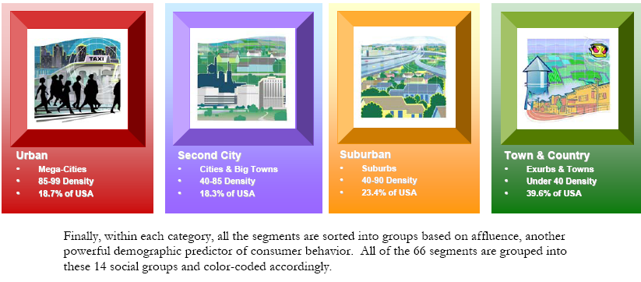

Slide 65
THE IBC STRATEGY: PART III

