Slide 1
THE IBC STRATEGY: PART III
Zeenat Jabbar

Slide 2
NIKE
Zeenat Jabbar

Slide 3
Definition
Market Segmentation:
  Dividing a market into distinct groups with distinct needs, characteristics, or behavior who might require separate products or marketing mixes.
Zeenat Jabbar

Slide 4
Know Your Market
What information do you need to reach your prospects successfully?
Do you understand their problems?
Have you thought about what you want people to think and feel about your brand?
Zeenat Jabbar

Slide 5
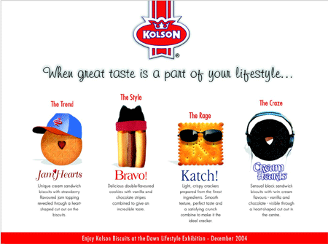
Zeenat Jabbar

Slide 6
Developing a
Market Segmentation Strategy
Define Product Market
Determine Bases for Segmentation
Describe Segments
1
Evaluate Potential Success
2
Select Target Markets
3
Determine Marketing Mix Strategies
4
5
6
Zeenat Jabbar

Slide 7

Zeenat Jabbar

Slide 8

Zeenat Jabbar

Slide 9
Target Information
Household income
Spending
Marrieds
Birthrate
Aging
Women
Men
Single-Person Households
Zeenat Jabbar

Slide 10
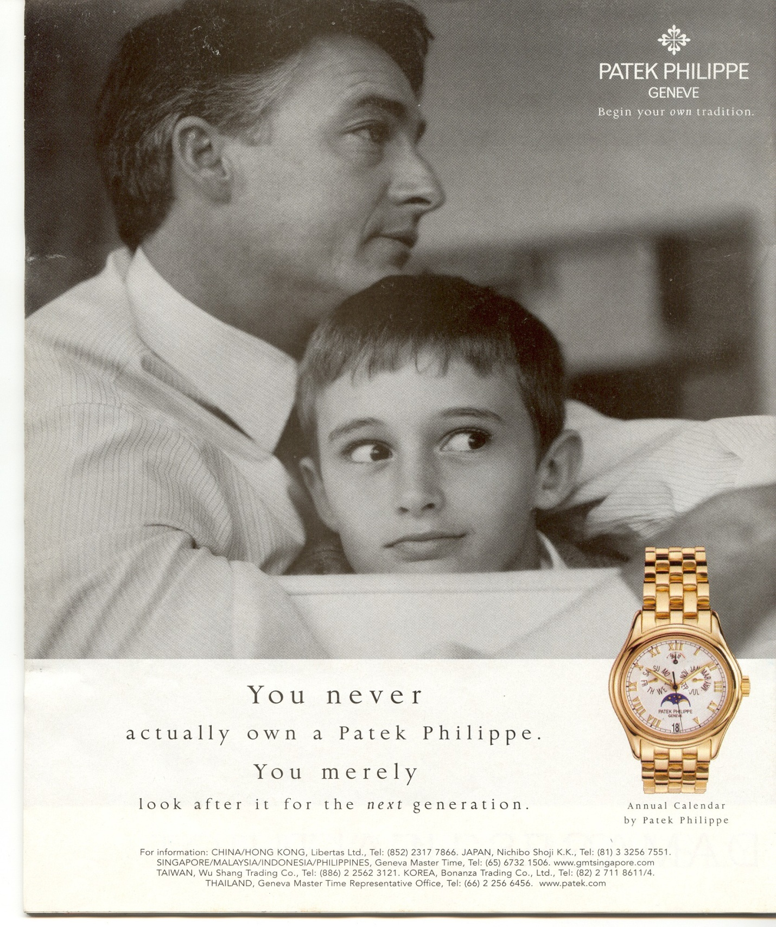
Zeenat Jabbar

Slide 11
Geographical segmentation
  Marketing mixes are
  customized geographically
Demographic segmentation
  Most popular segmentation
  Demographics are closely related to needs, wants and usage rates
Psychographic segmentation
  Lifestyle, social class, and personality-based segmentation
Behavioral segmentation
  Typically done first
Segmenting Consumer Markets
Zeenat Jabbar

Slide 12
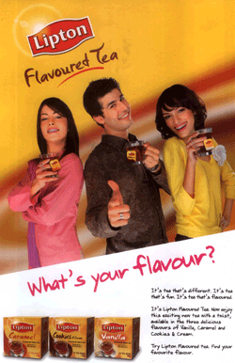
Zeenat Jabbar

Slide 13
Measurable
  Size, purchasing power, and profile of segment
Accessible
  Can be reached and served
Substantial
  Large and profitable enough to serve
Differentiable
  Respond differently
Actionable
  Effective programs can be developed
Requirements for Effective Segmentation
Zeenat Jabbar

Slide 14
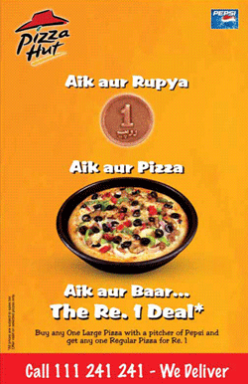
Zeenat Jabbar

Slide 15
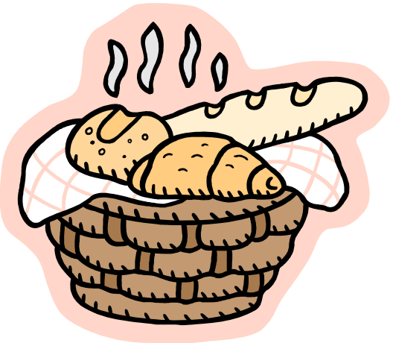
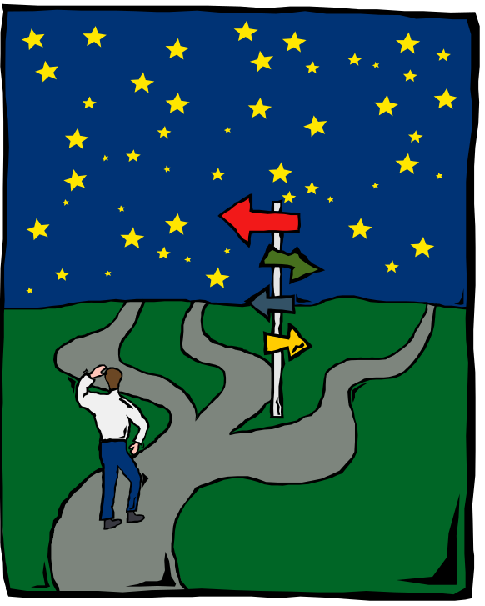
Bases for Segmentation
Needs
Profilers
Zeenat Jabbar

Slide 16
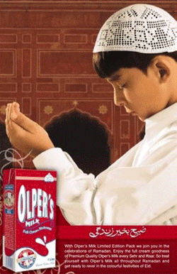
Advertising & Promotion for BBA2K7
Zeenat Jabbar

Slide 17
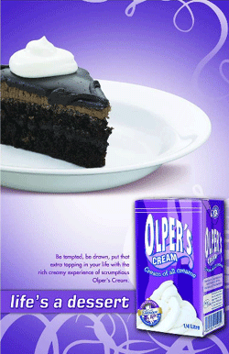
Zeenat Jabbar

Slide 18
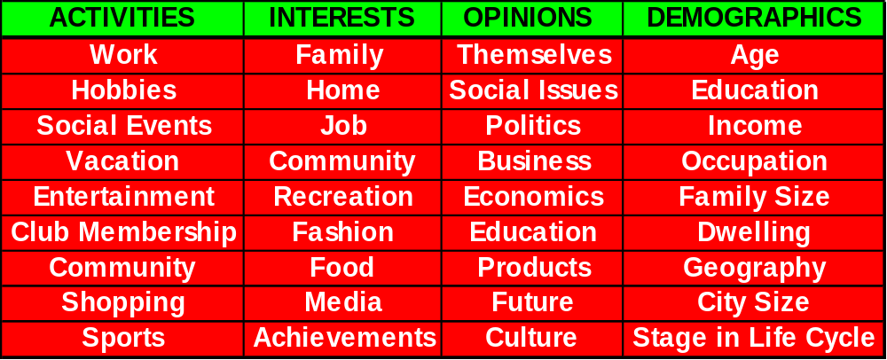
Elements of Lifestyle
Zeenat Jabbar

Slide 19
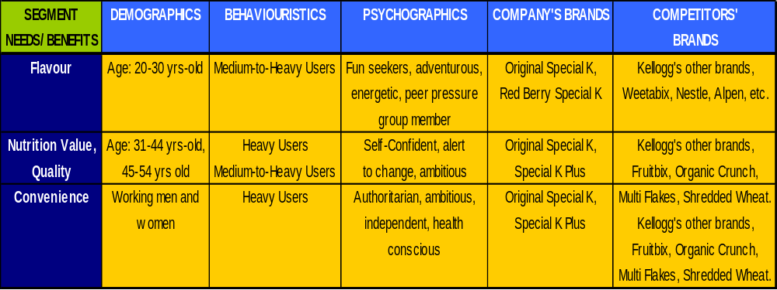
Kellogg’s Special K
Zeenat Jabbar

Slide 20
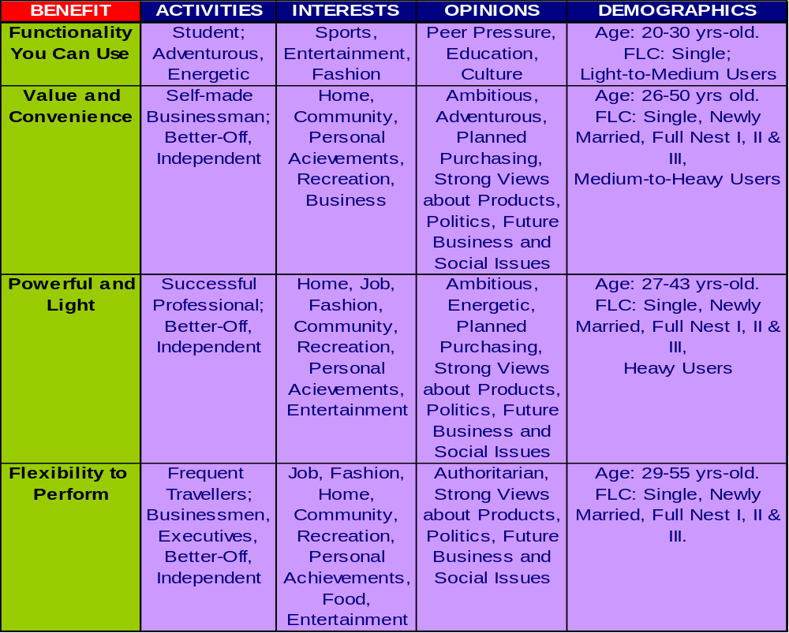
Laptops
Zeenat Jabbar

Slide 21
ASIAN PAINTS
Zeenat Jabbar

Slide 22
Target Generations
Good warriors (1909-1928)
Matures (1929-1945)
Baby boomers (1946-1964)
Gen Xers (1965-1982)
Gen Yers (1983-2001)
Generation Zers (2002+)
Zeenat Jabbar

Slide 23
Planning the Advertising
Market segmentation is the division of an entire market of consumers into groups whose similarity makes them a market for products serving their special needs.
A situation analysis is the part of the advertising plan that answers the questions: Where are we today and how did we get here?
Zeenat Jabbar

Slide 24
Steps in the
Market Segmentation Process
Segment your market
Target a segment
Position your product
Communicate your positioning
Zeenat Jabbar

