Slide 1
BRAND PERSONALITY
Zeenat Jabbar

Slide 2
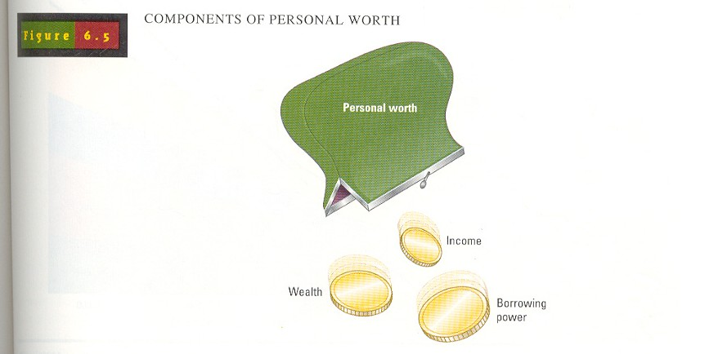

Slide 3
Personality refers to a person’s unique psychological makeup and how it consistently influences the way a person responds to his or her environment.
Most now agree that both personality and situational factors play a role in determining people’s behavior.
Personality is usually involved, along with:
  A person’s choices of leisure activities, political outlook, aesthetic tastes, and
  Other individual factors to segment customers in terms of Lifestyles.

Slide 4
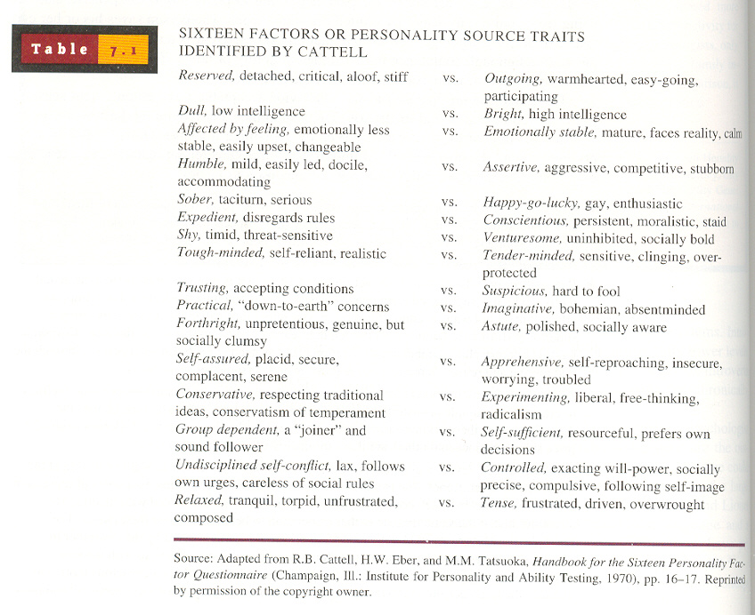

Slide 5
Lifestyle: Who We Are, What We Do
Lifestyle refers to a pattern of consumption reflecting a person’s choices of how he or she spends time and money.
It represents how a person allocates income:
  To different products and services, and
  To specific alternatives within these categories.
A Lifestyle Marketing Perspective recognizes that people sort themselves into groups on the basis of:
  Things they like to do,
  How they like to spend their leisure time, and
  How they choose to spend their disposable income.

Slide 6
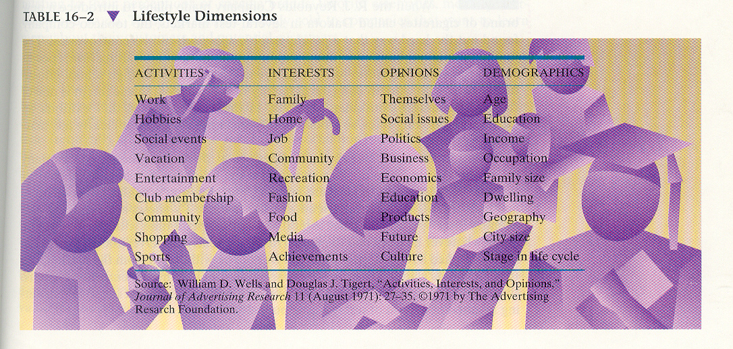
LIFESTYLE DIMENSIONS

Slide 7
COKE1
COKE2
COKE3

Slide 8
BRAND PERSONALITY
Coca-Cola is a well established person, someone who is the epitome of triumph and success. He is someone who encapsulates the vitality of life beautifully and redefines the collage of life for himself in his own tones
He is an astounding showcase of modernity and progression but at the same time his roots are grounded well in traditions and the montage of culture and values. Wherever he is, he easily meshes in the social fabric.
He loves the time spent with family and friends. He values the existence of close knit unit, be it his friends or his family. He loves to paint the traditional customs and events with his vibrancy.
He is omnipresent, ubiquitous and all pervading

Slide 9
TAPAL1
TAPAL2

Slide 10
BRAND PERSONALITY
TAPAL TEA is a 27 years old urban female with traditions and values running deep in her blood. She did her bachelors from a local women college and was then married to a far-off relative and now lives in a nice little house with her in-laws. The family is well off and well respected in the neighborhood. For TAPAL, a happy home is where you invest your heart and soul for the wellbeing of everyone….
….She loves exploring new things and trying out new recipes. She believes in taking risks but after a very analytical decision to move ahead.
TAPAL loves shopping and usually prefers what is best reviewed by her society. Life is a passion for her and she gives it her best shot always.
Tapal is a member of many ladies’ committee societies and clubs. She loves hanging out and having chitchat with her friends.
Brand horoscope: Virgo.

Slide 11
Ten Fundamental Emotions People Experience:
  Disgust Interest
  Joy Surprise
  Sadness Anger
  Fear Contempt
  Shame Guilt
Zeenat Jabbar

Slide 12
Attitude:
  A lasting, general evaluation of people (including oneself), objects, advertisements, or issues
  Anything toward which one has an attitude is called an object (A_{o}).
  Attitudes are lasting because they tend to endure over time.
Zeenat Jabbar

Slide 13
What is Personality?
The inner psychological characteristics that both determine and reflect how a person responds to his or her environment.
Personality reflects individual differences
Personality is consistent and enduring
Personality can change
Zeenat Jabbar

Slide 14
A Brand Personality Framework
Brand Personality
Sincerity
Excitement
Competence
Sophistication
Ruggedness
Down-to-earth
Honest
Wholesome
Cheerful
Daring
Spirited
Imaginative
Up-to-date
Reliable
Intelligent
Successful
Upper class
Charming
Outdoorsy
Tough
Zeenat Jabbar

Slide 15
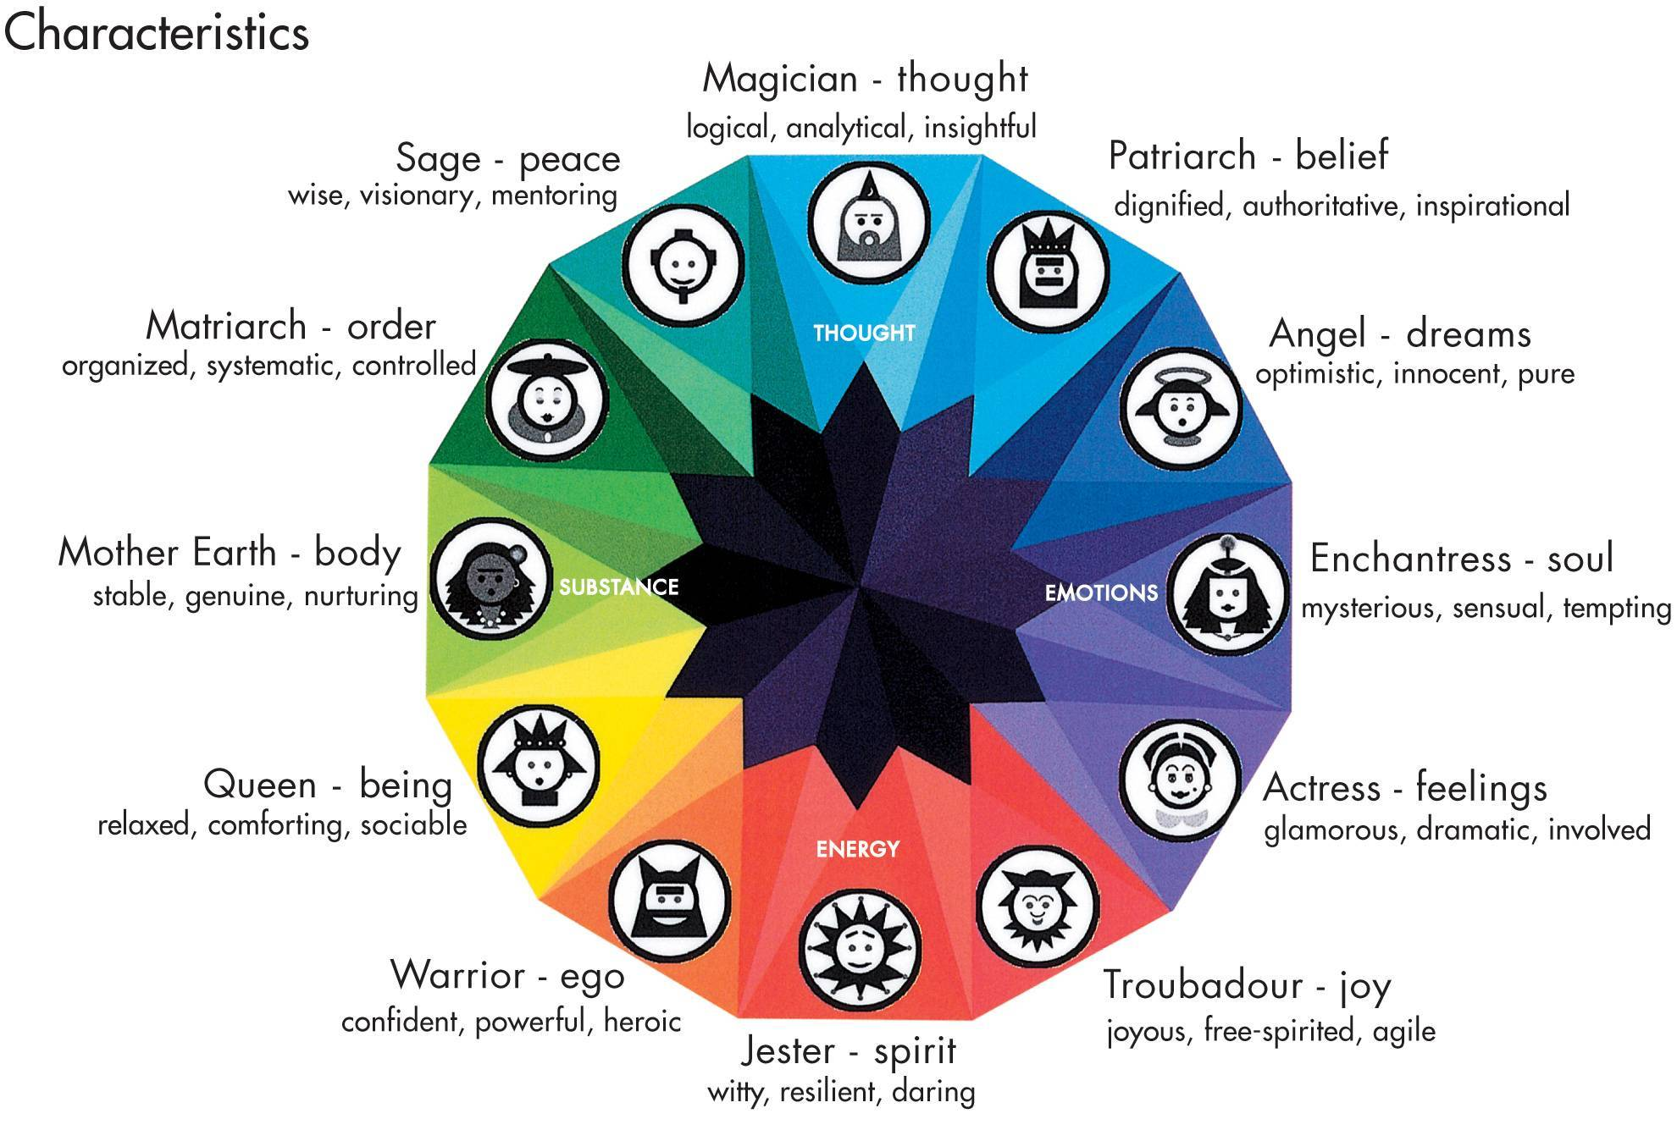
BrandAsset Valuator Archetypes
Zeenat Jabbar

Slide 16
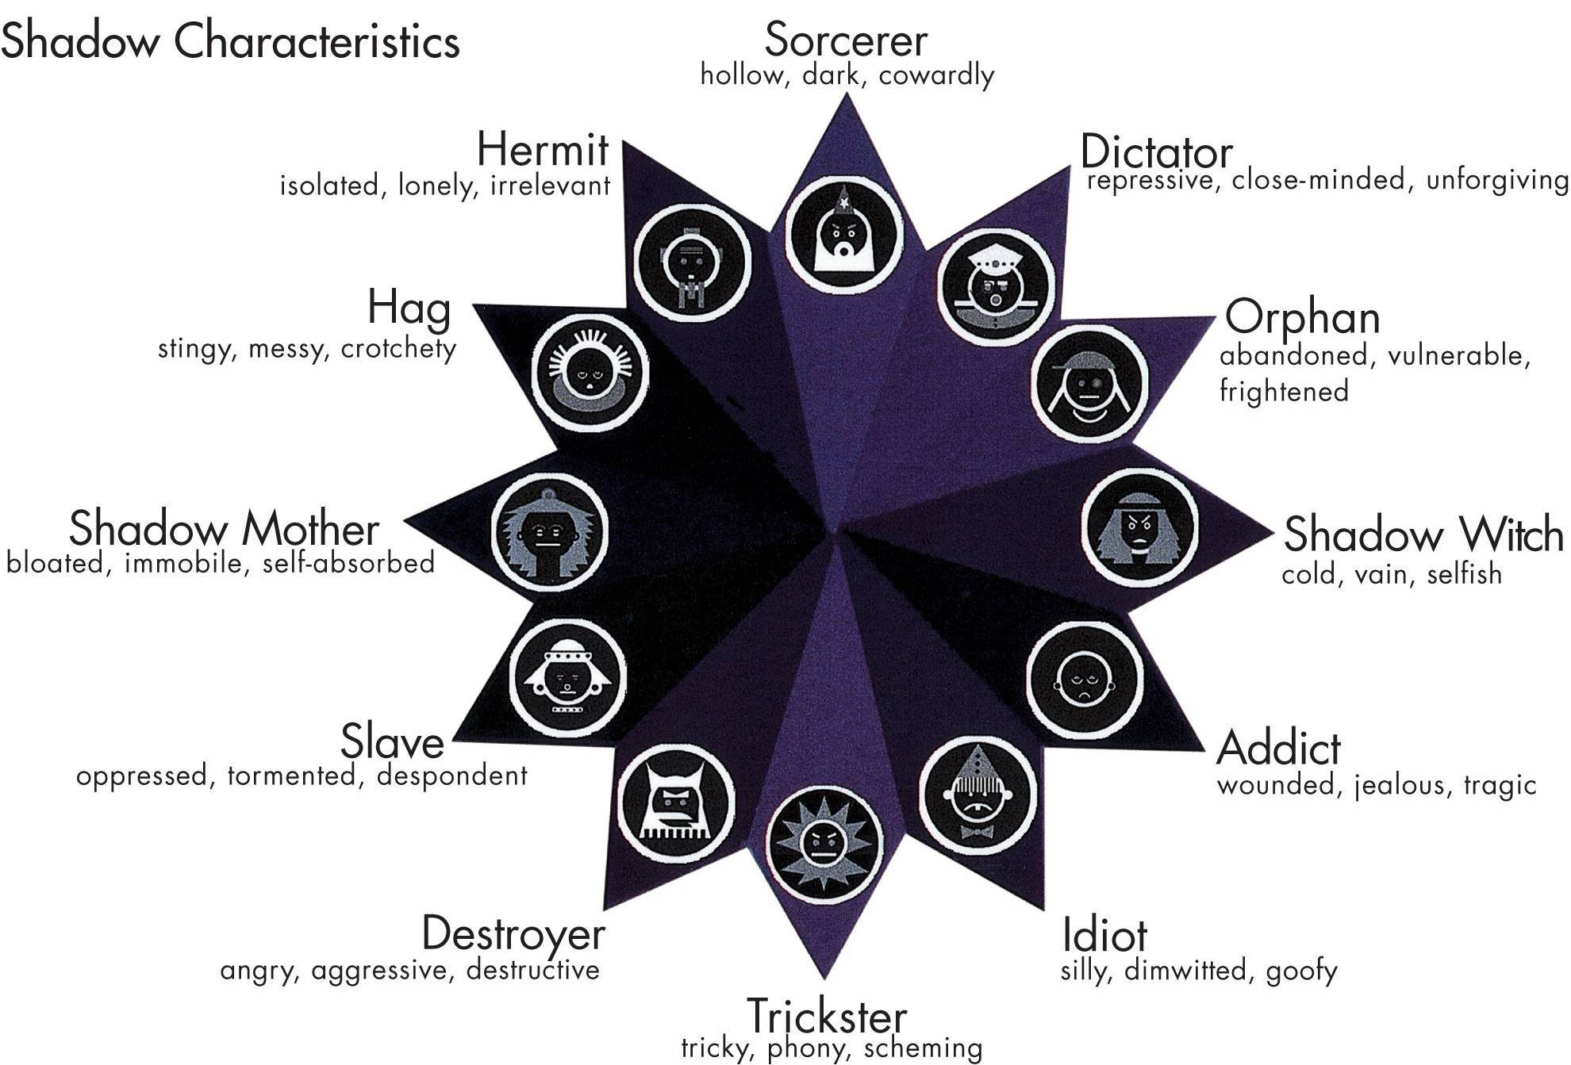
BrandAsset Valuator Archetypes
Zeenat Jabbar

Slide 17
RAYMOND 1-6

Slide 18
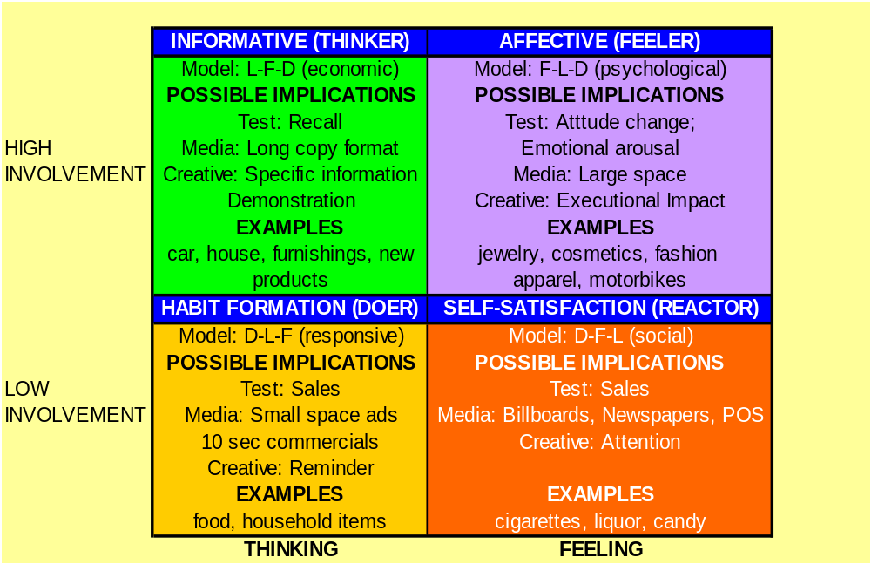
THE FCB GRID
Zeenat Jabbar

Slide 19
YOUNG & RUBICAM’S
BRAND ASSET VALUATOR

Slide 20
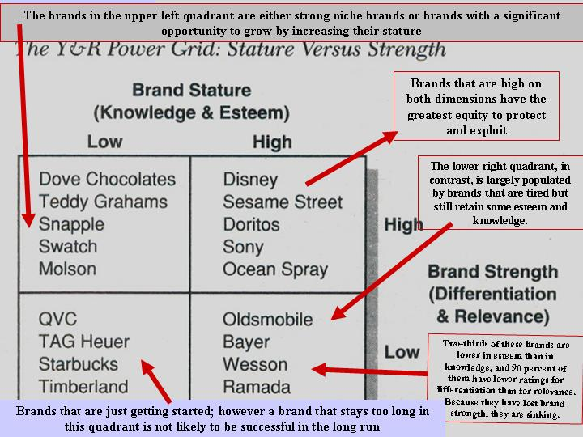

Slide 21
