Slide 1
Building Brand Value
Zeenat Jabbar

Slide 2
Other Aspects of Culture
Although Every Culture is Different, 4 Dimensions Appear to Account for Much of This Variability.
Power Distance
Uncertainty Avoidance
How Interpersonal Relationships
Form When Power Differences
Exist.
Degree to Which People Feel
Threatened by Ambiguous
Situations.
Degree to Which Sex Roles Are
Clearly Delineated.
Extent to Which the Welfare of the
Individual Versus the Group is
Valued.
Masculinity/ Femininity
Individualism

Slide 3
UA versus PD

Slide 4
M versus I

Slide 5
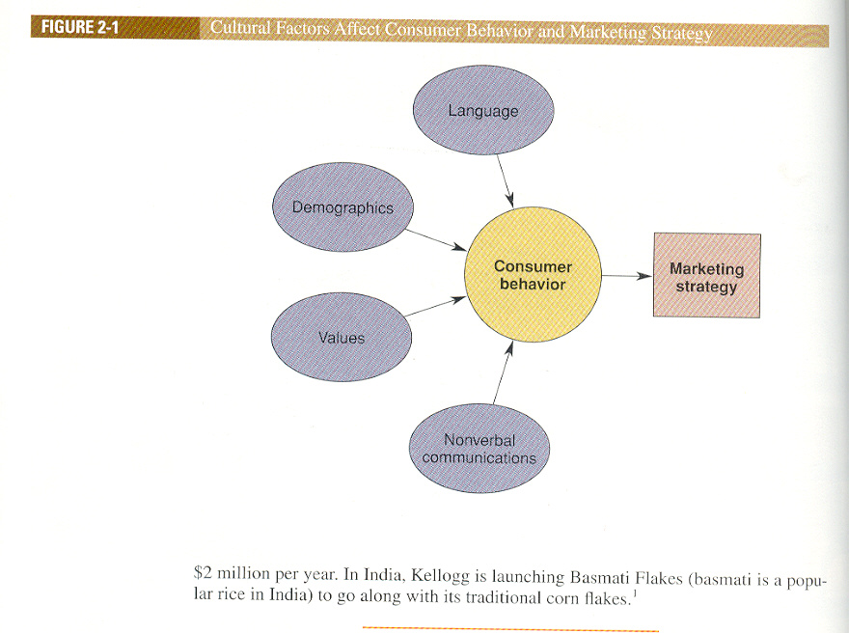

Slide 6
Values of a Culture
Values are Very General Ideas About Good and Bad Goals
Enacted Norms
Explicitly Decided On
Crescive Norms
Embedded in Culture
Customs
Mores
Conventions

Slide 7
Types of Ritual Experience
Religious
A Ritual is a Set of Multiple, Symbolic Behaviors That Occur in a Fixed Sequence and That Tend to Be Repeated Periodically.
Rites of Passage
Ritual Type
Examples
Baptism, Meditation, Mass
Group
Graduation, Marriage
Cultural
Festivals, Holidays
Family
Civic
Parades, Elections, Trials
Personal
Business Negotiations
Mealtimes, Birthdays
Grooming, Household

Slide 8
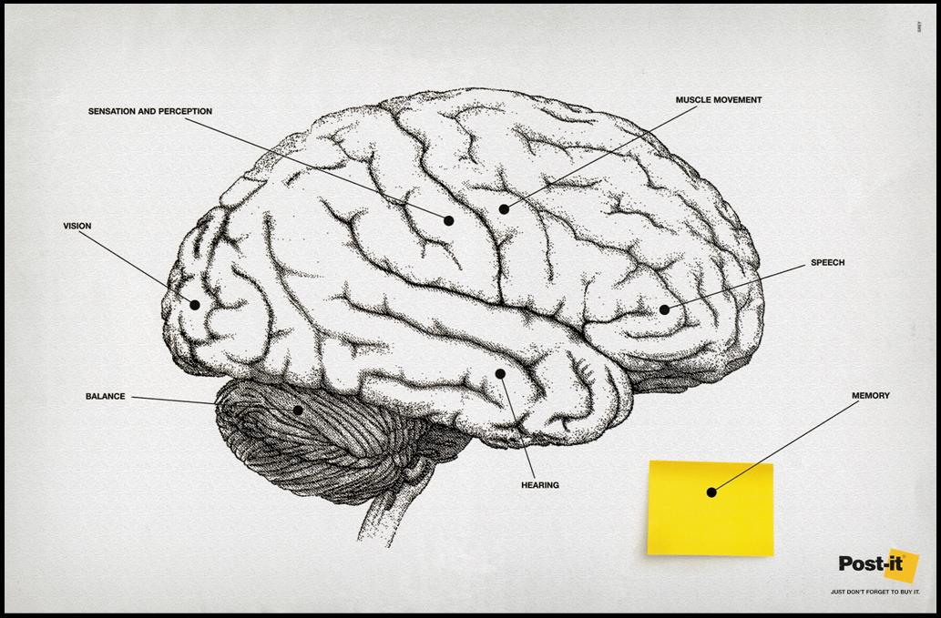
Motivation and Learning

Slide 9
Motivation refers to the processes that cause people to behave as they do.
Once a need is aroused, a state of tension exists that drives the consumer to attempt to reduce or eliminate the need.
Needs can be:
  Utilitarian: a desire to achieve some functional or practical benefit.
  Hedonic: an experiential need, involving emotional responses or fantasies.

Slide 10
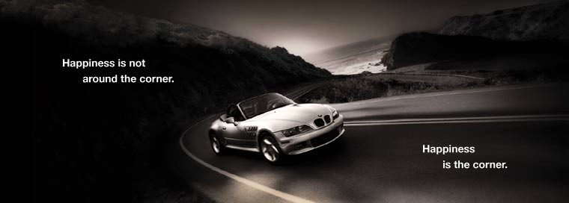

Slide 11
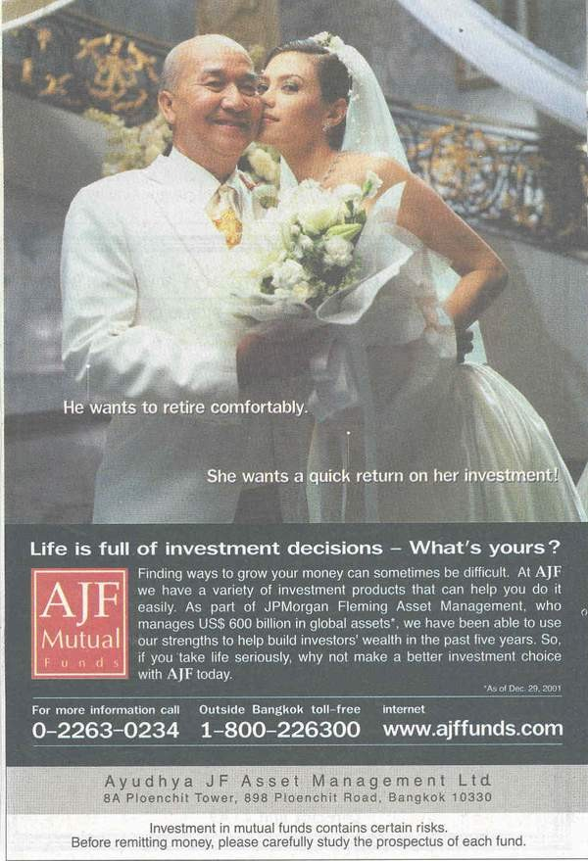

Slide 12
Model of the Motivation Process
Learning
Needs wants, and desires
Tension
Drive
Behavior
Goal or need fulfill-
ment
Cognitive processes
Tension reduction

Slide 13
The Motivation Process
Drive:
  The degree of arousal present due to a discrepancy between the consumer’s present state and some ideal state
Want:
  A manifestation of a need created by personal and cultural factors.
Motivation can be described in terms of:
  Strength: The pull it exerts on the consumer
  Direction: The particular way the consumer attempts to reduce motivational tension

Slide 14
Motivational Strength
Biological vs. Learned Needs:
  Instinct: Innate patterns of behavior universal in a species
  Tautology: Circular explanation (e.g. instinct is inferred from the behavior it is supposed to explain)
Drive Theory:
  Biological needs produce unpleasant states of arousal. We are motivated to reduce tension caused by this arousal.
  Homeostasis: A balanced state of arousal
Expectancy Theory:
  Behavior is pulled by expectations of achieving desirable outcomes – positive incentives – rather than pushed from within

Slide 15
Types of Needs
Innate Needs
  Physiological (or biogenic) needs that are considered primary needs or motives
Acquired needs
  Generally psychological (or psychogenic) needs that are considered secondary needs or motives

Slide 16
Classifying Consumer Needs
Henry Murray need dimensions:
  Autonomy: Being independent
  Defendance: Defending the self against criticism
  Play: Engaging in pleasurable activities
Thematic Apperception Technique (TAT):
  (1) What is happening?
  (2) What led up to this situation?
  (3) What is being thought?
  (4) What will happen?
  People freely project their subconscious needs onto the stimulus

Slide 17
Murray’s List of
Psychogenic Needs
Needs Associated with Inanimate Objects:
Acquisition, Conservancy, Order, Retention, Construction
Needs Reflecting Ambition, Power,
Accomplishment, and Prestige:
Superiority, Achievement, Recognition, Exhibition, Infavoidance
Needs Connected with Human Power:
Dominance, Deferrence, Similance, Autonomy, Contrariance

Slide 18
Sado-Masochistic Needs :
Aggression, Abasement
Needs Concerned with Affection between People:
Affiliation, Rejection, Nurturance, Succorance, Play
Needs Concerned with Social Intercourse:
Cognizance, Exposition

Slide 19
Measuring Cultural Values
The Rokeach Value Survey
  Terminal Values: Desired end states
  Instrumental Values: Actions needed to achieve terminal values
The List of Values (LOV) Scale
  Developed to isolate values with more direct marketing applications
  Identifies nine (9) consumer segments based on the values they endorse
  Relates each value to differences in consumption

Slide 20
The Means-End Chain Model
Laddering:
  A technique that uncovers consumers’ associations between attributes and consequences
Hierarchical value maps:
  Show how product attributes are linked to desired end states
Means-End Conceptualization of the Components of Advertising Strategy (MECCAS):
    Message Elements
    Consumer Benefits
    Executional Framework
    Leverage Point
    Driving Force

Slide 21
Values
Value:
  A belief that some condition is preferable to its opposite (e.g. freedom is better than slavery)
Core Values:
  General set of values that uniquely define a culture
    Value system: A culture’s unique set of rankings of the relative importance of universal values.
  Enculturation:
    Process of learning the value systems of one’s own culture
  Acculturation:
    Process of learning the value system of another culture
  Cultural beliefs are taught by socialization agents (i.e., parents, friends, and teachers)

Slide 22
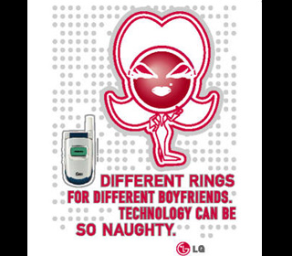

Slide 23
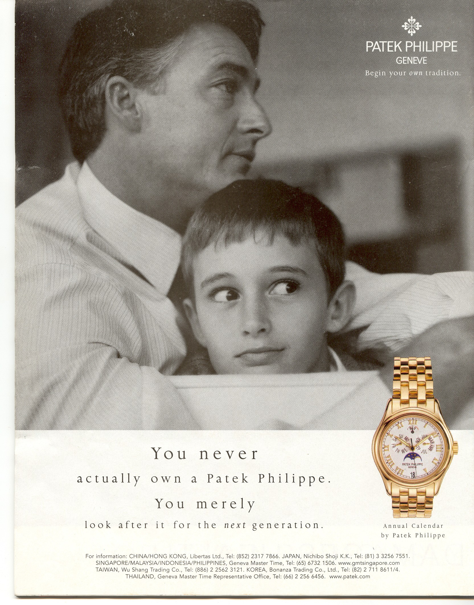

Slide 24
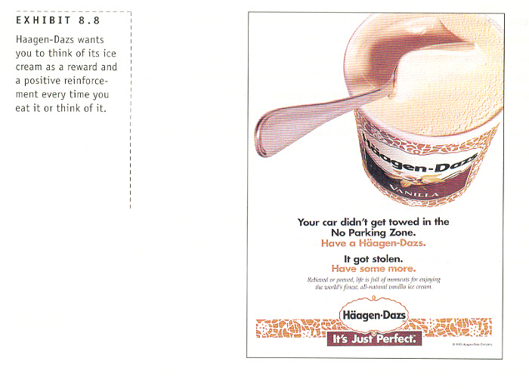

Slide 25
KELLOGGS

Slide 26
TRADITION

Slide 27
NOKIA

