Slide 1
BRANDS & BRANDING
Zeenat Jabbar

Slide 2
Do Marketers Create Artificial Needs?
Objective of marketing: create awareness that
needs exist, not to create needs
Need: a basic biological motive
Want: one way that society has taught us that the need can be satisfied
versus

Slide 3
VODAFONE

Slide 4
Defining Consumer Behavior
Consumer Behavior is the Process Involved When Individuals or Groups Select, Use, or Dispose of Products, Services, Ideas or Experiences (Exchange) to Satisfy Needs and Desires.

Slide 5
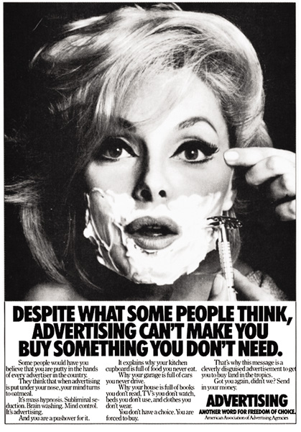

Slide 6
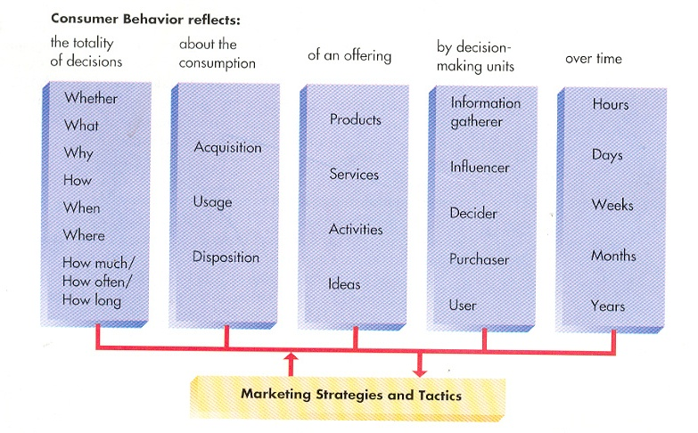
Identifies consumers as actors on the marketplace stage
ROLE THEORY

Slide 7
HEINZ

Slide 8
Self-Concept Attachment
Helps to Establish the User’s Identity
The Meaning of Consumption
Nostalgic Attachment
Serves as a Link With a Past Self
Types of Relationships a Person May Have With a Product:
Interdependence
Part of the User’s Daily Routine
Love
Elicits Bonds of Warmth, Passion, or Other
Strong Emotion

Slide 9
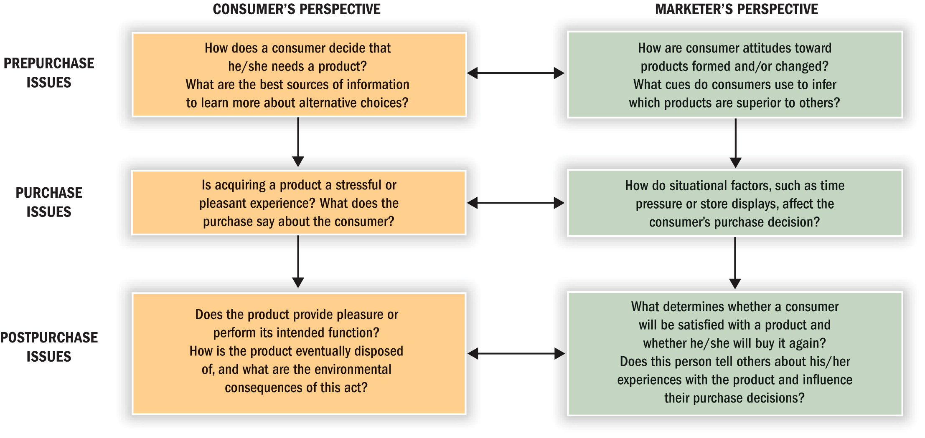
Consumer Behavior is a “Process”

Slide 10
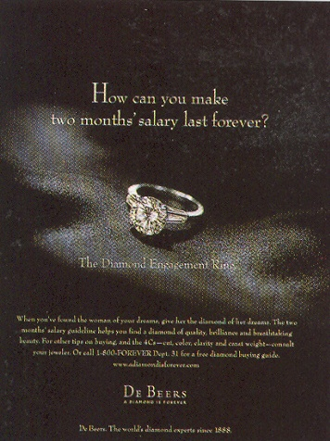

Slide 11
Segmenting Consumers:
Demographics: statistics that measure observable aspects of a population, such as:
Age
Gender
Family structure
Social class and income
Race and ethnicity
Geography
Psychographics
The way we feel about ourselves
The things we value
The things we do in our spare time

Slide 12
UFONE

Slide 13
ZONG

